Slide 1
AIP Mini-Project - Reinforcement Learning
A3C in VizDoom
Anders Christiansen

Slide 2
Table of Contents
Project description
Motivation
Tools/Resources
Contribution
Algorithm explanation
Evaluation
Discussion

Slide 3
Project Description
Running the “Asynchronous Advantage Actor-Critic” method in the VizDoom environment, comparing scenarios and hyperparameters.

Slide 4
Motivation
VizDoom state-of-the-art within RL
Great environment for comparing hyperparameters
A3C paper did not test in VizDoom, but in OpenAI

Slide 5
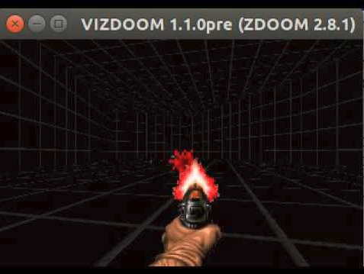
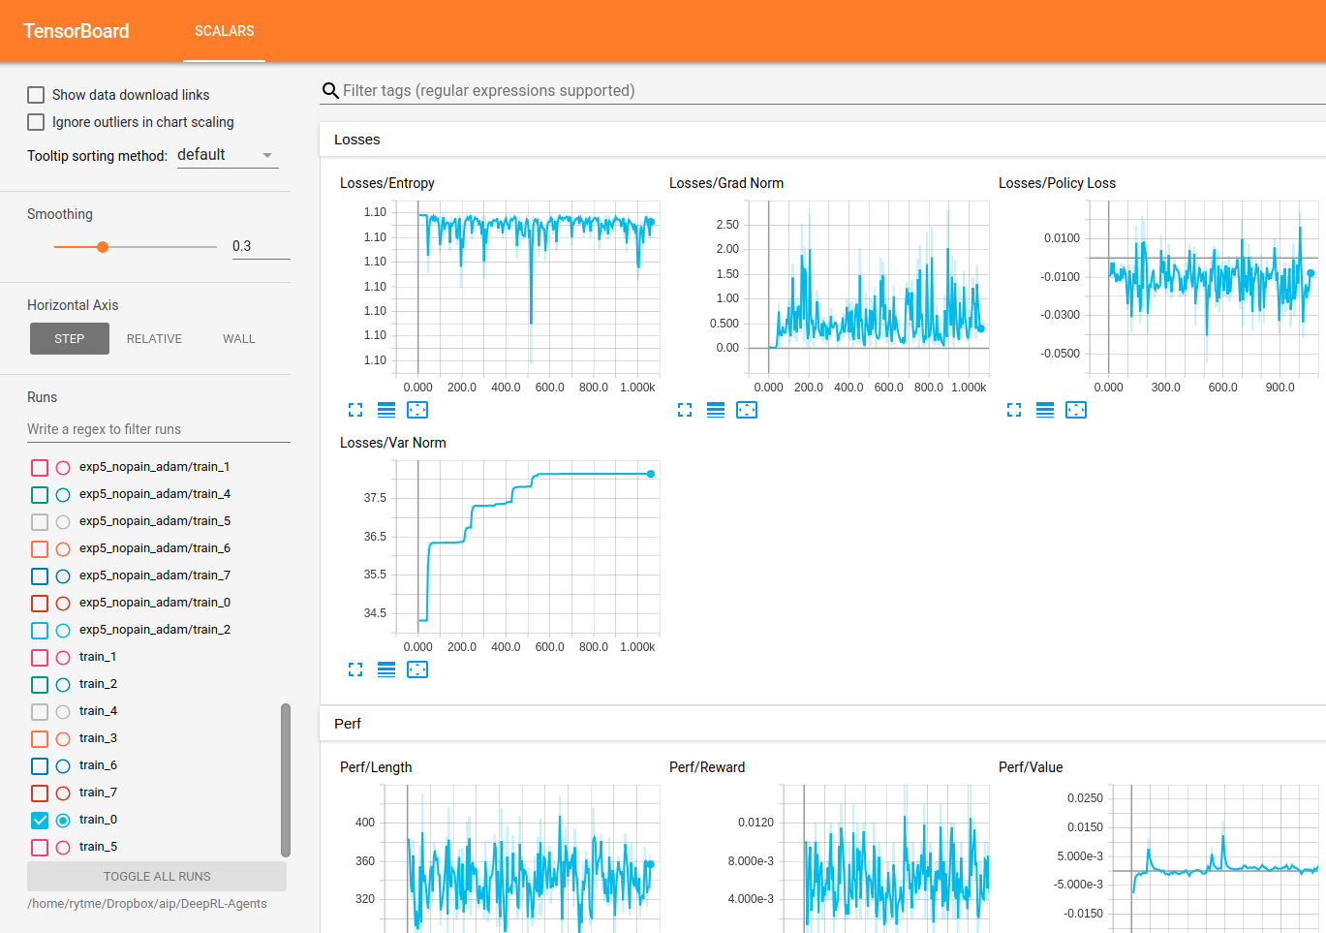
Tools
VizDoom
Tensorflow
TensorBoard
Run on NVIDIA GeForce 980 GTX

Slide 6
Resources
A3C based on Juliani implementation
  https://medium.com/emergent-future/simple-reinforcement-learning-with-tensorflow-part-8-asynchronous-actor-critic-agents-a3c-c88f72a5e9f2
VizDoom - https://github.com/mwydmuch/ViZDoom
Project Git - https://github.com/RytmeAnders/aip_miniproject

Slide 7
Contribution
Modifying VizDoom
Modifying hyperparameters
Results written to a list, then exported to a .txt

Slide 8
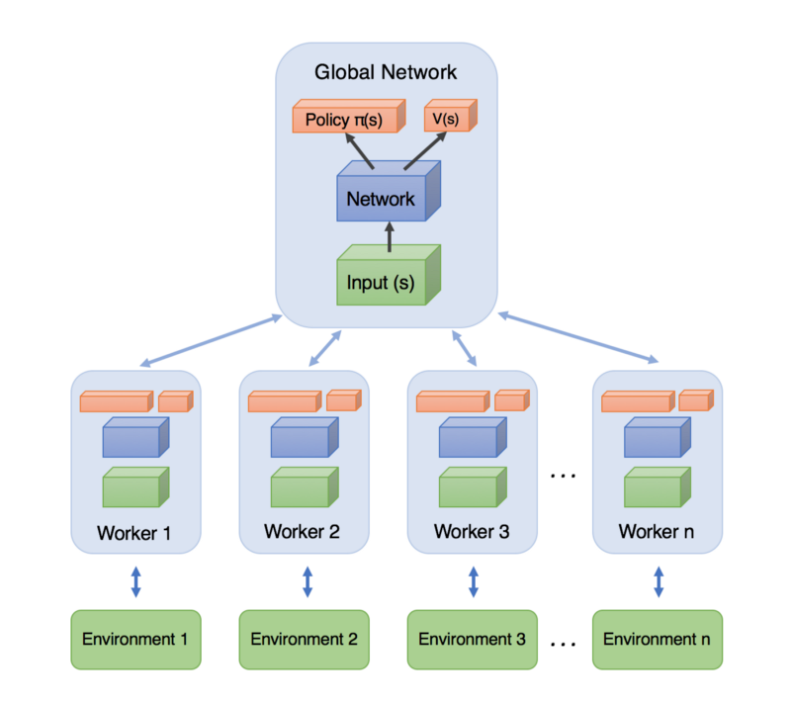
Algorithm - A3C
Asynchronous: Multiple agent running in parallel, each with their unique instance of the environment
Advantage: Calculating how much better a chosen action is than expected ( R – V(s) )
Actor-Critic: Combining Q-learning and policy gradient methods. The agent (the actor) determines a policy, which is then updated by a state-value-estimate from the environment (the critic)

Slide 9
Algorithm - A3C
Proposed by Mnih et. al. (2016)
  https://arxiv.org/pdf/1602.01783.pdf
Works in discrete and continuous state-spaces
Much faster than a traditional Deep Q-Network (DQN)

Slide 10


Algorithm - A3C
Learning by value loss and policy loss
Value loss: The sum of squared advantages across n workers
                L = Loss function
                A = advantage
                R = discounted return
                V = state-value
                N = number of threads (CPU kernels)
Policy loss: Negative logarithm of the product of the policy, the advantage, and the entropy
                Π(s) = policy for state s
                A(s) = advantage of state s
                Β = weight/coefficient
                H(Π) = entropy of policy Π

Slide 11
List of configurations
Name | Hyperparameters | Value | Scenario
2: nopain_rms | Living Reward: Optimizer: Learning Rate: Discount Factor: Epsilon-Greed: | 0 RMSprop 7e-4 0.99 0.1 | Basic.wad
3: pain_adam | Living Reward: Optimizer: Learning Rate: Discount Factor: Epsilon-Greed: | -1 ADAM 1e-4 0.99 0 | Basic.wad
4: pain_rms | Living Reward: Optimizer: Learning Rate: Discount Factor: Epsilon-Greed: | -1 RMSprop 7e-4 0.99 0.1 | Basic.wad
5: nopain_adam | Living Reward: Optimizer: Learning Rate: Discount Factor: Epsilon-Greed: | 0 ADAM 1e-4 0.99 0 | Basic.wad
6: defend | Death Penalty: Optimizer: Learning Rate: Discount Factor: Epsilon-Greed: | 1 ADAM 1e-4 0.99 0 | DefendTheCenter.wad
7: lowLR | Living Reward: Optimizer: Learning Rate: Discount Factor: Epsilon-Greed: | -1 ADAM 1e-10 0.99 0 | Basic.wad

Slide 12
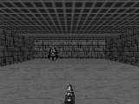
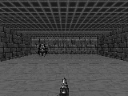
Results
RMSprop episode 50 RMSprop episode 2100

Slide 13
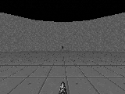
Results
ADAM episode 25 ADAM episode 1875

Slide 14
Results
Tensorboard

Slide 15
Discussion
In contrast to the A3C paper, ADAM optimization seems best for VizDoom
Very small learning rate does not seem to converge
Also -1 reward on movement is not that necessary in the current configuration

