Slide 1
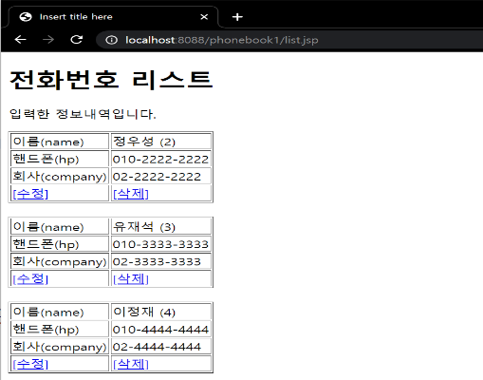
phonebook2 개요 및 분석
01
분석-삭제
action=delete&personId=2
http://localhost:8088/phonebook2/pbc
Rqeust(요청)
Tomcat
phonebook2
Request header
Request body
(파라미터)
Contoller(servlet)
객체
phoneDao 객체
rquest
delete일때
personDelete()
response
리스트 요청
Response(응답)
Response header
Response body
(리다이렉트코드)
DB
http://localhost:8088/phonebook2/pbc?action=list

Slide 2
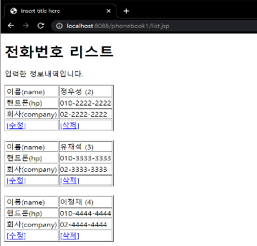
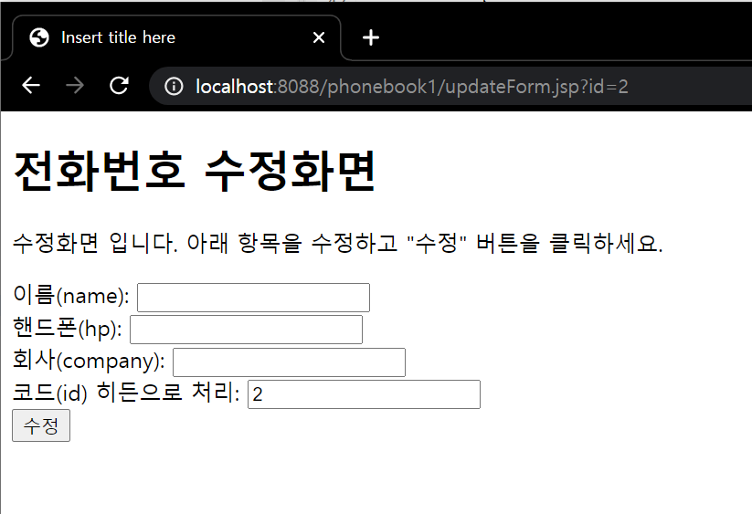
phonebook2 개요 및 분석
01
분석-수정폼
Tomcat
Rqeust(요청)
phonebook2
Request header
Request body
Contoller(servlet)
객체
phoneDao 객체
upform일때
http://localhost:8088/phonebook2/pbc?action=upform
rquest
upform
response
포워드
updateForm.jsp
객체
Response(응답)
Response header
Response body
(html)
DB

Slide 3
phonebook2 개요 및 분석
01
분석-수정
action=update&name=박명수&hp=010-6666-6666&company=02-6666-6666
http://localhost:8088/phonebook2/pbc
Rqeust(요청)
Tomcat
phonebook2
Request header
Request body
(파라미터)
Contoller(servlet)
객체
phoneDao 객체
rquest
update일때
personUpdate()
response
리스트 요청
Response(응답)
Response header
Response body
(리다이렉트코드)
DB
http://localhost:8088/phonebook2/pbc?action=list

