Slide 1
Census Income Data
1402040 JiseungRyu
Notes:
Hello everyone. My name is Jiseung Ryu.
My data to analysis is census income data.

Slide 2
Contents
EDA
Data Structure
Frequency plot of each variable
Relationship between income and other variables
Analysis
PCA
LDA
Notes:
I’m going to split my talk into two parts : First EDA and then Analysis

Slide 3
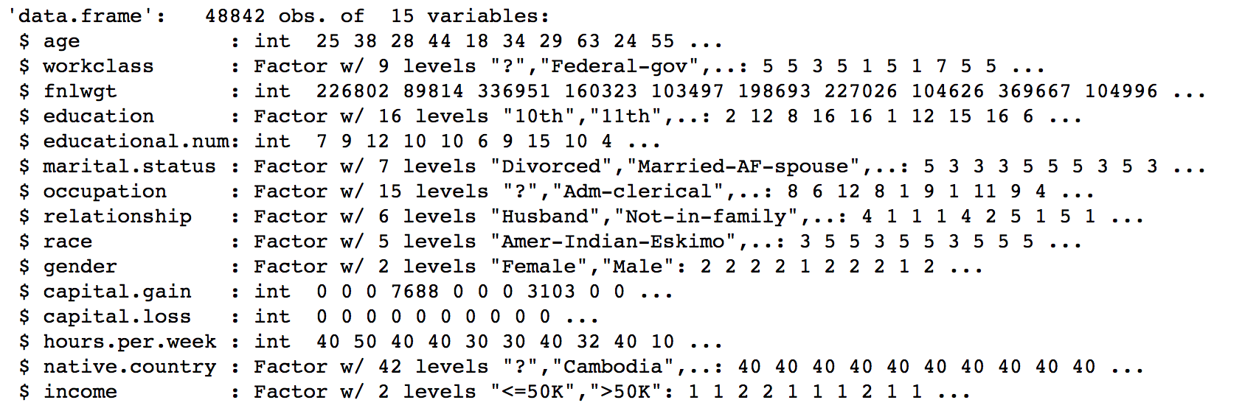
Data Structure
EDA
# of Data : 48842
# of variables : 15
Notes:
look at the data structure.
Number of data is approximately fifty thousand.
There are 15 variables.
But, I don’t use final weight variable because it is difficult to know meaning.
Subject of income data is Prediction task to determine whether a person makes over 50K a year.

Slide 4
EDA
Frequency plot of each variables
Dependent variables
income
Independent variables
Continuous variables
Age
Educational.num
Capital.gain
Capital.loss
Hours.per.week
Categorical variables
Workclass
Education
Occupation
Relationship
Race
Gender
Native.country
Notes:
So, dependent variables is income.
13 Independent variables include in 5 Continuous and 8 categorical variables.
Look at the each variables.

Slide 5
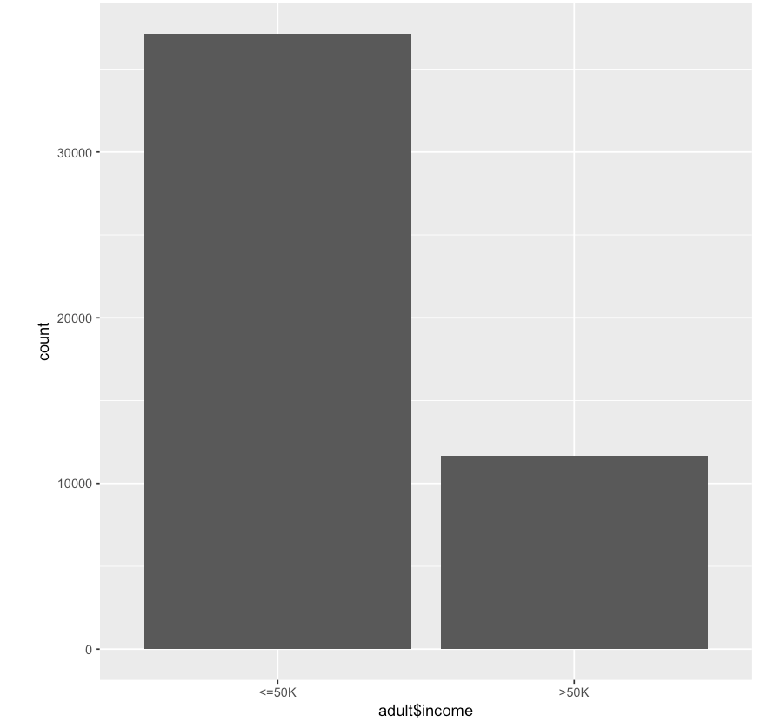
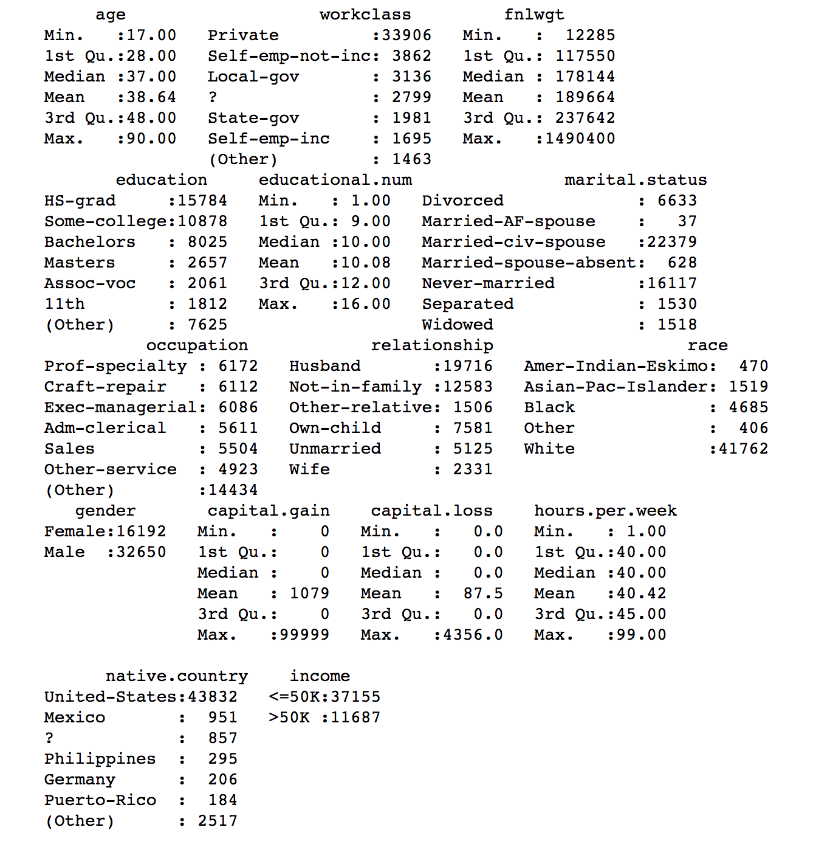
Dependent variable (income)
EDA
Categorical
Notes:
This is income bar plot.
“50K” indicates “fifty thousand dollar”
This is most
Less than or equal to 50K is more than greater than 50K in plot

Slide 6
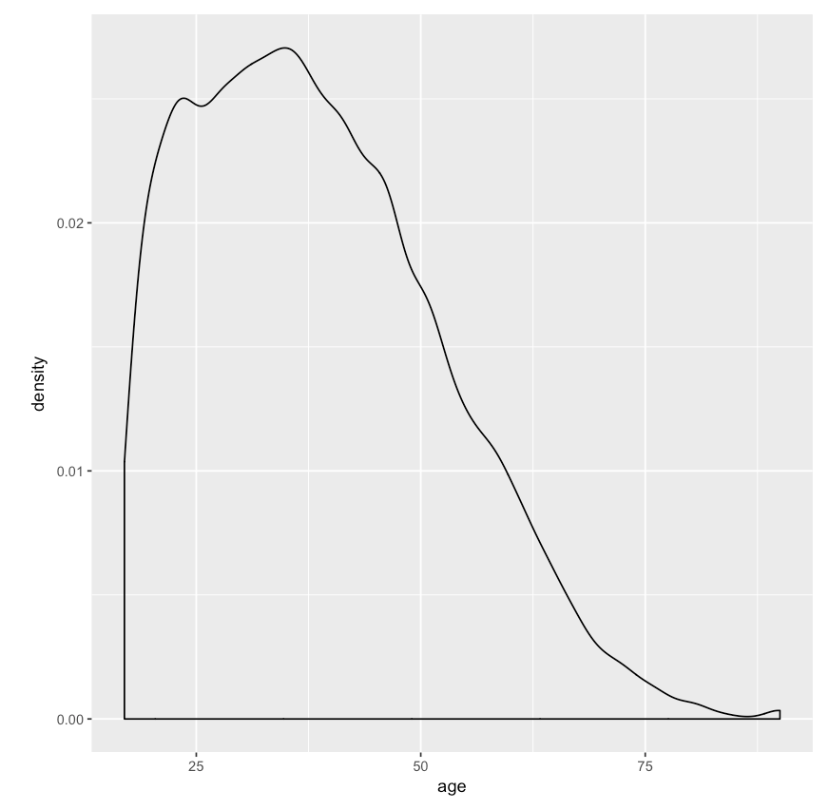
Independent variable (age)
EDA
Continuous
Notes:
This is age density plot

Slide 7
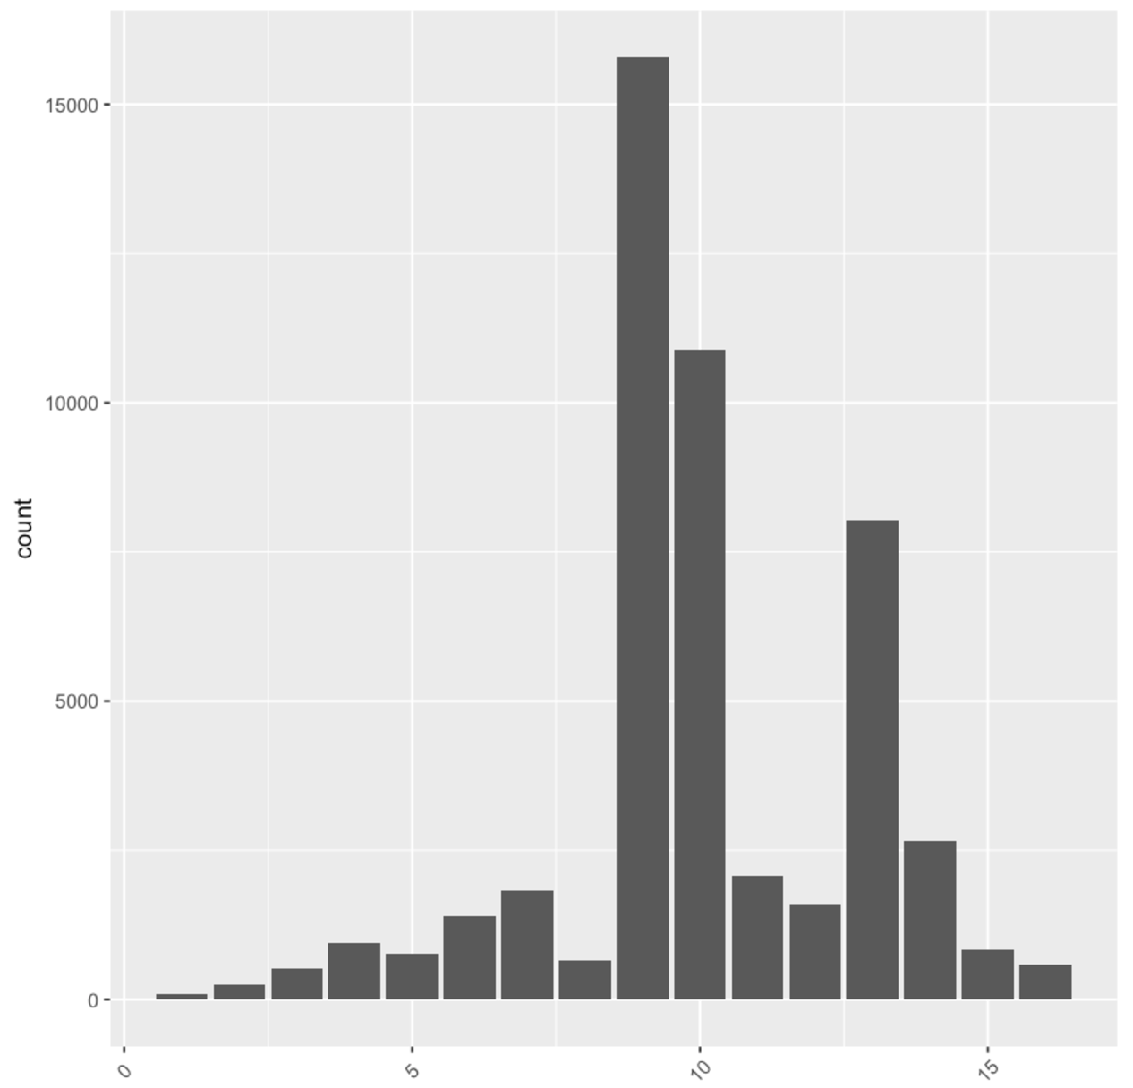

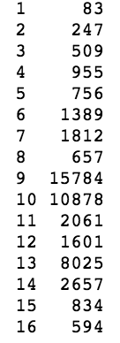
Independent variable (education)
EDA
Continuous
Notes:
This is education barplot.

Slide 8
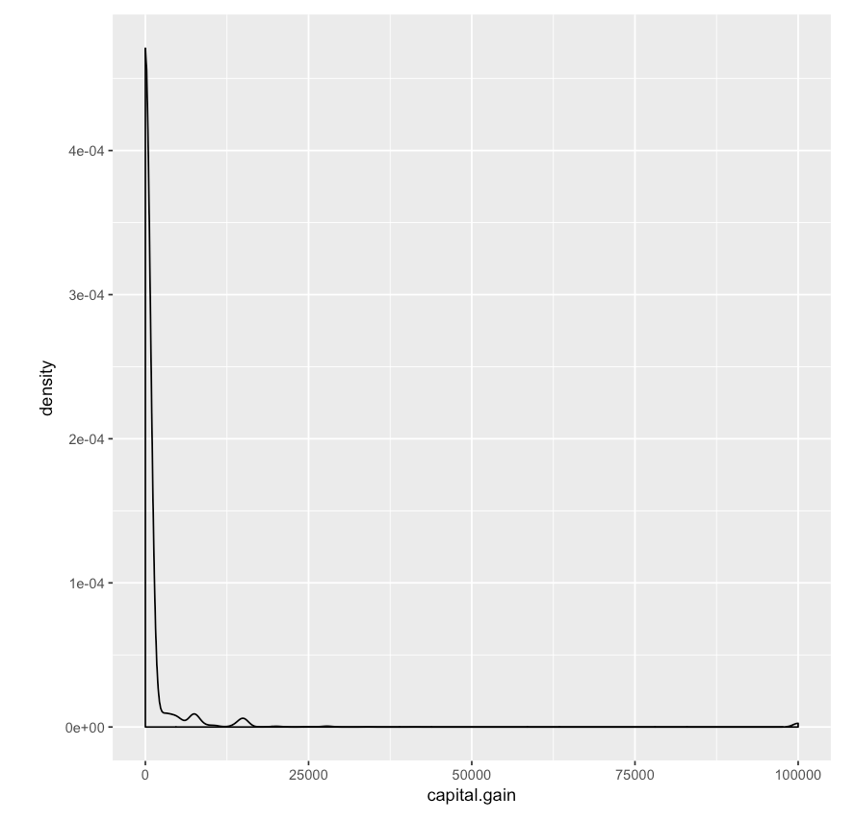
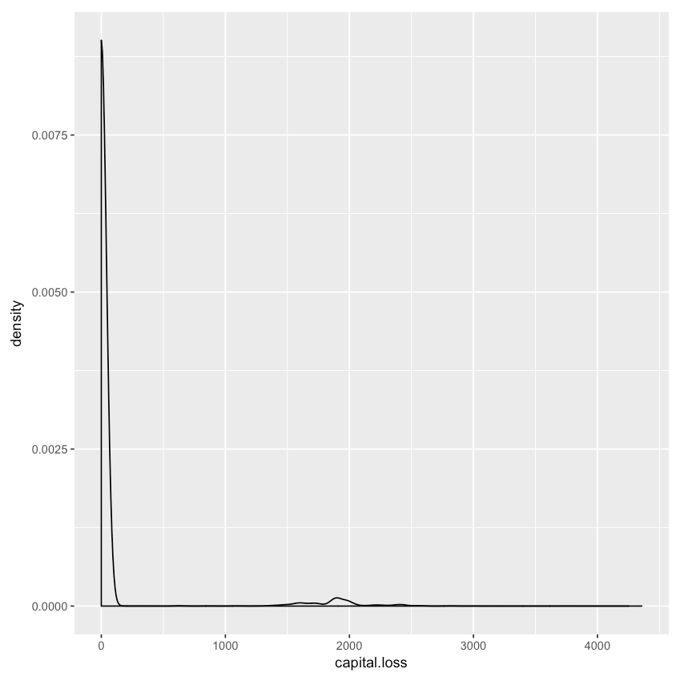
Independent variable (capital.gain,loss)
EDA
Continuous
Notes:
left is capital.gain density plot and right is capital.loss density plot.
The capital gain and loss may not be useful for classification as it is quite skewed and mostly concentrated at zero value.

Slide 9
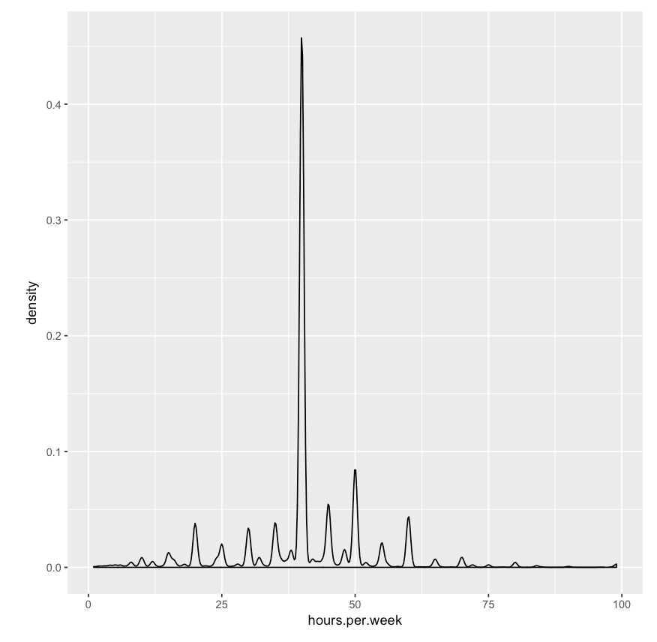
Independent variable (hours.per.week)
EDA
Continuous
Notes:
This is hours.per.week density plot.

Slide 10
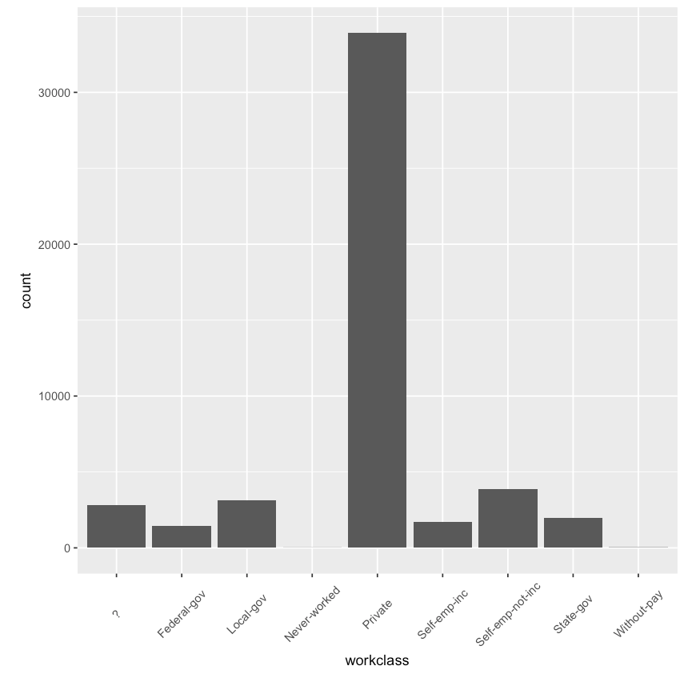
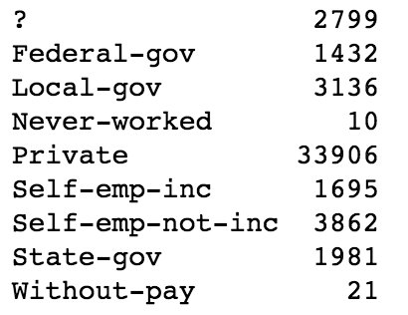
Independent variable (workclass)
EDA
Categorical
Notes:
This is workclass barplot.
Most are private

Slide 11
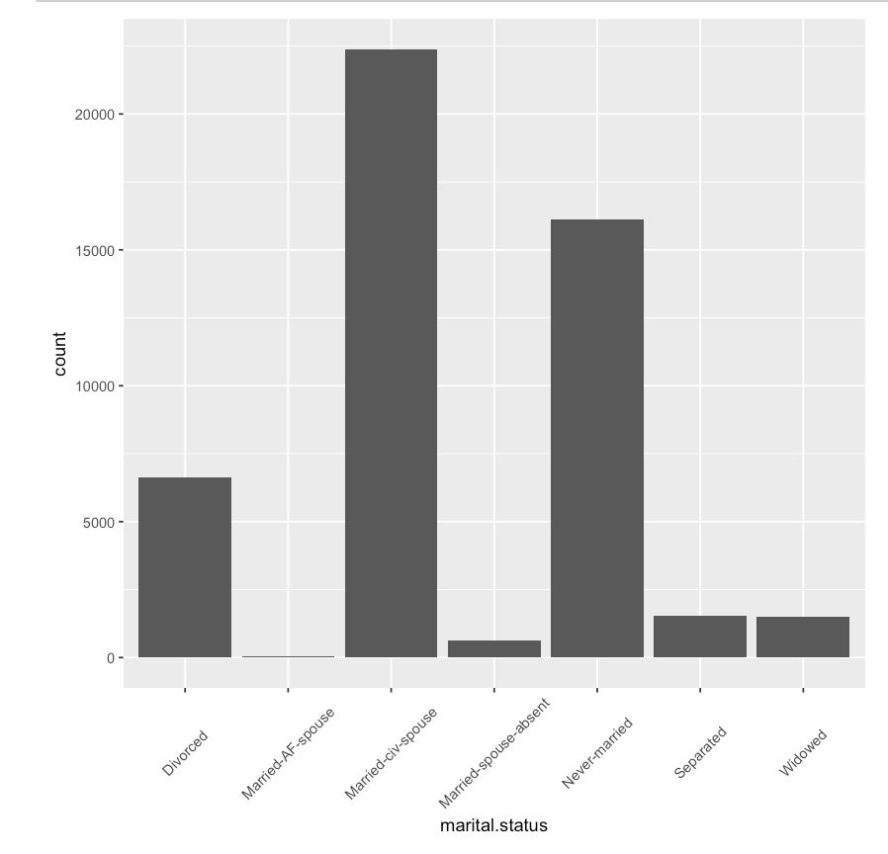
Independent variable (marital.status)
EDA
Categorical
Notes:
This is marital.satatus barplot.
Married-AF-spouse = Armed Forces
Married-civ-spouse = Civilian
1 - 결혼 한 배우자
2 - 이혼
3 - 결혼하지 않았다.
4 - 분리 된
5 - 사별 한
6 - 기혼 배우자 결석
7 - 결혼 한 AF 배우자

Slide 12
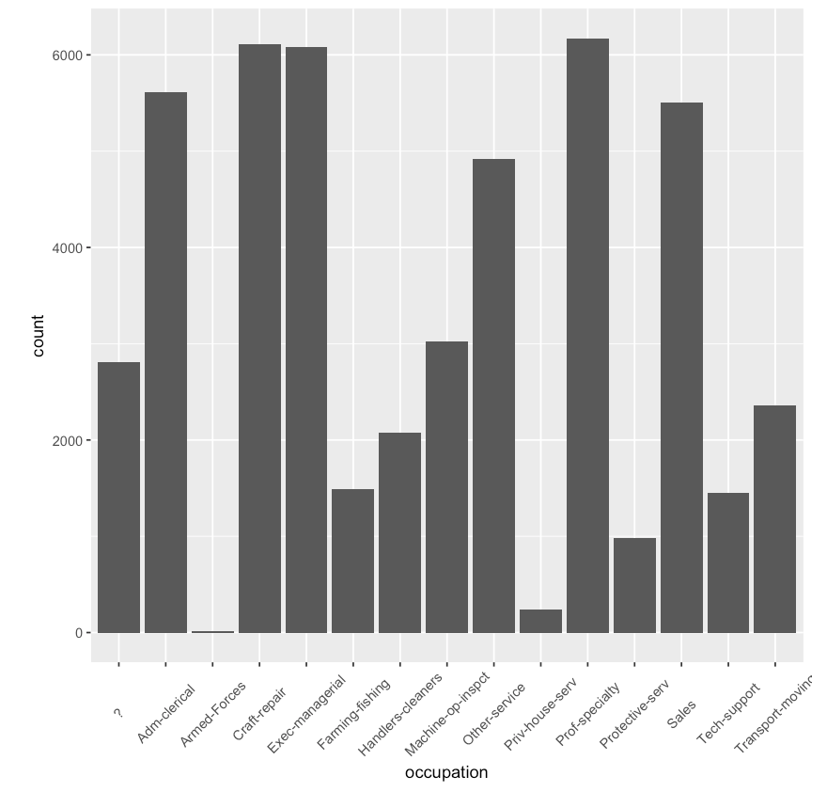
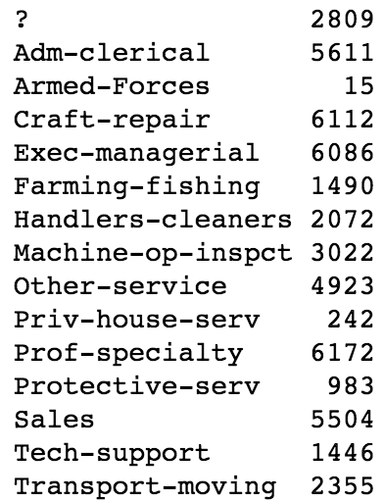
Independent variable (occupation)
EDA
Categorical
Notes:
This is occupation barplot.
Tech-support(기술자), Craft-repair(기능공), Other-service(제3서비스업), Sales, Exec-managerial, Prof-specialty, Handlers-cleaners, Machine-op-inspct, Adm-clerical, Farming-fishing, Transport-moving, Priv-house-serv, Protective-serv, Armed-Forces.

Slide 13
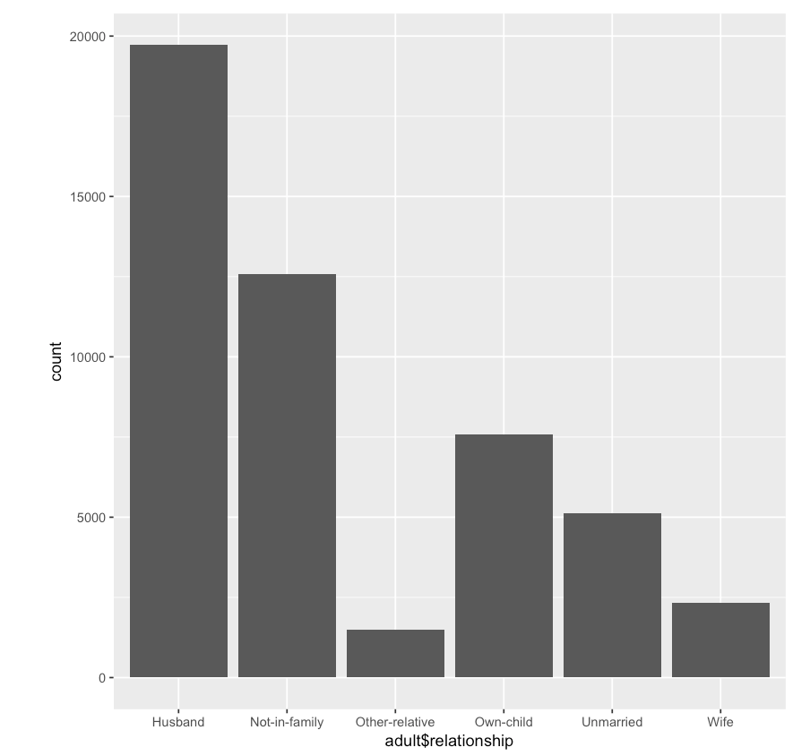
Independent variable (relationship)
EDA
Categorical
Notes:
This is relationship barplot.
1 - 아내
2 - 본인
3 - 남편
4 - 가족이 아님
5 - 기타 - 상대적
6 - 미혼

Slide 14
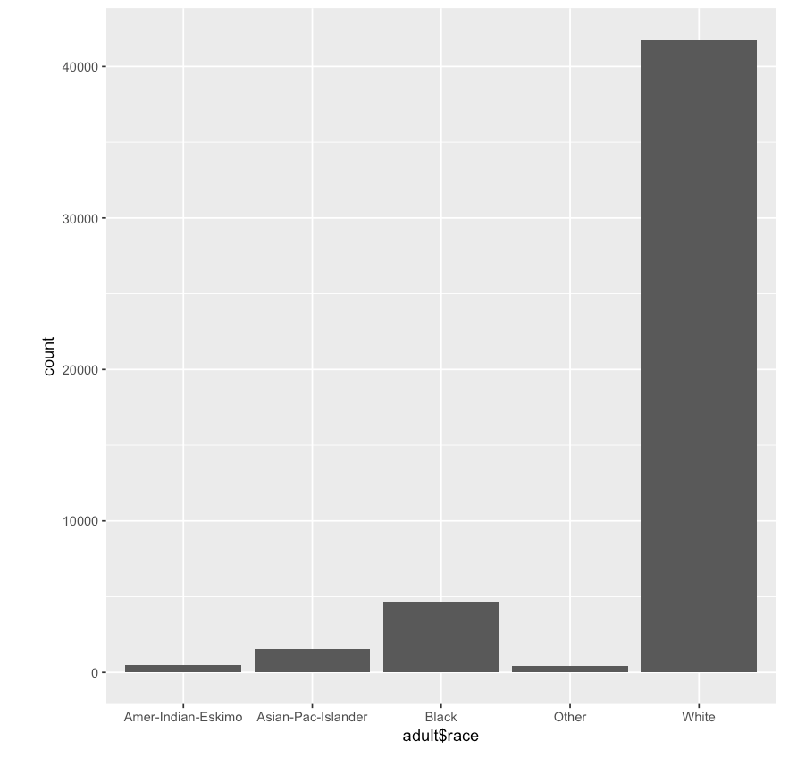
Independent variable (race)
EDA
Categorical
Notes:
This is race barplot.
Most are white

Slide 15
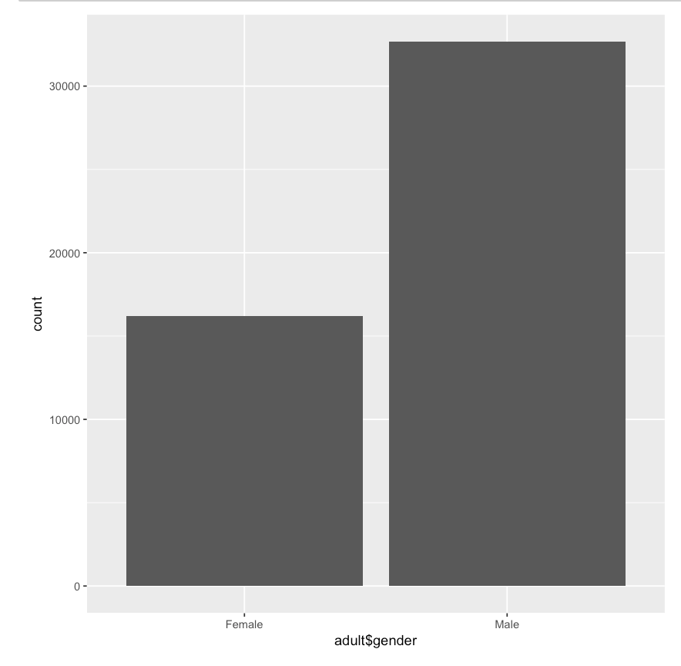
Independent variable (gender)
EDA
Categorical
Notes:
This is gender barplot.

Slide 16
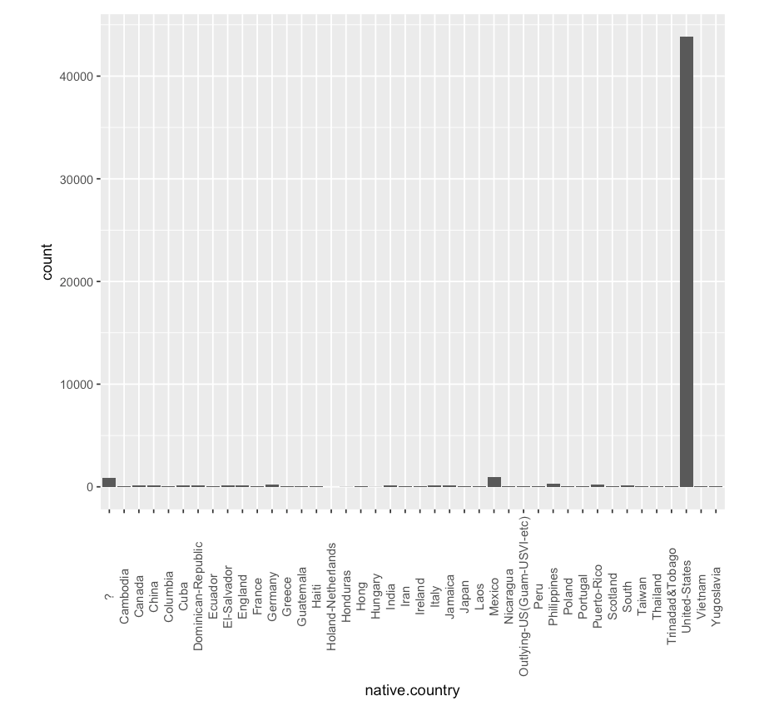
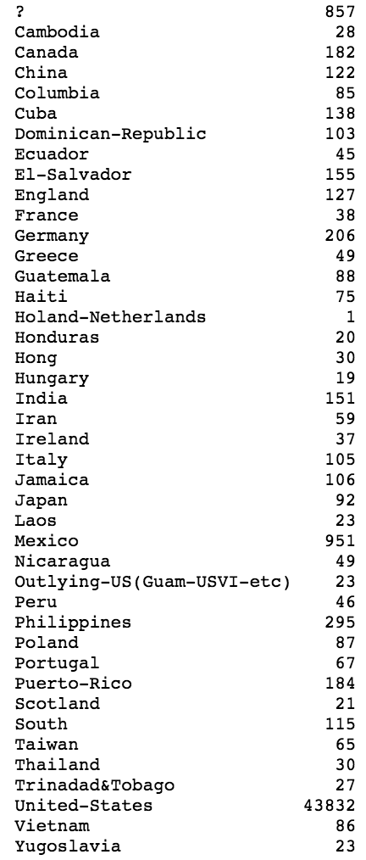
Independent variable (native.country)
EDA
Categorical
Notes:
This is native.country barplot.
Most is united states

Slide 17
EDA
Relationship between income and
other variables
Notes:
Let's look at the variables grouped by income.

Slide 18
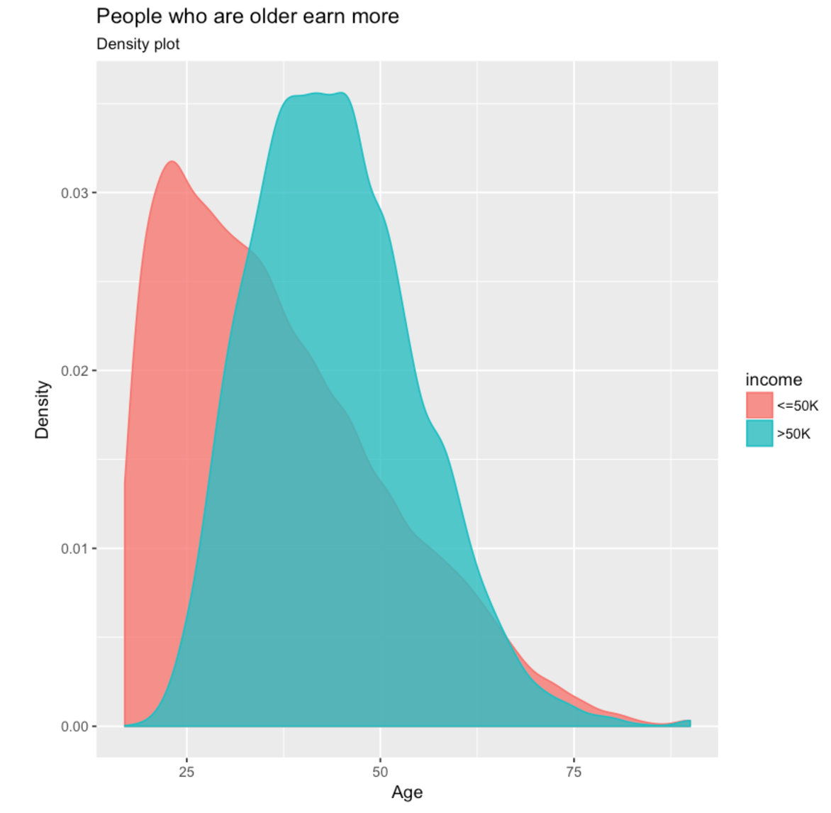
Relationship between income and age
EDA
Notes:
First, Explore Continuous Variable
We can find that People who are older earn more

Slide 19
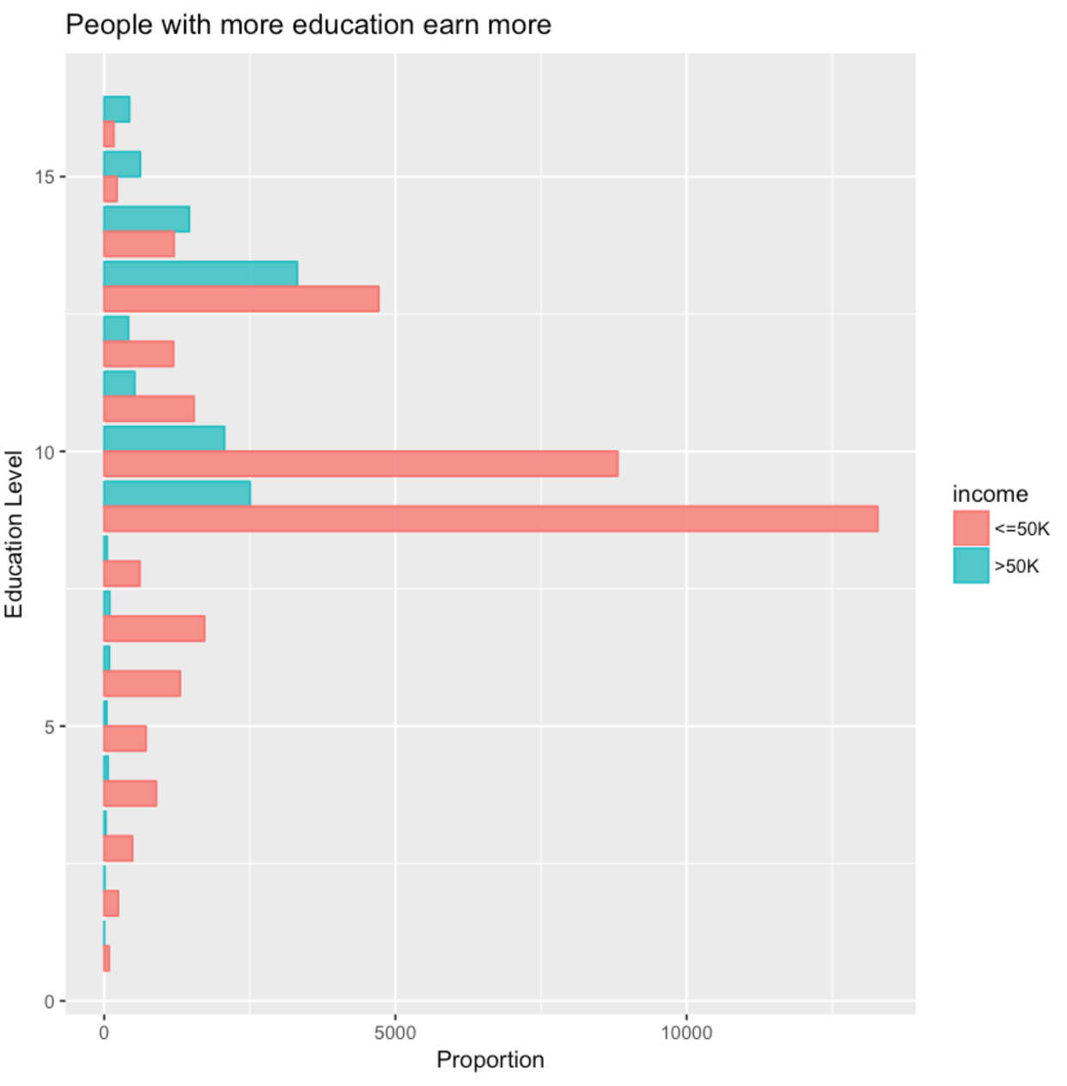
Relationship between income and education
EDA
Notes:
B: Education
Higher education level may result in a higher possibility of well-paid employment.

Slide 20
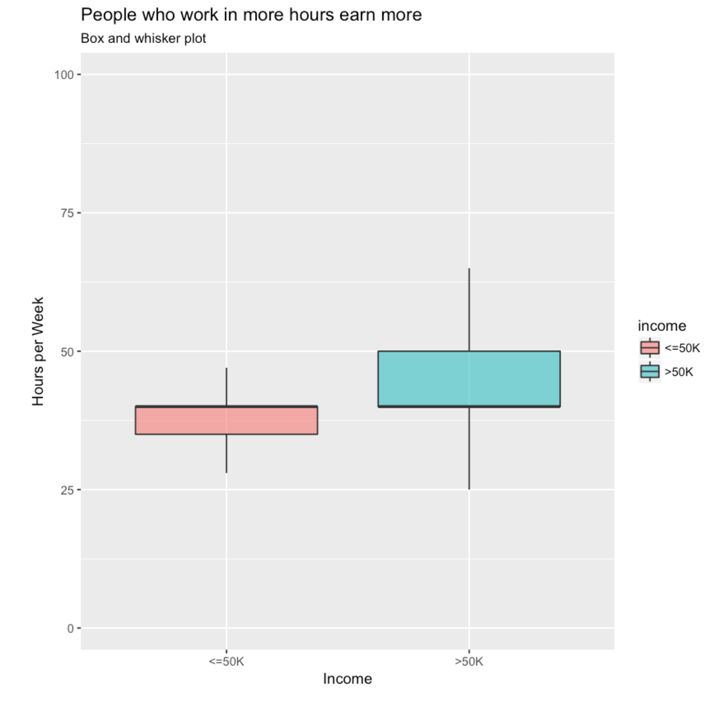
Relationship between income and hours per week
EDA
Notes:
People who work in more hours earn more

Slide 21
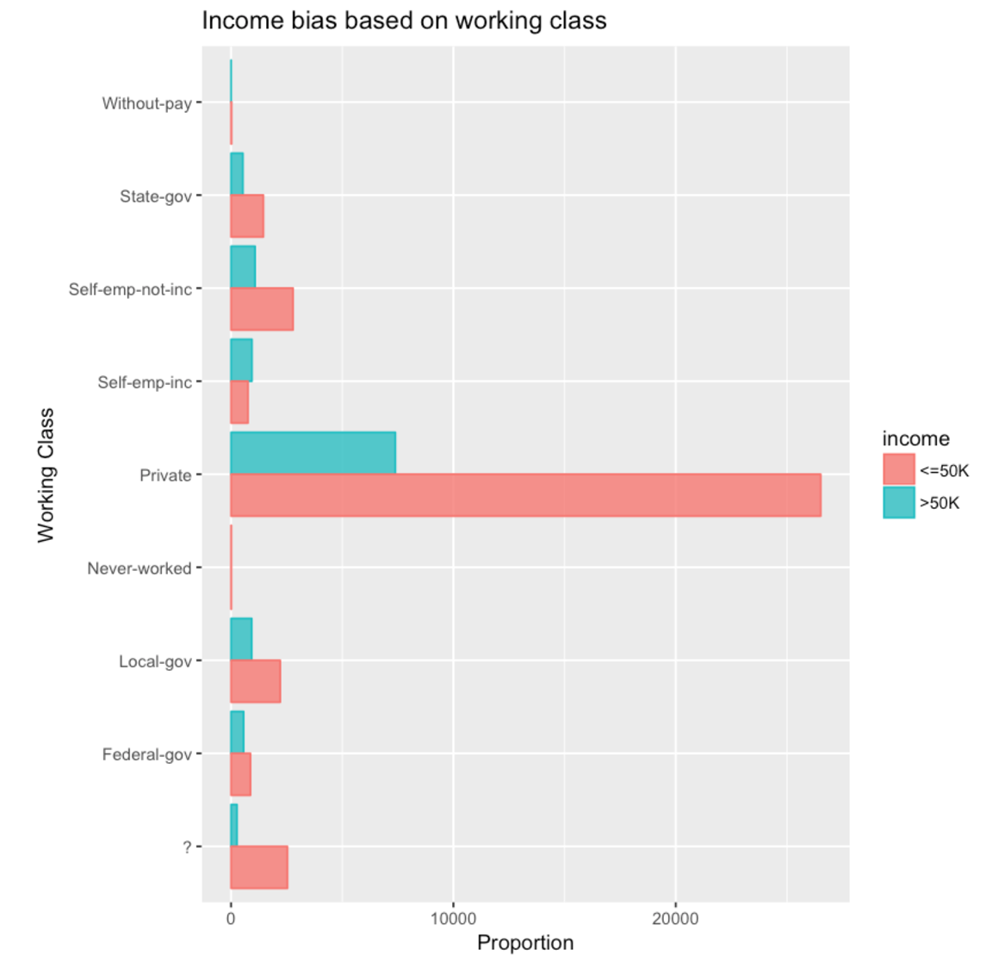
Relationship between income and workclass
EDA
Notes:
Explore Categorical Data
A: Work Class
The private sector, which has the most people work in, has the largest number of population that earn more than 50K per year.
However, in terms of the proportion, the self-employed people are the winner.

Slide 22
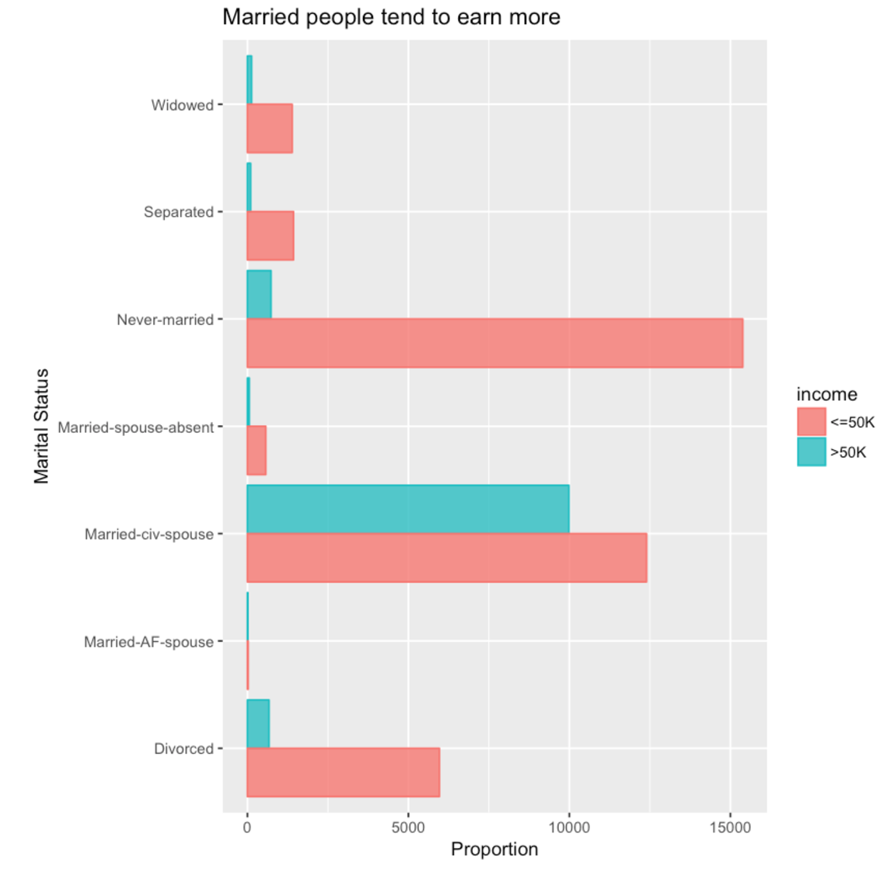
Relationship between income and Marital Status
EDA
Notes:
C: Martial Status
Married people tend to earn more
A good marital relationship is also a key for earning more money.

Slide 23
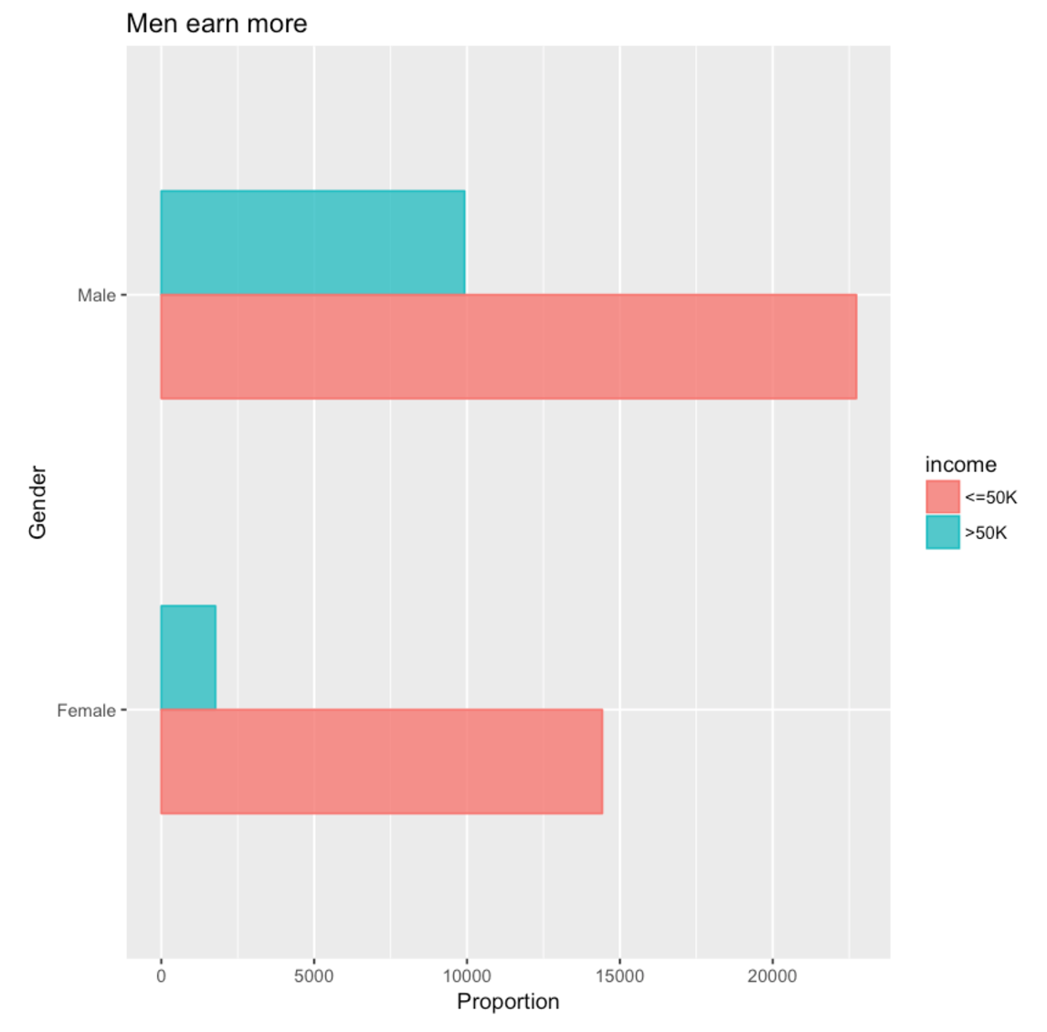
Relationship between income and gender
EDA
Notes:
E: Sex
Male employees are more competitive in terms of salary

Slide 24
Summary EDA
Continuous variables
Age
educational.num
hours.per.week
Categorical variables
Maritial statues
Working Hours
gender
Notes:
We can see that age, educational.num, hours.per.week, Maritial statues, Working Hours and gender really matters if you want to earn more than 50K per year.
In contrary, the working class is not that important.
Generally speaking, you will get equal opportunity if you work hard enough, no matter what kinds of job are you doing.

Slide 25
Analysis(PCA, LDA)
Analysis
Notes:
Let's move on to the next.
In analysis, I use clustering, pca, and lda

Slide 26
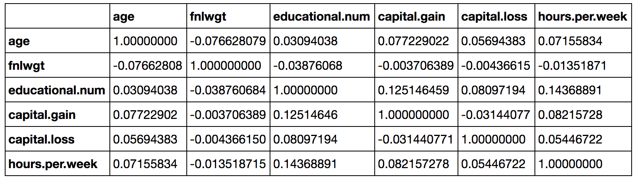
Correlation between continuous variables
EDA
Analysis
Notes:
Before analysis, I make correlation table between continuous variables.
We can know Less correlation.

Slide 27
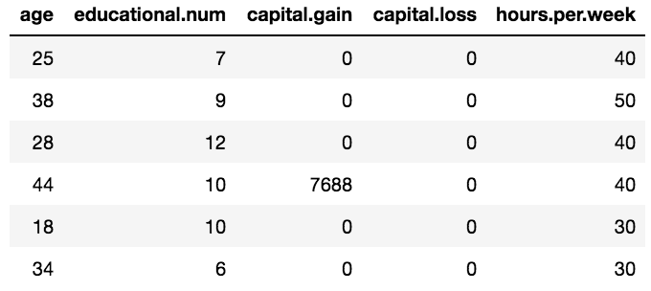
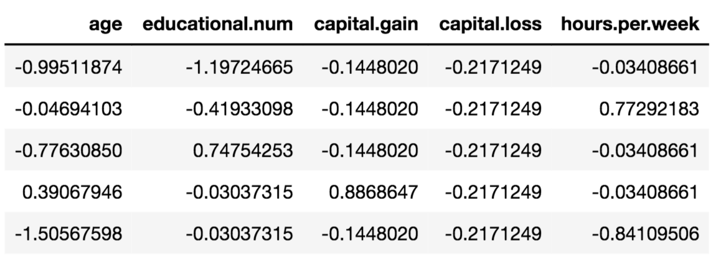
Standardaztion
Analysis
Notes:
I use 5 continuous variables in using analysis method because in PCA and LDA, we can use only continuous variables.
And 5 variables have different scale.
So, I standardized 5 variables

Slide 28
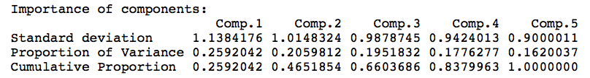
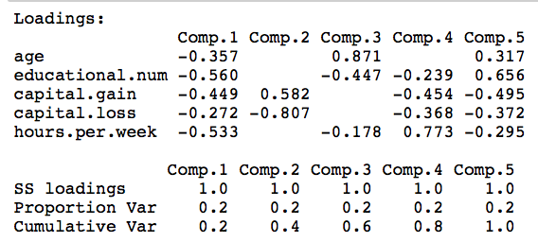
PCA
Analysis
Notes:
I try PCA and LDA.
This is PCA result.
I select comp.1 and comp.2 because standard deviation is bigger than 1(rule)
#comp 1 meaning is average of 5 variables
#comp 2 meaning is capital.gain - capital.loss, equal total capital.gain

Slide 29
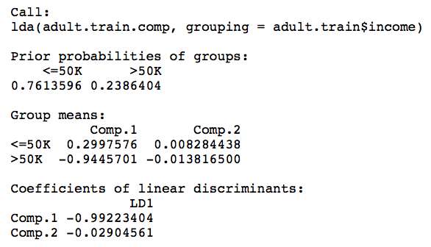
LDA using PCA result
Analysis
Notes:
This is LDA result using comp1 and comp2
Since there are two groups, there is only LD1
We can find that comp.1 is dominated in LD1.

Slide 30
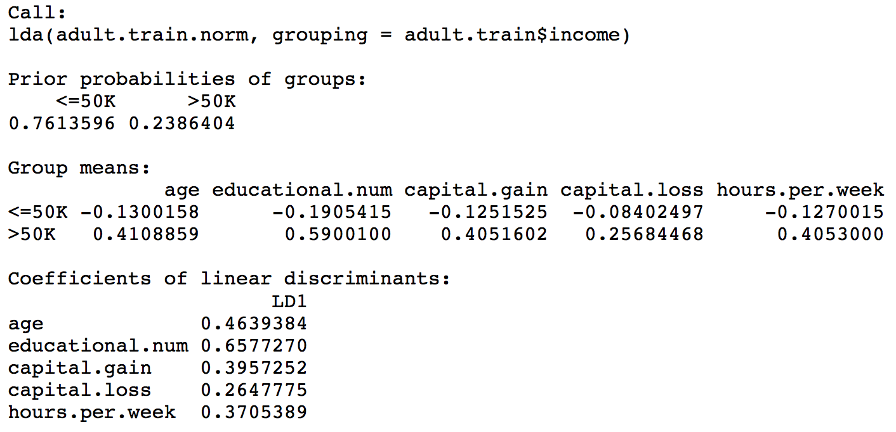
LDA
Analysis
Notes:
And then, try lda using 5 variables.
LD1 is average of 5 variables same as comp1.

Slide 31
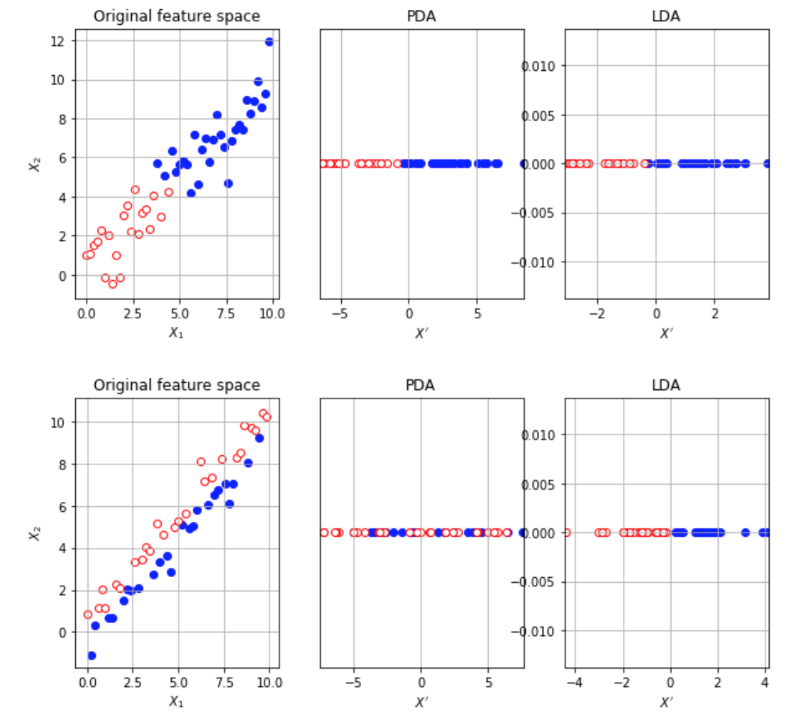
Comparison
Analysis
PCA
PCA
Notes:
It shows that my continuous data is distributed like top figure.
It is different with my data. I just get the image to explain data distribution when PCA result is same with LDA result.
The bottom figure is the opposite of the upper figure.
It does not work properly to use the PCA for calssification.

Slide 32
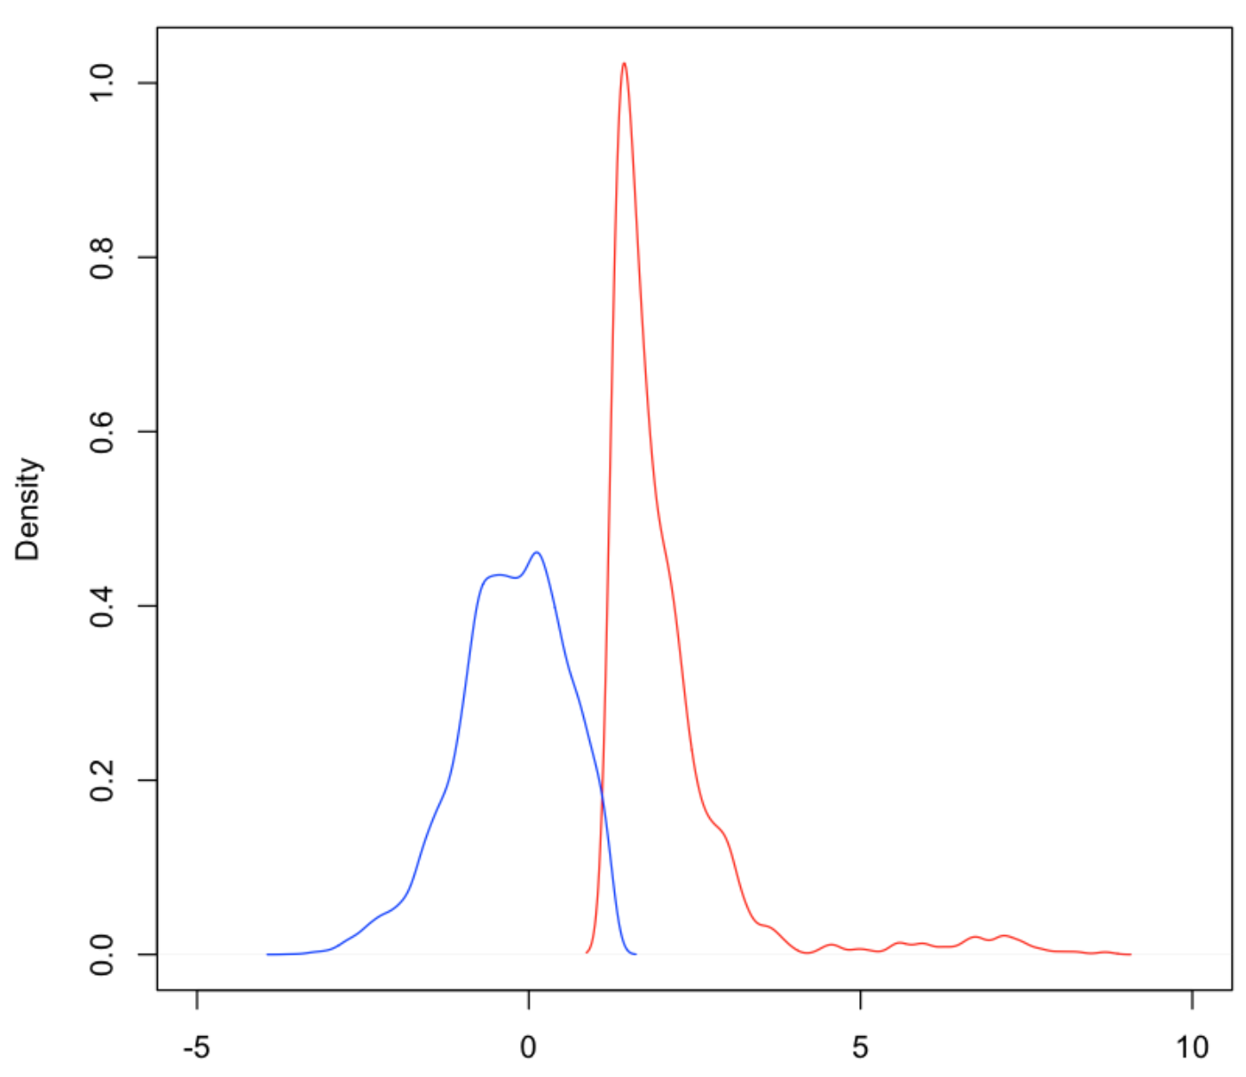
LD1 density plot grouped by income
Analysis
Red : >50K
Blue : <=50K
Precision : 0.8
X: LD1
Notes:
This is the density plot LD1 grouped by income
We can find that LD1 classifies income well in plot.
Precision also tells us same information.

Slide 33
Thank you for listening
Notes:
Thank you for listening

