Slide 1
Salesforce Agentforce Specialist Certification
Deepika Khanna

Slide 2
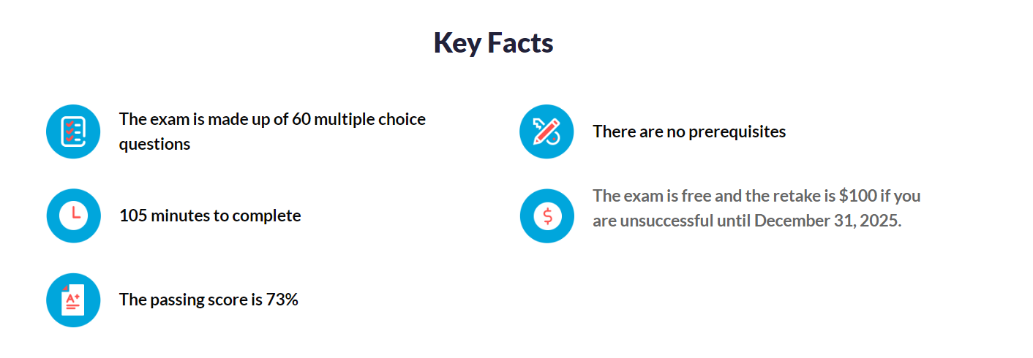
Key Facts

Slide 3
Exam Topics
Prompt Engineering: 30%
Agentforce Concepts: 30%
Agentforce and Data Cloud: 20%
Agentforce and Service Cloud: 10%
Agentforce and Sales Cloud: 10%

Slide 4
Our Foundation: Trust
At Salesforce, trust is our number one value.
This commitment to trust extends directly to our agentic AI offerings.
We are proactively addressing the emerging challenges of AI agents on our platform.

Slide 5
What are Agents ?
Agents are autonomous and goal-oriented.
They can perform tasks and business interactions with minimal human input.
Key capabilities include:
Beginning and completing single or multiple tasks
Handling natural language conversations
Securely providing relevant answers from business data
Agents can:
Support and collaborate with Salesforce users
Act on behalf of a user or customer
They can be integrated into your Salesforce interface or customer channels.

Slide 6
Agentic AI
Agentic AI is an AI system that enables AI agents to operate autonomously, make decisions, and adapt to change.
It fosters collaboration between AI agents and humans
This is achieved through tools and services that facilitate learning and adaptation

Slide 7
Guiding Principles for Responsible Agentic AI
Accuracy
Safety
Honesty
Empowerment
Sustainability

Slide 8
Accuracy
Our reasoning engine uses topic classification to map user requests to specific topics.
Topics include instructions, business policies, and actions the agent can take, keeping it on task.
The grounding process incorporates relevant context from your Salesforce org into the prompt.
Agents use your organization’s Salesforce data to base their responses, improving accuracy and relevance

Slide 9
Safety
Our agents have built-in safeguards to prevent unintended consequences and ensure safe responses.
System policies limit the scope of agent responses, ensuring they stay on topic and respond ethically.
The Einstein Trust Layer detects harmful content in agent responses and logs it for monitoring.
We have a zero data retention policy with third-party LLM providers, ensuring your data isn't stored outside the Salesforce trust boundary or used for training

Slide 10
Honesty
We respect the source of data and obtain consent for its use.
We maintain transparency about AI-generated content by stating when an AI has created it.
Standard disclosures are included when AI generates responses for user transparency

Slide 11
Empowerment
We focus on the partnership between humans and AI, where AI supports human tasks requiring judgment.
While some tasks can be fully automated, human oversight remains crucial for high-risk decisions.
We aim to empower people to make important decisions while automating routine tasks for effective human-AI collaboration

Slide 12
Sustainability
We aim to create efficient AI models to reduce environmental impact.
Smaller, well-trained models can often outperform larger ones.
We utilize efficient hardware and low-carbon data centers.
Agents use optimized models like xLAM and xGen-Sales, tailored for high performance with minimal environmental impact

Slide 13
Salesforce has established a strong foundation through:
The Einstein Trust Layer
Agentforce guardrails
Trust patterns
Ethical red-teaming
An AI Acceptable Use Policy (AUP)

Slide 14
Salesforce has two main types of guardrails:
Platform Guardrails
Agentforce Guardrails

Slide 15
Platform Guardrails
Platform Guardrails: These are like general safety rules for everything on Salesforce.
The Acceptable Use Policy (AUP) tells you what you can and cannot do with Salesforce, so you don't accidentally cause problems. For example, you can't use it to send spam.
The AI Acceptable Use Policy (AI AUP) has specific rules for using Salesforce AI. A big one is that AI can't make important decisions, like legal ones, without a person checking it first.
Model Containment Policies are rules about how our AI brains (models) are used. This stops them from being misused or doing things they shouldn't, like accidentally sharing private information. These rules help keep Salesforce safe and fair

Slide 16
Agentforce Guardrails
These are more specific rules for different Salesforce tools and how you use them for your business.
They also help make sure the AI follows local laws.
These guardrails help reduce AI mistakes (called hallucinations) and protect against things like sneaky attacks (prompt injections)

Slide 17
Topics, Topic Instructions, and Actions
Topics are categories of actions related to a specific task an agent needs to perform.
Actions are the actual tools or jobs that an agent can execute. Salesforce provides standard actions out-of-the-box for common tasks, meaning your agent can be helpful right away. For instance, an action might involve drafting and revising an email using relevant Salesforce data.
Topic instructions provide the essential context and guidelines for agent behavior, ensuring they perform their jobs effectively. These instructions often take the form of "Always...", "Never...", or "If x, then y..." to ensure clear and consistent actions

Slide 18
Einstein Trust Layer
All our AI agents are integrated with the Einstein Trust Layer. This is a secure AI architecture built directly into Salesforce, designed for enterprise-level security.
Key features of the Einstein Trust Layer include:
Data grounding: This ensures that AI prompts are based on and enriched with your trusted company data.
Zero-data retention: Your data is never retained by third-party large language model (LLM) providers.
Toxicity detection: Potentially harmful responses generated by the LLM are identified and flagged.
AI monitoring: All AI interactions are recorded in event logs, providing you with visibility into the outcomes of each user interaction

Slide 19
To make sure AI is safe, we need to test it carefully
Red-Teaming is like a special kind of testing where experts try to find problems in the AI system.
These experts, who know about security and doing the right thing with AI, try to "break into" the system to find weaknesses.
This helps fix problems like the AI giving bad information.
Salesforce uses both people and computers to do this testing. They look for bad uses, attacks, and accidents to make sure their AI is safe from things like saying harmful stuff or being biased.

Slide 20
There are different ways to test:
Manual testing uses clever people to think up complicated attacks that computers might miss. They can change their approach depending on the situation.
Automated testing uses computer programs to try many attacks quickly. This helps see how risky the AI system is, but it's not as good as having real people test it. Salesforce also gets help from experts to test their AI

Slide 21
When you use AI helpers called agents, you need to think about security:
Access Control: Only let people who really need to use the AI agents have access to them. Be careful about what these agents can do. For important actions, it might be safer to limit what each agent can access.
Monitoring and Auditing: Keep an eye on who is using the AI agents to catch any unusual activity.
Data Protection: Make sure your company and customer data is safe and secure. Follow the rules for keeping your apps secure and backing up your information. If you're dealing with customer information, handle it correctly and get their permission when needed. Don't let AI hide what it's doing from customers.
Responsible Use: Use filters to block bad content from the AI. Have rules for using AI ethically, respecting people's privacy and security

Slide 22
What Is Agentforce Sales Coach?
Agentforce Sales Coach is an autonomous sales agent built on the Agentforce platform.
Using generative AI and CRM data, it provides sellers with stage-specific feedback to help push deals forward and boost ROI.

Slide 23
Agentforce Testing Center
To launch an agent that’s trustworthy and reliable, you want to thoroughly test it.
Agent Builder is well suited for testing out a conversation, but if you want to test large numbers of scenarios, the process can be time-consuming.
Testing Center uses batch testing so you can quickly assess multiple requests in a single test. To make the process even quicker, you can use gen AI to create test cases for you. By reducing testing time, you can launch trusted agents quickly.

