Slide 1
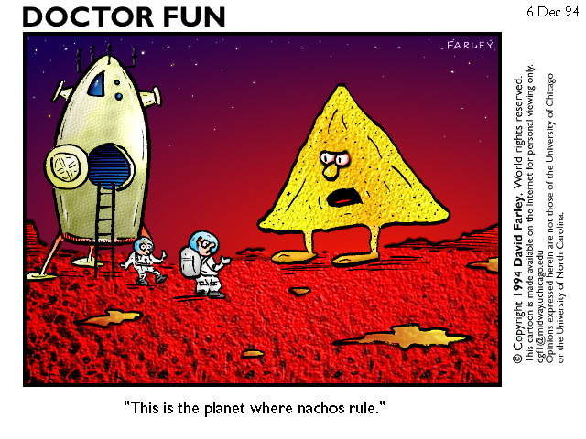
CS 162 Nachos Tutorial
Image courtesy of Thomas Andersen: http://www.cs.washington.edu/homes/tom/nachos/

Slide 2
Outline
What is Nachos?
  Capabilities, purpose, history
How does it work?
How do I get started?

Slide 3
What is Nachos?
An instructional operating system
Includes many facets of a real OS:
  Threads
  Interrupts
  Virtual Memory
  I/O driven by interrupts
You can (and will) modify and extend it

Slide 4
What else is Nachos?
Nachos also contains some hardware simulation.
  MIPS processor
    Can handle MIPS code in standard COFF, except for floating point instructions
    You can (and will) write code in C, compile it to MIPS and run it on Nachos.
  Console
  Network interface
  Timer

Slide 5
Why Nachos?
What better way to learn how an OS works than by building one?
Much easier and more reasonable to build a simulated one in Java
Skeleton code allows us to work on, replace, or upgrade one piece at a time.

Slide 6
History of Nachos
Originally created here at Berkeley in 1992 in C++
By Wayne A. Christopher, Steven J. Procter, and Thomas E. Anderson
Used at many universities
Rewritten in Java by Daniel Hettena
  Now simpler, easier to grade, type-safe, portable, and more students now know Java.

Slide 7
How are we using it?
Four Nachos assignments - “Phases”
Phase 1 - Threading
Phase 2 - Multiprogramming
Phase 3 - Caching and Virtual Memory
Phase 4 - Networks and Distributed Systems

Slide 8
How does Nachos work?
Entirely written in Java
Broken into Java packages:
  nachos.ag (autograder classes)
  nachos.machine (most of the action)
  nachos.network (Phase 4)
  nachos.security (tracks priviledge)
  nachos.threads (Phase 1)
  nachos.userprog (Phase 2)
  nachos.vm (Phase 3)

Slide 9
Booting Nachos
When you run Nachos, it starts in nachos.machine.Machine.main
Machine.main initializes devices - interrupt controller, timer, MIPS processor, console, file system
Passes control to the autograder.
AutoGrader will create a kernel and start it (this starts the OS)

Slide 10
The Machine!
nachos.machine.Machine
Kicks off the system, and provides access to various hardware devices:
  Machine.interrupt()
  Machine.timer()
  Machine.console()
  Machine.networkLink()

Slide 11
Interrupt Controller
Kicks off hardware interrupts
nachos.machine.Interrupt class maintains an event queue, clock
Clock ticks under two conditions:
  One tick for executing a MIPS instruction
  Ten ticks for re-enabling interrupts
After any tick, Interrupt checks for pending interrupts, and runs them.
Calls device event handler, not software interrupt handler

Slide 12
Interrupt Controller (cont.)
Important methods, accessible to other hardware simulation devices:
  schedule() takes a time, handler
  tick() takes a boolean (1 or 10 ticks)
  checkIfDue() invokes due interrupts
  enable()
  disable()
All hardware devices depend on interrupts - they don’t get threads.

Slide 13
Timer
nachos.machine.Timer
Hardware device causes interrupts about every 500 ticks (not exact)
Important methods:
  getTime() tells many ticks so far
  setInterruptHandler() tells the timer what to do when it goes off
Provides preemption

Slide 14
Serial Console
Java interface nachos.machine.SerialConsole
Contains methods:
  readByte() returns one byte (or -1) and waits to interrupt when it has more
  writeByte() takes one byte and waits to interrupt when its ready for more
  setInterruptHandlers() tells the console who to call when it receives data or finishes sending data
Normally implemented by nachos.machine.StandardConsole, hooked up to stdin and stdout

Slide 15
Other Hardware Devices
Disk
  Didn’t make the jump to Java from C++, we don’t use it for our Nachos assignments
Network Link
  Similar to console, but packet based.
  Used for Phase 4.
  You should be able to figure it out by then.

Slide 16
The Kernel
Abstract class nachos.machine.Kernel
Important methods
  initialize() initializes the kernel, duh!
  selfTest() performs test (not used by ag)
  run() runs any user code (none for 1st phase)
  terminate() Game over. Never returns.
Each Phase will have its own Kernel subclass
Oh, how I hated the kernel, with his wee beady eyes, and smug look on his face! “Oh, you’re gonna buy my chicken!”

Slide 17
Threading
Happens in package nachos.threads
All Nachos threads are instances of nachos.thread.KThread (or subclass)
KThread has status
  New, Ready, Running, Blocked, Finished
Every KThread also has a nachos.machine.TCB
Internally implemented by Java threads

Slide 18
Running threads
Create a java.lang.Runnable(), make a Kthread, and call fork().
Example:
class Sprinter implements Runnable {
public void run() {
// run real fast
}
}
Sprinter s = new Sprinter();
new KThread(s).fork();

Slide 19
Scheduler
Some subclass of nachos.machine.Scheduler
Creates ThreadQueue objects which decide what thread to run next.
Defaults to RoundRobinScheduler
Specified in Nachos configuration file

Slide 20
Nachos Configuration
nachos.conf file lets you specify many options
  which clases to use for Kernel, Scheduler
  whether to be able to run user progs
  etc.
Different one for each project.

Slide 21
How to get started
Go to class web page
Download and install nachos package
Read the README, make sure you can make proj1 OK
The first phase will be posted soon with detailed instructions for first Nachos assignment

Slide 22
Advice
One step at a time. Get a little bit working. Then a little more. Then a little more, etc.
Find a good tool, including a debugger, and use it. One choice - Eclipse.

Slide 23
For More Information
README file in the installation has lots of good stuff
See the Class Web Page for intros, background, and the code itself.
Read the code! You can see exactly what is going on.

