Slide 1


PREPOSITION POWER
Click here to start
Notes:
This STAIR will address middle school students with a working knowledge of nouns, pronouns, verbs, adjectives, adverbs, articles and conjunctions as well as an understanding of simple and compound.

Slide 2
Lesson One: Prepositions
A preposition is a part of speech that shows a relationship between two things.
  Location (on, under, in)
  Timing (before, after, during)
  Direction (from, toward, to)
Notes:
Rule-Eg Strategy (Deductive)

Slide 3
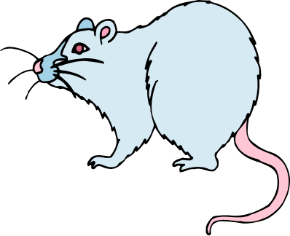
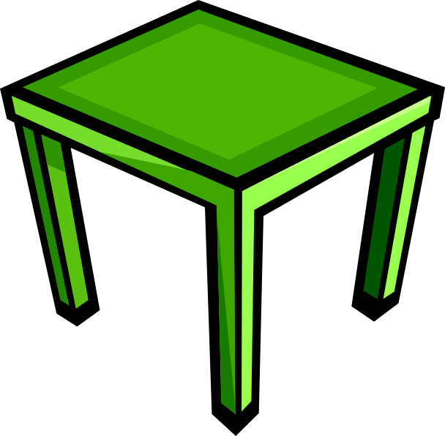
Lesson One: Prepositions (cont.)
The mouse is on the table.
Two things: mouse + table
Relationship: one is on the other
On is a preposition!

Slide 4
Lesson One: Prepositions (cont.)
The mouse is under the table.
Two things: mouse + table
Relationship: one is under the other
Under is a preposition!

Slide 5
Lesson One: Prepositions (cont.)
Here is a list of the most common prepositions:
aboard | along | behind | but (except) | from | off | past | until
about | amid | below | by | in | on | since | up
above | among | beneath | down | inside | onto | through | upon
across | around | beside | during | into | out | to | with
after | at | between | except | near | outside | toward | within
against | before | beyond | for | of | over | under | without

Slide 6
Lesson One: Prepositions (cont.)
Here is a list of the most common prepositions:
aboard | along | behind | but (except) | from | off | past | until
about | amid | below | by | in | on | since | up
above | among | beneath | down | inside | onto | through | upon
across | around | beside | during | into | out | to | with
after | at | between | except | near | outside | toward | within
against | before | beyond | for | of | over | under | without

Slide 7
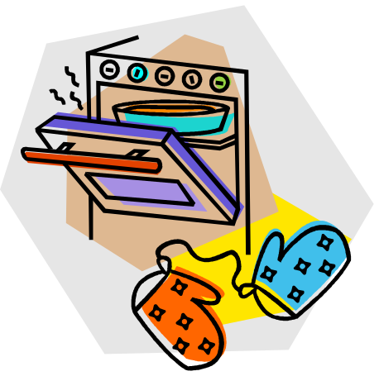
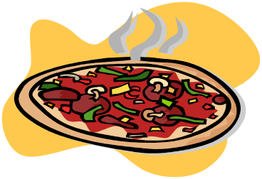
Test Your Knowledge 1
Which word is a preposition?
The pizza in the oven is mine.
pizza
in
oven
mine
Check the list of prepositions.

Slide 8
RIGHT!
Two things are related to each other
by the preposition!
You have PREPOSITION POWER!

Slide 9
WRONG!
Click here to try again
Click here to check the list of prepositions before trying again!

Slide 10
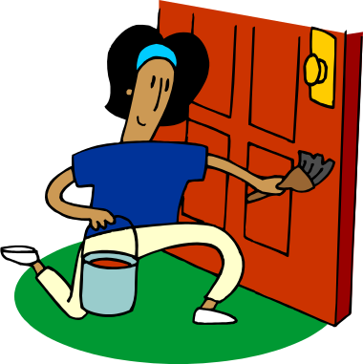
Test Your Knowledge 2
Which word is a preposition?
The girl by the door is my sister.
girl
by
door
my
Check the list of prepositions.

Slide 11
RIGHT!
Two things are related to each other
by the preposition!
You have PREPOSITION POWER!

Slide 12
WRONG!
Click here to try again
Click here to check the list of prepositions before trying again!

Slide 13
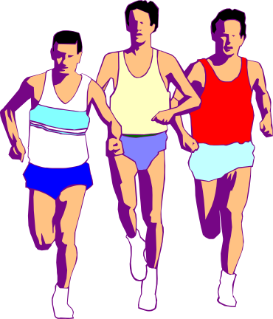
Test Your Knowledge 3
Which word is a preposition?
The runners raced around the track.
runners
around
the
track
Check the list of prepositions.

Slide 14
RIGHT!
Two things are related to each other
by the preposition!
You have PREPOSITION POWER!

Slide 15
WRONG!
Click here to try again
Click here to check the list of prepositions before trying again!

Slide 16
Lesson 2: Prepositional Phrases
Let’s look again at the sentences you practiced with.
The pizza in the oven is mine.
The girl by the door is my sister.
The runners raced around the track.
Notes:
Eg-Rule Strategy (Inductive)

Slide 17
Lesson 2: Prepositional Phrases
in the oven
by the door
around the track
These are prepositional phrases. Prepositional phrases start with a preposition and end with the object of a preposition.
Notes:
Eg-Rule Strategy (Inductive)

Slide 18
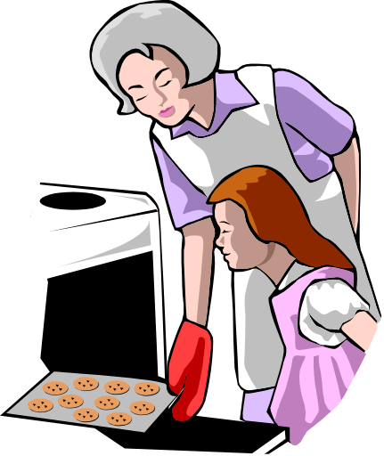
Lesson 3: Object of a Preposition
The object of a preposition
  must be a noun or a pronoun
  always comes at the end of a prepositional phrase
Example: The cookies are in the oven.
Oven is a noun that ends the prepositional phrase. Oven is the object of the preposition.
Notes:
Rule-Eg Strategy

Slide 19
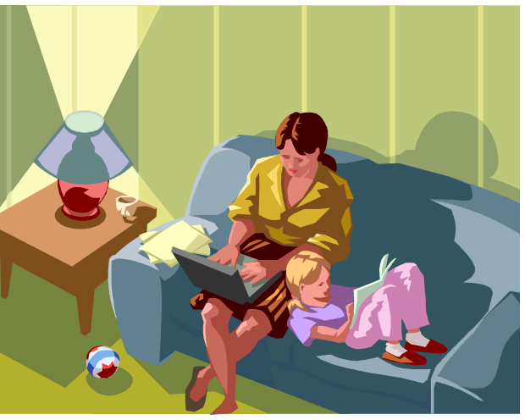
Test Your Knowledge 4
Identify the prepositional phrase.
I sat with my mom.
I sat with
with my
with my mom

Slide 20

RIGHT!
You found the prepositional phrase!
Well done!

Slide 21

WRONG!
Remember: a prepositional phrase starts with a preposition (check list again) and ends with a noun or pronoun.
Try the question again!

Slide 22
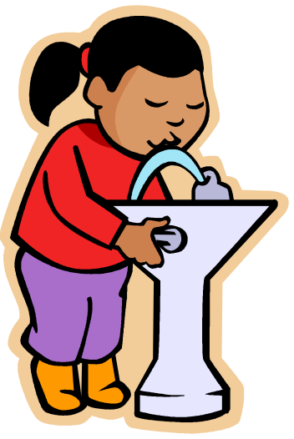
Test Your Knowledge 5
Identify the prepositional phrase.
After gym class, we got a drink.
After gym
After gym class
After gym class, we

Slide 23
RIGHT!
You found the prepositional phrase!
Well done!

Slide 24
WRONG!
Remember: a prepositional phrase starts with a preposition (check list again) and ends with a noun or pronoun.
Try the question again!

Slide 25

Test Your Knowledge 6
Identify the prepositional phrase.
I chose a book from the library.
chose a book
book from the library
from the library

Slide 26
RIGHT!
You found the prepositional phrase!
Well done!

Slide 27
WRONG!
Remember: a prepositional phrase starts with a preposition (check list again) and ends with a noun or pronoun.
Try the question again!

Slide 28

CONGRATULATIONS!
You’ve shown your PREPOSITION POWER!
END

