Slide 1
Definition:-
Preposition is a word, which is used before a noun, a noun phrase or a pronoun , connecting it to another word.

Slide 2

@ Simple prepositions: Prepositions which consists only one word.
e.g. in, on, at, with, against etc..,
@ Compound prepositions: Prepositions which consists of two or more words.
e.g. instead of, in the middle of, by the side of etc..,

Slide 3
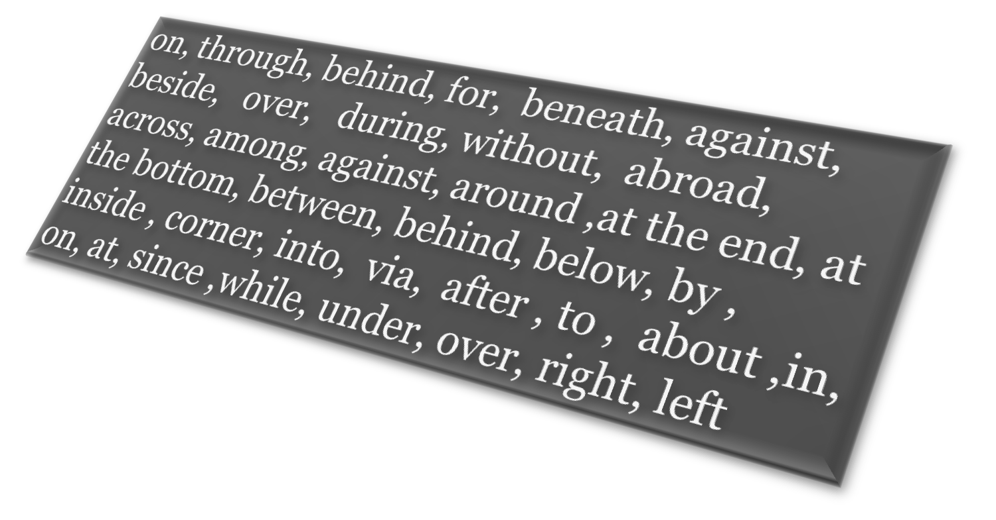
Some prepositions

Slide 4
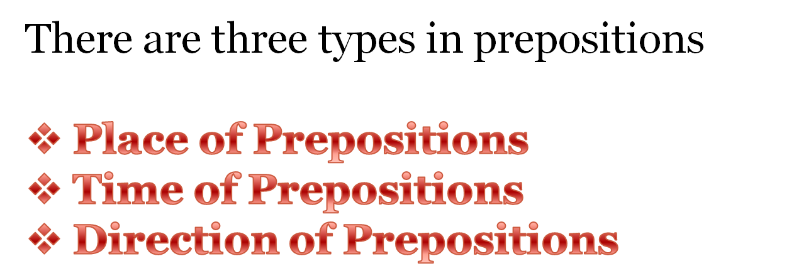
Kinds of Prepositions

Slide 5


Prepositions of Place
Some prepositions show where something happens. They are called prepositions of place.
Examples:-
Sanny was sitting under a tree.
There’s a wooden floor underneath the carpet.
Some geese flew over their house.
John and Sarah were hiding inside the wardrobe.
There was a tree beside the river.
I have a friend who lives in America.

Slide 6


Prepositions of Time
Some prepositions show when something happens. They are called prepositions of time.
Examples:-
School starts at nine o’clock.
We’re going to the zoo on Saturday.
No, you can’t watch a video. It’s past your bedtime already.
I visited my grandparents during the summer.
You must finish the work by Friday.
I’ll do my homework before dinner.

Slide 7

Prepositions of Direction
Some prepositions show where something is going. They are called prepositions of direction.
Examples:-
The boys chased after each other.
The football rolled down the hill.
A man was walking his dog along the riverbank.
The freeway goes right through the city.
We were travelling towards Miami.

Slide 8

Prepositions with special uses
Usage of OF
Our modules are full of real life examples.
I ate a plate of rice and a quarter of milk.
Would you like a glass of lemon juice?
I need three pieces of paper.
Most of the children in my class like Education.
There are several ways of cooking Upma.

Slide 9
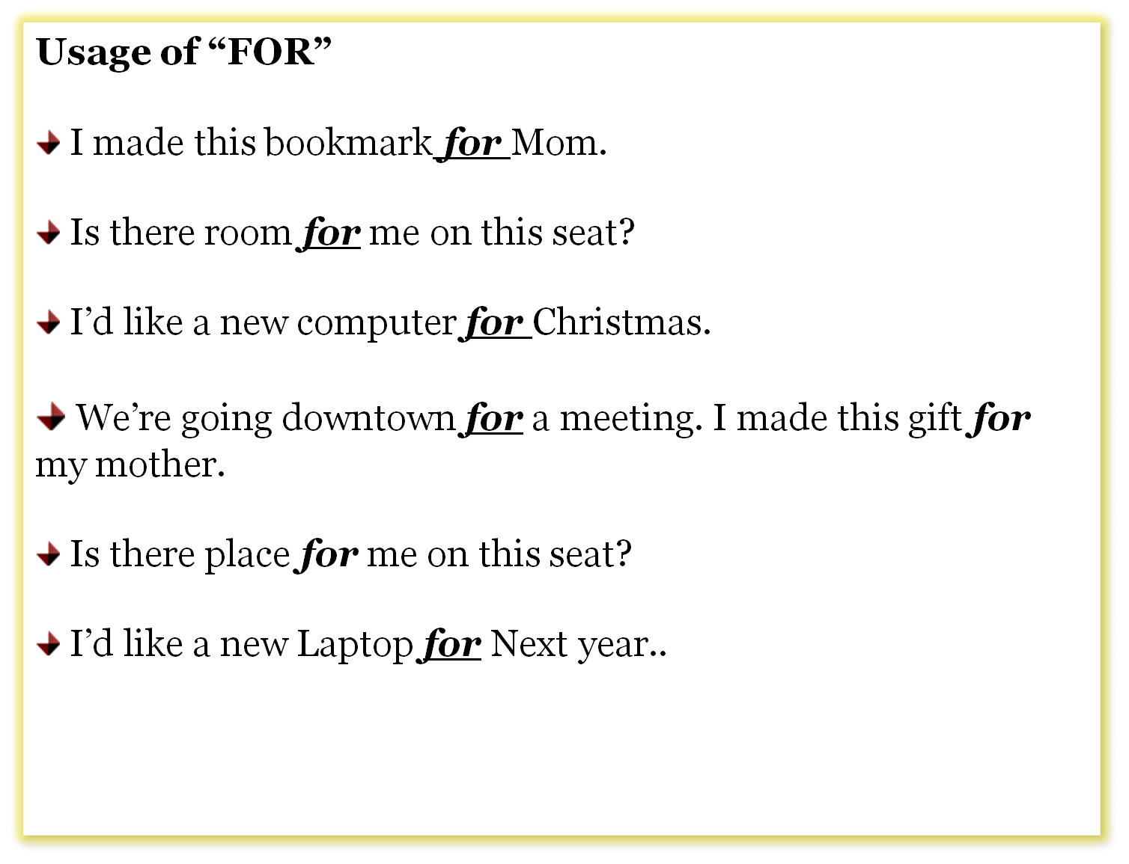

Slide 10
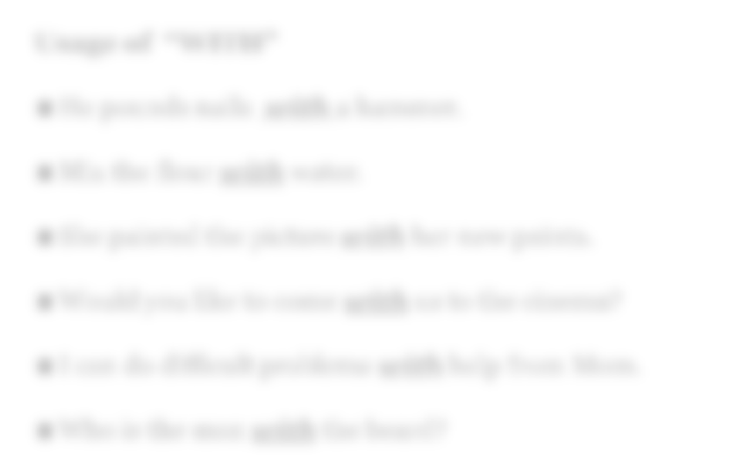
Usage of “WITH”
He pounds nails with a hammer.
Mix the flour with water.
She painted the picture with her new paints.
Would you like to come with us to the cinema?
I can do difficult problems with help from Mom.
Who is the man with the beard?

Slide 11
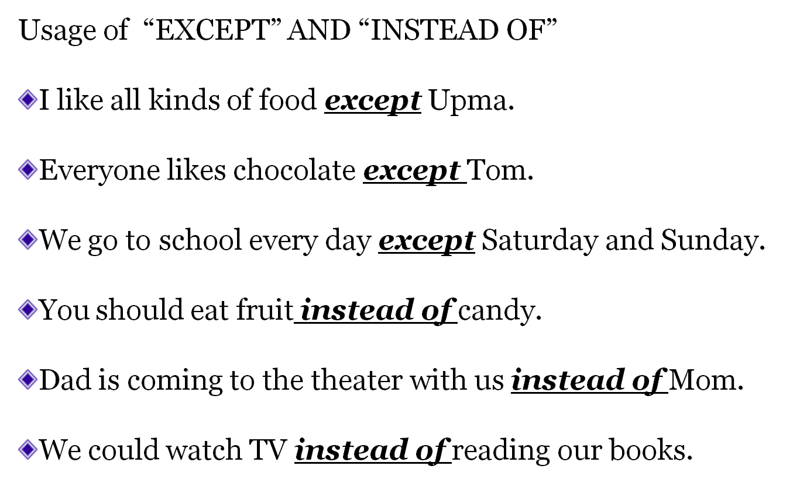

Slide 12
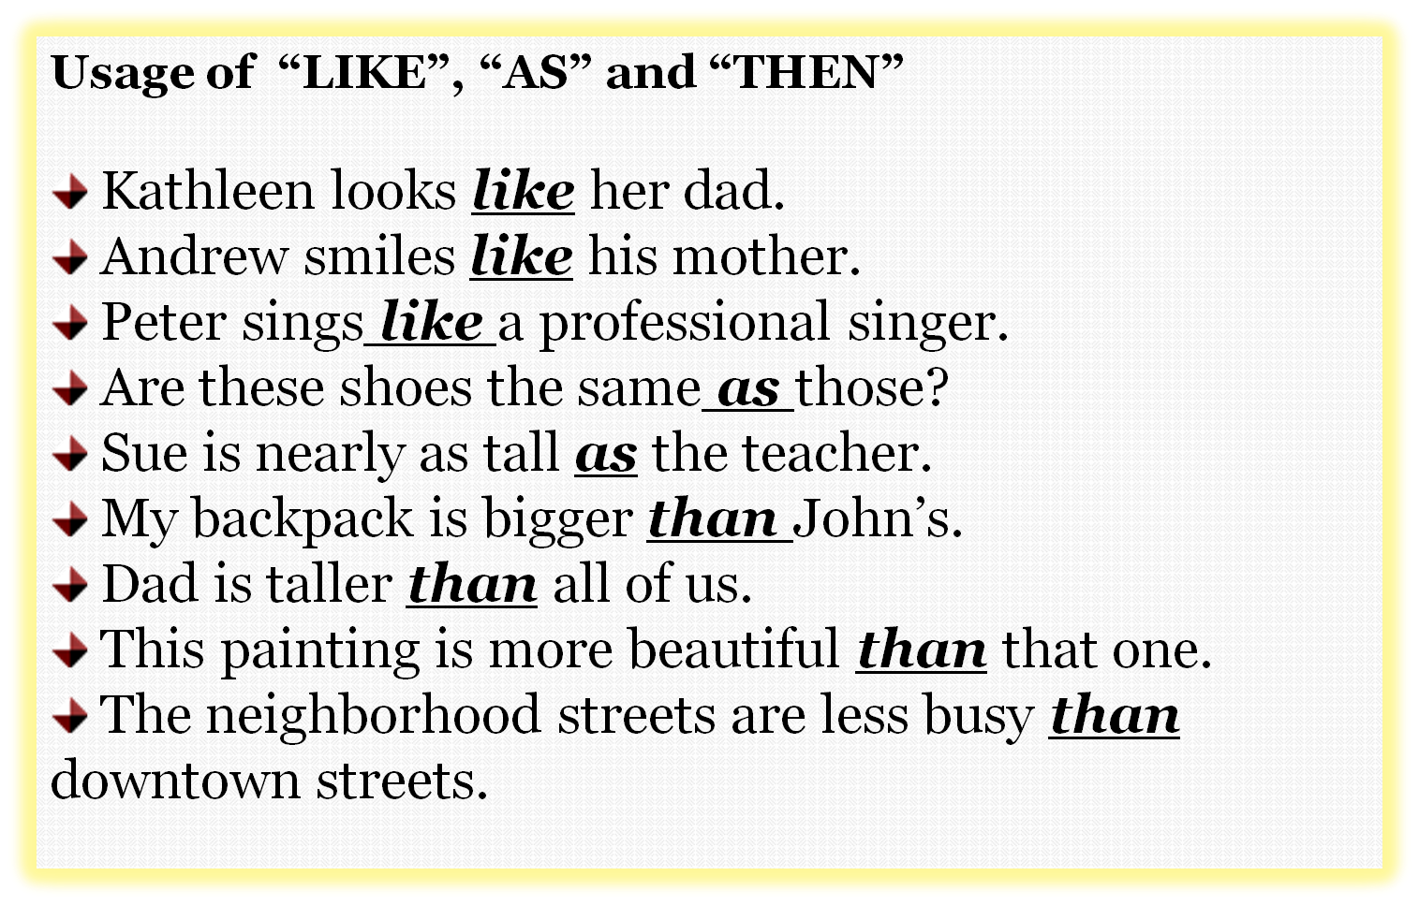

Slide 13

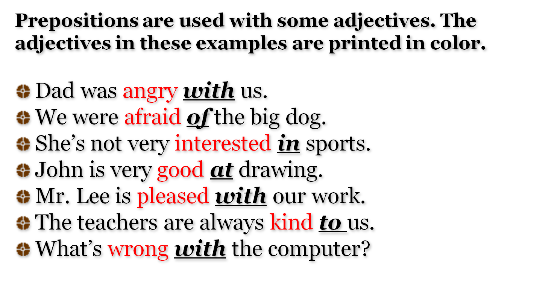
Prepositions with Adjective ,Verbs .

Slide 14

Prepositions are used with some verbs. The verbs in these examples are printed in color.
I’m looking for my pencil. Have you seen it?
Can you think of another word for ‘pleased’?
Does this book belong to you?
We’re listening to CDs.
I agree with you.
Tell me about the show you saw.
Cut the cake into five pieces.
They borrowed money from the bank.

Slide 15
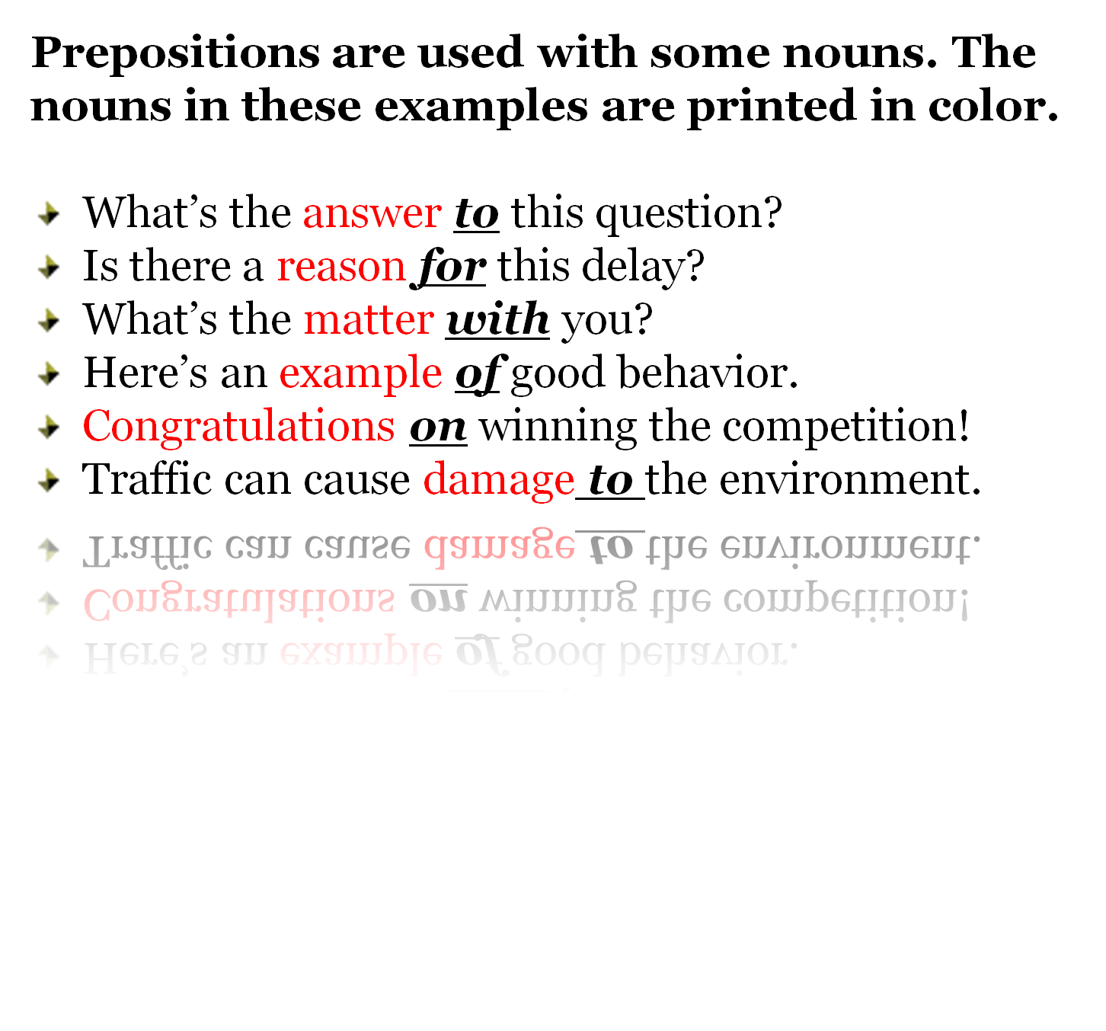

Slide 16
TRY THIS:
1. A cat was sitting _______the roof of my car. (place)
2. Some people were talking ___the movie. (time)
3. A man was coming____ us on his bike. (direction)
4. The party starts_____ six o’clock. (time)
5. She put the book ____her bag. (place)
6. We walked____ the street to the park. (place)
7. She keeps her slippers____ her bed. (place)
8. We always wash our hands ____meals. (time)
9. She ran ____the dog because she was frightened. (direction)

Slide 17

Thank you.

Slide 18
This powerpoint was kindly donated to www.worldofteaching.com
http://www.worldofteaching.com is home to over a thousand powerpoints submitted by teachers. This is a completely free site and requires no registration. Please visit and I hope it will help in your teaching.

