Slide 1
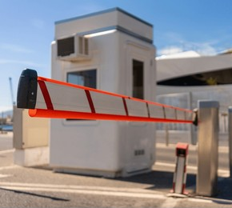

A Smart Parking System
with Vehicle Detection
and Barrier Control
INSERT PARKING / BARRIER IMAGE
IoT102 Project – Group 7
Use a clean image of a parking gate, barrier, or smart parking system.
Members: Nguyễn Sỹ Minh Mẫn, Đỗ Thành Triết, Trần Đăng Khoa, Bùi Đình Long
Instructor: Nguyễn Đức Lợi – Class: SE2045
Smart Parking System

Slide 2
Team Members
Team members and their main roles, sub roles
SE201643 Bùi Đình Long
Hardware & Arduino
Report writing
SE201632 Đỗ Thanh Triết
Hardware & Arduino
Server & Yolo
SE201631 Nguyễn Sỹ Minh Mẫn
Web Dashboard & SQL
Server
SE201635 Trần Đăng Khoa
Web Dashboard & SQL
Report writing
IoT102 Project – Group 7
Main role & sub role
INSERT PARKING / BARRIER IMAGE
Use a clean image of a parking gate, barrier, or smart parking system.
Members: Nguyễn Sỹ Minh Mẫn, Đỗ Thành Triết, Trần Đăng Khoa, Bùi Đình Long
Instructor: Nguyễn Đức Lợi
Smart Parking System | 2

Slide 3
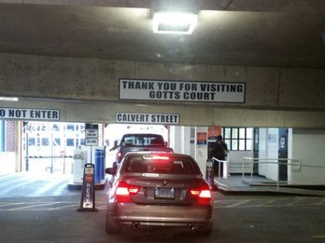
Background / Problem Context
Why is this system needed?
Parking control is still mostly manual.
Entry and exit checking can be slow.
Real-time monitoring is limited.
Parking records are difficult to manage.
Security and efficiency can be improved.
INSERT PARKING CONTEXT IMAGE
Example: crowded parking gate, manual checkpoint, or parking entrance.
Therefore, a smart parking system is needed to automate detection, barrier control, and monitoring.
Smart Parking System | 3

Slide 4
Limitations of the Old System
Manual parking control creates operational and management problems.
Old System
Problems Caused
Manual checking
Delayed response
No image verification
Difficult record management
No dashboard monitoring
Gate congestion
Human error
Weak security
Hard to review incidents
Inefficient management
Main message: the old system lacks automation, storage, and remote monitoring.
Smart Parking System | 4

Slide 5
Project Objectives and Key Functions
What can the proposed system do?
Detection
Processing
Management
Detect vehicle by HC-SR04
Capture image by ESP32-CAM
Send image to YOLO server
Return OPEN/CLOSE decision
Control barrier
Save logs to SQL Server
Monitor on dashboard
car, motorcycle, bus and truck
confidence threshold 0.45
Expected results
Faster gate operation
Reduced manual workload
Better monitoring
Improved security
Data-driven management
Smart Parking System | 5

Slide 6
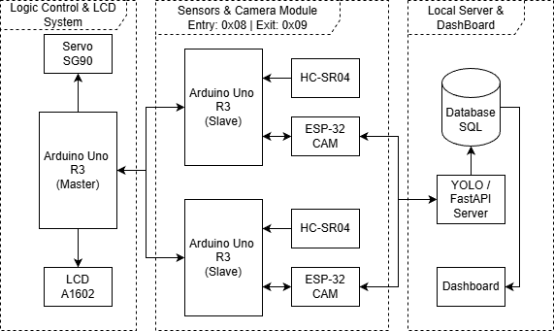
Hardware Block Diagram
Physical modules and communication paths.
Explanation
Slave handles sensor and camera.
Master controls output devices.
I2C is used between Master and Slave.
UART is used between Slave and ESP32-CAM.
Servo opens/closes the barrier.
LCD is used for debug only
INSERT HARDWARE BLOCK DIAGRAM
Include Master Arduino, Slave Arduino, HC-SR04, ESP32-CAM, Servo SG90, LCD1602, LED.
Smart Parking System | 6

Slide 7
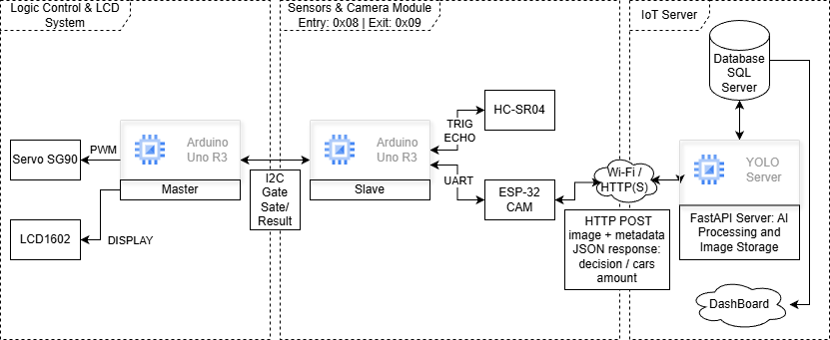
Overall System Architecture
Hardware, AI server, database, and dashboard integration.
INSERT OVERALL SYSTEM ARCHITECTURE DIAGRAM
Use the full architecture diagram showing Device Layer, Server Layer, and Application Layer.
The system connects embedded hardware, AI image processing, SQL Server database, and a web dashboard.
Smart Parking System | 7

Slide 8
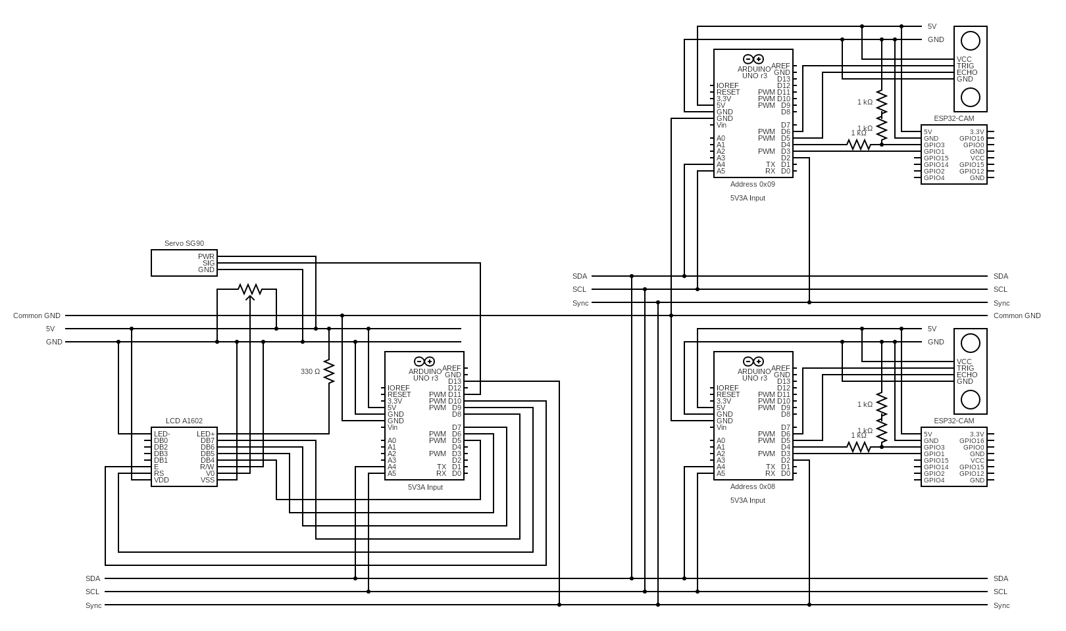
Hardware Circuit Diagram
Physical wiring and electrical connections.
Upload your final circuit image as PNG/JPG.
Smart Parking System | 8

Slide 9
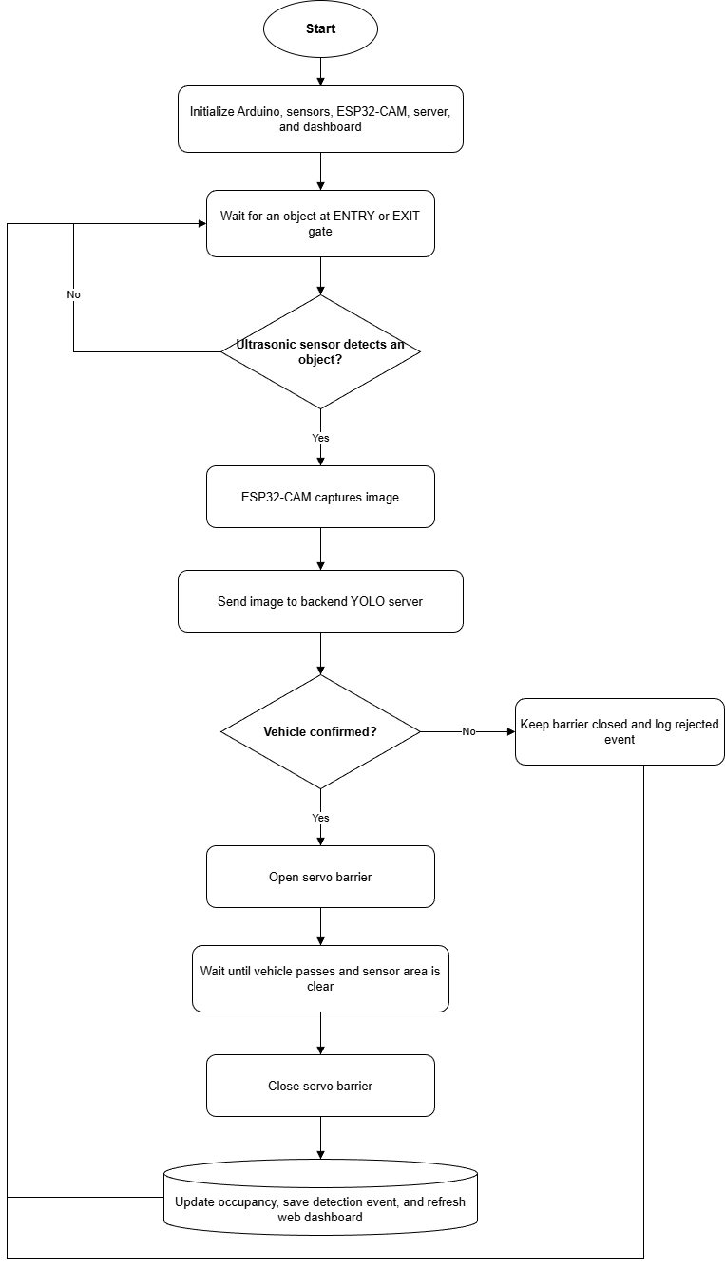
System Flowchart
Step-by-step operation from detection to gate control.
Decision logic
OPEN
Open barrier
Update LCD
Save log
CLOSE
Keep gate closed
Show status
Save log
Smart Parking System | 9

Slide 10
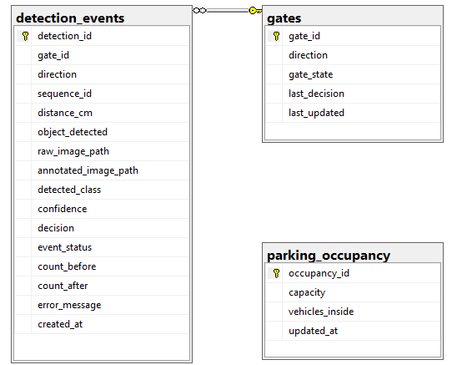
System ERD
Step-by-step operation from detection to gate control.
Gates
Stores the current status of each parking gate.
Identifies ENTRY and EXIT gates.
Stores the current gate state.
Records the latest OPEN or CLOSE decision.
Tracks the most recent update time.
Detection Events
Stores the history of every vehicle-detection process.
Sensor distance and object-detection result.
Raw and YOLO-annotated image paths.
Detected vehicle class and confidence score.
Final gate decision and processing status.
Vehicle count before and after each event.
Error details when processing fails.
Parking Occupancy
Stores the current parking-space status.
Maximum parking capacity.
Current number of vehicles inside.
Last occupancy update time.
Smart Parking System | 10

Slide 11
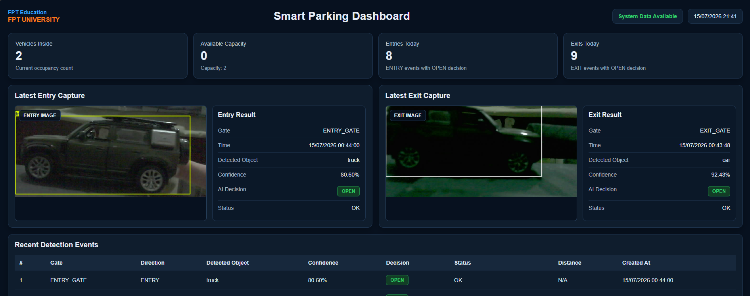
Web Dashboard Interface
Real-time monitoring for parking management.
INSERT WEB DASHBOARD SCREENSHOT / MOCKUP
Insert the final dashboard image, or a mockup if the implementation is not finished.
Dashboard includes
Total vehicles • Entries today • Exits today • Parking logs • Latest captured images
Smart Parking System | 11

Slide 12
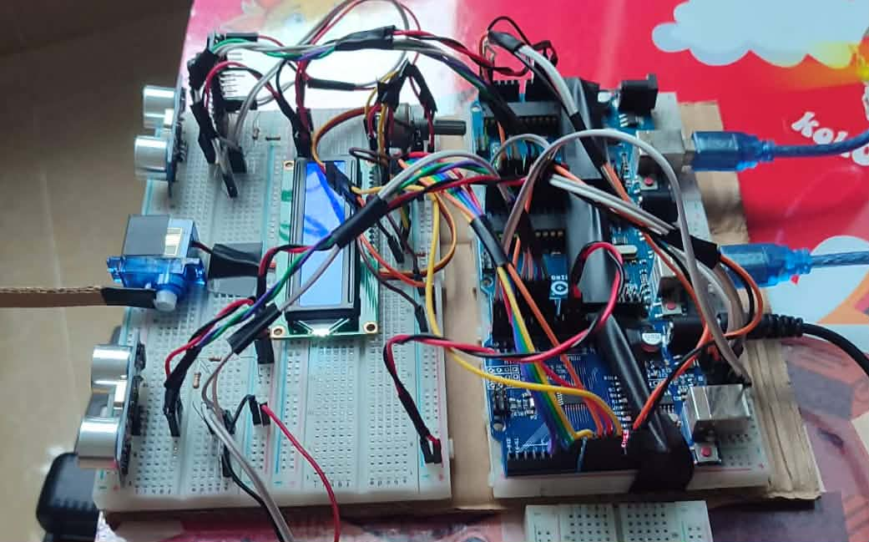
Complete hardware prototype
Complete wiring and functional prototype & demonstrate
INSERT WEB DASHBOARD SCREENSHOT / MOCKUP
Insert the final dashboard image, or a mockup if the implementation is not finished.
Prototype includes
Master module, Slave modules + ESP32-Cam
Smart Parking System | 12

Slide 13
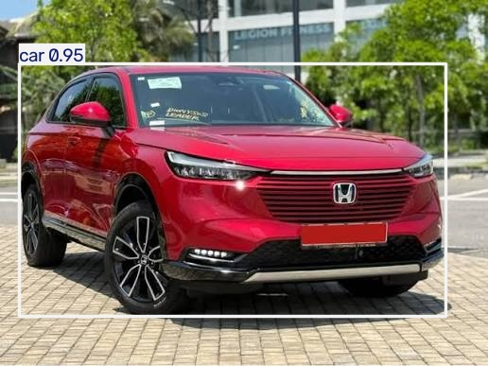
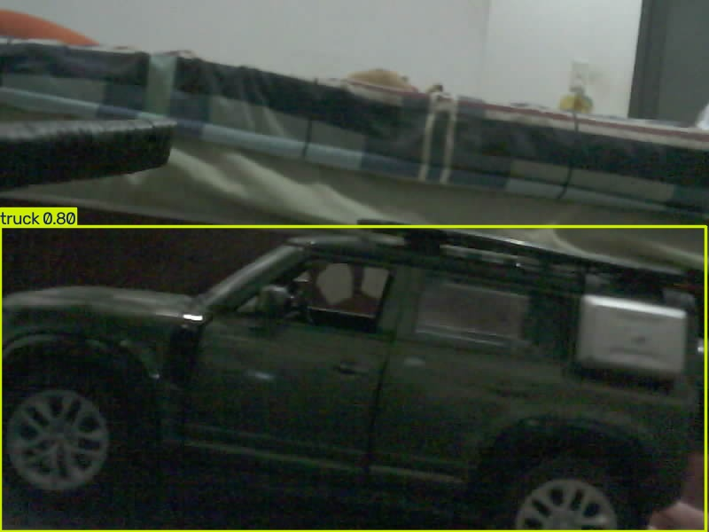
Testing Method and Conditions
Experimental and prototype results
Experimental Results
YOLO26l annotated result
Allowed classes for OPEN: ['bus', 'car', 'motorcycle', 'truck’]
Confident threshold: 0.45
Total input images: 146
OPEN decisions: 66
CLOSE decisions: 80
Positive-sample detection rate: 45.21%
Miss rate: 54.79%
Average inference time: 432.23 ms
Median inference time: 415.76 ms
Maximum inference time: 837.82 ms
Mean confidence of accepted detections: 72.63%
Accepted classes: 43 trucks and 23 cars
image size 640
Test image: detect car with confident: 0.95
Prototype income image: detect truck with confident: 0.80
Smart Parking System | 13

Slide 14
Results and Benefits
Expected technical output and practical value.
Technical Results
Practical Benefits
Vehicle detection
Image capture
AI processing
Barrier control
Database logging
Reduce manual work
Faster gate operation
Better monitoring
Improved security
Easier management
Smart Parking System | 14

Slide 15
Conclusion and Future Work
Summary and possible improvements.
Conclusion
Future Work
Low-cost IoT-based parking solution.
Combines sensors, camera, AI server, and dashboard.
Improves automation and monitoring.
License plate recognition
Multiple parking slots
Cloud deployment
Mobile app integration
The proposed system provides a practical foundation for smart parking automation and future AI-based expansion.
Smart Parking System | 15

