Slide 1
Accessing inaccessible information via quantum indistinguishability
Sebastian Horvat & Borivoje Dakić
Quantum resources: from mathematical foundations to operational characterisation
Singapore, 6 December 2022
Talk based on arXiv:2203.16592

Slide 2
Plan
Indistinguishable particles and entanglement
Presentation of the task
Quantum protocol that solves the task
Discussion
Outlook

Slide 3
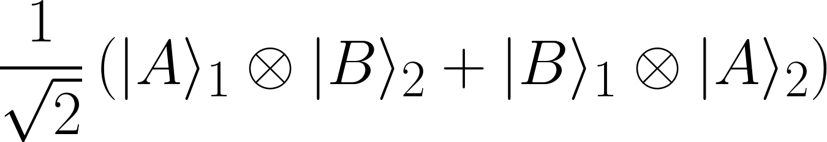

Indistinguishable particles (1)
Consider two independently prepared bosons located at positions A and B.
Two ways of representing their quantum state:
"First quantization":
"Second quantization":
FQ: systems 1 and 2 are entangled
SQ: systems A and B are not entangled

Slide 4
Indistinguishable particles (2)
Are two independently prepared bosons entangled or not?
The answer depends on which systems we are talking about. . .
This talk: information-theoretic task that can be accomplished equally well with independently prepared bosons or with maximally entangled distinguishable particles

Slide 5
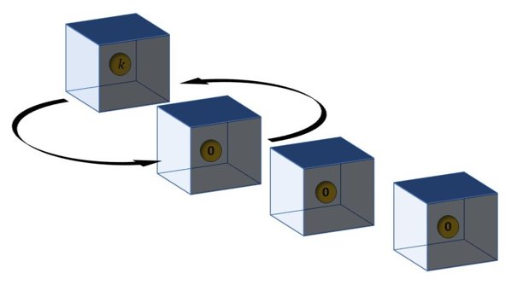
The task (informally)
A box contains an atom, which is prepared in one of two perfectly distinguishable states, thereby encoding a bit of information k (= 0 or 1)
You're only allowed to move the box through space; you cannot open the box and "directly" read out k
You may have other objects (e.g. other boxes containing atoms) but they are also not sensitive to the bit
Can you learn k?

Slide 6

The task (more formally)
The further objects are named A and are insensitive to k:
A system named T is located at x and encodes bit k:
Can you learn k solely by manipulating D?
Classically: no
QM: if T and A are distinguishable systems, then also no
What if the additional quantum systems are identical to the first one?
You have a device D that can move the box upon interaction:

Slide 7


The quantum protocol
Let D, A and T interact:
Let A be indistinguishable from T and its internal state be 0:
Prepare the device D in state
D and the targets get entangled upon interaction if and only if k=1
The reduced state of D is thus a function of k
Alice can learn k by performing an appropriate measurement on D
The probability of a correct guess can be raised close to 1 by adding more boxes

Slide 8
Discussion (1)
The protocol is equivalent to the "swap-test": in order to check whether two qubits are in equal or mutually orthogonal states one performs a control-swap on them
Independently prepared distinguishable systems:
'spatial swap' ≠ 'swap'
Independently prepared indistinguishable systems:
'spatial swap' = 'swap'

Slide 9
Discussion (2)
Is there a quantum mechanical protocol that respects the assumptions of the task and that solves the latter without the possibility of entangling D and the targets?
In the paper we prove that the answer is No.
Our task is thus solvable within QM thanks to
the indistinguishability of the target objects, and
the possibility of entangling D and the targets.
Alternatively, the task could be solved equally well with maximally entangled distinguishable systems (but then violating the assumption of independent preparation of D and A)
Simple example for which indistinguishability and entanglement figure as equivalent resources!

Slide 10
Outlook
Can the task be formulated in a more general framework, e.g. in GPTs? How do entanglement and indistinguishability figure there as resources?
Can the task be made less theory- and device-dependent?
Practical applications?
We analyzed only a very particular task. Generalize . . .

Slide 11
Thank you!

