Slide 1
Lab-1
Basic programming structures
Faculty- Junali Jasmine Jena
Programmers- Jitendra Send, Asit Lenka

Slide 2
Lab Evaluation- 60+40
Daily Lab-60
Record-15
Activity-10
Attendance-10
Lab Program-10
Quiz-15
Sessional-40
Program writing
Execution
Viva

Slide 3
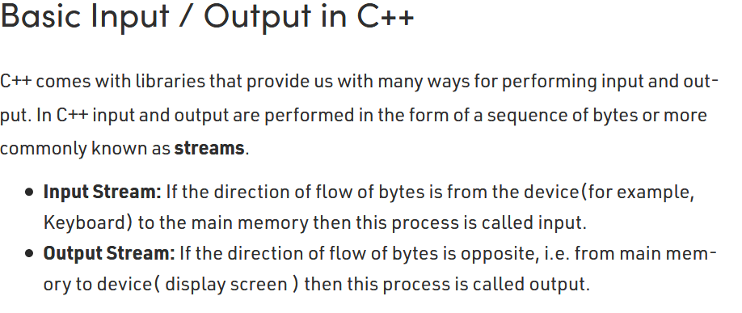
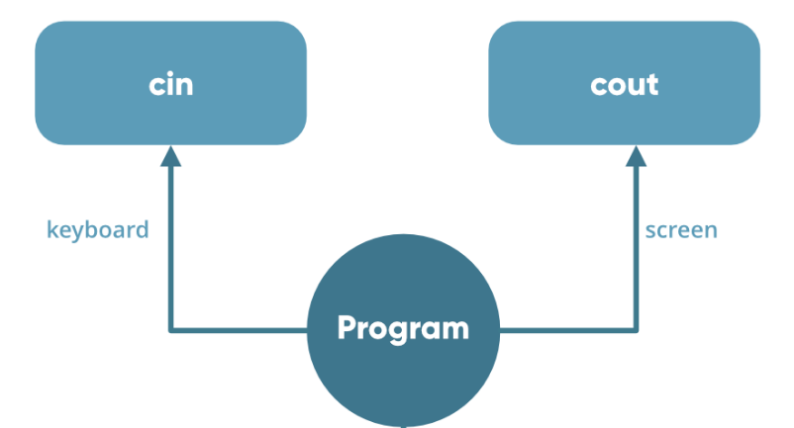
Input/Output

Slide 4
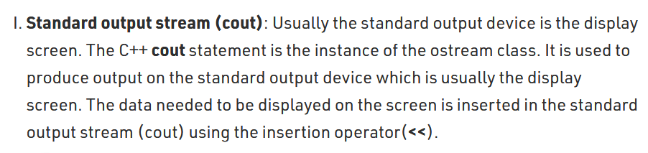
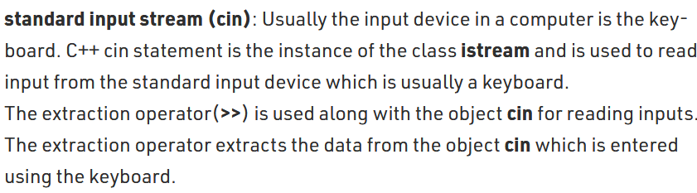
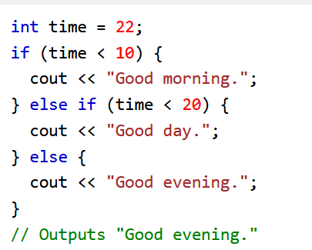
Input/Output

Slide 5
Conditional Statements

Slide 6
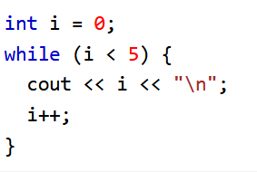
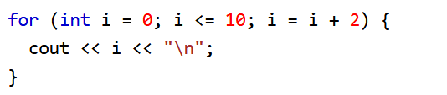
Loops
While Loop For Loop

Slide 7
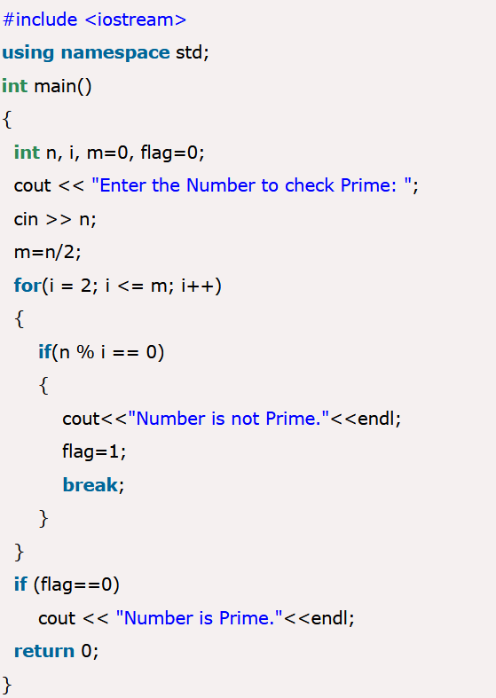
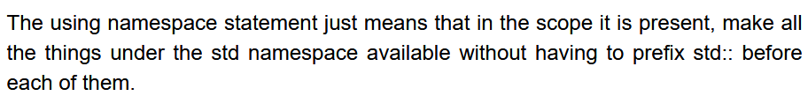
Example- check whether a no is prime or not

