Slide 1
RL بالعربي
L01: Introduction to RL

Slide 2
Agenda
Types of Learning
RL Process
RL Applications

Slide 3

Types of Learning
Supervised learning
Circle
Triangle
???
Square

Slide 4
Types of Learning
Unsupervised learning

Slide 5
Types of Learning
Reinforcement learning (RL)

Slide 6

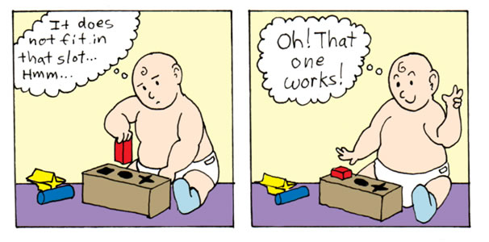
Types of Learning
Reinforcement learning (RL)

Slide 7


Reinforcement Learning: Process
Action a
State s
Reward r
Agent
Environment
Agent should MAXIMIZE its EXPECTED REWARD

Slide 8

RL Applicatons: Learning to run

Slide 9
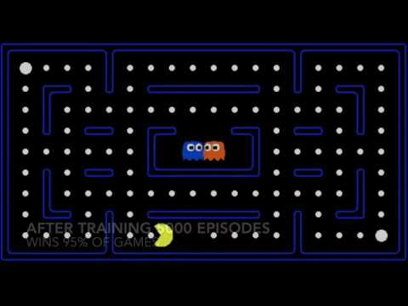
RL Applications: Pacman

Slide 10
References
http://ai.berkeley.edu/
https://www.quora.com/What-is-the-difference-between-supervised-and-unsupervised-learning-algorithms
http://cs231n.stanford.edu

