Slide 1
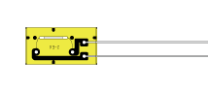
PC
Strain Amp.
A/D
USB
Memory
Bridge Supply Voltage
V

