Slide 1
Verfügbare Symbole im PDF Export
Global
${PAGENUMBER}
${PAGECOUNT}
${FILENAME}
${PROJEKTNAME}

Slide 2
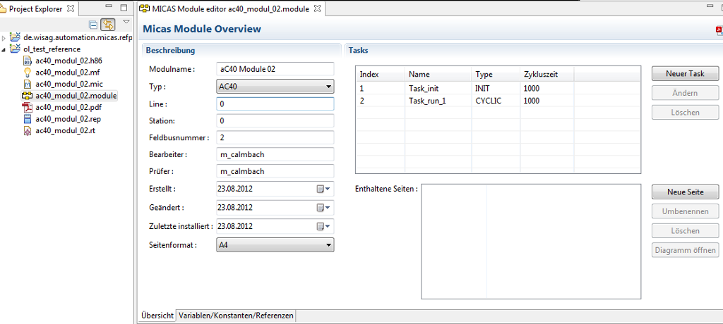
${PROJECTNAME}
${MODULE::name}
${TASK::index}
${FILENAME}
${MODULE::kind}
${TASK::cycleTime}
${MODULE::lineNumber}
${TASK::name}
${MODULE::stationNumber}
${TASK::kind}
${MODULE::fieldBusNumber}
${MODULE::processor}
${MODULE::examiner}
${PAGE::name}
${MODULE::createdDate}
${MODULE::lastModifiedDate}
${MODULE::lastModifiedDate}

