Slide 1
Classifying Quiz Bowl Questions
Ryzeson Maravich

Slide 2
Background
Each question is 5-8 sentences and belongs to a specific category and subcategory
History
American
Classical
European
World
Literature
American
British
European
World
Science
Biology
Chemistry
Math
Physics
Fine Arts
Audio
Other
Visual
Geography
Mythology
Philosophy
Religion
Social Science

Slide 3
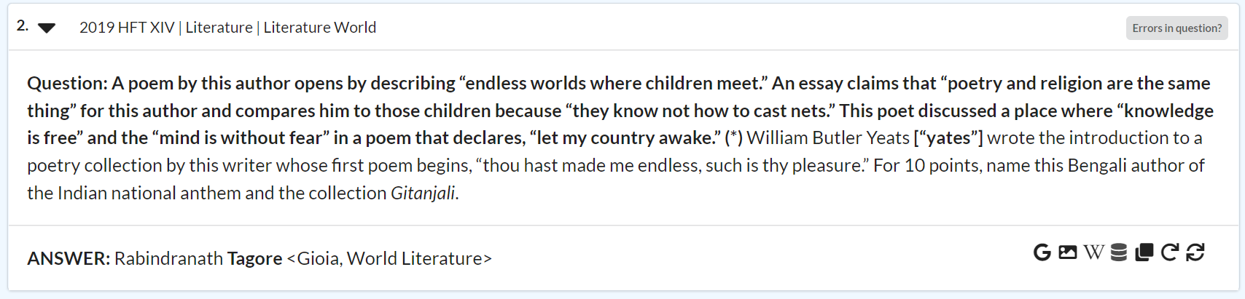
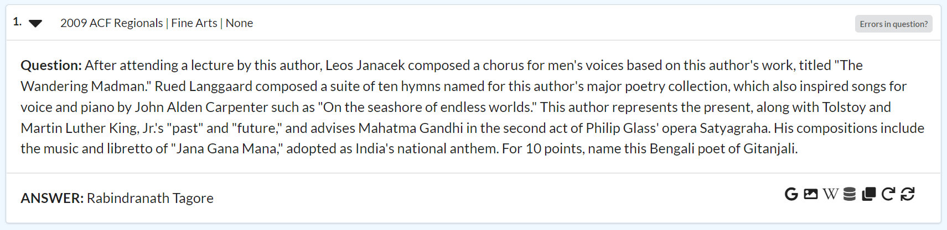
Background

Slide 4
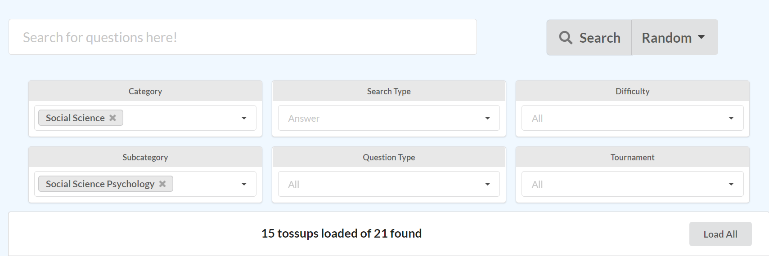
Motivation
Improving QuizDB (no longer exists)

Slide 5
Methods
Naive Bayes
Data Collection
Preprocessing
Tf-idf Vectorizer
Cosine Similarity

Slide 6
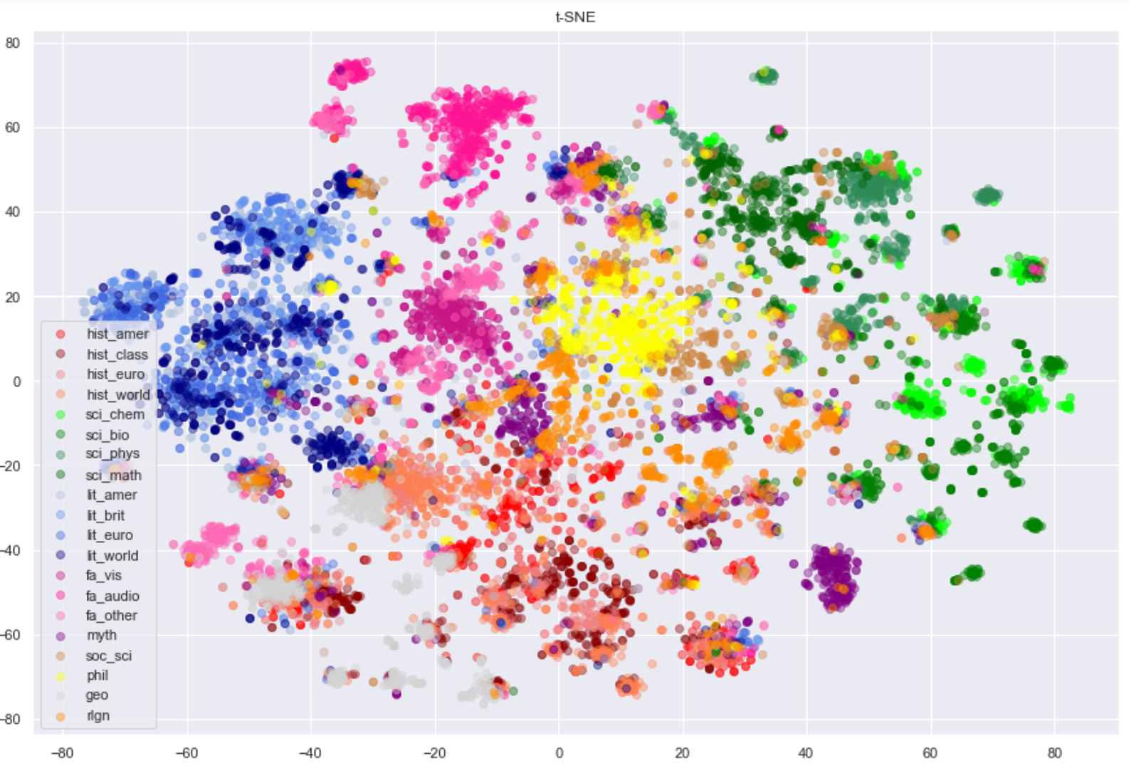
Visualization

Slide 7
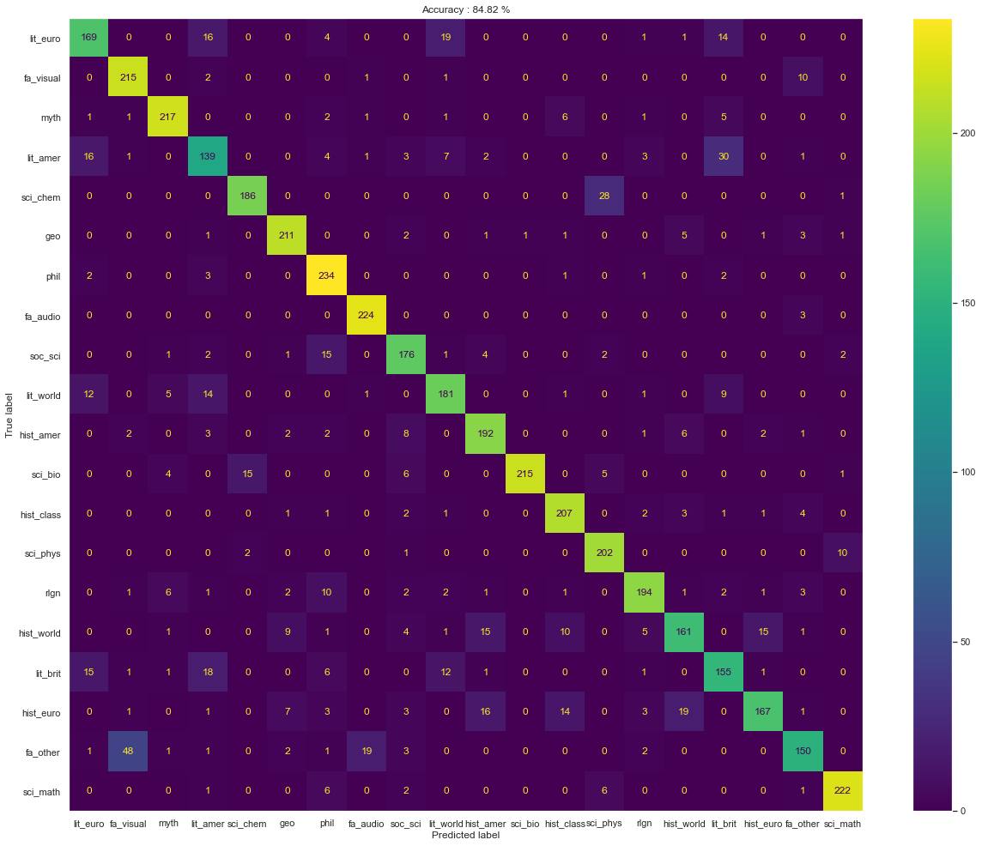
Results
Model | Accuracy
Big Three | 99.07%
All Categories | 90.04%
Subcategories | 84.82%
Cosine Similarity | 67.50% (84.10%)

Slide 8
Trivia
Used subcategory model to classify trivia questions
58.71% Accuracy
Problems
Different category definitions
Questions too short

Slide 9
Conclusion
Overall success
Did not translate to other datasets
Possible improvements

