Slide 1

CAPSTONE PROJECT — DSN4091 · PHASE-1 · REVIEW-1
TriSense
A Unified Edge-AI Wearable for Real-Time Assistance to the
Visually, Hearing, and Speech Impaired
Team Members
Supervisor
1. <<Register No.>> <<Name 1>>
2. <<Register No.>> <<Name 2>>
3. <<Register No.>> <<Name 3>>
4. <<Register No.>> <<Name 4>>
5. <<Register No.>> <<Name 5>>
<<Supervisor Name>>
School of Computing Science & Engineering
VIT Bhopal University, Bhopal, Madhya Pradesh

Slide 2
B. Objective
Why this project
Aim
2.2 billion+ people live with vision impairment worldwide (WHO).
430 million+ people experience disabling hearing loss.
Millions rely on sign language, with interpreter availability a persistent bottleneck.
Existing solutions are single-purpose, costly, and rarely reach low-resource users.
To design and build a single low-cost, offline-capable, edge-AI wearable that gives real, everyday independence to three different disability groups — through one shared on-device compute engine.
Real-time obstacle & collision-time prediction (Blind Mode)
Live, on-device speech-to-text captioning (Deaf Mode)
Sign-language-to-speech translation (Mute Mode)
All three running fully offline, on one shared low-cost board
TriSense — DSN4091 Capstone Project, Phase-1 Review-1
2

Slide 3
C. Clarity & Significance of the Problem Statement
Problem Statement
Visually, hearing, and speech-impaired individuals each depend on single-purpose, often expensive assistive devices (canes, hearing aids, interpreter services) that address only one need, are frequently unaffordable in low-resource settings, and largely rely on cloud connectivity that isn't always available.
No predictive safety
No live captioning
Interpreter dependency
White canes give no time-to-collision warning — only contact-range detection.
Hearing aids amplify sound but do not transcribe group speech in real time.
Sign language communication with non-signers needs a human interpreter, not always available.
Significance: a single affordable device addressing all three needs has direct, quantifiable social impact for underserved communities, including rural India.
TriSense — DSN4091 Capstone Project, Phase-1 Review-1
3

Slide 4
D. Feasibility & Scope of the Project
In Scope
Out of Scope (Phase-1)
Blind Mode: ultrasonic + depth-based obstacle/collision alert
Deaf Mode: fully on-device live speech-to-text captioning
Mute Mode: landmark-based sign-to-speech translation (stretch)
Single Raspberry Pi 4 edge unit, belt-mounted, battery powered
Quantized models for real-time, offline inference
Multi-language sign vocabularies beyond the pilot set
Cloud sync / multi-device fleet management
Medical-grade certification or clinical validation
Continuous (sentence-level) sign language translation
Feasibility for a 5-member team, 2 semesters
All three pipelines share ~70% of the compute pipeline (edge board, quantization workflow, sensor bus). Public datasets exist for ASR and sign recognition, so the team is not blocked on data collection. Every hardware part ships from Indian electronics retailers within days, and total prototype cost is under ₹10,000.
TriSense — DSN4091 Capstone Project, Phase-1 Review-1
4

Slide 5
E. Existing Projects & Differentiation
Existing Solution | Approach | Limitation
Ultrasonic smart canes (HC-SR04 based) | Threshold-based buzzer/vibration alert on obstacle detection | No collision-time prediction; single-purpose device only
AR captioning glasses (e.g., XRAI Glass, Access on Demand) | Cloud-hosted ASR streamed to a near-eye display | Depends on internet connectivity; specialised, costly hardware
Edge sign-language recognizers (landmark + LSTM research systems) | MediaPipe landmarks + lightweight temporal classifier on embedded boards | Standalone research systems; not integrated with other assistive modes
TriSense's differentiation
No reviewed system serves all three impairment categories from one shared, fully offline, edge-deployed engine. TriSense's contribution is a reusable multi-modal inference architecture — not a new individual algorithm — that cuts hardware cost and complexity for affordable assistive technology.
TriSense — DSN4091 Capstone Project, Phase-1 Review-1
5

Slide 6
E(i). Quality of Initial Prototypes / Research Findings
At proposal stage, the team has validated feasibility through a focused literature survey and an early architectural proof-of-concept (see Fig. — System Architecture, next slide).
84–99%
<100 ms
₹7–9.5k
reported accuracy of CNN-LSTM sign classifiers on constrained vocabularies (literature)
latency achieved by landmark-based sign recognition on embedded boards (literature)
estimated per-unit prototype hardware cost (team's own BOM costing)
Early finding: obstacle-detection (Blind Mode) and captioning (Deaf Mode) rely on well-established, lower-risk techniques and will be prioritized for a working proof-of-concept by Review-2; sign-recognition (Mute Mode) is the highest-risk module and is planned as a staged extension.
TriSense — DSN4091 Capstone Project, Phase-1 Review-1
6

Slide 7
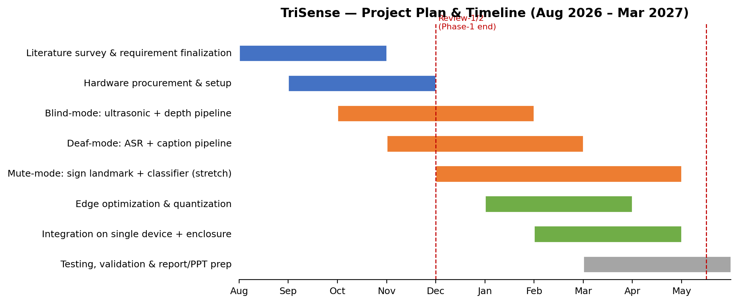
E(ii). Adherence to Project Plan & Timeline
TriSense — DSN4091 Capstone Project, Phase-1 Review-1
7

Slide 8
E(iii). Research & Literature Review
Blind Mode
Deaf Mode
Mute Mode
Ultrasonic (HC-SR04) smart canes — cheap, reliable, threshold-alert only
IoT-enabled sticks add camera-based recognition to ultrasonic ranging
Gap: no existing work computes predictive collision-time
Transparent-display / AR captioning preserves eye contact during conversation
Clinical ASR captioning studies show strong DHH usability outcomes
Gap: most systems depend on cloud ASR APIs, not offline-first
CNN-LSTM / 3D-CNN hybrids report 84–99% accuracy on gesture vocabularies
Landmark-based pipelines (MediaPipe) enable real-time edge inference
Gap: no system integrates SLR with other assistive modalities
TriSense — DSN4091 Capstone Project, Phase-1 Review-1
8

Slide 9
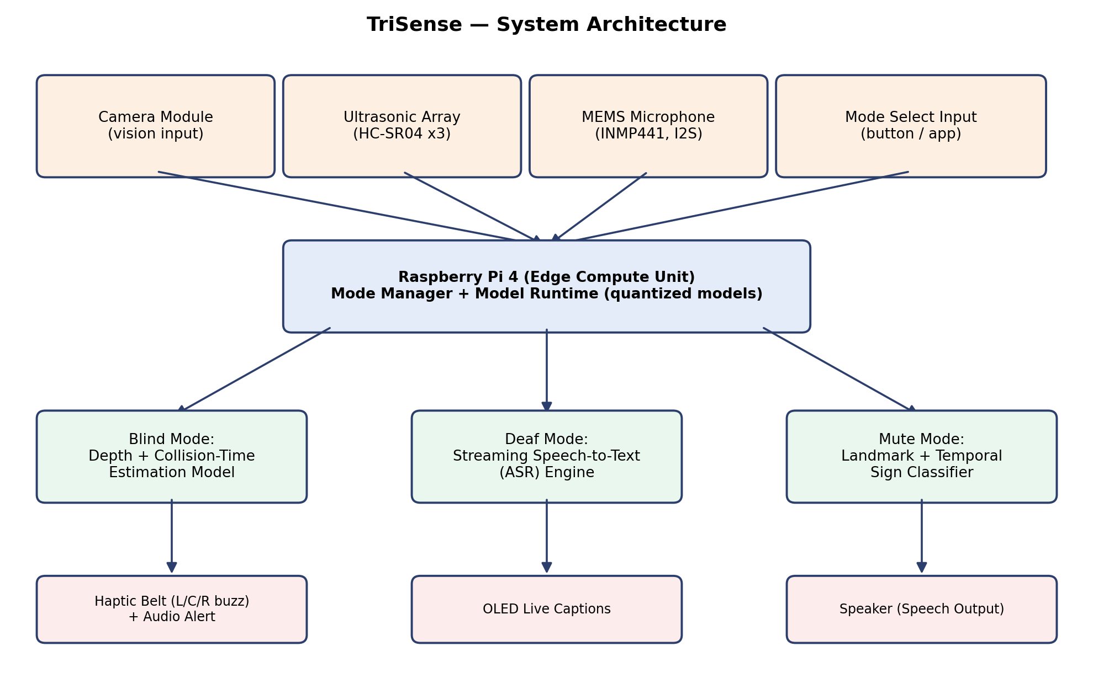
F. Project Modules — System Architecture
TriSense — DSN4091 Capstone Project, Phase-1 Review-1
9

Slide 10
F. Project Modules — Purpose of Each Component
Blind Mode
Deaf Mode
Mute Mode
Ultrasonic array + camera depth cues predict time-to-collision; directional haptic motors alert the user before contact.
On-device streaming ASR converts ambient speech to live rolling captions on a compact OLED display.
Camera captures hand motion; landmark extraction + temporal classifier translate signs to speech via speaker.
Shared backbone: Raspberry Pi 4 edge unit + mode manager, common power supply and enclosure across all three modules.
Component | Approx. Price (INR)
Raspberry Pi 4 (4GB) | ₹4,500 – 5,500
Camera module + ultrasonic array (x3) + mic + amp + OLED + haptics + battery pack | ₹2,500 – 4,000
TriSense — DSN4091 Capstone Project, Phase-1 Review-1
10

Slide 11
G. References
N. Islam et al., “Ultrasonic Sensor Based Smart Blind Stick,” IEEE ICCTCT, 2018.
S. Mohapatra et al., “Smart Walking Stick for Blind Integrated with SOS Navigation System,” IEEE ICCTCT, 2018.
D. Key et al., “Real-Time ASL Recognition Using 3D CNN and LSTM,” arXiv:2512.22177, 2025.
K. Yamamoto et al., “See-Through Captions: Real-Time Captioning for DHH People,” arXiv:2101.11326, 2021.
R. Mathew et al., “Access on Demand: Real-time Multi-modal Accessibility via AR,” ACM ASSETS, 2022.
Real-Time Attention-Based Embedded LSTM for Dynamic Sign Language Recognition on Edge Devices, J. Real-Time Image Processing (Springer), 2024.
Full reference list in the Phase-1 Report (Chapter: References & Publication).

