Slide 1
Education Analysis
Done by: Goh Rui Zhuo

Slide 2
Objectives
Goal
Analysing the trend of education in Singapore and in comparison with the United Kingdom, before further analysing the trend of post secondary education in Singapore

Slide 3
Datasets used
Graduates salary over the years
https://docs.google.com/spreadsheets/d/1eeKc0GoccpCrnHE0-UKeoP298fef1mCkbvoUNSw-sOo/edit?mode=html#gid=0
Universities - Intake, Enrolment and Graduates by Course
https://data.gov.sg/dataset/universities-intake-enrolment-and-graduates-by-course
Total expenditure (millions) for 'Education expenditure' for Primary education, Secondary education and Tertiary education in United Kingdom between 2015-16 and 2021-22
https://explore-education-statistics.service.gov.uk/data-tables/fast-track/2ea1719f-d160-4cc9-8196-80de42a7a8f8
Government Recurrent Expenditure On Education
https://data.gov.sg/dataset/government-recurrent-expenditure-on-education
Reading performance English and Math
https://www.oecd-ilibrary.org/education/reading-performance-pisa/indicator/english_79913c69-en
https://www.oecd-ilibrary.org/education/mathematics-performance-pisa/indicator/english_04711c74-en?parentId=http%3A%2F%2Finstance.metastore.ingenta.com%2Fcontent%2Fthematicgrouping%2Fd3c1c3ea-en
Polytechnics - Intake, Enrolment and Graduates by Course
https://data.gov.sg/dataset/polytechnics-intake-enrolment-and-graduates-by-course
LEO Graduate outcomes provider level data
https://explore-education-statistics.service.gov.uk/data-tables/fast-track/3a2f1049-d7a2-44bc-b593-1ea6c71eee53

Slide 4
ALL datasets
type function was used. I obtained the isnumeric value using np.unique(np.char.isnumeric) and used np.isnan.any to check for any null values. Max mean min variation, quartile, and median were also usefor a more detailed analysis of the datasets.
All graphs has interactivity using the onclick Matplotlib.function

Slide 5
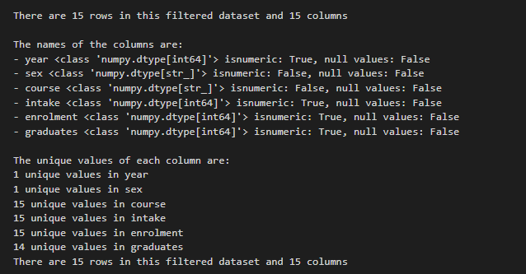
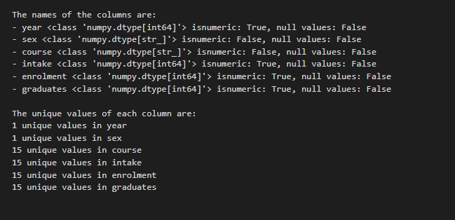
Nature of datasets
Universities - Intake, Enrolment and Graduates by Course
This dataset contains information about the inatake, enrolment, and graduates by course
The courses columns include additional commas, including the number which requires filtering of it
After filtering out 2005 and 2020,. we can see that below is the nature of the datasets
2005 2020

Slide 6
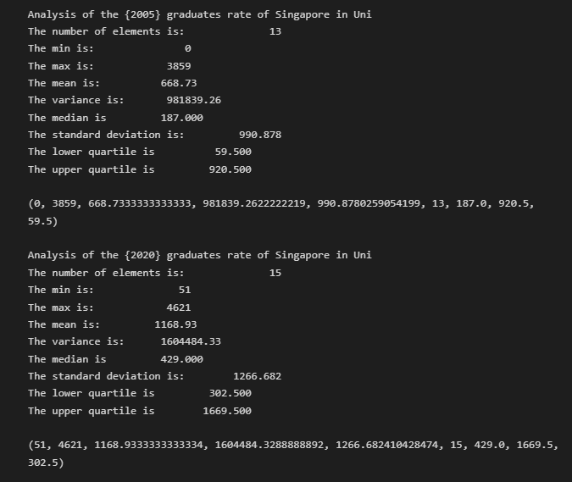
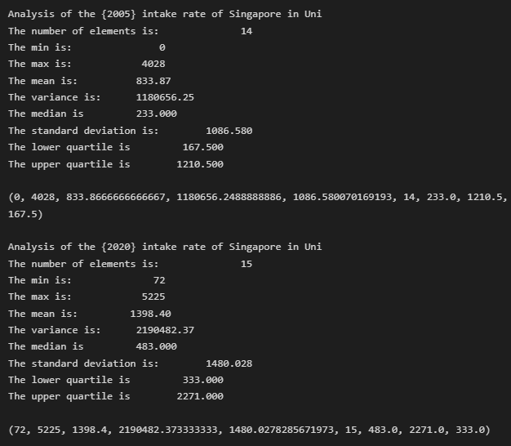
Explnation of process
Universities - Intake, Enrolment and Graduates by Course
As I wanted to show the comparison between 2005 and 2020, hence I use NumPy Boolean to filter the data out

Slide 7
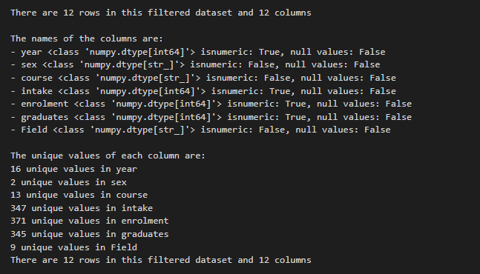
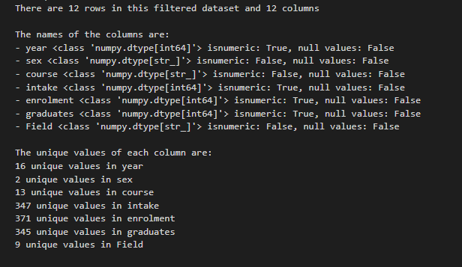
Nature of datasets (similar to previous dataset)
Polytechnic - Intake, Enrolment and Graduates by Course
2015 2020

Slide 8
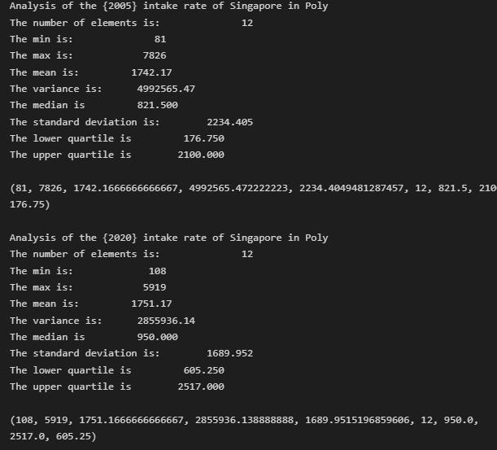
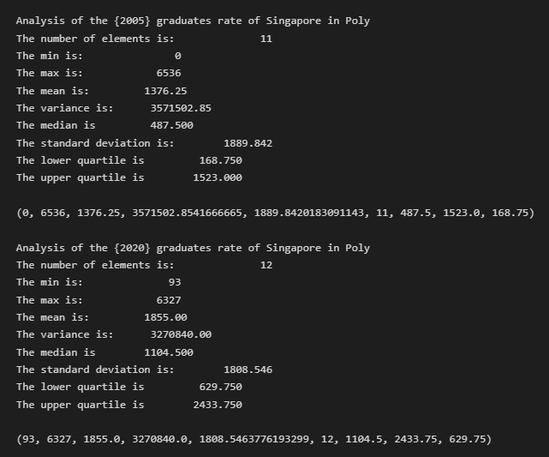
Explnation of process
Polytechnics - Intake, Enrolment and Graduates by Course

Slide 9
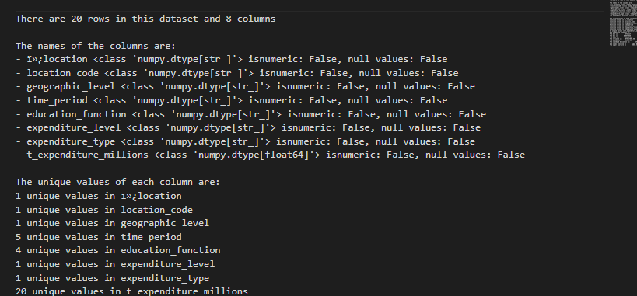
Nature of datasets
Total expenditure (millions) for 'Education expenditure' for Primary education, Secondary education and Tertiary education in United Kingdom between 2015-16 and 2021-22
This is a dataset on the expenditure on education in UK
The data includes from 2015 onwards
The info needed to be filtered out as it includes data of specific regions such as Wales
Below is the overall analysis of the dataset, the dataset does not have preclaurities

Slide 10
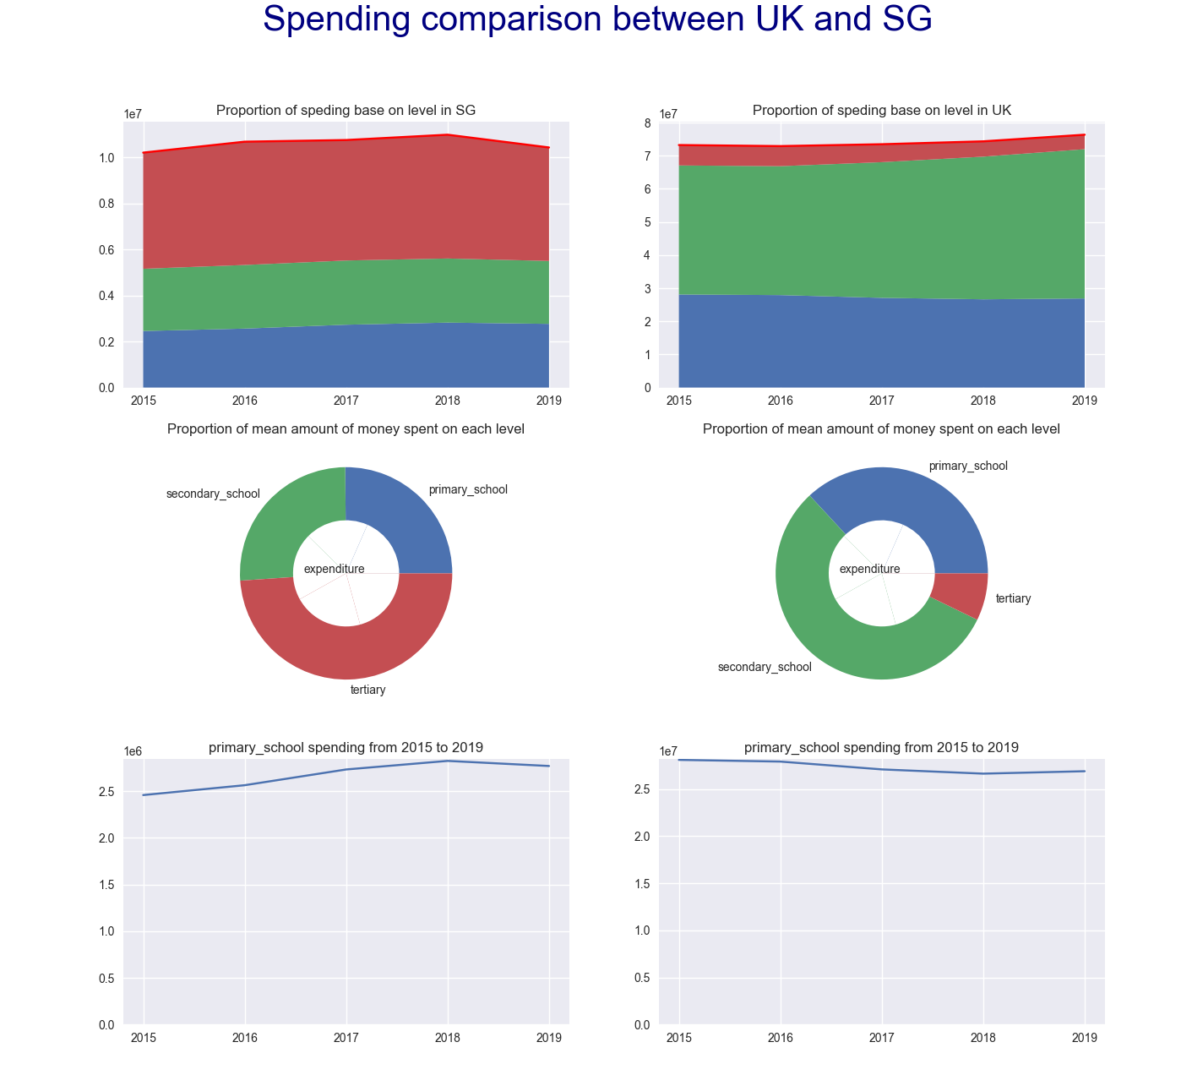
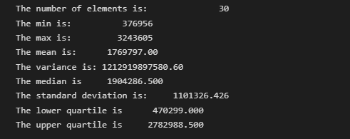
Explnation of process
Government Recurrent Expenditure On Education
As I wanted to show the expenditure from 2015 to 2019, hence I use NumPy Boolean indexing to filter out the years before analysing the dataset

Slide 11
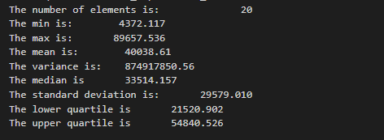
Explnation of process
Total expenditure (millions) for 'Education expenditure' for Primary education, Secondary education, and Tertiary education in the United Kingdom between 2015-16 and 2021-22
As I wanted to show the expenditure from 2015 to 2019, hence I use NumPy Boolean indexing to filter out the years before analysing the dataset

Slide 12
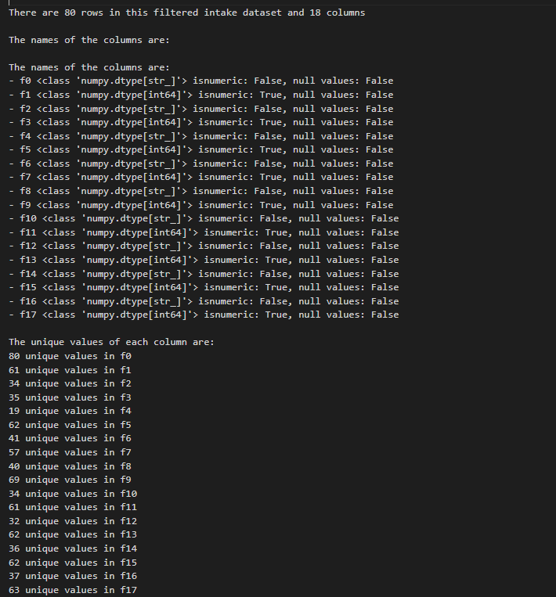
Nature of datasets
Reading performance English
This dataset shows the score for English
This dataset contains many number brackets

Slide 13
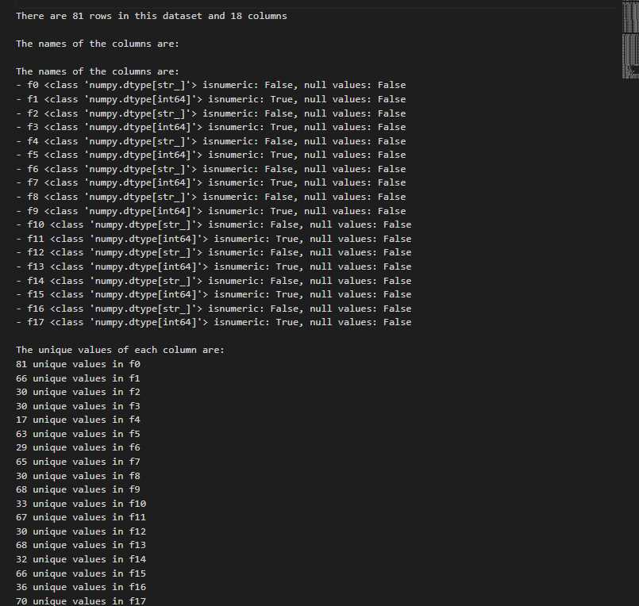
Nature of datasets
Reading performance math
This dataset shows the score for Math
Similarly, this dataset contains many number brackets

Slide 14
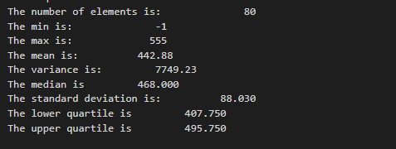
Explnation of process
Reading score English
Eliminated unwanted columns from the reading and maths scores and used only the average score columns.

Slide 15
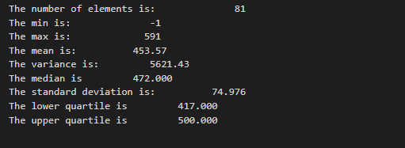
Explnation of process
Reading score Math
In addition, there is incorrect datatype, however I filtered it out for UK and SG

Slide 16
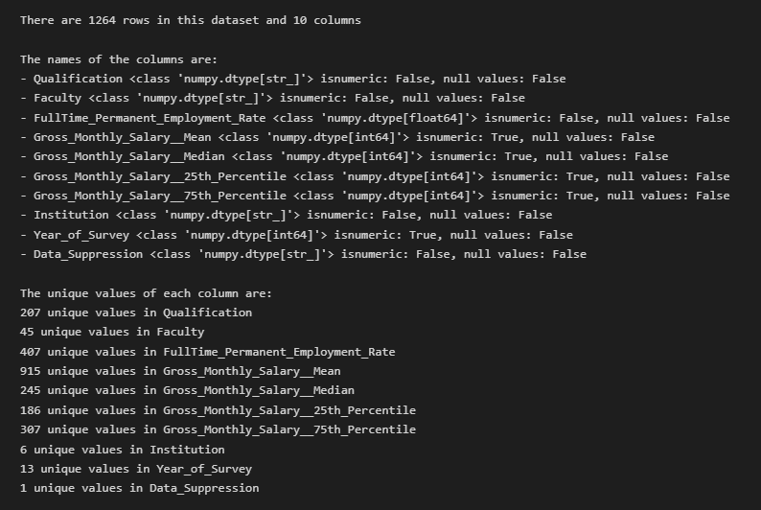
Nature of datasets
Graduate Salary Singapore
This dataset tells me about the salary across different courses over the years
Below is the nature of dataset

Slide 17
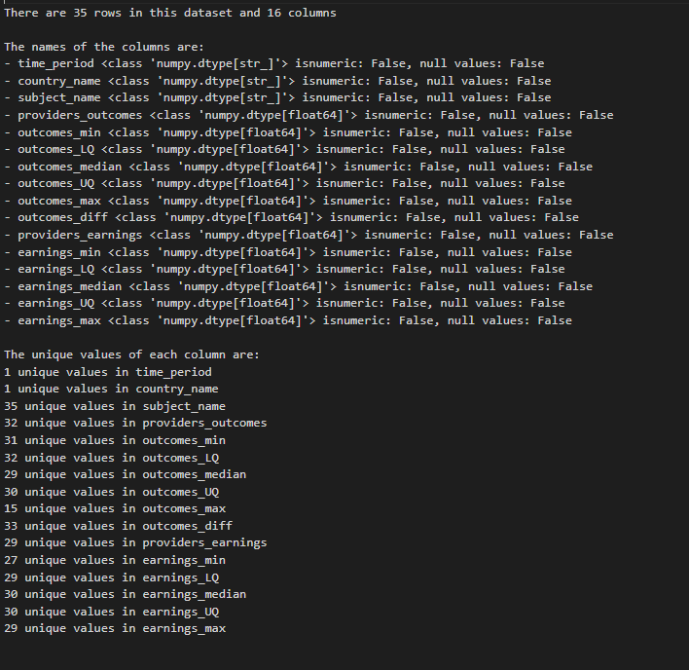
Nature of datasets
Graduate Salary UK
This dataset tells me about the salary across different courses over the years
Below is the nature of dataset

Slide 18
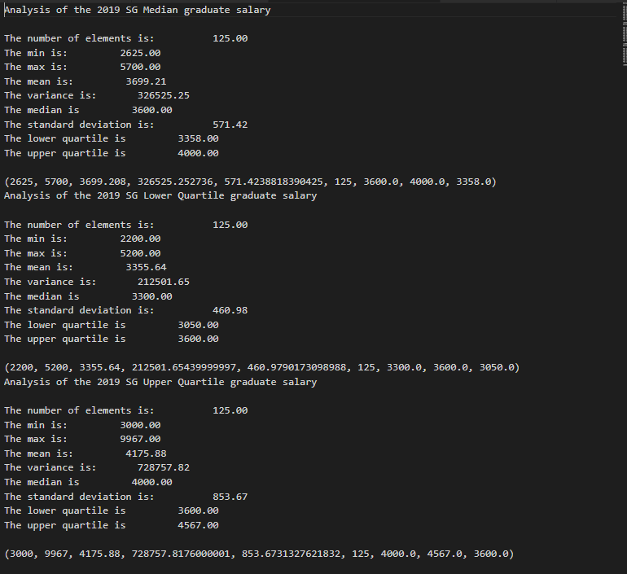
Explnation of process
Graduate Salary
Since I wanted the 25 percentiule, median and 75 percentile salary, I filtered it out and got the datas and se the year to 2019

Slide 19
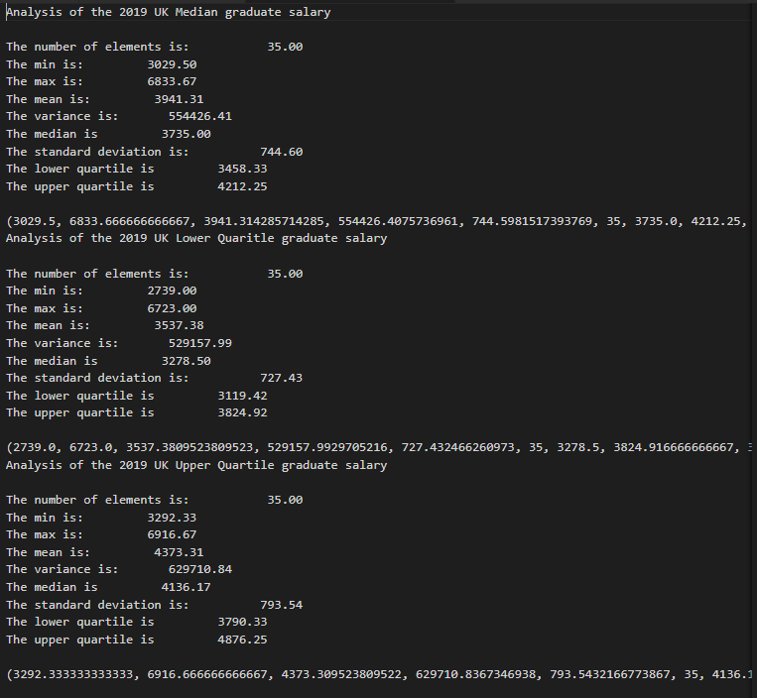
Explnation of process
Graduate Salary UK
Since I wanted the 25 percentiule, median and 75 percentile salary, I filtered it out and got the datas and se the year to 2019 for UK

Slide 20
Overall Data wrangling
To compare it to Singapore datasets efficiently and accurately, the three datasets into one file and used numpy append field to add the relational course columns to the UK datasets before adding the field column. Also, this information was combined with graduate salary.

Slide 21
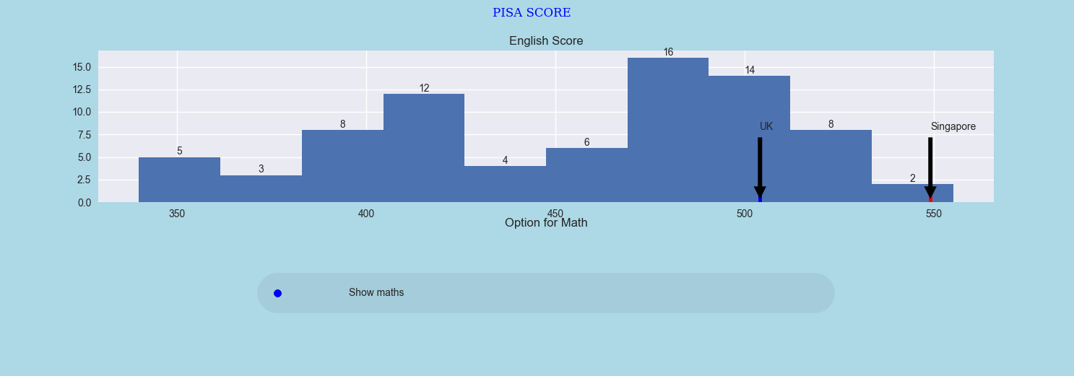
How does Singapore fare against other coutnries in the PISA score
Analysis and insights
Firstly, both Singapore and United Kingdom are ahead of the pack in terms of reading score
The highest number of countries is between the around the range 470 to 490 where there is 16 of them
However for the mean reading score, Singapore on average perform at a higher score as compared to UK as we can see from the annotation

Slide 22
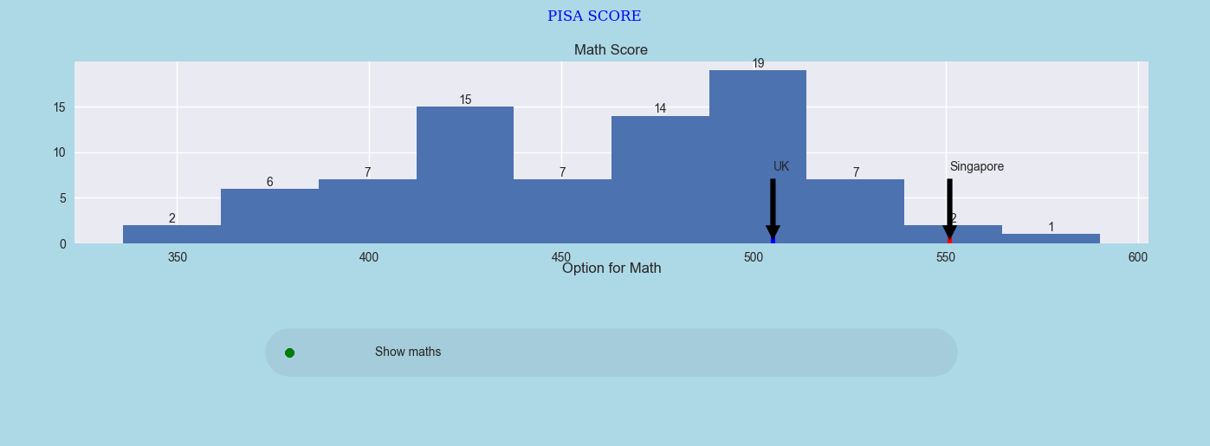
How does Singapore fare against other coutnries in the PISA score
Analysis and insights
For the math score, we can see that UK also perform at a worst score compared to Singapore, who is top 3 in terms of math score
From this, we can also see that UK perform at the mode of the math score which is around 500
Conclusion: Therefore , we can see that Students in 15 years old students perform better as compared to UK

Slide 23
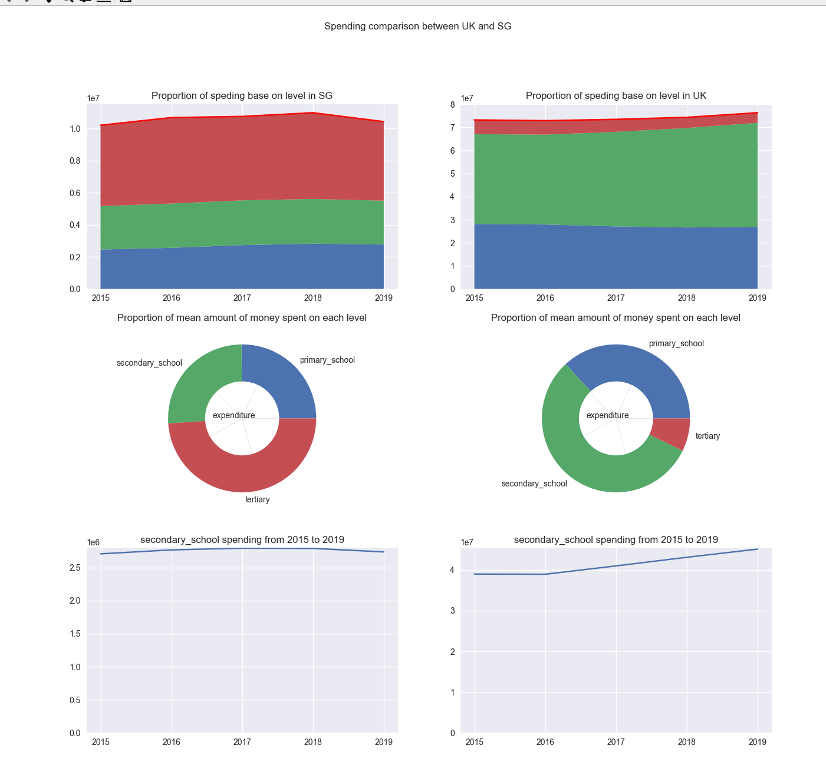
At which level is singapore focusing on spending its money on education?
Analysis and insights
Here, it is possible to see that SG has a slight decrease in total expenditure on primary school, secondary school, and tertiary education from year 2018 to 2019, meanwhile, the total expenditure in UK has been steadily increasing
In addition, there is also a difference in the in where UK and SG spend their money on in terms on education level, as we can see from the pie chart, Singapore focus more of its spending on tertiary education while UK is focus on secondary education
For all categories, Singapore has fluctuated from 2015 to 2019 while UK has mostyly been increasing except for tertiary education

Slide 24
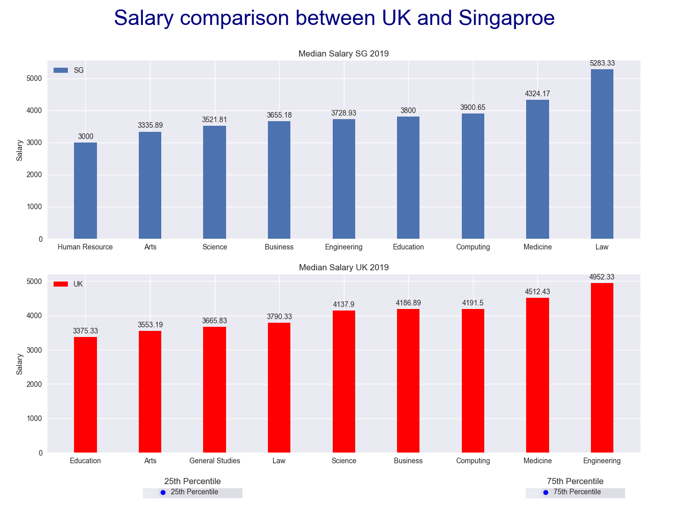
What does the salary like in UK and Singapore by field?
Analysis and insights
Therefore, we can see that UK pays at a higher rate for most field in 2019 and we can also see a difference in which field provides a higher median salary

Slide 25
Recommendations
In terms of spending, we can see that UK and Singapore have different goals in mind, I recommend that Singapore should spend a bit more on secondary school education

Slide 26
Now let us analyze deeper into Singapore tertiary trend

Slide 27
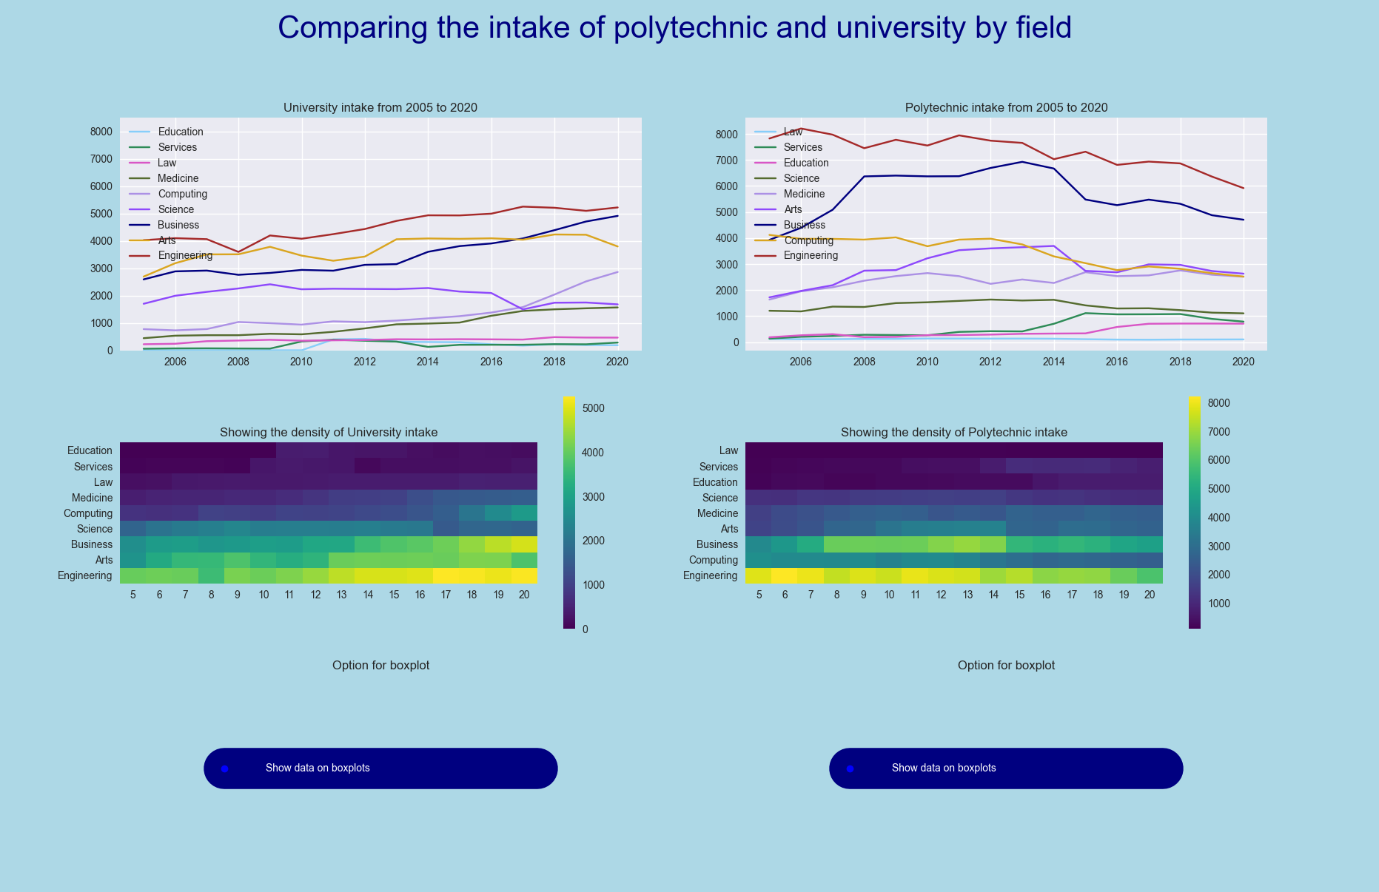
How does the Polytechnic intake compare with the University intake by field?
Analysis and insights
In line plots, we can see that the intake for university is lower as compared to polytechnic throughout the years and for almost every field
In heat mat for both Polytechnic and University intake, Engineering is at the highest intake over the years as seen from both the heat map and the line plot

Slide 28
How does the Polytechnic intake compare with the University intake by field?
Analysis and insights
However, while engineering students has been decreasing for polytechnic over the years, it has been increasing University Intake at an exponential rate
In addition, Services has the lowest intake in the majority of the years from 2005 to 2020 for University (0 to 50) however, Law has the lowest intake in the same period for Polytechnic (less than 50)

Slide 29
How does the Polytechnic intake compare with the University intake by field?
Analysis and insights
In terms of computing,it has gradually increased in intake for universities from 2005 to 2020. while it has gradually decreased in intake for polytechnic from 2005 to 2020 as seen from the heatmap and hence has surpass polytechnic

Slide 30
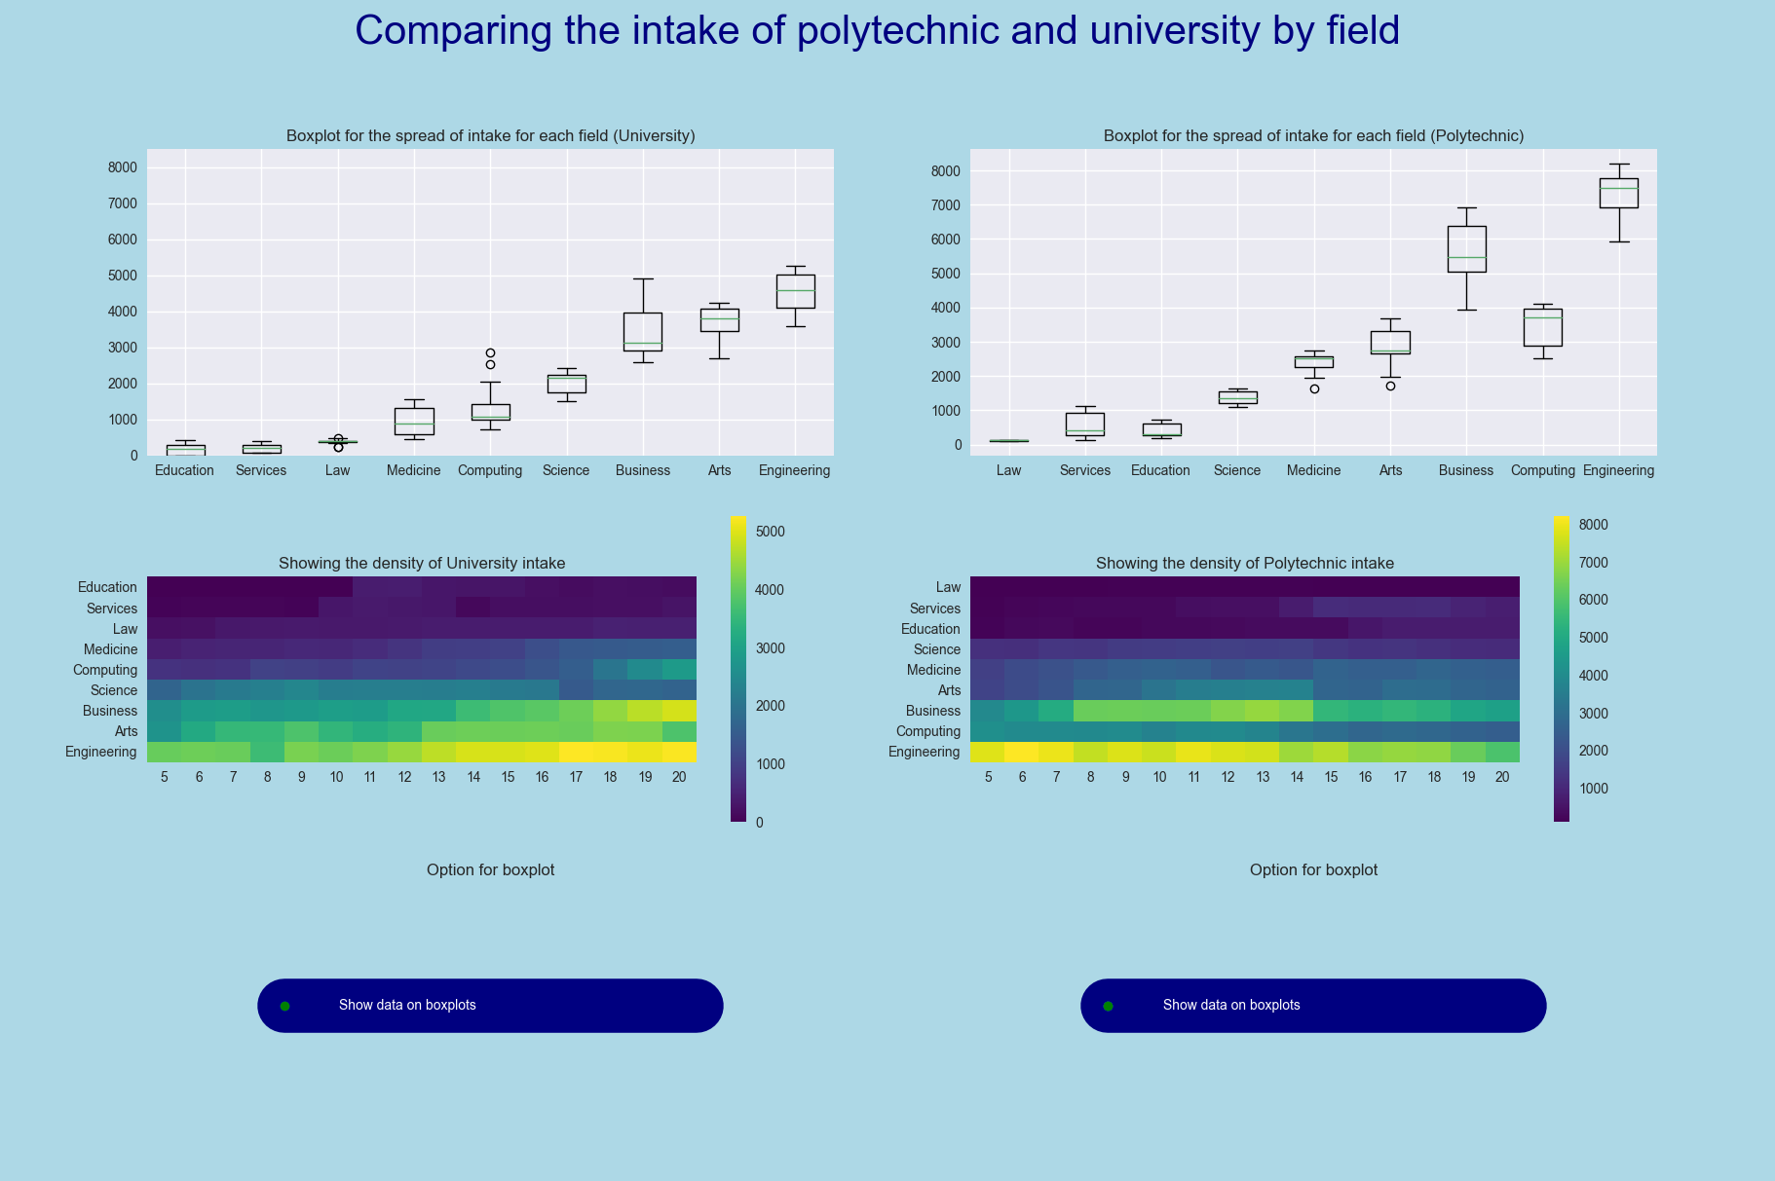
How does the Polytechnic intake compare with the University intake by field?
Analysis and insights
For universities, Arts, science and computing the intake was skewed negatively while business skewed positively with the rest having symmetrical distribution
Computing contains outlier
For polytechnic, business, arts, education , computing , science and service experience positively skewed while the rest experience negatively skewed intake data
Arts, Medicine,Education,Science also has outlier in terms of intake
Law intake is unable to justify

Slide 31
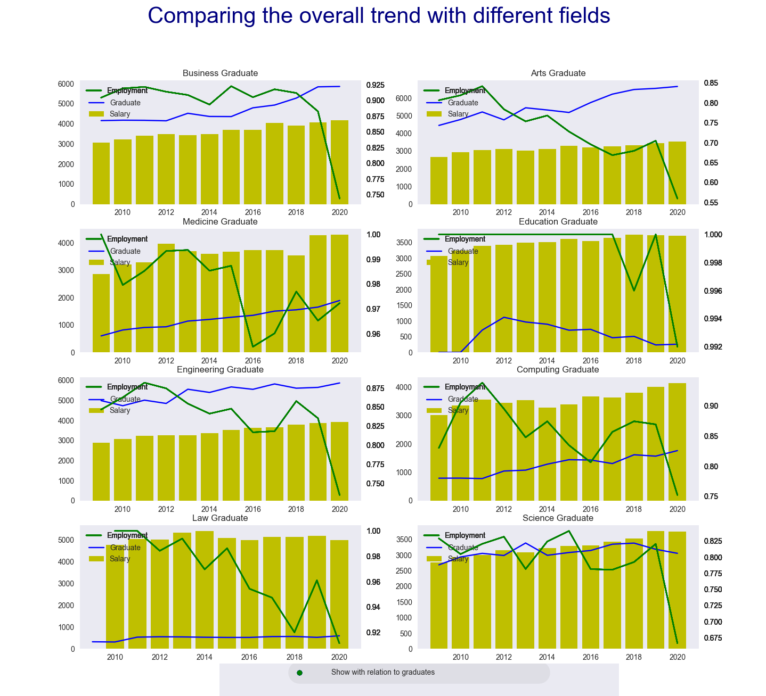
How does the intake ad graduate relate to employment and salary?
Analysis and insights
For business, the employment rate took a dip, but the salary has been increasing over the years, including the intake
For the arts field, the salary also has been increasing, however, the intake has been stable, with it decreasing during the year 20192020. Similarly, the employment rate took a plunge
For medicine, the salary has been unstable but has risen to its peak for the past 2 years, intake has been increasing while the employment rate also increased in the last 4 years after it took a hit
For education, salary has begun decreasing for the past 2, employment has remained consistent throughout the years

Slide 32
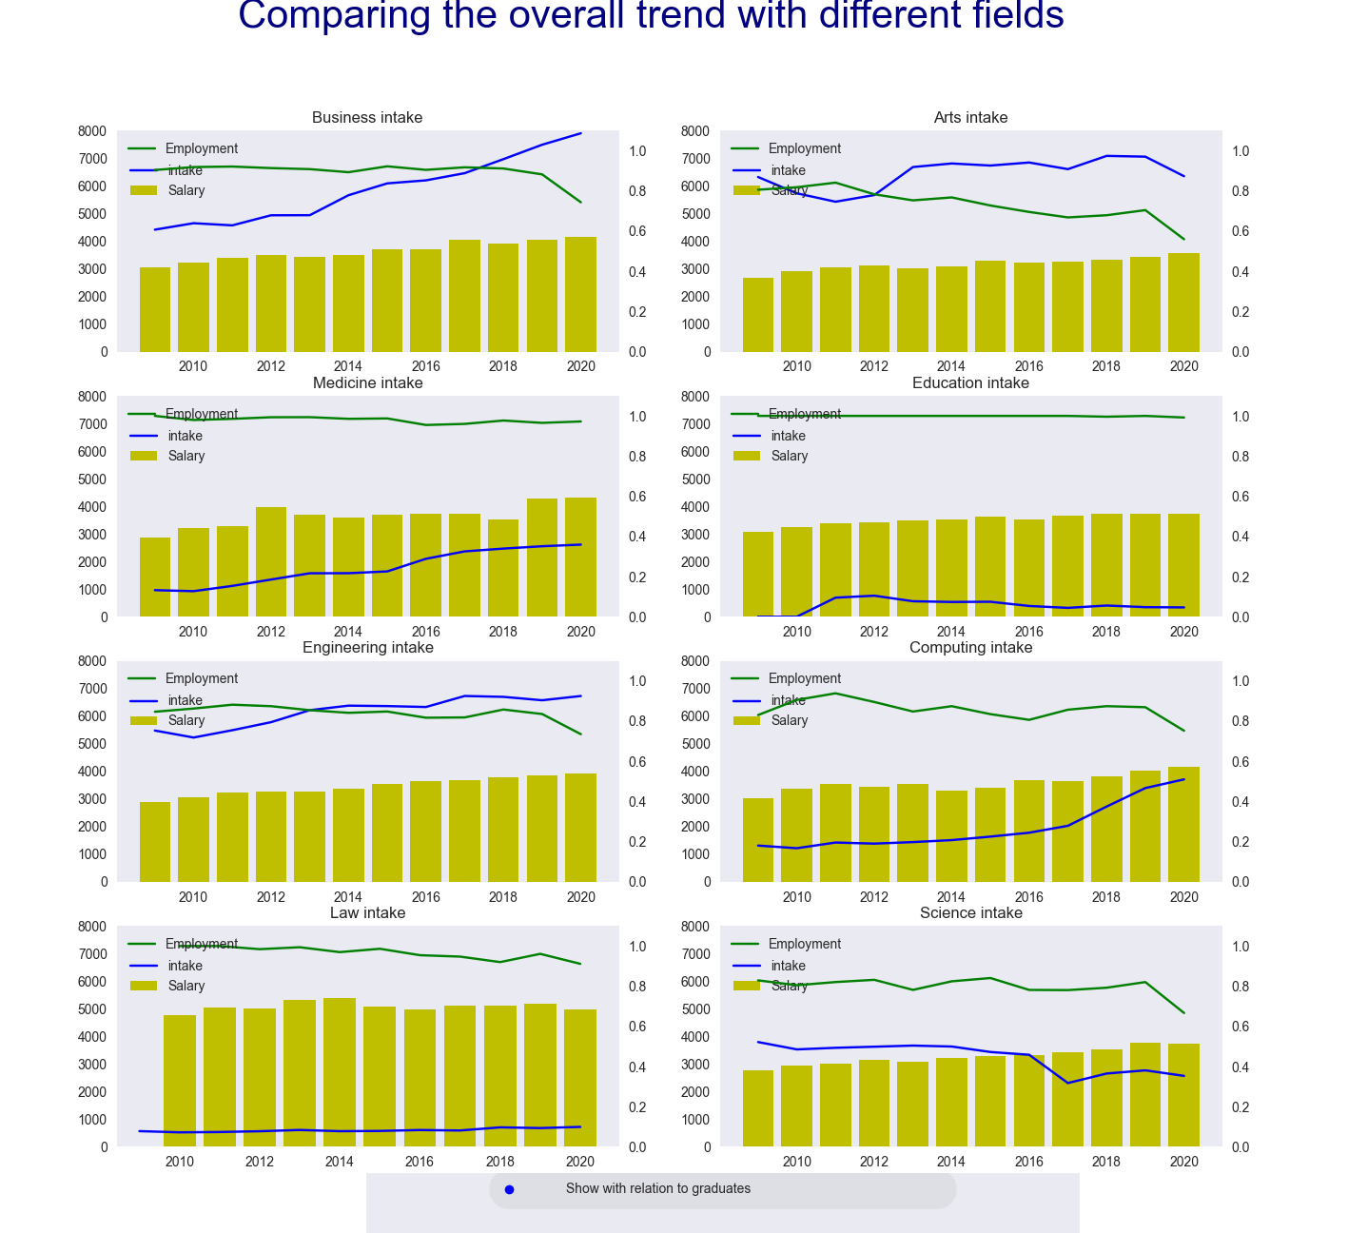
How does the intake ad graduate relate to employment and salary?
1.In engineering employment rate fell, but , salaries and intake have increased
2.In computing, salaries and intake have been rising linearly, but employment rates have fallen recently.
3.In law, salaries have been rising over time while employment rates and intake have stayed roughly the same.
4. In science salaries have increased, employment rates and intake have decreased
Analysis and insights

Slide 33
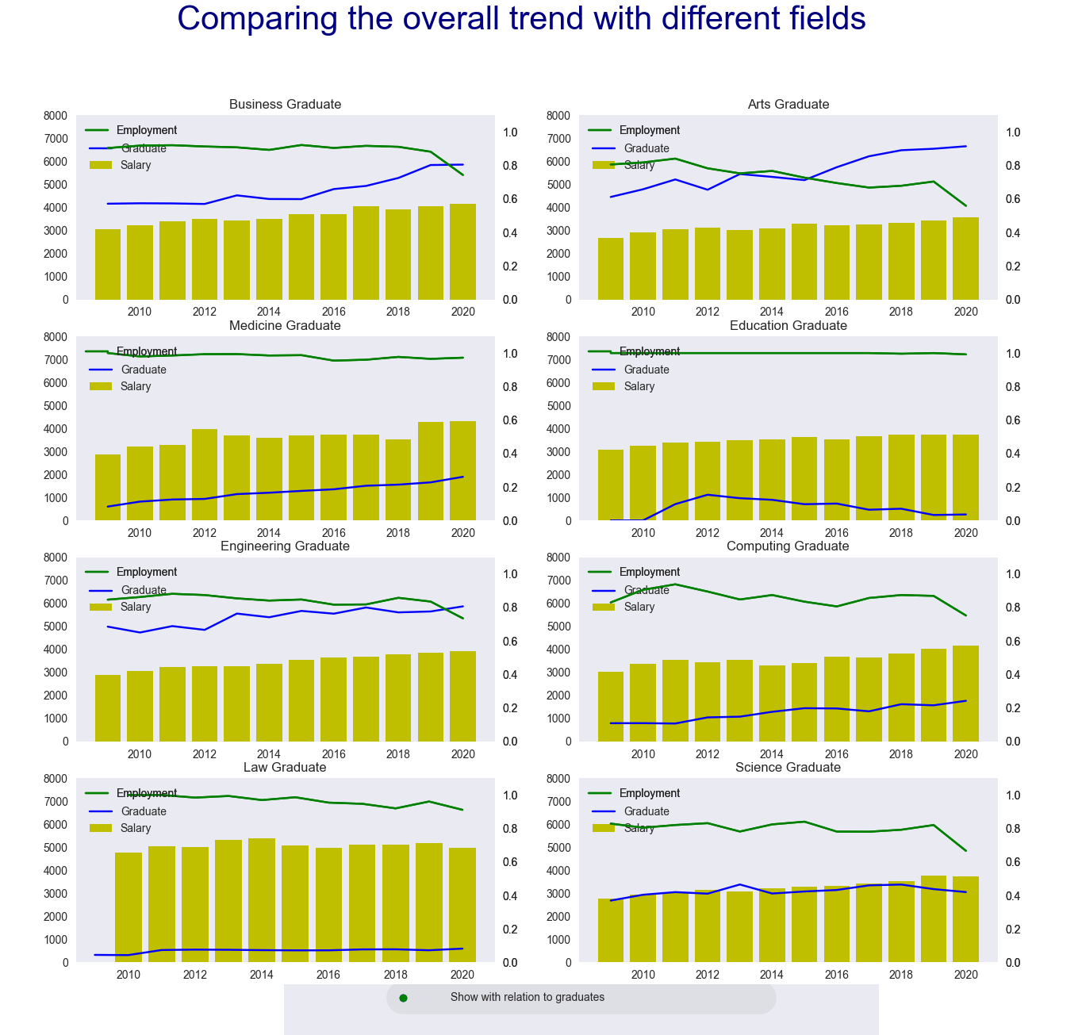
How does the intake ad graduate relate to employment and salary?
The trend between intake and graduate has relate to each other therefore, the trend is similar to that with intake
Conclusion: Therefore we can see that there is not a huge correlation between employment and salary, however we can see that there is a correlation between salary and intake
Analysis and insights

Slide 34
Overall Recommendations
We can see that the usual few field or courses has been at the front of intake, graduate, and salary, over the years in Singapore, it is time for Singaporeans to venture into other fields instead of following a rat race.

Slide 35
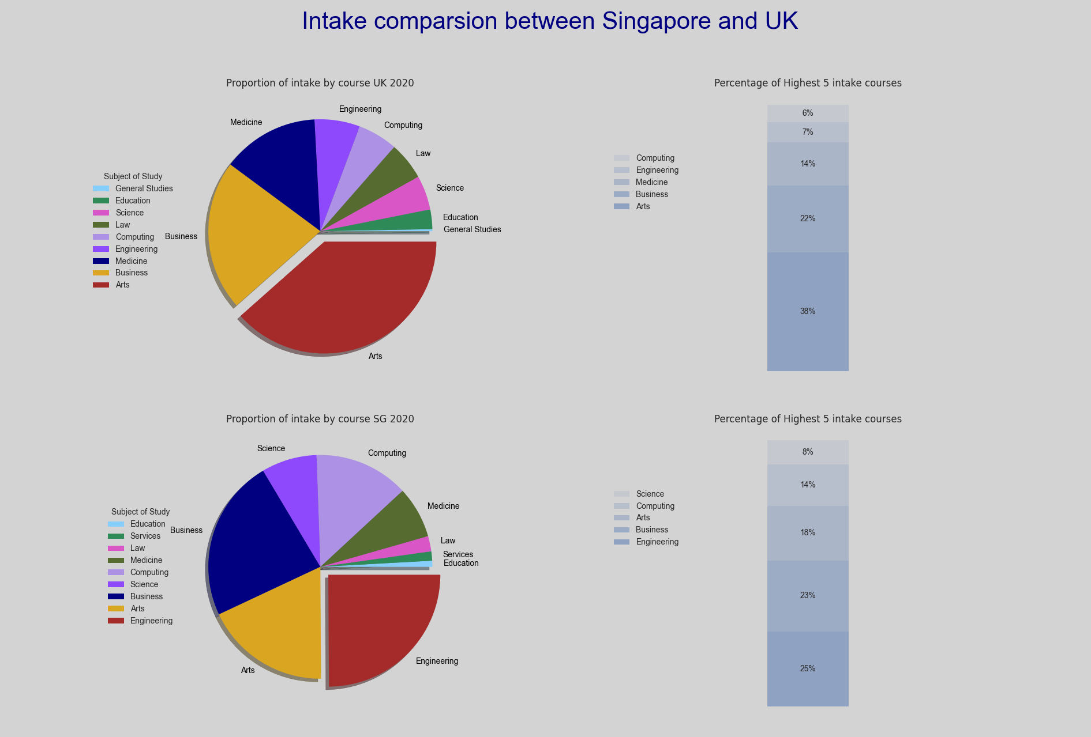
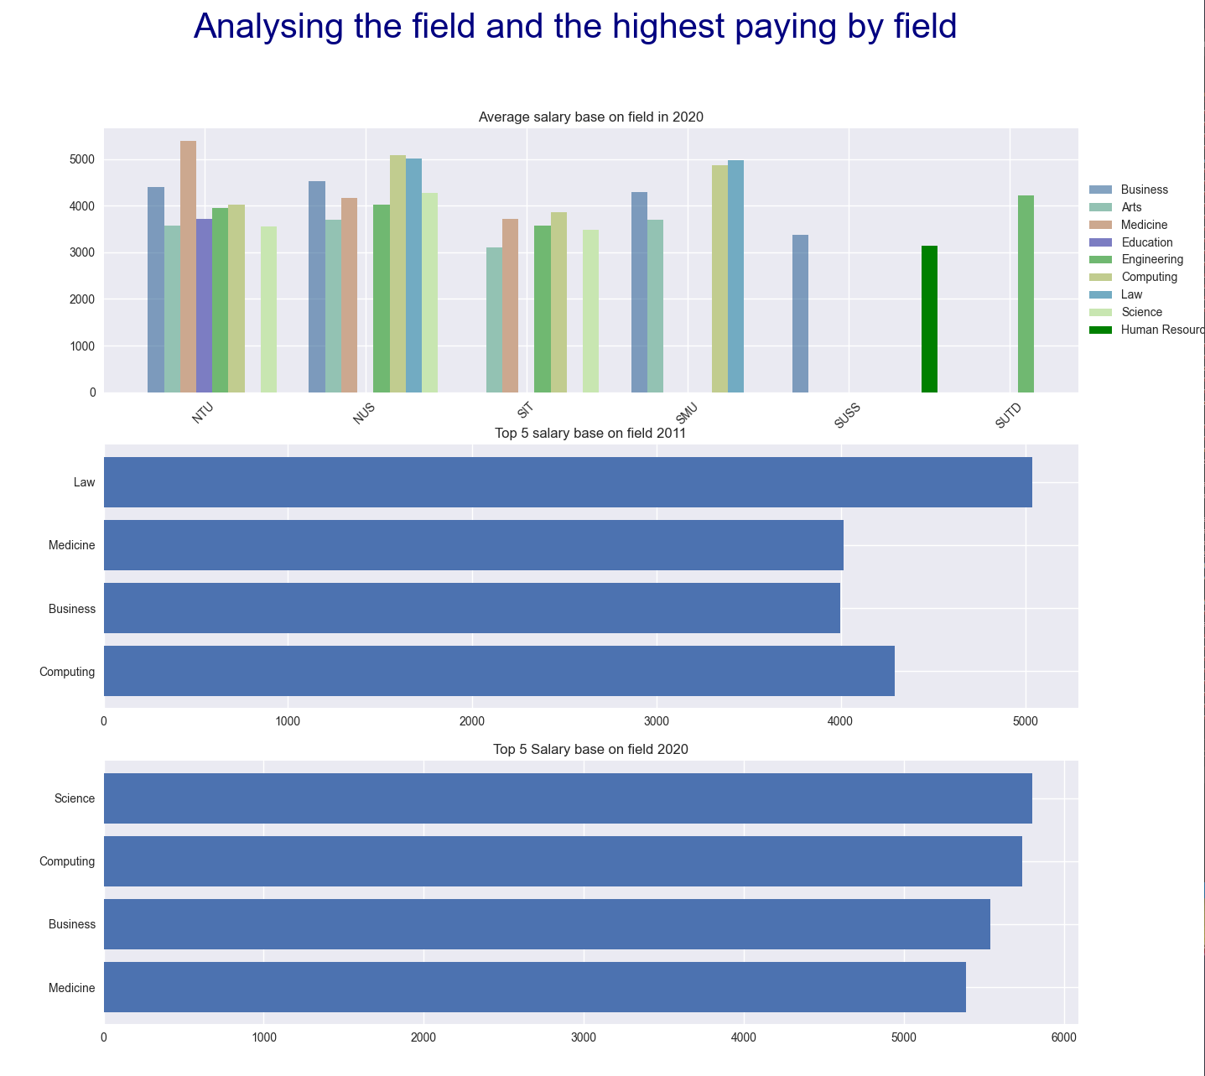
Additional Graphs

Slide 36
Thank You

