Slide 1
RNN Text Generator
Done By: Goh Rui Zhuo

Slide 2
01
Business Understanding

Slide 3
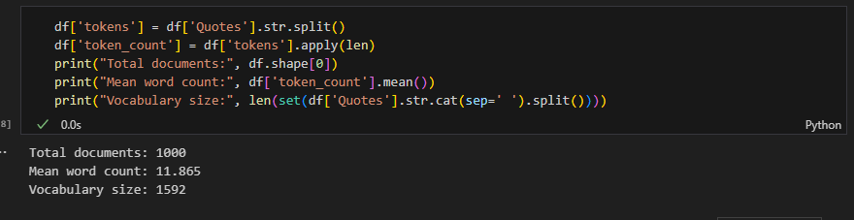
The goal of this assignment is to create a RNN model that can predict the next word 10 times
Creativity and evaluate the generated sequence of words, how meaningful they are, or how creative they are, using the given seed_texts as a benchmark.
Dataset contains 1000 rows
Mean word count is 11.865
1592 words of vocabulary
No Null values present

Slide 4
02
Exploratory Data Analysis

Slide 5
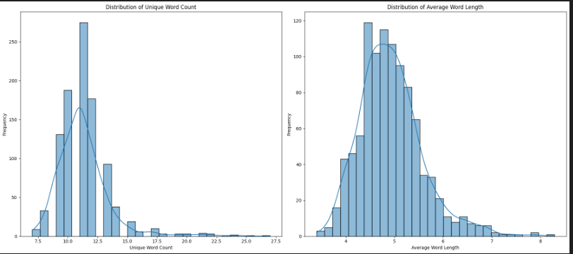
Distribution Analysis
In general, we can see that all the three word count, unique word count and average word length are all positively skewed
We see that for the unique word count is at 12.5 median and average word length isabout 4 to 5

Slide 6
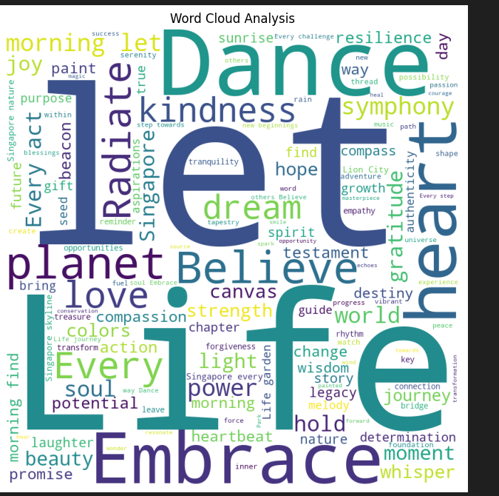
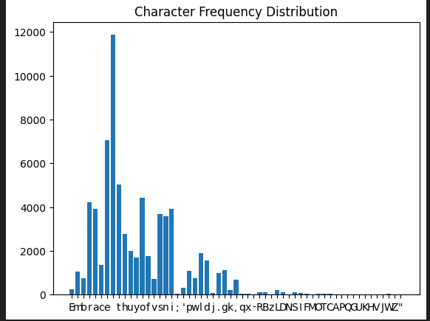
Word Cloud
From this word cloud, From above, we can see that words like Let life, dance appear pretty commonly
Character Distribution
From the character distribution, we can see that words are distributed with most at the character e

Slide 7
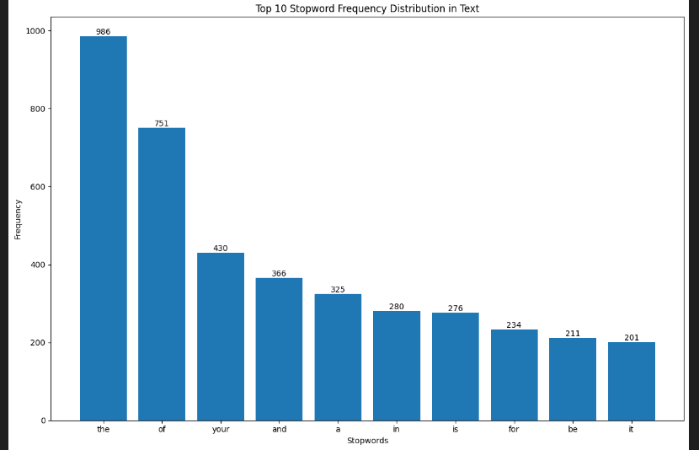
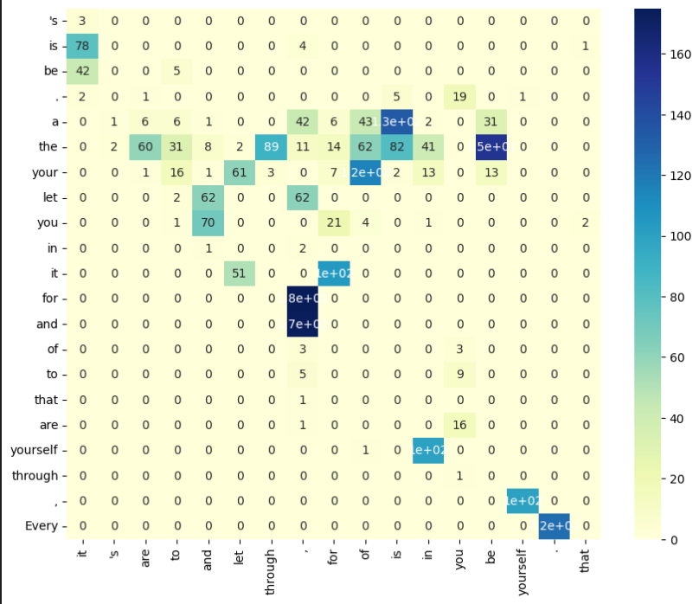
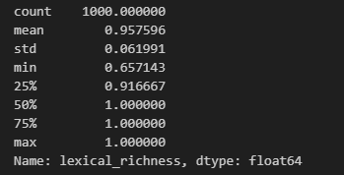
Top 5 Most Frequent Words
From the bar charts , top 5 most frequent words are all words that are short and are adjective mostly
BiGram Analysis
From it we can that worlds like for and , occurs the most frequently in the dataset
Lexical Richness Analysis
We can see that the quotes are pretty diverse

Slide 8
03
Data Preprocessing Part 1

Slide 9
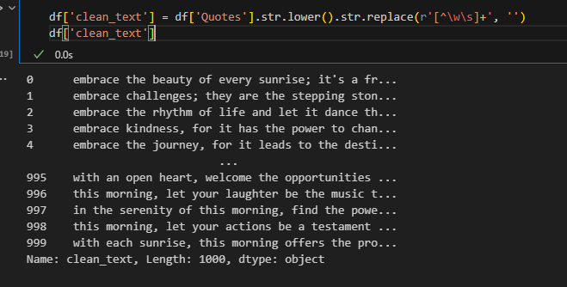
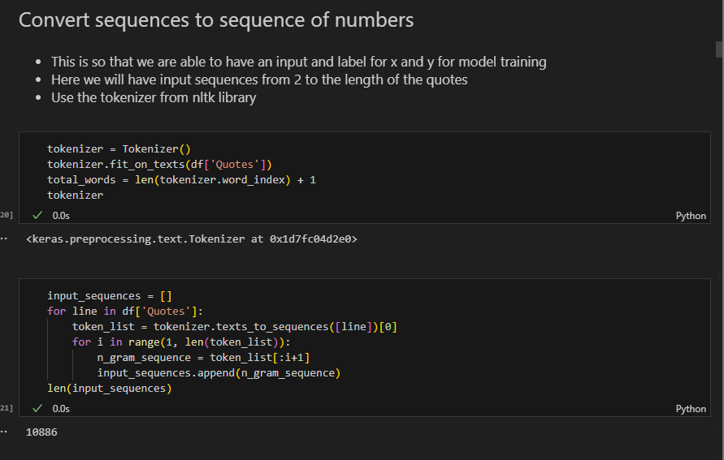
Clearing the commas and capitalization
Convert sequence to sequence of numbers with tokenizer

Slide 10
04
Feature Engineering Part 1

Slide 11
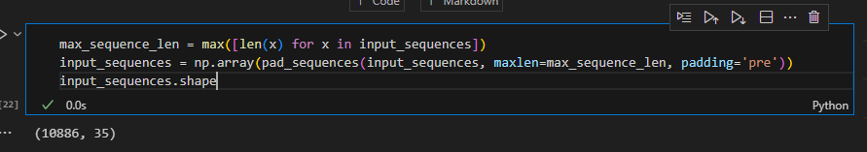
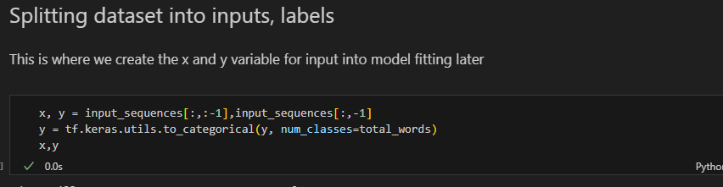
Padding of sequences
The padding of sequences ensures that all are of the same length
Provide consistent shape and size
This is so that we can batched the dataset as sequences with different length is unable to do so
Splitting the dataset into x and y labels

Slide 12
05
Evaluation Metrics

Slide 13
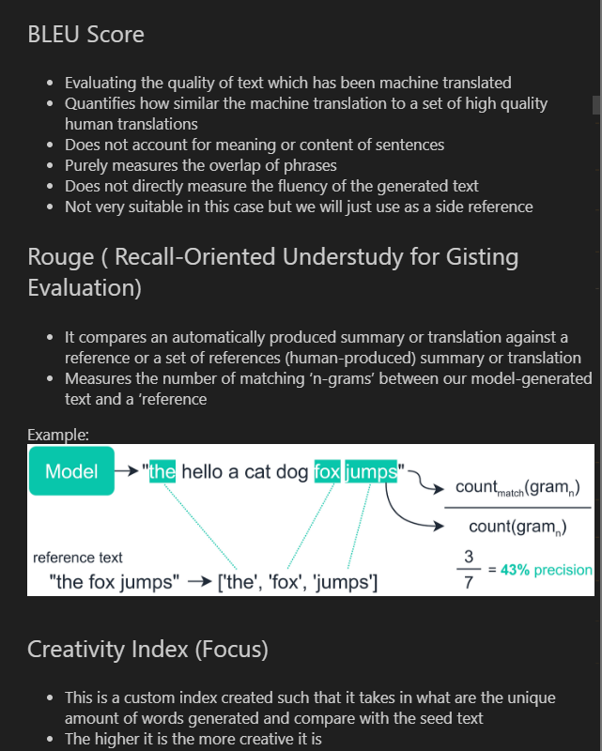
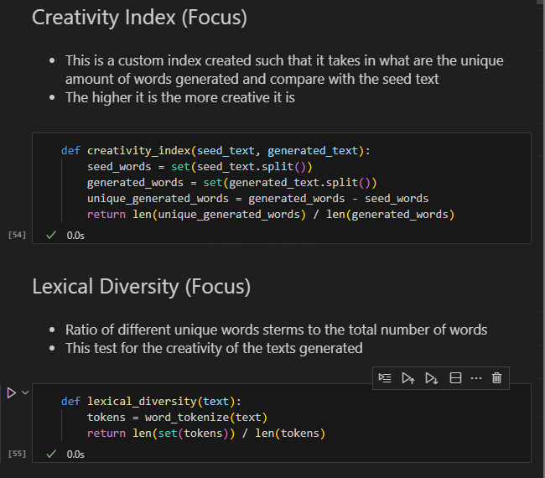
BLEU Score
Rouge Score
Creativity Index (Focus)
Lexical Diversity (Focus)
Cosine Similarity

Slide 14
06
Baseline Model

Slide 15
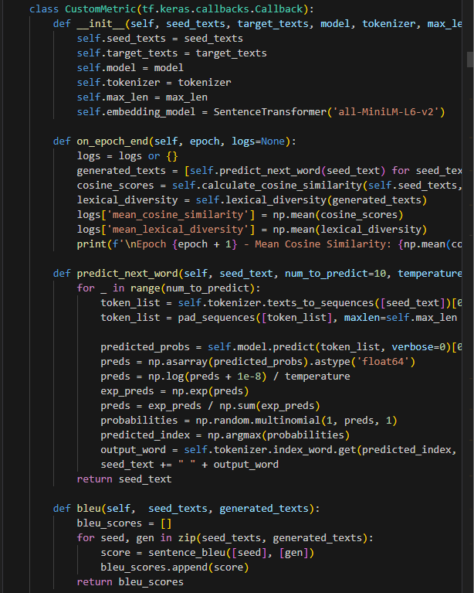
Custom Callback was created
Provide seamless way of identifying whether the model performs on special set of evaluation metrics
Helps able to store it in history and able to retrieve it

Slide 16
Baseline Models
Baseline Dense Model
3 dense layers
LSTM first model
2 LSTM layers
LSTM second model
3 layers of LSTM and 1 dense layer
GRU model
2 GRU layers
Bidirectional model
2 Bidirectional layers and 2 dropout layers

Slide 17
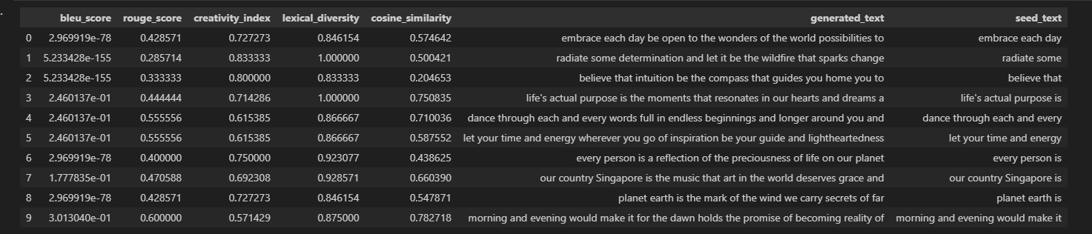
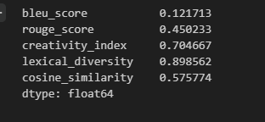
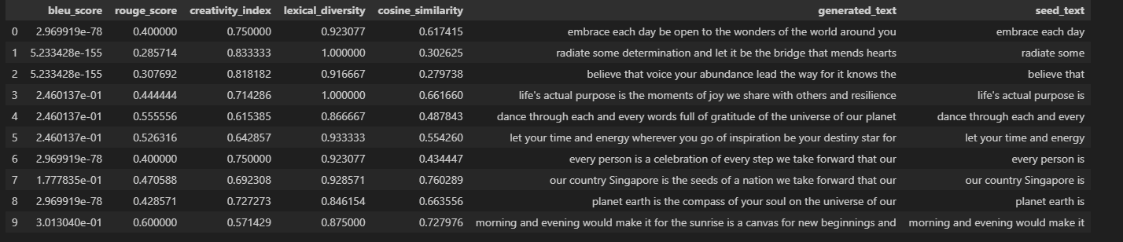
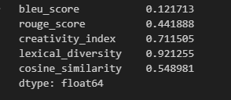
Baseline Models Evaluation
Acros the 5 models, the best performing ones are GRU model and LSTM model all around in terms of logically , accuracy, diversity score, creative index and other metrics
Therefore, they are use in the next stage of improvement

Slide 18
07
Feature Engineering

Slide 19
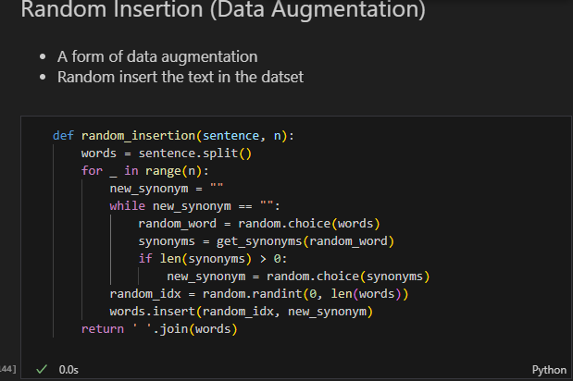
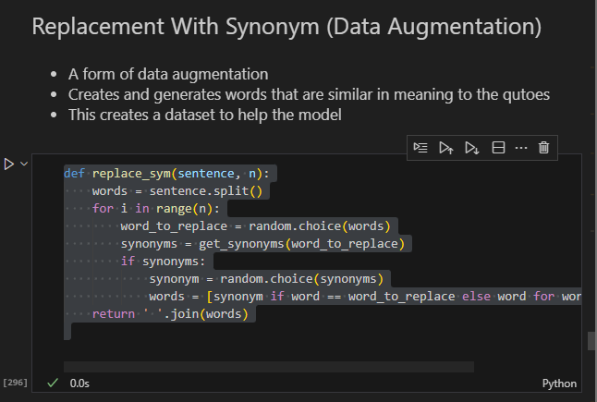
Random Insertion
This is a random insertion of words into the dataframe
Form of data augmentation
Synonym replacement
A form of data augmentation
Creates and generates words that are similar in meaning to the quotes
This creates a dataset to help the model

Slide 20
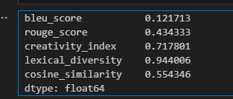
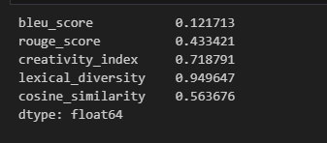
Random Insertion
Lead to an improvement of model with higher all round scores
Predicted text are more logical too
Synonym replacement
Similarly, lead to an improvement of model with higher all round scores
Predicted text are more logical too
Overall, synonym replacement is a better data augmentation method due to the more logical and diverse words

Slide 21
08
Model Improvement - Add Regularisation
Cosine Annealing

Slide 22
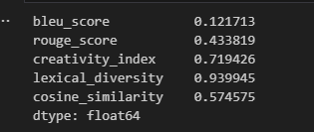
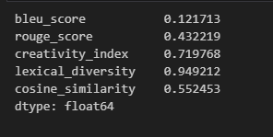
Regularisation
Adding regularisation prevents the possible overfitting of the dataset
However, in both of this case, the model did not improve with scores and the text predicted are of worser quality
Lower diversity and creativity here

Slide 23
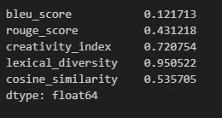
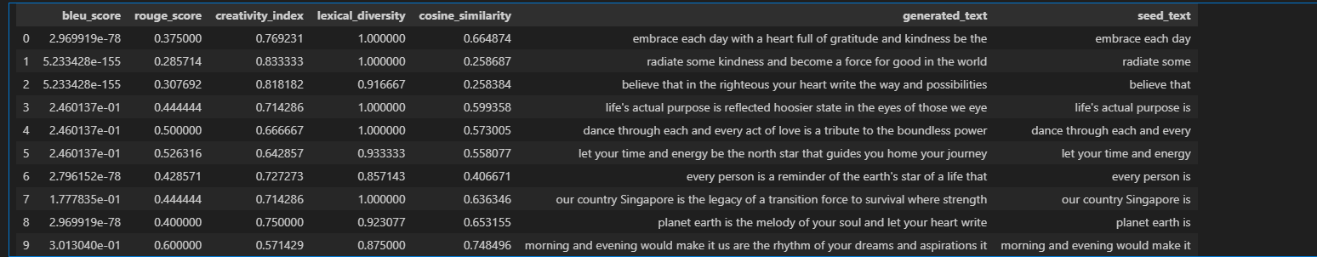
Cosine Annealing
Adding a learning rate schedule helps to find the best model
However, in both of this case, the model did not improve with scores and the text predicted are of worser quality
Lower matched of words

Slide 24
09
Hyperparameter Tuning

Slide 25
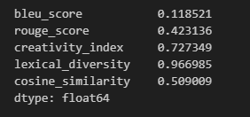
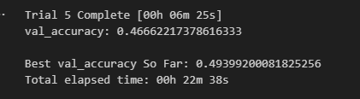
Hyperparameter Tuning
Helps to find the highest accuracy base on different parameters
However, the other evaluation metrics did not improve
Accuracy also did not improve compared to baseline

Slide 26
10
Final Model

Slide 27
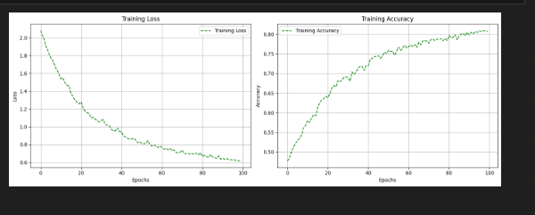
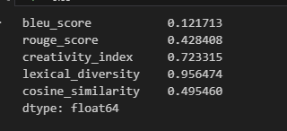
Final Model
LSTM 2 with synonym replacement
81% accuracy and 0l.61 loss
High diversity and 0.5 of similarity with reference text and pretty creative

Slide 28
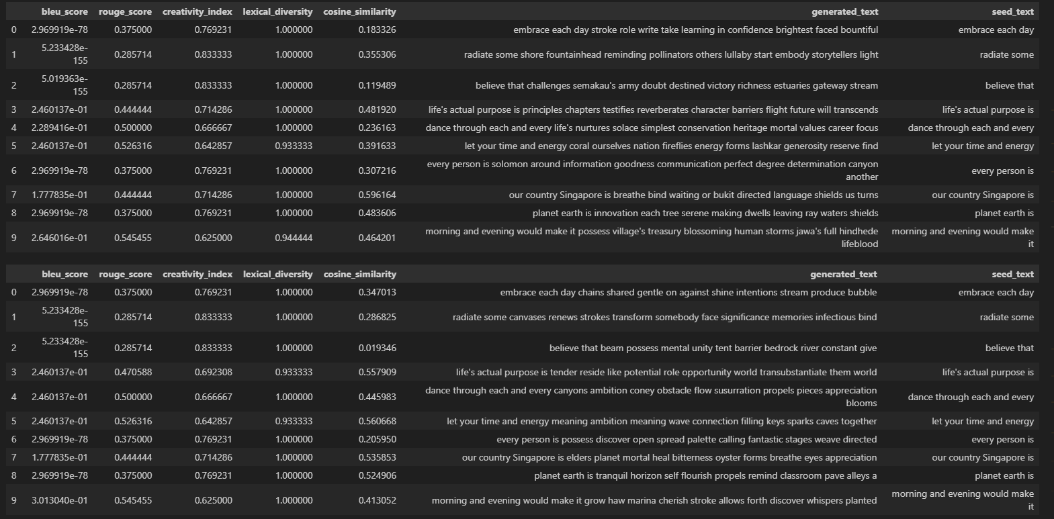
Final Model
Final testing with 5 output shows logical response and predicted text

Slide 29
Final Model

Slide 30
Overall, this model may not be the best in all metrics, but it certainly is creative, diverse and follows the seed text, resulting in an all around logical model

Slide 31
Thank You

