Slide 1
Ensemble Methods
Boosting vs Bagging
From-scratch Decision Tree, AdaBoost, Random Forest, PCA, K-Means, and DBSCAN
AI Academy · National AI Center · Spring 2026
İbrahim Mammadov · Nihat Rzayev · Fatma Mammadova · Fidan Allahverdiyeva
Ensemble Methods: Boosting vs Bagging
01

Slide 2
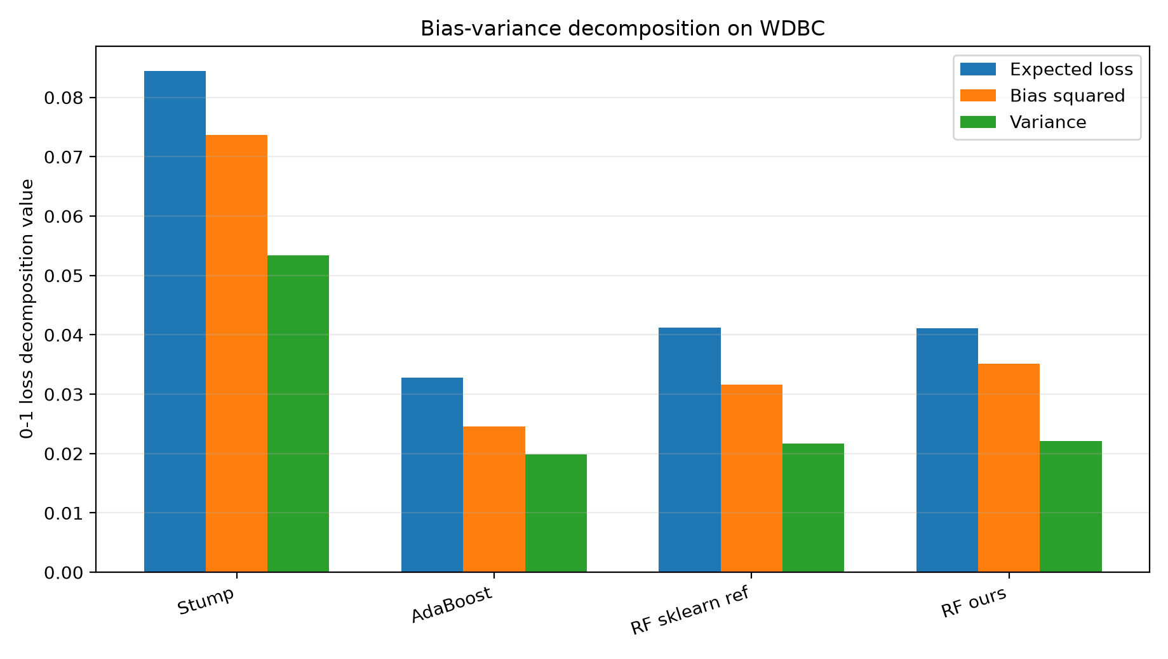
Research question and motivation
Problem
When does boosting outperform bagging, and when is bagging safer?
Boosting learns sequentially from errors; it can reduce bias but may chase mislabeled samples.
Bagging trains independent models on bootstrap samples; it mainly reduces variance.
The comparison must consider noise, imbalance, dimensionality, runtime, and stability.
Core defense line: boosting lowers bias; bagging lowers variance.
Ensemble Methods: Boosting vs Bagging
02

Slide 3
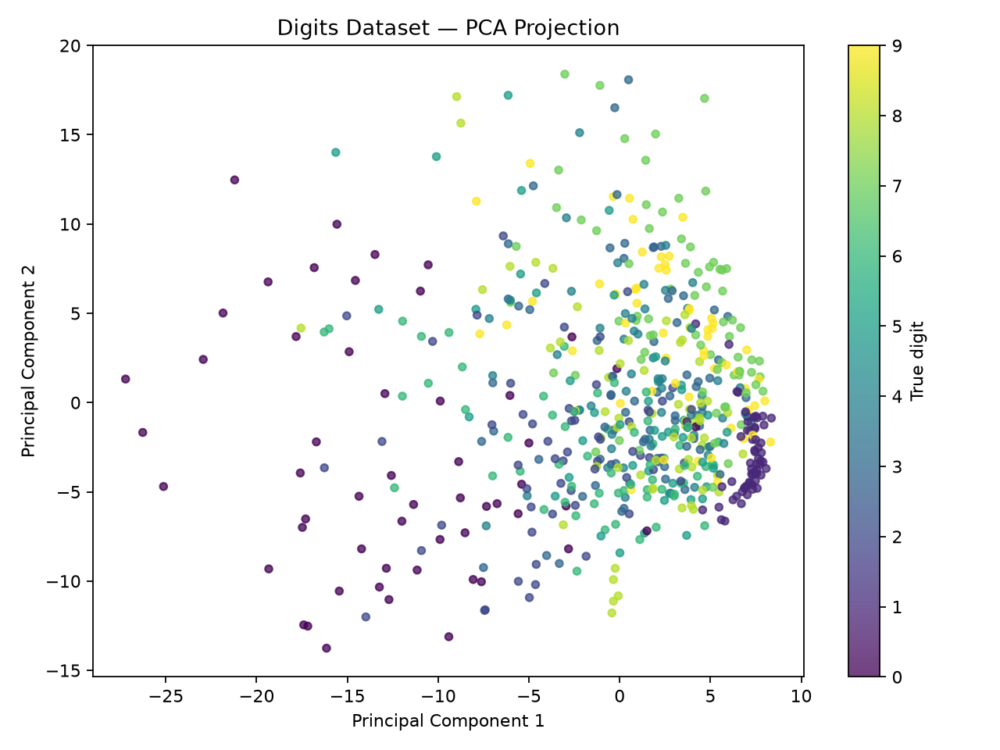
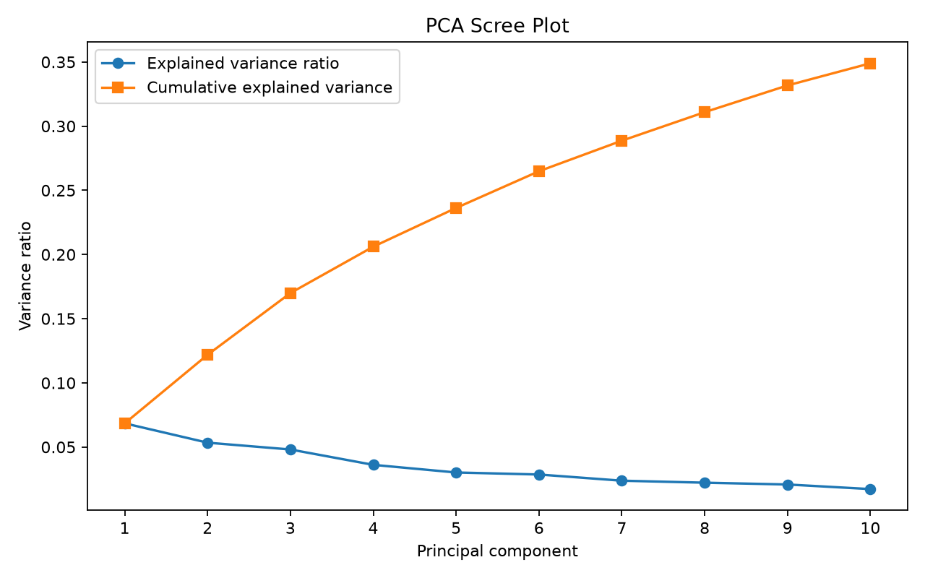
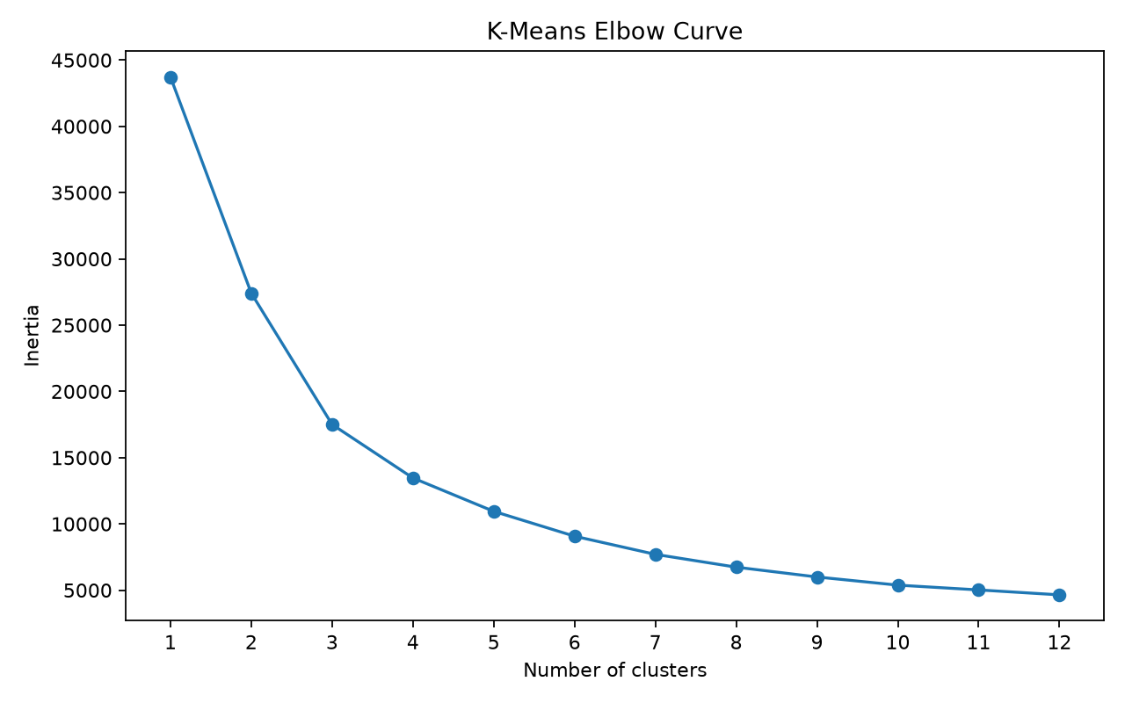
Data, preprocessing, and reproducibility
Pipeline
Local data files prepared by download scripts: WDBC, Adult, Covertype, MNIST 3-vs-8.
Train/test splits use fixed random_state and stratification.
Scaler is fitted on training data only to avoid leakage.
Raw dataset files are reproducible and should not be committed.
Dataset | Task | Size / features
WDBC | binary | 569 / 30
Adult | binary | 5,000 / 14
Covertype | multi/imb. | 5,000-10,000 / 54
MNIST 3-vs-8 | binary | 5,000 / 784
Ensemble Methods: Boosting vs Bagging
03

Slide 4
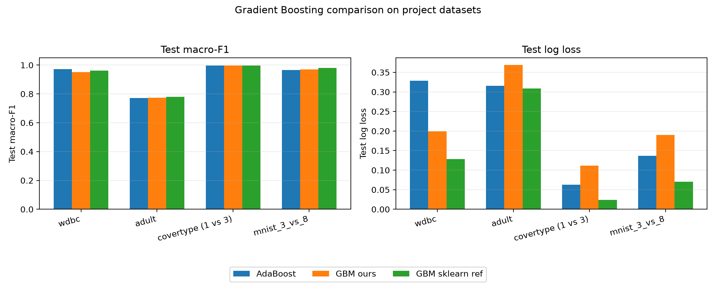
Repository architecture and work split
Implementation
trees/: CART Decision Tree, impurity, splitter, stopping logic.
boosting/: AdaBoost, SAMME/SAMME.R, Gradient Boosting bonus.
bagging/: RandomForestClassifier with OOB and multiprocessing.
unsupervised/: PCA, K-Means, DBSCAN.
experiments/: run_all, scaling, noise, CV, bias-variance, QA.
tests/: 151 passed, 1 skipped in latest local verification.
All main ML algorithms are implemented from scratch.
scikit-learn is used only for utilities, metrics, splitting, and references.
Deliverables include code, tests, report, slides, notebooks, figures, and contribution report.
Ensemble Methods: Boosting vs Bagging
04

Slide 5
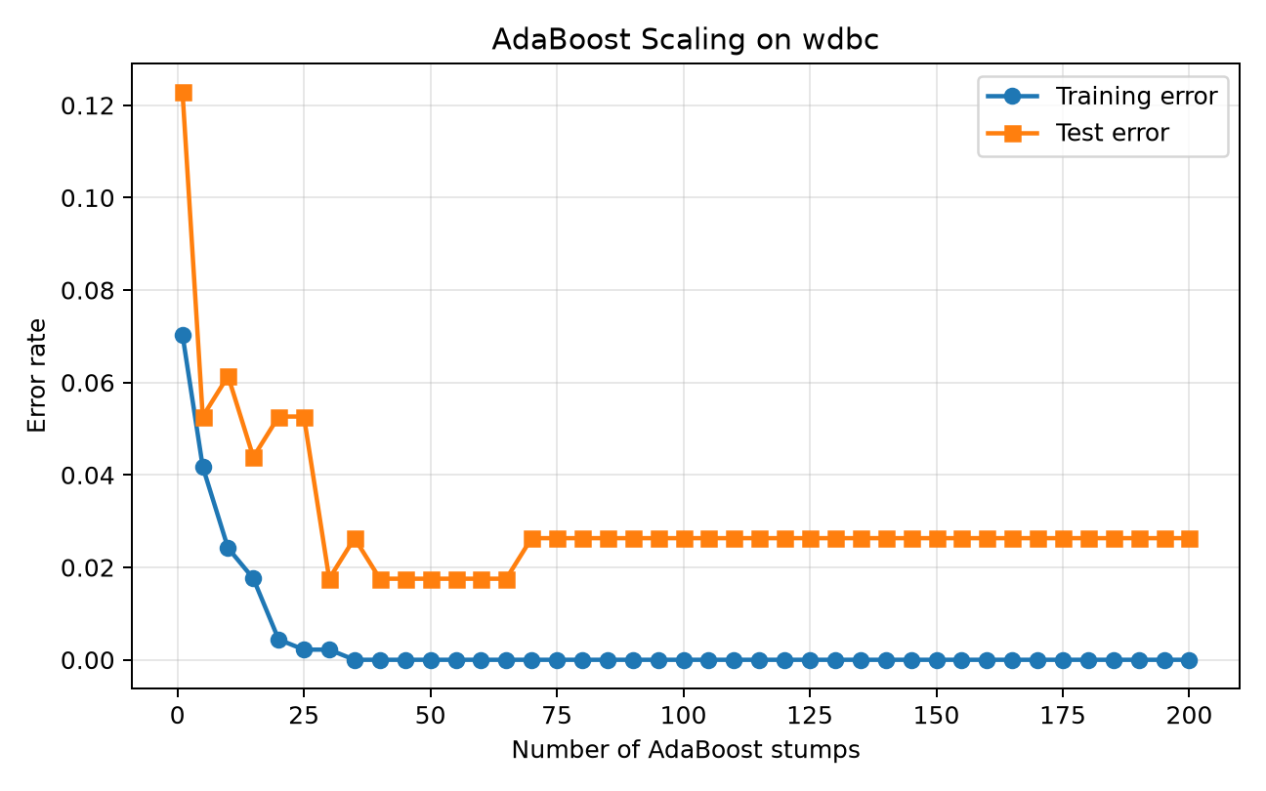
Decision Tree baseline validates the foundation
Decision Tree
CART-style binary split: x_j <= threshold.
Criteria: Gini and entropy.
Best split maximizes weighted impurity reduction.
Sample-weight support enables AdaBoost.
Model | Acc | Macro F1 | AUC
MyTree | 0.930 | 0.924 | 0.920
MyStump | 0.877 | 0.860 | 0.843
sklearn ref | 0.930 | 0.925 | 0.925
Ensemble Methods: Boosting vs Bagging
05

Slide 6
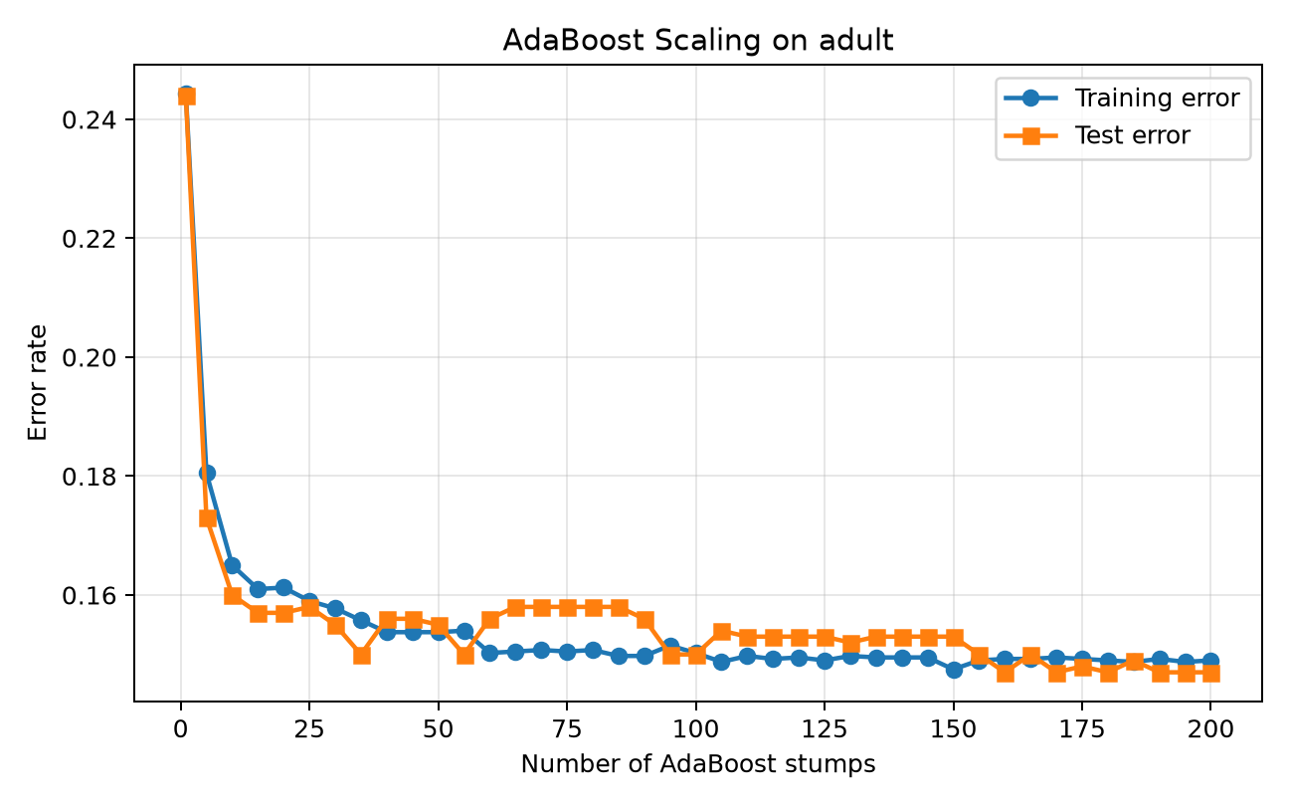
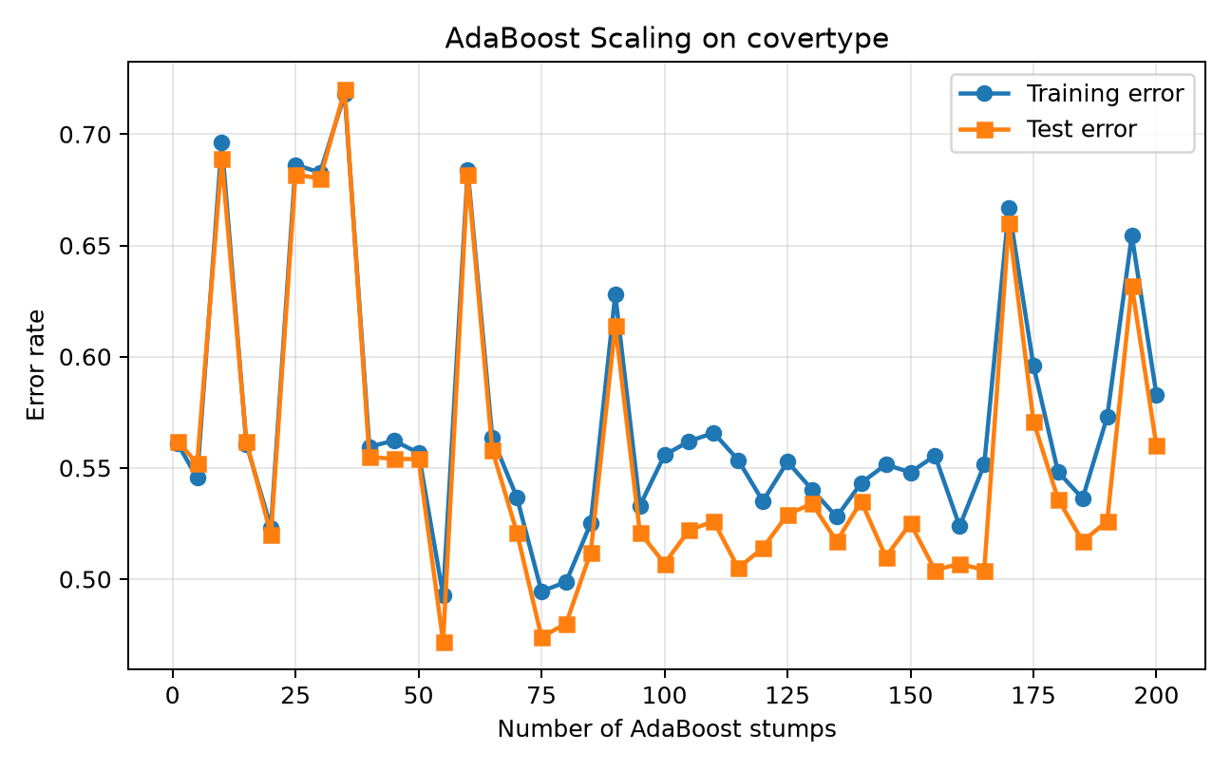
AdaBoost scaling: sequential error correction
Boosting
Decision stumps are weak learners.
Misclassified samples receive larger weights.
Estimator vote weight depends on weighted error.
Strength: clean structured data. Risk: noisy labels.
Ensemble Methods: Boosting vs Bagging
06

Slide 7
Person 3 focus: Random Forest internals
Random Forest
~63.2%
~36.8%
sqrt(p)
hard vote
unique in-bag rows
out-of-bag rows
features per node
predict()
Each tree is trained on a bootstrap sample with replacement.
Every node searches only a random subset of features to reduce tree correlation.
OOB score uses trees that did not see a sample during training.
Key QA edge case: a tree may miss a rare class; probabilities are aligned to global classes.
Implementation: private CART tree + RandomForestClassifier + process-based multiprocessing.Pool.
Ensemble Methods: Boosting vs Bagging
07

Slide 8
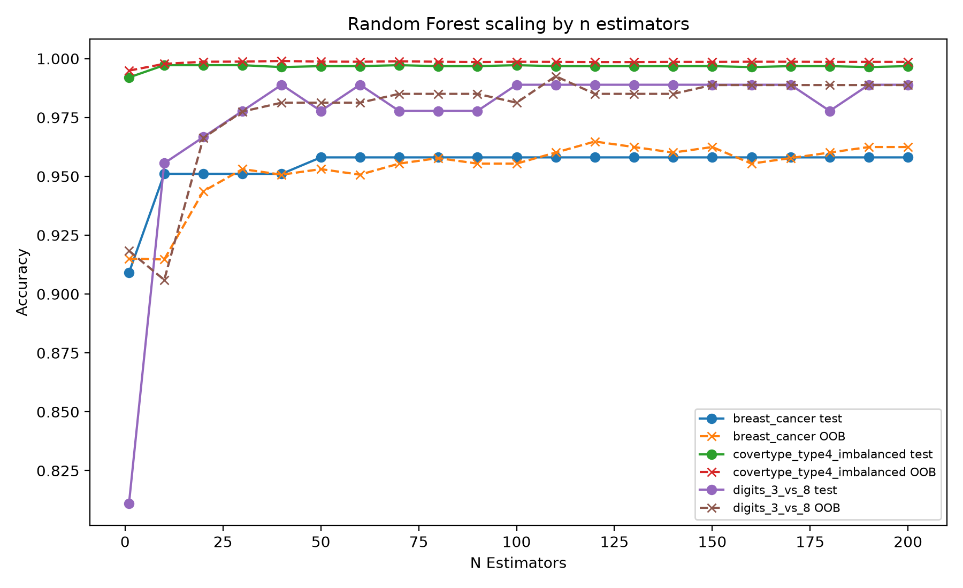
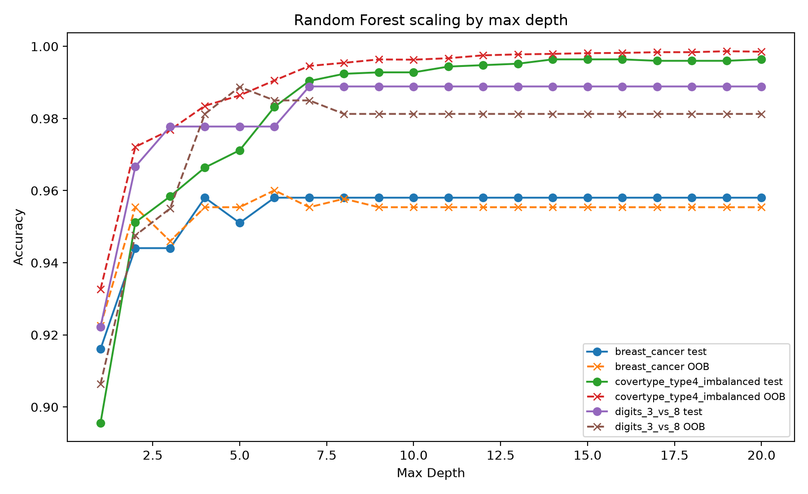
Random Forest scaling: estimators and depth
Random Forest results
Increasing trees stabilizes OOB/test curves; depth controls underfitting vs. individual-tree variance.
Ensemble Methods: Boosting vs Bagging
08

Slide 9
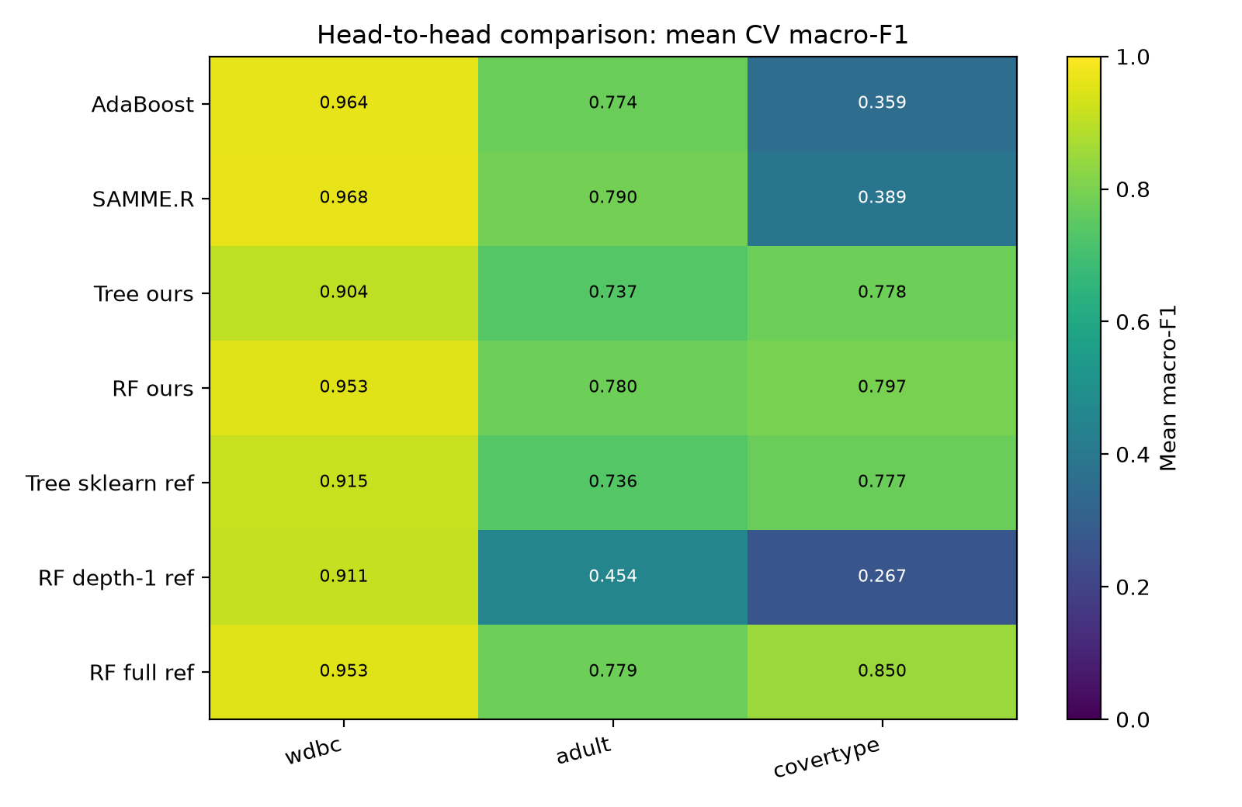
Head-to-head CV: fixed estimator resources
Comparison
Dataset | AdaBoost | RF
WDBC | 0.967 | 0.956
Adult | 0.848 | 0.849
Covertype | 0.483 | 0.829
WDBC: both models are strong.
Adult: close performance.
Covertype: Random Forest is clearly stronger.
Interpretation: bagging stabilizes heterogeneous tabular structure.
Ensemble Methods: Boosting vs Bagging
09

Slide 10
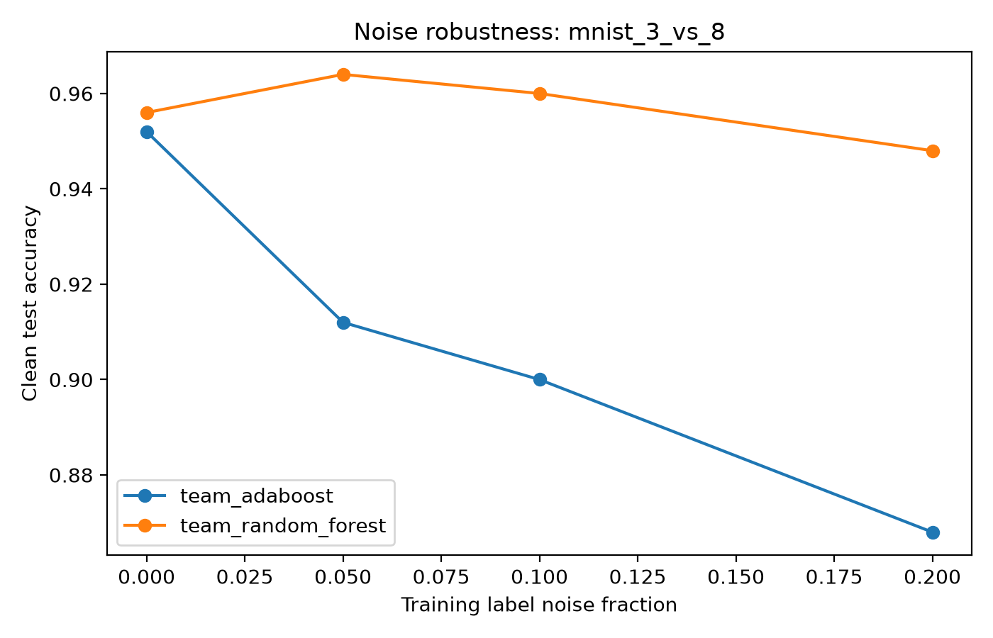
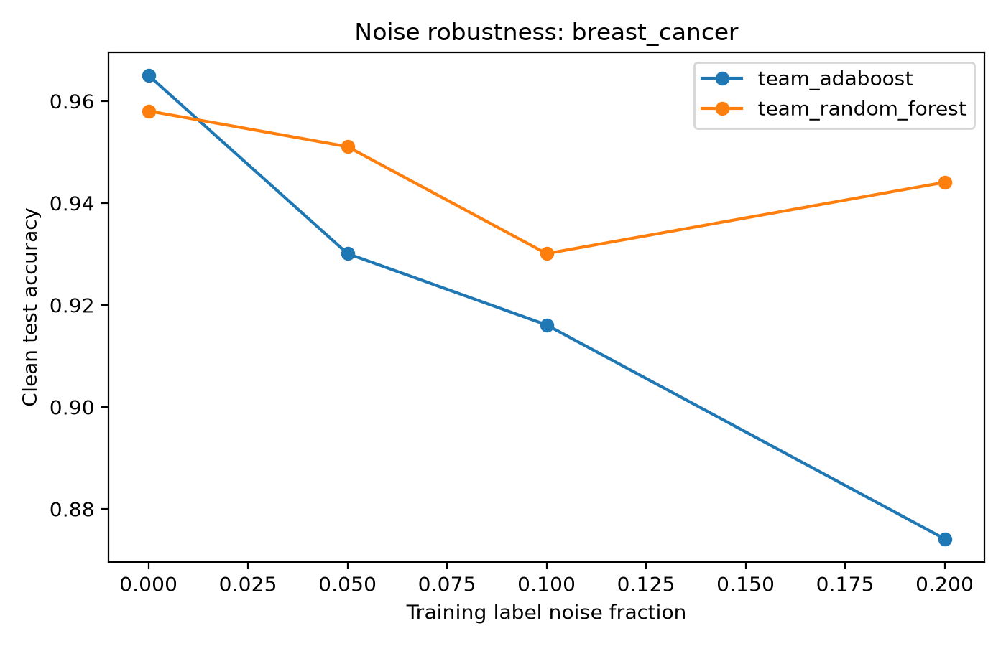
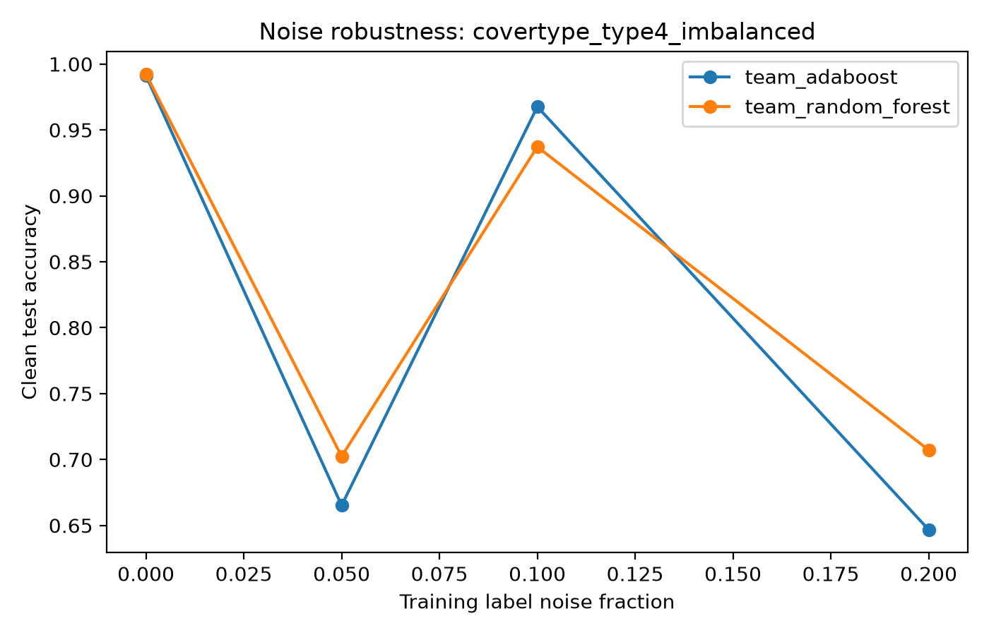
Noise robustness: clean test, corrupted training labels
Robustness
AdaBoost can up-weight mislabeled samples because it treats them as difficult examples.
Random Forest spreads noise across bootstrap trees and averages it out.
RF is more robust, not immune: extreme noise and severe imbalance still hurt.
Ensemble Methods: Boosting vs Bagging
10

Slide 11
Bias-variance decomposition supports the story
Theory ↔ results
Decision stump: high bias, low flexibility.
AdaBoost: reduces bias by correcting sequential errors.
Random Forest: reduces variance by averaging unstable trees.
Sklearn RF reference follows the same trend as our RF.
Ensemble Methods: Boosting vs Bagging
11

Slide 12
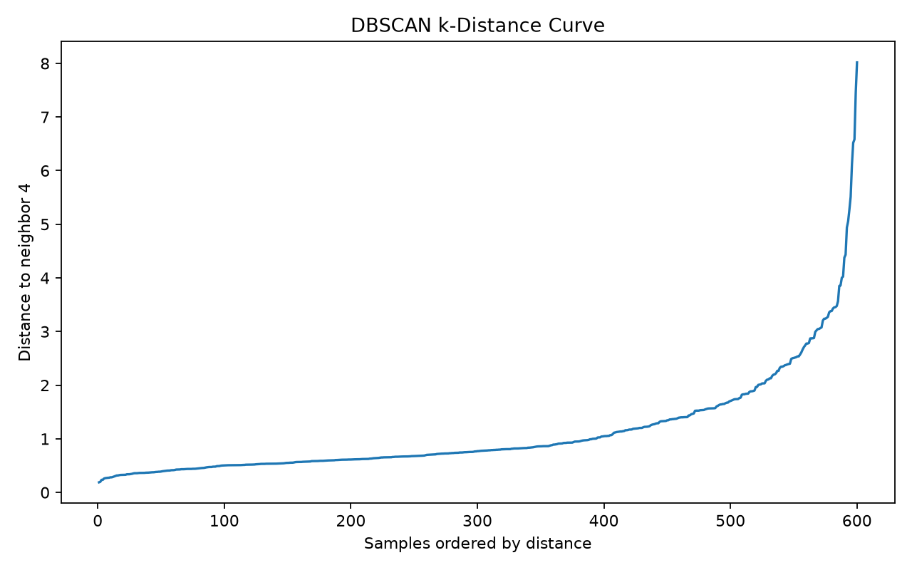
Unsupervised diagnostics: structure before classification
PCA · K-Means · DBSCAN
PCA shows only partial 2D separation.
K-Means elbow helps pick useful cluster counts.
DBSCAN detects density structure and noise, but is sensitive to eps in high dimensions.
Supervised models still need nonlinear boundaries.
Ensemble Methods: Boosting vs Bagging
12

Slide 13
QA and reproducibility
Testing
151
1
74%
60%
tests passed
skipped integration
Person 3 coverage
minimum required
RF tests: hard voting, probability sums, rare-class alignment, multiclass labels, OOB validation.
Experiment tests: utility loaders, noise injection, scaling smoke tests, coverage parsing.
Reproducibility: fixed seeds, local data files, root-level results/figures, run_all orchestration.
Data files are prepared by download scripts and should not be committed.
Ensemble Methods: Boosting vs Bagging
13

Slide 14
Defense readiness: what each member must defend
Contribution focus
İbrahim: Decision Tree, baseline, split logic.
Nihat: Random Forest, OOB, RF experiments, QA.
Fatma: AdaBoost, SAMME/SAMME.R, GBM bonus.
Fidan: PCA, K-Means, DBSCAN, visual diagnostics.
Everyone should derive AdaBoost weight update.
Everyone should explain bootstrap, OOB, Gini/entropy, and bias-variance.
Nihat should be ready for code-level RF questions: _fit_single_tree, predict_proba alignment, multiprocessing, and OOB.
Ensemble Methods: Boosting vs Bagging
14

Slide 15
Conclusion: choose the ensemble by data condition
Final message
AdaBoost
Random Forest
Unsupervised
Best when labels are clean and sequential error correction can lower bias.
Best when robustness, variance reduction, OOB monitoring, and parallel tree fitting matter.
Helps explain structure, dimensionality, clusterability, and why nonlinear supervised models are needed.
Final answer: Boosting lowers bias; bagging lowers variance. The winner depends on noise, imbalance, dimensionality, and stability.
Thank you
Ensemble Methods: Boosting vs Bagging
15

