Slide 1

Y WASTE – Food Waste Management & Redistribution System
Internship Project Presentation
Presented by:
Ananya Aggarwal
Shikha B.Tech CSE (AI & ML)
Dev Bhoomi Uttarakhand University

Slide 2

Introduction
Food waste is rising due to restaurants & events
Many people still face hunger daily
There is a need for an organized redistribution system
Y Waste aims to safely redirect surplus food to NGOs
Short intro about why this topic matters.

Slide 3
Problem Statement
No Unified Platform
NGO Challenges
Restaurant Issues
No unified digital platform for food donation
NGOs struggle to locate verified donors
Restaurants lack a system to manage leftover food
Environmental Impact
Coordination Gap
Unmanaged food waste harms the environment
Need for faster donor–NGO coordination

Slide 4
Objectives
Connect Donors & NGOs
Reduce Waste
Enable Communication
Build a platform connecting donors & NGOs
Reduce food waste & promote sustainability
Provide reliable communication tools
Ensure Safety
Scale Digitally
Ensure food tracking, safety, and verification
Create a scalable digital solution

Slide 5
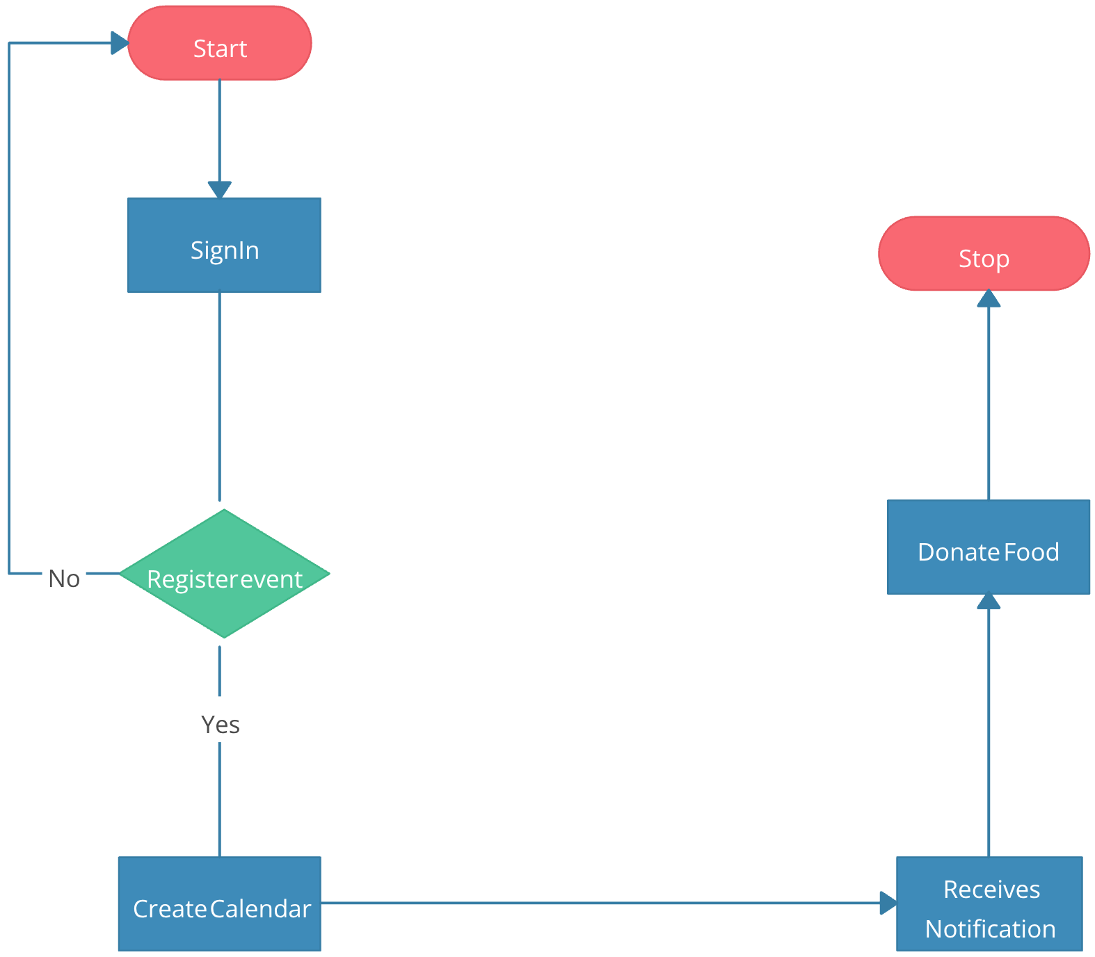
System Workflow
How the System Works
01
02
03
Donor Registration
NGO Notification
Donation Acceptance
Donor registers and lists surplus food
NGO receives notification
NGO accepts the donation
04
05
Pickup & Delivery
Completion Recording
Pickup & delivery arranged
Completion recorded in the system

Slide 6
Key Features
Donor & NGO Registration
Surplus Food Listing System
Real-time Notifications
Chat/Call Communication
Admin Monitoring Panel
Food Pickup Confirmation
Secure and Simple Interface

Slide 7
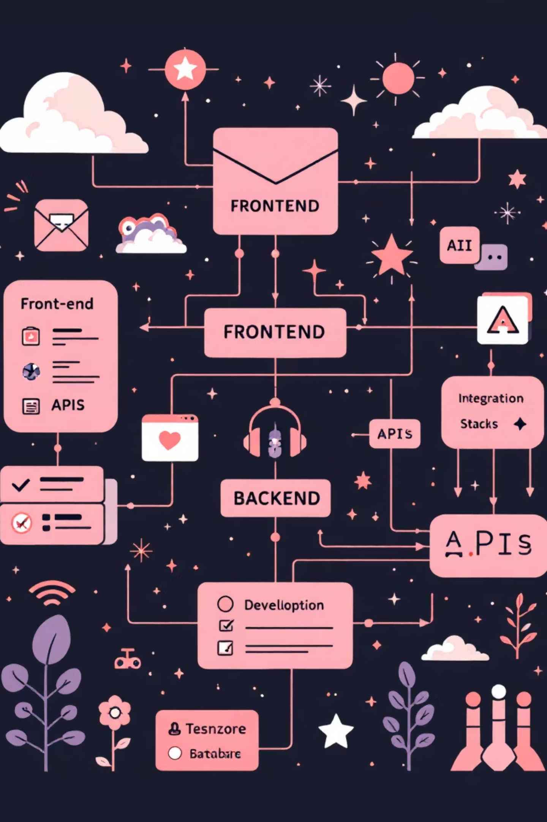
Technology Stack
Frontend
Backend
HTML
Firebase / PHP
CSS
JavaScript
Database
Tools & Additional
Firebase Realtime DB / SQL
Android Studio
VS Code
Authentication
Maps API
Validation

Slide 8
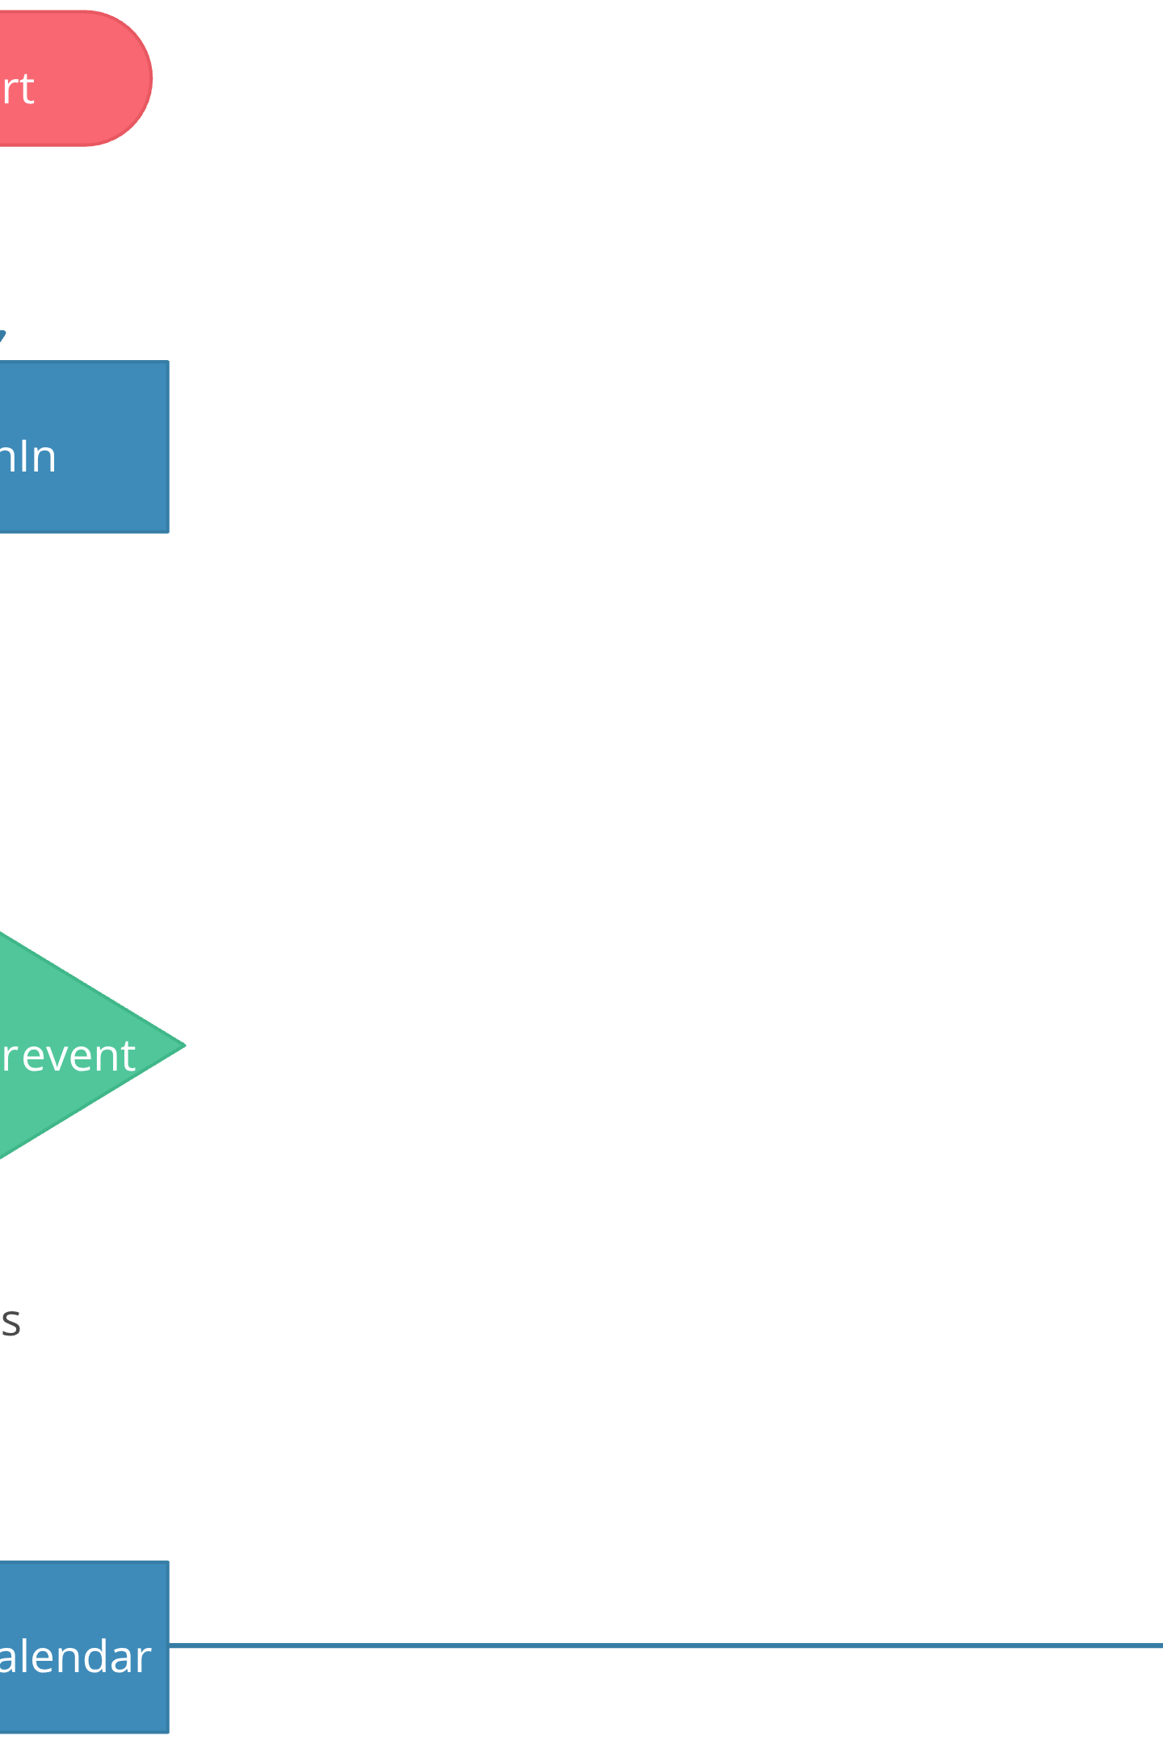
System Architecture
High-Level Architecture Diagram
The system follows a three-tier architecture connecting donors, the central platform, and NGOs through secure communication channels and real-time database synchronization.
Explain donor → system → NGO workflow using the diagram.

Slide 9

Internship Learnings & Outcomes
Learnings
Outcomes
Improved frontend & backend development
Built a functional food redistribution system
Understood Firebase authentication & real-time database
Reduced NGO–donor coordination time
Supported environmental sustainability
Enhanced debugging & testing skills
Improved awareness about food waste reduction
Learned professional teamwork & communication

Slide 10
Conclusion
Bridge the Gap
Enable Efficiency
Y Waste bridges the gap between surplus food & needy people
Enables efficient redistribution with a digital platform
Support SDG Goals
Foster Responsibility
Supports SDG goals: Zero Hunger & Responsible Consumption
Encourages social responsibility and community welfare
Presented by: Ananya Aggarwal & Shikha
Thank You!

