Slide 1
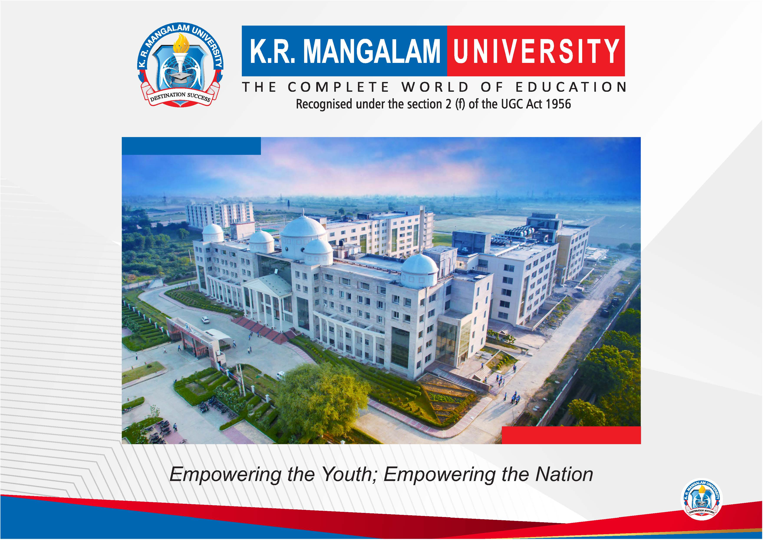

Slide 2


TECHTASTIC
Second Year Project Synopsis
Submitted by
ROLL | NAME
2301010145 | Shashwat Gupta
2301010144 | Arya Agrahari
2301010163 | Shriya jayaswal
Industry Mentor: Mr. Tanishq Gupta.
Faculty Mentor: Mr. Amit
Notes:
New Courses replaced with New Programmes

Slide 3

Project Overview
In today’s fast-paced business environment, keeping track of physical and digital assets can be a major challenge. Many organizations still rely on outdated manual systems, leading to misplaced equipment, inaccurate records, and unnecessary costs. Idoraa’s AI-powered asset management solution is designed to solve these issues by providing a smart, automated, and real-time tracking system.With the rise of remote and hybrid work models, businesses need an efficient way to monitor their assets across multiple locations. Idoraa’s cloud-based platform integrates AI, IoT sensors, and predictive analytics to ensure assets are always accounted for, reducing losses and improving productivity.
Notes:
New Courses replaced with New Programmes

Slide 4
About the Problem
Outdated, Manual Tracking Systems: Many organizations still rely on outdated asset management methods, leading to misplacement, outdated records, security risks, and financial losses.
Lack of Real-Time Tracking: Without real-time asset monitoring, businesses struggle to manage assets across multiple locations, resulting in operational inefficiencies.
Error-Prone and Time-Consuming Processes: The absence of automation makes asset tracking prone to errors, consuming significant time and resources, and impacting overall productivity.
Compliance Challenges: Inaccurate records make audits difficult and increase the risk of compliance issues, creating barriers to smooth operations.
Unforeseen Downtimes Due to Equipment Failures: Without predictive maintenance, unexpected equipment breakdowns can lead to costly downtimes, affecting business continuity.
Need for Advanced Asset Management Solutions: Existing solutions using barcodes or basic software lack real-time visibility, predictive analytics, and seamless integration—highlighting the need for modern, AI-powered, IoT-based platforms like Idoraa’s.
Notes:
New Courses replaced with New Programmes

Slide 5
Problem Statement
Defining the problem
• Inefficient Asset Visibility: Without real-time tracking, businesses struggle to gain accurate insights into asset locations and status, leading to operational inefficiencies.
• Manual Errors and Data Inaccuracies: Traditional asset management methods like spreadsheets and paper logs are prone to human errors, resulting in discrepancies and unreliable records.
• Vulnerabilities to Theft and Misuse: Poor asset tracking increases the risk of unauthorized movements and theft, leading to financial losses and security concerns.
• Limited Predictive Maintenance: Without automated systems, businesses cannot anticipate equipment failures, causing unplanned downtimes and higher repair costs.
• Difficulty in Compliance and Auditing: Inaccurate records make it challenging to meet compliance standards and prepare for audits, increasing legal and financial risks.
Notes:
New Courses replaced with New Programmes

Slide 6
Problem Statement
Expected Impact of Solving the Problem
•Increased efficiency through AI-powered automation.
•Reduced losses with real-time tracking and security alerts.
•Optimized maintenance using predictive analytics.
• Improved Compliance and Audit Readiness: With accurate, automated records, businesses can easily track assets and ensure they meet regulatory requirements, simplifying the audit process.
• Enhanced Decision-Making: Real-time insights and data-driven analytics empower organizations to make informed decisions, leading to better resource allocation and strategic planning.
Notes:
New Courses replaced with New Programmes

Slide 7
Objectives
To develop an intelligent asset management system that improves tracking, reduces losses, and enhances efficiency using AI and automation.
Specific Objectives
•Ensure real-time tracking and monitoring of assets.
•Reduce errors and losses by automating asset management.
•Improve maintenance planning with predictive analytics.
Notes:
New Courses replaced with New Programmes

Slide 8
Methodology, Tools, and Techniques
To solve the challenges of asset management, an AI-driven, cloud-based system is developed using automation, real-time tracking, and predictive analytics. The approach ensures efficiency, security, and seamless integration with enterprise systems.
Approach Taken
•AI-powered tracking – Machine learning models monitor asset movements and detect anomalies.
•IoT-based sensors – RFID technology provide real-time location tracking.
•Cloud-based platform – Centralized dashboard enables remote access and instant updates.
Tools and Software Used
•Programming Language: Python
•Cloud Infrastructure: AWS
•Database Management: MySQL
•AI & Machine Learning: TensorFlow.
Notes:
New Courses replaced with New Programmes

Slide 9
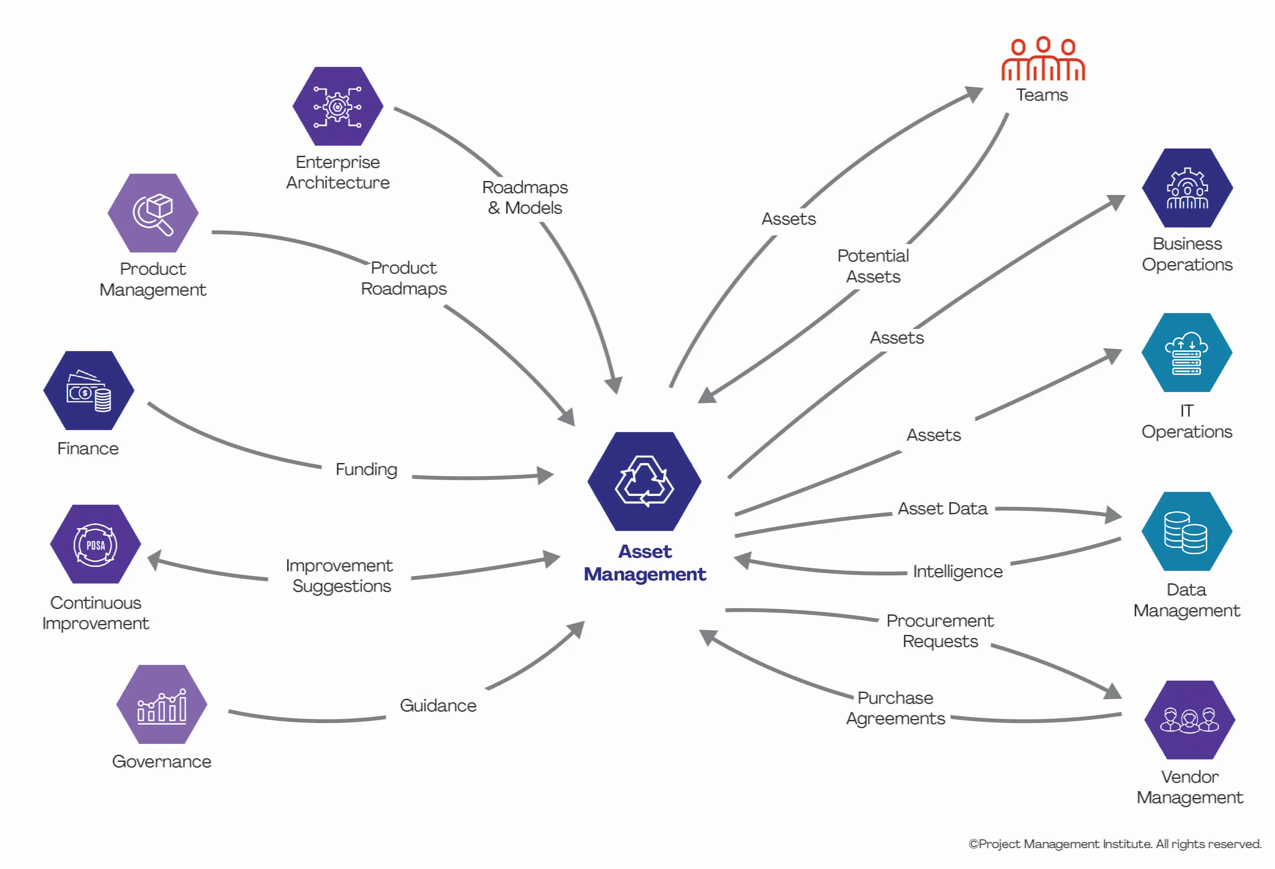
Methodology Flowchart
Notes:
New Courses replaced with New Programmes

Slide 10
Usage
Industries:
Manufacturing, Healthcare, IT, Transportation, Facilities Management, and more
Usage Scenarios:
Streamlined asset management operations
Optimized asset utilization
Compliance with regulatory requirements
Downtime reduction through maintenance scheduling
Efficient auditing and scrap management
Notes:
New Courses replaced with New Programmes

Slide 11
Technical inputs and Outputs
Technical Capabilities:
Centralized Repository for asset information
Asset Tracking and Maintenance Scheduling
Inventory Management and Reporting
Store, Aisle, Shelf, and Box Mapping
Modules:
Purchase, Storage, Asset Management, Audit
Workflow Automations:
Vendor Management
Purchase Order Generation
Asset Receiving & Storage Management
Assigning Assets to Employees
Scrapping Mechanism
Notes:
New Courses replaced with New Programmes

Slide 12
Results & Conclusion
Results:
Enhanced asset lifecycle visibility
Improved operational efficiency
Reduced losses through timely audits and maintenance
Cost optimization by managing end-of-life assets through scrapping
Conclusion:
I-AMS offers a complete solution to manage assets from procurement to disposal.
It is adaptable across multiple industries, ensuring better asset governance and business growth.
Notes:
New Courses replaced with New Programmes

Slide 13
THANK YOU

