Slide 1
Towards Smarter Customer Retention: A Machine Learning Approach to ISP Churn Prediction in Kenya.
Group 2 Capstone Project-Moringa School-Phase 5
Presented by:
1.Mary Asunta
2.Brian Mburu
3.Susan Maina
4.Jerome Juma
5.Kabira Timothy

Slide 2
Introduction
Customer churn is a critical challenge for Internet Service Providers (ISPs). In Kenya’s fast-growing and competitive ISP market, customers can easily switch providers due to price sensitivity, service quality, or customer support. High churn not only reduces revenue but also undermines long-term investments in costly network infrastructure.
Retaining existing customers is far more cost-effective than acquiring new ones. Studies in telecommunications show that effective churn prediction and retention strategies can save up to five times the cost of bringing in new subscribers. For ISPs, this makes churn management a strategic necessity rather than just a technical issue.

Slide 3
Introduction… cont…
Machine learning provides a powerful solution. By analyzing customer behavior, demographics, and feedback, predictive models can identify customers at risk of leaving before they churn. This enables ISPs to implement proactive and targeted interventions, strengthening customer loyalty and supporting broader goals of digital inclusion and sustainable economic growth in Kenya.

Slide 4
Business problem
High churn erodes revenue and undermines customer lifetime value for Kenyan ISPs.
Retention is cheaper than acquisition, but predicting churn remains a major challenge.
Key churn drivers include poor service quality, high prices, weak customer support, and changing usage patterns.
Need: A predictive model to flag high-risk customers early and explain why they churn.
Impact: Lower churn, stronger loyalty, and competitive advantage in a crowded market.

Slide 5
Project Objective
Develop a supervised ML model to predict customer churn risk for Internet Service Providers using behavioral, transactional, and feedback data.
Enable proactive retention strategies by identifying customers at high risk of churning.
Analyze churn patterns to determine which customer segments exhibit the highest churn rates.
Identify key predictors of churn across behavioral and demographic variables.

Slide 6
Project Objectives…. Cont.…
Evaluate loyalty strategies and their effectiveness in retaining customers.
Provide actionable insights to design practical retention strategies targeting high-risk profiles.
Incorporate sentiment analysis from customer feedback to improve prediction accuracy.

Slide 7
Data source
The dataset for this project is sourced from Hugging Face’s Customer Churn Dataset, which contains 36,992 customer records with 23 features in CSV format. It combines both structured and unstructured data, covering customer demographics such as age, gender, and region, subscription details like membership category and internet option, as well as behavioral indicators including average time spent and days since last login. In addition, it includes customer interactions such as complaints, feedback, and churn risk scores. This rich blend of attributes provides a strong foundation for applying both classical machine learning models.

Slide 8
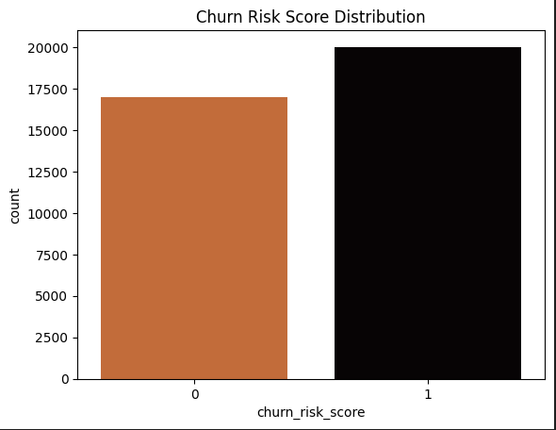
Data Understanding(target distribution)

Slide 9
Data Understanding(target distribution)…cont…
The analysis of the churn risk distribution shows that customers in category 1, representing those at risk of leaving, slightly outnumber those in category 0, who are not at risk. This finding implies that more customers are vulnerable to churning than those likely to remain loyal. From a business perspective, this highlights the urgency of implementing proactive churn management strategies, as the potential revenue loss from at-risk customers could be significant. Prioritizing retention efforts toward category 1 customers is therefore critical to sustaining profitability and strengthening customer loyalty.

Slide 10
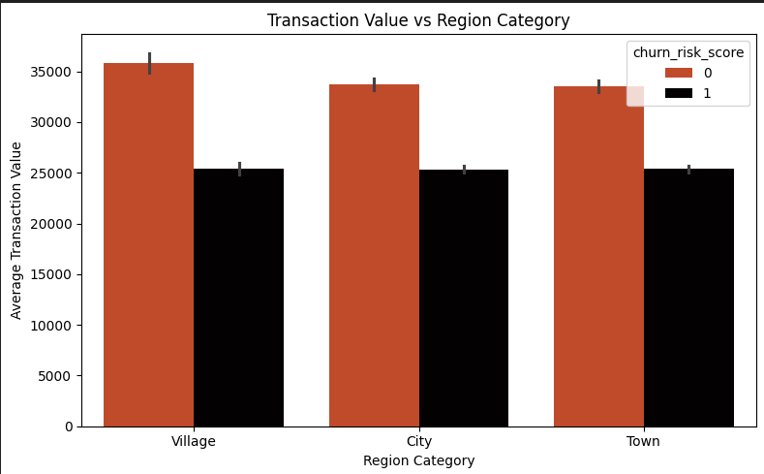
Data Understanding(Transaction Value vs Region Category)

Slide 11
Data Understanding(Transaction Value vs Region Category)…cont…
The analysis reveals that customers from the village demographic record the highest average transaction value, followed by those in the city, with town-based customers ranking lowest. This suggests that rural customers may represent a more valuable segment in terms of spending behavior, potentially offering ISPs an opportunity to tailor premium packages or targeted retention strategies for this group, while also exploring ways to boost engagement among city and town customers.

Slide 12
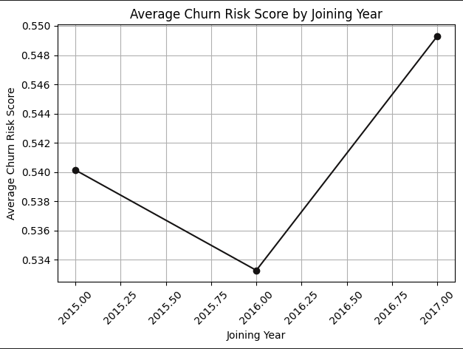
Data Understanding(Average Churn Risk score byjoining year)

Slide 13
Data Understanding(Average Churn Risk score byjoining year)
The churn risk score shows a decline in 2015, followed by a rise in 2017. However, there is no consistent upward or downward trend over the years, suggesting that the year of customer acquisition does not play a significant role in determining churn likelihood. This indicates that churn risk may be influenced more by other variables such as customer behavior, service quality, or demographic factors rather than the year of joining. Further analysis focusing on months, seasons, or other time-based patterns could provide deeper insights into whether churn risk is affected by shorter-term temporal factors.

Slide 14
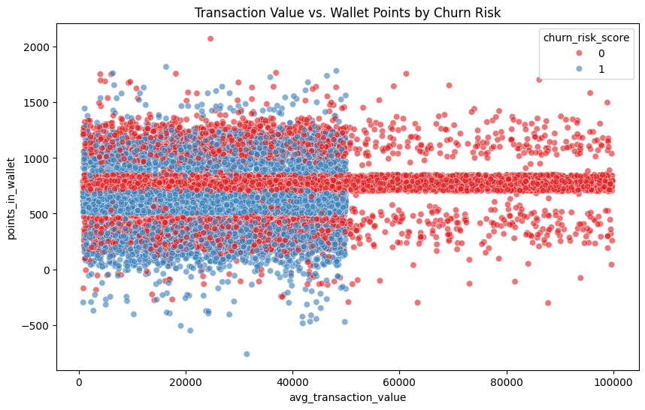
Data Understanding(Transaction Value vs Wallet points by Churn Risk)

Slide 15
Data Understanding(Transaction Value vs Wallet points by Churn Risk)
Transaction values range widely, but most customers cluster around 500 to 1,000 wallet points. Low-risk customers are concentrated at these thresholds, likely due to loyalty milestones, while high-risk customers are more dispersed. This suggests that encouraging structured wallet point accumulation could help reduce churn.

Slide 16
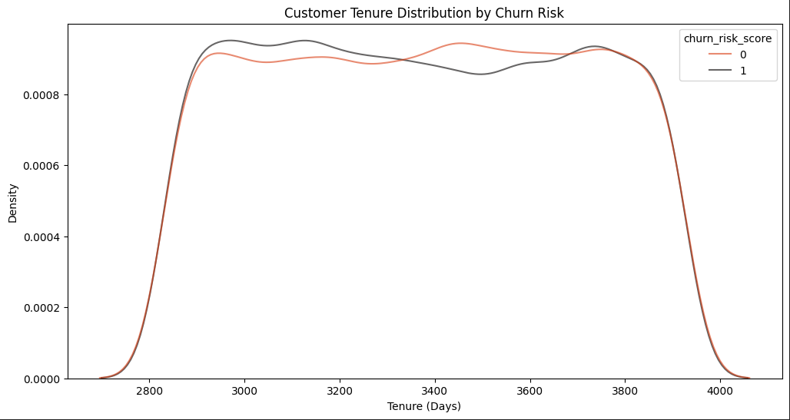
Data Understanding(Customer Tenure Distribution By Churn Risk)

Slide 17
Data Understanding(Customer Tenure Distribution By Churn Risk)
The KDE plot indicates that high churn-risk customers are concentrated between 2,800 and 3,000 days of tenure, while low-risk customers are more widely distributed. This shows that although longer tenure often signals loyalty, a subset of long-tenured customers still faces elevated churn risk. The overlap around 3,000–3,200 days suggests that tenure alone is not a reliable predictor of churn, highlighting the importance of combining it with behavioral factors such as complaints for more accurate predictions.

Slide 18
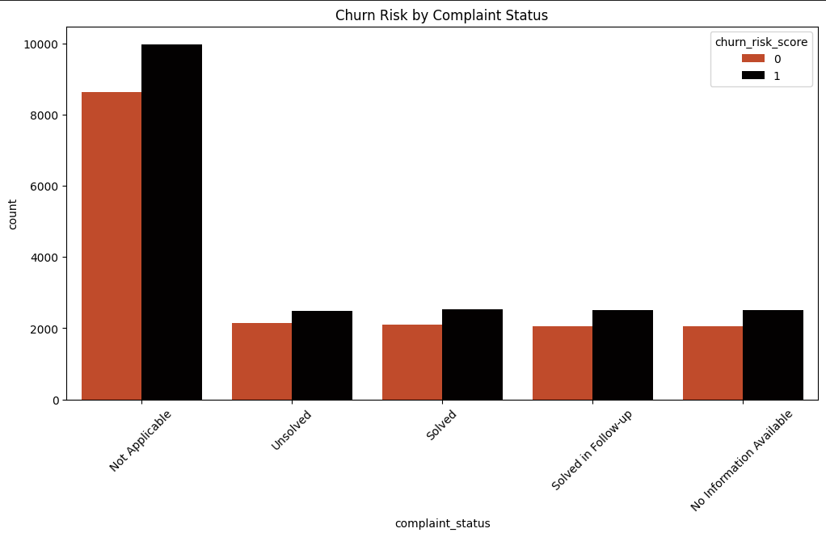
Data Understanding(Churn risk by complaint status)

Slide 19
Data Understanding(Churn risk by complaint status)
Most customers fall under the "Not Applicable" complaint status, suggesting they did not raise any complaints, yet even in this group, churn-risk customers outnumber those not at risk. Across all other complaint categories—whether "Unsolved," "Solved," "Solved in Follow-up," or "No Information Available"—the number of churn-risk customers is consistently higher. This indicates that the very presence of a complaint, regardless of resolution status, is strongly linked to higher churn risk. The fact that churn remains elevated even when complaints are marked as solved suggests potential gaps in customer satisfaction or follow-up effectiveness.

Slide 20
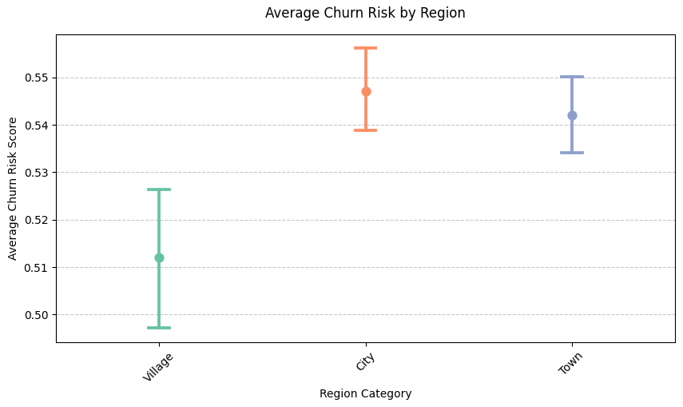
Data Understanding(Average Churn Risk By Region)

Slide 21
Data Understanding(Average Churn Risk By Region)
Customers in city regions exhibit the highest average churn risk, followed by those in towns, while villages report the lowest. The narrow confidence intervals suggest these differences are statistically significant, especially between city and village customers. This pattern indicates that urban customers are more prone to churn, likely due to higher service expectations and greater availability of alternatives. These insights highlight the importance of developing location-based retention strategies that address the unique needs of different customer groups.

Slide 22
Data Analysis-Machine Learning findings.
Ensemble models (Random Forest, XGBoost, LightGBM) outperformed others, achieving ~93% accuracy and ROC-AUC >0.97. LightGBM showed the best overall balance. Logistic Regression was decent but weaker on recall, while the MLP Neural Net underperformed.

Slide 23
Key Findings – ISP Churn Prediction
Churn Patterns: Basic members churn most (27%) vs. Gold (8%), and urban customers are 1.6x more likely to churn.
Complaints Matter: Customers with complaints—solved or not—remain twice as likely to churn, revealing gaps in satisfaction.
Engagement Signals: Wallet points strongly reduce churn (correlation = –0.47), but high-risk customers are less aligned with loyalty milestones.
Tenure Effect: Long tenure usually implies loyalty, yet a subset of 2,800–3,000 days shows high churn, proving tenure alone is insufficient.
Model Results: Ensemble models (Random Forest, XGBoost, LightGBM) outperformed others, achieving recall >85% and ROC-AUC ≈0.97.

Slide 24
What the Model Does.
Model Performance – Churn Prediction
What the model does: Predicts whether a customer is likely to churn or stay based on their behavior and profile data.
Evaluation metrics used: Accuracy, Precision, Recall, F1 Score, ROC-AUC.
Key findings:
Logistic Regression performed reasonably well but less than advanced models.
Random Forest, XGBoost, and LightGBM achieved the best results with high accuracy and balanced precision/recall.
Neural Network underperformed, showing lower recall despite high precision.
Best models: Tree-based ensembles (Random Forest, XGBoost, LightGBM) are most effective for churn prediction.

Slide 25
Uses of Key Findings
Targeted Retention: Focus loyalty offers and upgrades on high-risk customer groups (e.g., Basic and urban segments).
Complaint Management: Use complaint data to trigger early intervention and improve post-resolution follow-up.
Engagement Boost: Design gamified loyalty programs and reward thresholds to strengthen wallet-point participation.
Geo-Marketing: Allocate marketing budgets strategically toward cities and towns with the highest churn risk.
Predictive Alerts: Deploy the churn model to flag at-risk customers (churn probability > 0.65) for personalized outreach.
Continuous Improvement: Monitor churn trends and retrain models quarterly for adaptive, data-driven decision-making.

Slide 26
Recommendations
1. Strengthen Retention Programs: Offer loyalty incentives that motivate Basic members to upgrade early.
2. Improve Complaint Handling: Set up a dedicated team to resolve issues quickly and personally.
3. Boost Wallet Engagement: Gamify rewards with streaks, points, and milestone bonuses.
4. Target Urban Customers: Run tailored retention campaigns in high-churn city areas.
5. Use Early-Warning Triggers: Send retention offers when churn probability exceeds 0.65.
6. Keep Models Updated: Retrain models regularly to reflect changing customer behavior.

