Slide 1
Improving Lecture Engagement
with Automatic Chapter Indexing
Samiksha Aveg
SID: 510574673
Bachelor of Engineering (Software) — Honours
Specialisation: Computer Engineering
Supervisor: Dr. Nicholas Tse
USYD | 2026
1 / 13

Slide 2
MOTIVATION
Why Automatic Chapter Indexing?
The TikTok Effect: Short-form video (TikTok, Reels, Shorts) has reshaped how students consume content — average attention spans dropped from 12s to 8s[Microsoft, 2015].
8s
~50%
43%
30%
avg attention span
(down from 12s)
median engagement for
9-12 min videos
of students use lectures
in targeted sections
lower retention linked
to heavy short-video use
Key Challenges
Manual chapter creation is labour-intensive and inconsistent across instructors
Students conditioned to 15-60s content struggle with 2-hour lectures
Text-only segmentation ignores visual slide transitions
Fixed-length windows produce arbitrary, incoherent breaks
Existing tools lack multi-modal awareness
USYD | School of Computer and Electrical Engineering
2 / 13

Slide 3
OBJECTIVES
Research Objectives
1
Pre-process Lecture Video
Extract audio via FFmpeg, transcribe with Whisper ASR (large-v3-turbo), produce word-level timestamped transcripts
2
Multi-Modal Boundary Detection
Fuse textual and visual modalities: fixed tumbling-window baseline vs. sliding-window cosine-distance visual segmentation
3
LLM Chapter Labelling
Generate descriptive chapter titles and summaries using Qwen2.5-1.5B-Instruct with zero-shot JSON prompting
4
Interactive Web Interface
Locally-run Python Flask player with chapter timeline, keyboard navigation, and chapter search
USYD | School of Computer and Electrical Engineering
3 / 13

Slide 4
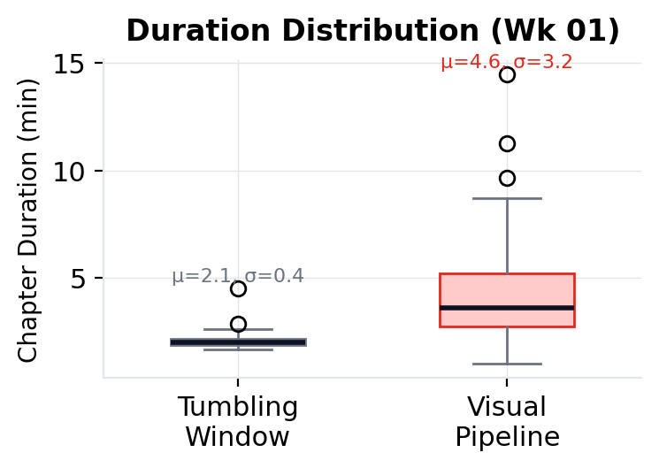
PIPELINE
Base Pipeline (Text-First)
Audio Extraction
(FFmpeg)
Whisper ASR
(word-level timestamps)
Tumbling Window
(~300 words fixed chunks)
ResNet-18
(every 15s, 512-dim)
Transcript Slicing + SBERT Embeddings
(all-Mini-L6-v2, 384-dim)
Qwen-2.5-1.5B-Instruct
Chapter Labelling (JSON)
→
→
→
→
→
Limitations Identified
Short chapters with boundaries splitting mid-sentence
Uniform 300-word window ignores visual cues entirely
All chapters similar length (mean ~2 min) regardless of content complexity
Produces 40–58 chapters per 2-hour lecture — too granular for navigation
This motivates the Visual-focused pipeline where boundaries are driven by visual content changes.
USYD | School of Computer and Electrical Engineering
4 / 13

Slide 5
MAIN PIPELINE
Visual-Based Pipeline (Proposed)
FFmpeg
Audio Extraction
Whisper ASR
(word-level timestamps)
→
ResNet-18
(every 15s, 512-dim)
→
Sliding Window
(W=60s, S=5s) &
cosine distance peaks
→
Transcript Slicing + SBERT
(at visual breakpoints, 384-dim)
→
Qwen2.5-1.5B-Instruct
Chapter Labelling (JSON)
→
NEW: Sliding Window replaced Tumbling Window
Content-Driven
Variable Length
Multi-Modal
Boundaries emerge from visual discontinuities, not arbitrary word counts
Chapters adapt to actual topic duration (7–20 min vs uniform 2 min)
Visual cues lead; transcript sliced at detected breakpoints for semantic fusion
USYD | School of Computer and Electrical Engineering
5 / 13

Slide 6
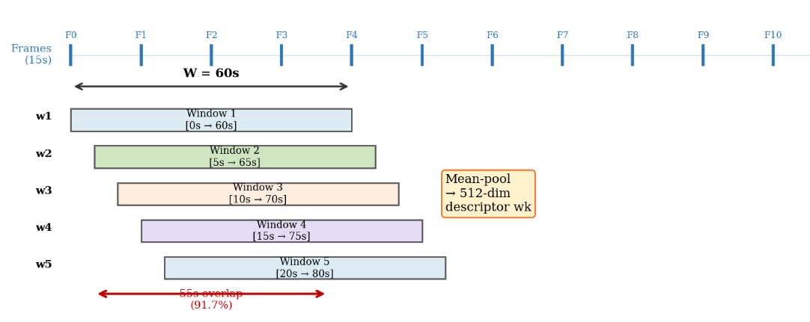
ALGORITHM
Sliding Window Cosine-Distance Segmentation
1
Frame Sampling
Implementation Parameters
Extract frames every 15 seconds via OpenCV
2
Feature Extraction
FRAME_SAMPLE_RATE
15 s
ResNet-18 (fc removed) → 512-dim vector per frame
W_VIS (window width)
60 s
cosine dist-1
Sliding Window
S_VIS (window step)
5 s
3
cosine dist-2
W = 60s, S = 5s, 91.7% overlap; mean-pool features per window
SMOOTH_SIGMA
2.0
PEAK_PROMINENCE
0.01
4
Cosine Distance
Compute 1 − cos(wᵢ, wᵢ₊₁) between consecutive windows
PEAK_MIN_DIST_S
60 s
MIN_CHAPTER_WORDS
60
5
Peak Detection
SBERT_MODEL
all-MiniLM-L6-v2
Gaussian smooth (σ = 2.0), prominence ≥ 0.01, min gap = 60s
6
Boundary Output
Peak timestamps become chapter boundaries
USYD | School of Computer and Electrical Engineering
6 / 13

Slide 7
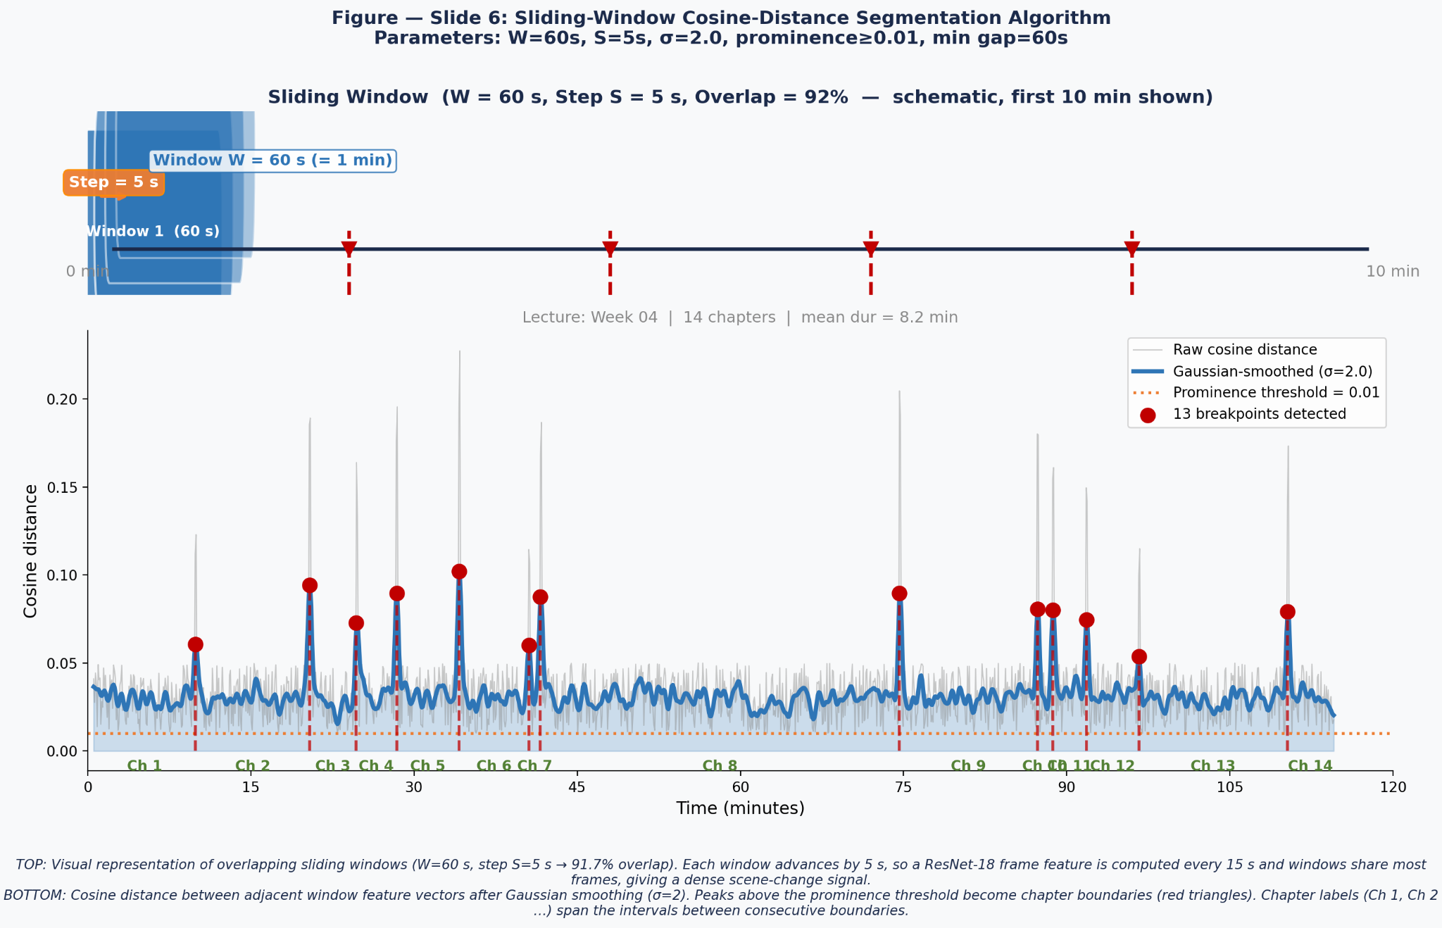
ALGORITHM

Slide 8
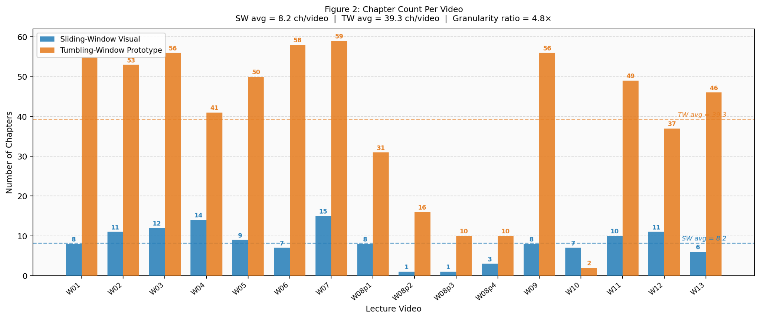
COMPARISON
Text-First vs Visual-First: Boundary Quality
USYD | School of Computer and Electrical Engineering
7 / 13

Slide 9
FEATURES
Multi-Modal Features and LLM Labelling
Input Features
Qwen2.5-1.5B-Instruct [5]
SBERT all-MiniLM-L6-v2 → 384-dim text embeddings
ResNet-18 (ImageNet) → 512-dim visual features
Combined: 896-dim multi-modal feature vector
KeyBERT keyword extraction per chapter
Time range, duration, word count metadata
Zero-shot JSON generation
Temperature = 0.1 (near-deterministic)
5–8 word descriptive chapter titles
1–2 sentence technical summaries
Regex JSON extraction + 3-retry loop
Key/skip binary classification per chapter
LLM Prompt Template:
Generate a chapter summary JSON for this lecture segment.
Time Range: {start_time} to {end_time} | Duration: {dur}s | Word Count: {word_count}
Requirements: chapter (5-8 word title), description (1-2 sentence summary, <50 words)
Output ONLY valid JSON. No markdown. No explanation.
USYD | School of Computer and Electrical Engineering
8 / 13

Slide 10
INTERFACE
Flask Web Interface
HTML5 Video Player
SVG chapter timeline with colour-coded segments
(key = green accent, skip = dimmed)
Background Processing
Non-blocking 6-step pipeline via Python threading;
real-time progress logs
Keyboard Navigation
Arrow keys for chapter-to-chapter jumping;
search bar for keyword lookup
Video Library
Drag-and-drop upload; previously processed lectures auto-detected
Built with Flask, Jinja2 templating, vanilla JS frontend with dark/light theme toggle.
USYD | School of Computer and Electrical Engineering
9 / 13

Slide 11
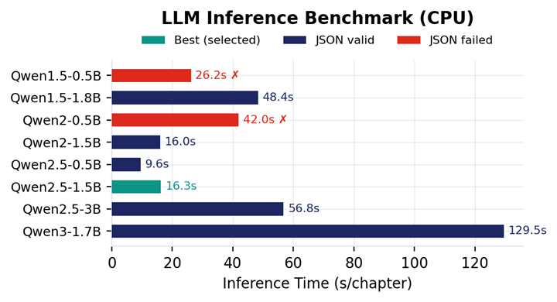
RESULTS
Key Results: LLM Model Comparison
Model | Params | JSON Valid | tok/s | RAM (MB)
Qwen1.5-0.5B | 0.5B | ✗ | 1.6 | 2,471
Qwen1.5-1.8B | 1.8B | ✓ | 2.3 | 3,261
Qwen2-0.5B | 0.5B | ✗ | 3.8 | —
Qwen2-1.5B | 1.5B | ✓ | 2.3 | 3,743
Qwen2.5-0.5B | 0.5B | ✓ | 6.6 | 182
Qwen2.5-1.5B | 1.5B | ✓ | 2.2 | 155
Qwen2.5-3B | 3.0B | ✓ | 0.6 | 766
Qwen3-1.7B | 1.7B | ✓ | 0.4 | —
Best overall: Qwen2.5-1.5B-Instruct — Reliable JSON, descriptive titles, 16.3s/chapter on CPU, lowest RAM (155 MB delta).
USYD | School of Computer and Electrical Engineering
10 / 13

Slide 12
RESULTS
Key Results: Quality Benchmarks
B1
Key/Skip Ratio
> 0.68
Most chapters are substantive content
key / total
B2
Duration CV
0.58–1.64
Variable-length = content-driven (higher = better)
σ / μ
B3
Short-Chapter Penalty
≈ 0
Near zero for visual pipeline (vs high for tumbling)
(<2min) / total
B4
Title Uniqueness
> 0.80
Distinct, non-repetitive chapter titles
|set(titles)| / n
B5
Title Word Count
2–3
Concise, descriptive titles
mean(words)
79%
boundary-topic
alignment (manual annotation in Week 1 lecture)
USYD | School of Computer and Electrical Engineering
11 / 13

Slide 13
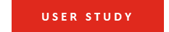
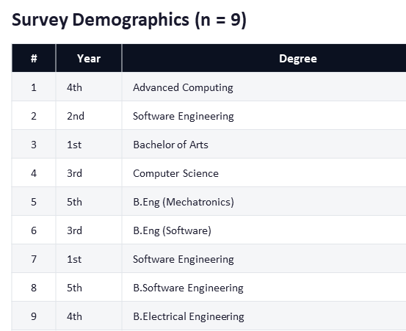
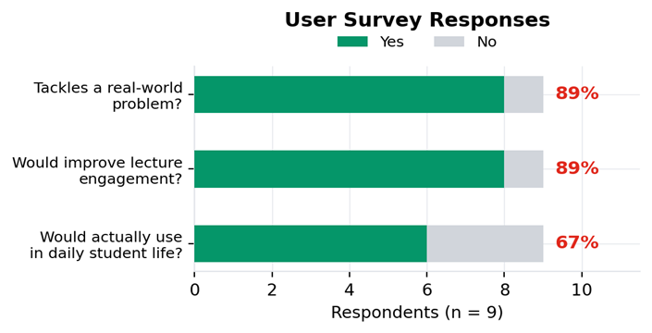
User Study

Slide 14
LIMITATIONS
Limitations
Processing time
Absence of ground-truth annotations from Lecturer
The dominant bottlenecks are Whisper transcription and LLM inference.
lack of human-labelled chapter boundary annotations to help quantify chapter boundary quality
Single course Evaluation
Restricted hardware profile
Only COMP2017 lectures were tested plus other STEM lecture recordings during user survey.
CPU-based pipeline only; need testing with GPU
Empirical parameter selection
Parameters tuned manually tuned, proper parameter search over a labelled multi‑course dataset is required to establish optimal, generalisable values.
USYD | School of Computer and Electrical Engineering
12 / 13

Slide 15
OUTLOOK
Future Outlook
User Study
Relevance Feedback
Evaluate navigation efficiency and student satisfaction with auto-generated chapters
Combine with student-driven feedback system to refine key/skip classification
Cross-Subject Testing
Short-Form Reels
Validate pipeline on lectures from diverse disciplines beyond Systems Programming
Generate bite-sized learning clips from segmented chapters
LMS Integration
Multi-Lingual Support
Deploy within Echo360 and Canvas for institutional adoption
Extend Whisper and LLM pipeline to support non-English lecture content
USYD | School of Computer and Electrical Engineering
12 / 13

Slide 16
References
[1] A. Radford et al., Robust Speech Recognition via Large-Scale Weak Supervision, Proc. ICML, 2023.
[2] M. A. Hearst, TextTiling: Segmenting Text into Multi-paragraph Subtopic Passages, Comp. Linguistics, 1997.
[3] K. He et al., Deep Residual Learning for Image Recognition, Proc. IEEE CVPR, 2016.
[4] N. Reimers and I. Gurevych, Sentence-BERT: Siamese BERT-Networks, EMNLP-IJCNLP, 2019.
[5] A. Yang et al., Qwen2.5 Technical Report, arXiv:2412.15115, 2024.
[6] A. Vaswani et al., Attention Is All You Need, NeurIPS, 2017.
[7] J. Devlin et al., BERT: Pre-training of Deep Bidirectional Transformers, NAACL-HLT, 2019.
[8] Pallets Projects, Flask: A Python Micro Web Framework, 2010.
[9] P. Virtanen et al., SciPy 1.0: Fundamental Algorithms for Scientific Computing, Nature Methods, 2020.
[10] J. Deng et al., ImageNet: A Large-Scale Hierarchical Image Database, IEEE CVPR, 2009.
[11] L. M. Lim, Why Students Use (and Do Not Use) Recorded Lectures, Proc. ASCILITE, 2019.
[12] Microsoft Canada, Attention Spans: Consumer Insights, Microsoft, 2015.
[13] S. Alfatih et al., Influence of TikTok Short-Form Videos on Attention Span, EDUTECH, 2024.
[14] IJSR, Impact of Short Videos on Attention Span and Academic Performance, IJSR, 2024.
13 / 13

Slide 17
COMPARISON
Metric | Tumbling Window | Sliding Window (Visual)
Chapter Count (Wk 01) | 55 | 25
Chapter Count (Wk 03) | 40 | 33
Chapter Count (Wk 08) | 25 | 28
Chapter Count (Wk 13) | 26 | 21
Mean Duration (Wk 01) | 2.1 min | 4.6 min
Mean Duration (Wk 03) | 2.9 min | 3.4 min
Mean Duration (Wk 08) | 4.6 min | 4.0 min
Mean Duration (Wk 13) | 4.4 min | 5.5 min
Key Chapter % (Wk 01) | 81.8% | 68.0%
Key Chapter % (Wk 03) | 92.5% | 84.8%
Key Chapter % (Wk 13) | 80.8% | 95.2%
Visual-first reduces chapter fragmentation and produces content-driven segments aligned to actual topic transitions.
USYD | School of Computer and Electrical Engineering
7 / 13

Slide 18
EVALUATION
Why These Benchmarks?
Lecture chaptering has no standard ground-truth corpus. These six benchmarks provide automated, reproducible quality signals without manual annotation:
B1
Key/Skip Ratio: Measures content density: a useful index should surface mostly substantive material, not administrative filler. A ratio below 0.5 would indicate most chapters are non-educational.
B2
Duration CV: Quantifies whether chapters are variable-length (content-driven) or uniform (arbitrary). Higher CV means the pipeline adapts to topic length rather than imposing a fixed window.
B3
Short-Chapter Penalty: Chapters under 2 minutes are too fragmented for meaningful navigation. This penalises over-segmentation, the primary failure mode of tumbling-window approaches.
B4
Title Uniqueness: Catches degenerate LLM output where the model repeats the same generic title. A ratio near 1.0 confirms distinct, informative labels per chapter.
B5
Title Word Count: Validates the LLM follows the 5–8 word constraint, producing scannable titles rather than full sentences or single-word labels.
B6
Keyword Diversity: Confirms the segmentation captures distinct topics. Low diversity would indicate redundant chapters covering the same vocabulary.
USYD | School of Computer and Electrical Engineering
11b / 14

Slide 19
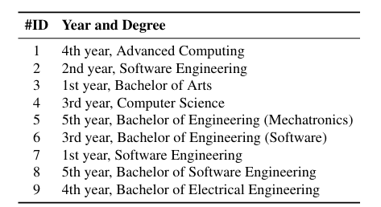
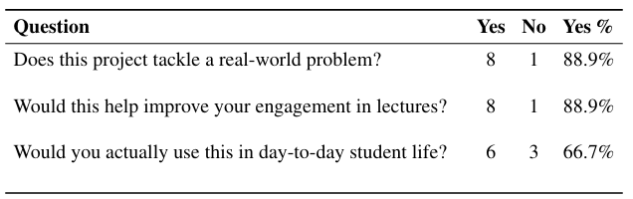
LIMITATIONS
User Study
Total Responses: 9
USYD | School of Computer and Electrical Engineering
12 / 13

