Slide 1
UNIT-4
Numpy, Matplotlib, Scikit learn

Slide 2
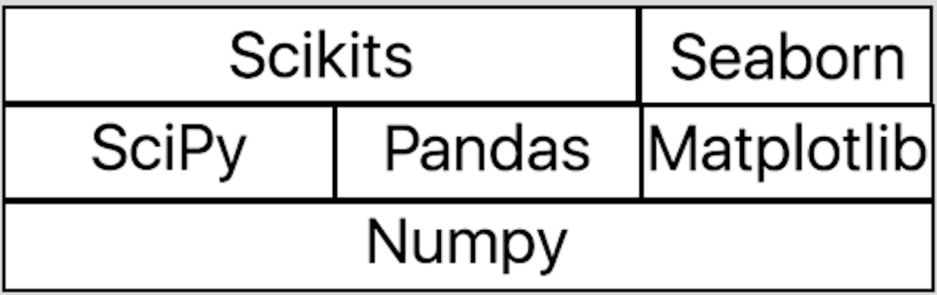
Python Libraries

Slide 3
NumPy: Numerical Python
It is an extension to the Python Programming language that adds support for large and multidimensional arrays.
It has an extensive API for mathematical, logical, statistical and many more functions to operate on arrays.
Installation of Numpy:
Download Numpy from Python Extension Packages for Windows - Christoph Gohlke (uci.edu)
Open windows terminal
Type pip install path-of-numpy installation file

Slide 4
Alternative ways
Install Anacond python distributions, Numpy is pre-installed in it.
Use can user google colab to work with Numpy
Importing Basic Numpy:
import numpy as np
np is shorthand for numpy

Slide 5
L=[1,2,3]
L
[1, 2, 3]
import numpy as np
A=np.array([1,2,3])
A
array([1, 2, 3])
L.append(4)
L
[1, 2, 3, 4]
A.append(4)
---------------------------------------------------------------------------
AttributeError Traceback (most recent call last)<ipython-input-6-a17c4d6940c3> in <cell line: 1>()
----> 1 A.append(4)
AttributeError: 'numpy.ndarray' object has no attribute 'append'

Slide 6
L*2
[1, 2, 3, 4, 1, 2, 3, 4]
A*2
array([2, 4, 6])
A+ [2]
array([3, 4, 5])

Slide 7
N-dimensional arrays:
N dimensionl arrays or ndarrays are numpy core object used for storing items of the same datatype.
It provides an efficient data structure that is superior to ordinary python lists.
Vector operations on arrays execute much faster than loops

Slide 8
Creating an Array:
Empty array:
np.empty((2,3))
array([[0., 0., 0.],
[0., 0., 0.]])
Converting a List into an array:
np.array([0,1,2,3])
array([1, 2, 3, 4])

Slide 9
Functions for Array Creation
arange() for array creation
np.arange(4):
array([0, 1, 2, 3])
Array creating zeros
np.zeros((3,2))
array([[0., 0.],
[0., 0.],
[0., 0.]])

Slide 10
Functions for Array Creation
Creating array using Ones
np.ones((3,2))
array([[1., 1.],
[1., 1.],
[1., 1.]])
Creating array using diagonal elements
np.eye((3,2))
array([[1., 0.],
[0., 1.],
[0., 0.]])

Slide 11
Functions of array creation
Create linear-spaced array items:
np.linspace(0,1,21)
array([0. , 0.05, 0.1 , 0.15, 0.2 , 0.25, 0.3 , 0.35, 0.4 , 0.45, 0.5 , 0.55, 0.6 , 0.65, 0.7 , 0.75, 0.8 , 0.85, 0.9 , 0.95, 1. ])

Slide 12
Scalar operations on Vectors
Elementwise operations will be performed on vectors.
h=np.array([20,12,43,19])
print(h)
array([20, 12, 43, 19])
h+10
array([30, 22, 53, 29])
h*5
array([100, 60, 215, 95])
I =np.array([1,0,0,0])
h*I
array([20,0,0,0])

Slide 13
Matrix multiplication
Dot function
h.dot(h)
2754
@
h@h
2754

Slide 14
Append function
Returns a copy with values appended but not in-place
x=np.array([1,2,3,4])
np.append(x,[5,6,7,8])
array([1, 2, 3, 4, 5, 6, 7, 8])
X
array([1, 2, 3, 4])

Slide 15
Column stack and row stack
Horizontal Stack
x=np.array([0,1,2])
y=np.array([2,3,4])
z=np.array([4,5,6])
np.hstack((x,y,z))
array([0, 1, 2, 2, 3, 4, 4, 5, 6])
Vertical Stack
np.vstack((x,y,z))
array([[0, 1, 2],
[2, 3, 4],
[4, 5, 6]])

Slide 16
Multidimensional array accessing
x = np.arange(16).reshape((4,4))
print(x)
[[ 0 1 2 3]
[ 4 5 6 7]
[ 8 9 10 11]
[12 13 14 15]]

Slide 17
Transposing an array
arr = np.arange(10).reshape(2, 5) print(arr)
[[0 1 2 3 4]
[5 6 7 8 9]]
arr.transpose() (or) arr.T
array([[0, 5],
[1, 6],
[2, 7],
[3, 8],
[4, 9]])

Slide 18
Broadcasting array operations
Arithmetic operations are performed elementwise on Numpy arrays.
For arrays of identical shape, this means that the operation is executed between elements at corresponding indices
a = np.arange(6).reshape(2, 3)
b = np.ones(6).reshape(2, 3)
print(a)
[[0 1 2]
[3 4 5]]
print(b)
[[1. 1. 1.]
[1. 1. 1.]]
a+b
array([[1., 2., 3.],
[4., 5., 6.]])

Slide 19
Properties of Arrays
X.shape:
Retrieves the shape of the array X.
X.dtype:
Retrieves type of elements in the array X.
X.ndim:
Retrieves the dimensions of the array X.

Slide 20
Random Module in NumPy
np.random.rand(5)
Generates 5 random numbers from a uniform distribution [0, 1) array([ 0.4071833 , 0.069167 , 0.69742877, 0.45354268, 0.7220556 ])
np.random.seed(n)
The seed method makes the random number same for n times
np.random.randint(10, 20, (5, 5))
Creates a 5x5 random integer array ranging from 10 (inclusive) to 20 (inclusive)

Slide 21
Unary functions
abs()
sqrt()
square()
sign()
exp()
log(),log10(),log2
ceil()
floor()
cos(),cosh(),sin(),sinh(),tan(),tanh()

Slide 22
Binary Functions
• add()
• substract()
• multiply()
• divide()
• floor_divide()
• power()
• maximum()
• minimum()
• mod()
greater(),greater_equal(),less(),less_equal(),equal(),not_equal()
logical_and(),logical_or(),logical_xor()

Slide 23
Basic Statistical methods
sum()
mean()
std()
var()
min()
max()
cumsum()
cumprod()
sort()

Slide 24
Matplotlib

Slide 25
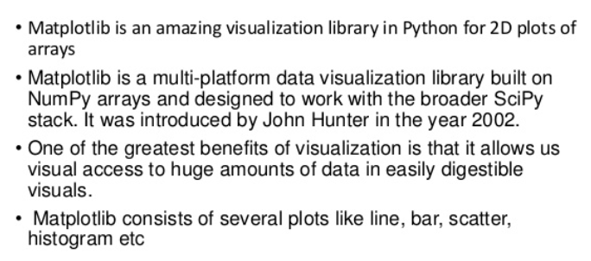
Matplotlib is a plotting library for Python. It provides object-oriented APIs for embedding plots into applications.
Install Matplotlib in Windows:
pip install matplotlib (in Command Prompt)

Slide 26
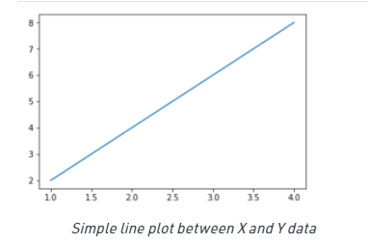
Line Plot
# importing the required libraries
import matplotlib.pyplot as plt
import numpy as np
# define data values
x = np.array([1, 2, 3, 4]) # X-axis points
y = x*2 # Y-axis points
plt.plot(x, y) # Plot the chart
plt.show() # display

Slide 27
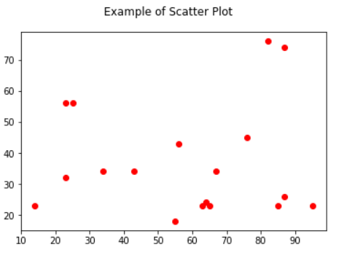
Scatter plot
A scatter plot is a chart type that is normally used to observe and visually display the relationship between variables.
import matplotlib.pyplot as plt
x = [43,76,34,63,56,82,87,55,64,87,95,23,14,65,67,25,23,85]
y = [34,45,34,23,43,76,26,18,24,74,23,56,23,23,34,56,32,23]
plt.scatter(x,y,color='red')
plt.suptitle("Example of Scatter Plot")
plt.show()

Slide 28
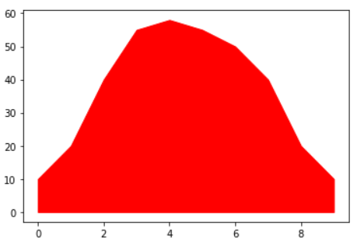
Shaded Line
import matplotlib.pyplot as plt
x = [0,1,2,3,4,5,6,7,8,9]
y1 = [10,20,40,55,58,55,50,40,20,10]
plt.fill_between(x,y1,color='red')
plt.show()

Slide 29
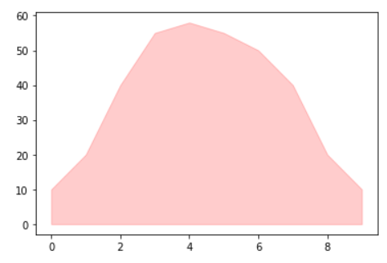
Shaded Region with transparency
import matplotlib.pyplot as plt
x = [0,1,2,3,4,5,6,7,8,9]
y1 = [10,20,40,55,58,55,50,40,20,10]
plt.fill_between(x,y1,color='red',alpha=0.2)
plt.show()

Slide 30
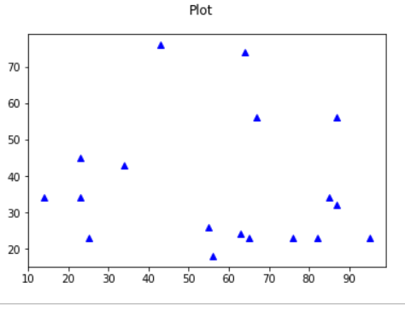
Simple Plot
import matplotlib.pyplot as plt
x = [14,23,23,25,34,43,55,56,63,64,65,67,76,82,85,87,87,95]
y = [34,45,34,23,43,76,26,18,24,74,23,56,23,23,34,56,32,23]
plt.plot(x, y, 'b^')
plt.suptitle("Plot")
plt.show()

Slide 31
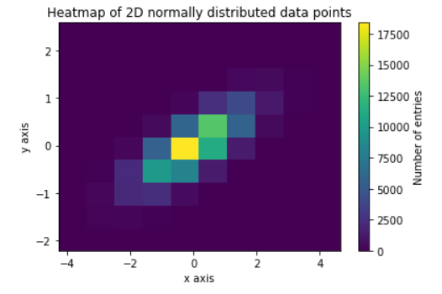
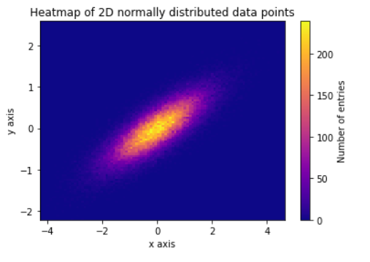
Heatmap
Heatmaps are useful for visualizing scalar functions of two variables. They provide a “flat” image of two-dimensional histogram import numpy as np
import matplotlib.pyplot as plt N_numbers = 100000 N_bins = 100 np.random.seed(0) x, y = np.random.multivariate_normal(mean=[0.0, 0.0], cov=[[1.0, 0.4],[0.4, 0.25]], size=N_numbers).T
plt.hist2d(x, y) cb = plt.colorbar() cb.set_label('Number of entries') plt.title('Heatmap of 2D normally distributed data points') plt.xlabel('x axis') plt.ylabel('y axis') plt.show()

Slide 32
Heatmap
Import numpy as np
import matplotlib.pyplot as plt N_numbers = 100000 N_bins = 100 np.random.seed(0) x, y = np.random.multivariate_normal(mean=[0.0, 0.0], cov=[[1.0, 0.4],[0.4, 0.25]], size=N_numbers).T
plt.hist2d(x, y, bins=N_bins) cb = plt.colorbar() cb.set_label('Number of entries') plt.title('Heatmap of 2D normally distributed data points') plt.xlabel('x axis') plt.ylabel('y axis') plt.show()

Slide 33
Figure and Axes Objects
The figure contains all the plot elements. The main way to create a figure in matplotlib is to use pyplot.
import matplotlib.pyplot as plt fig = plt.figure()
You can optionally supply a number, which you can use to access a previously-created figure.

Slide 34
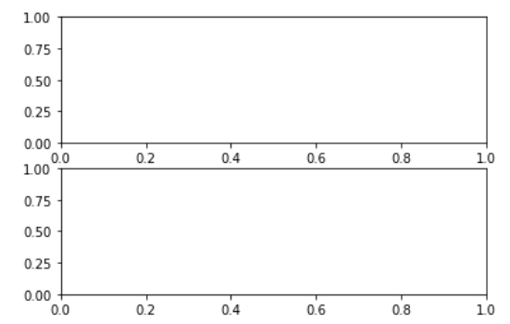
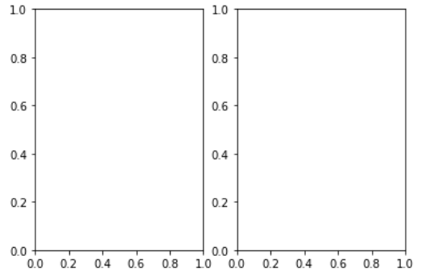
Create an axes
import matplotlib.pyplot as plt
fig,(ax1,ax2)=plt.subplots(1,2)
fig,(ax1,ax2)=plt.subplots(1,2)

Slide 35
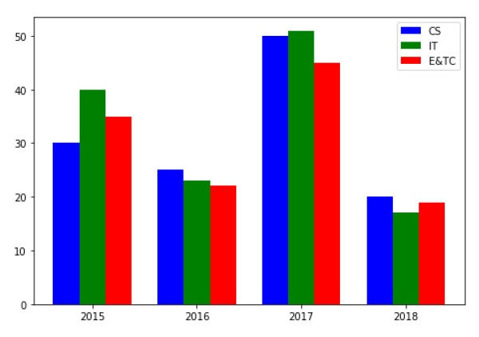
Bar graph
A bar chart or bar graph is a chart or graph that presents categorical data with rectangular bars with heights or lengths proportional to the values that they represent.
import numpy as np
import matplotlib.pyplot as plt
data = [[30, 25, 50, 20],
[40, 23, 51, 17],
[35, 22, 45, 19]]
X = np.arange(4)
fig = plt.figure()
ax = fig.add_axes([0,0,1,1])
ax.bar(X + 0.00, data[0], color = 'b', width = 0.25)
ax.bar(X + 0.25, data[1], color = 'g', width = 0.25)
ax.bar(X + 0.50, data[2], color = 'r', width = 0.25)
ax.legend(labels=['CS', 'IT',E&TC])
ax.set_xticks(ind, ('2015', '2016', '2017', '2018'))
ax.set_yticks(np.arange(0, 50, 10))
plt.show()

Slide 36
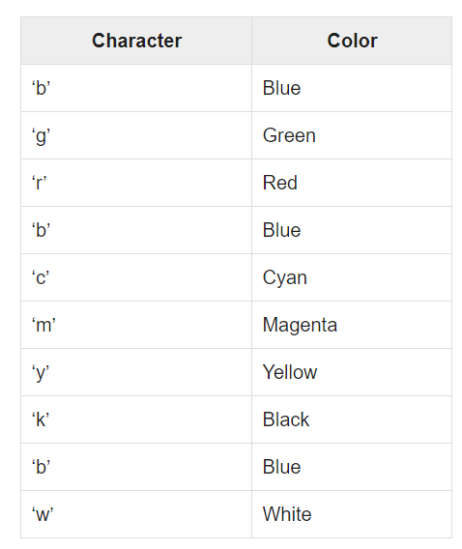
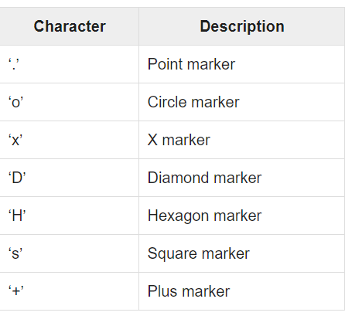
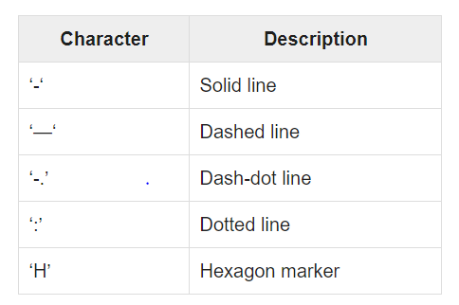
Color, Marker and Line codes

Slide 37
Scikit-Learn

Slide 38
scikit-learn is a general-purpose open-source library for data analysis written in python.
scikit-learncontains a number of implementation for different popular algorithms of machine learning.
Installing with Scikit-learn
pip install scikit-learn

Slide 39
Dataset Loading
A collection of data is called dataset.
It is having the following two components:
Features: The variables of data are called its features.
They are also known as predictors, inputs or attributes.
Feature matrix: It is the collection of features, in case there are more than one.
Feature Names: It is the list of all the names of the features.
Response: It is the output variable that basically depends upon the feature variables. They are also known as target, label or output.
Response Vector: It is used to represent response column.

Slide 40
from sklearn.datasets
import load_iris
iris = load_iris()
X = iris.data
y = iris.target
feature_names = iris.feature_names
target_names = iris.target_names
print("Feature names:", feature_names)
print("Target names:", target_names)
Feature names: ['sepal length (cm)', 'sepal width (cm)', 'petal length (cm)', 'petal width (cm)']
Target names: ['setosa' 'versicolor' 'virginica']

Slide 41
Splitting the dataset
X = iris.data
y = iris.target
from sklearn.model_selection import train_test_split
X_train, X_test, y_train, y_test = train_test_split(X, y, test_size=0.3, random_state=1)
print(X_train.shape)
print(X_test.shape)
print(y_train.shape)
print(y_test.shape)
(105, 4)
(45, 4)
(105,)
(45,)

Slide 42
Training and Prediction
from sklearn.neighbors import KNeighborsClassifier
classifier_knn = KNeighborsClassifier(n_neighbors=3)
classifier_knn.fit(X_train, y_train)
y_pred = classifier_knn.predict(X_test)
from sklearn.linear_model import LinearRegression
model = LinearRegression(fit_intercept=True)
model.fit(X_train, y_train)
y_pred = classifier_knn.predict(X_test)

Slide 43
SVM, Naïve Bayesian
from sklearn.svm import SVC
SVCClf = SVC(kernel='linear',gamma='scale', shrinking=False,) SVCClf.fit(X_train, y_train)
y_pred=SVCClf.predict(X_test)
from sklearn.naive_bayes import GaussianNB
GNBclf = GaussianNB()
GNBclf.fit(X_train, y_train)
y_pred=GNBclf.predict(X_test)

Slide 44
Decision Tree, Random Forest
X_train, X_test, y_train, y_test = train_test_split(X, Y, test_size=0.3, random_state=1)
DTclf = tree.DecisionTreeClassifier()
DTclf.fit(X_train,y_train)
y_pred=DTclf.predict(x_test)
X_train, X_test, y_train, y_test = train_test_split(X, y, test_size=0.30) RFclf = RandomForestClassifier(n_estimators=50)
RFclf.fit(X_train, y_train)
y_pred = RFclf.predict(X_test)

Slide 45
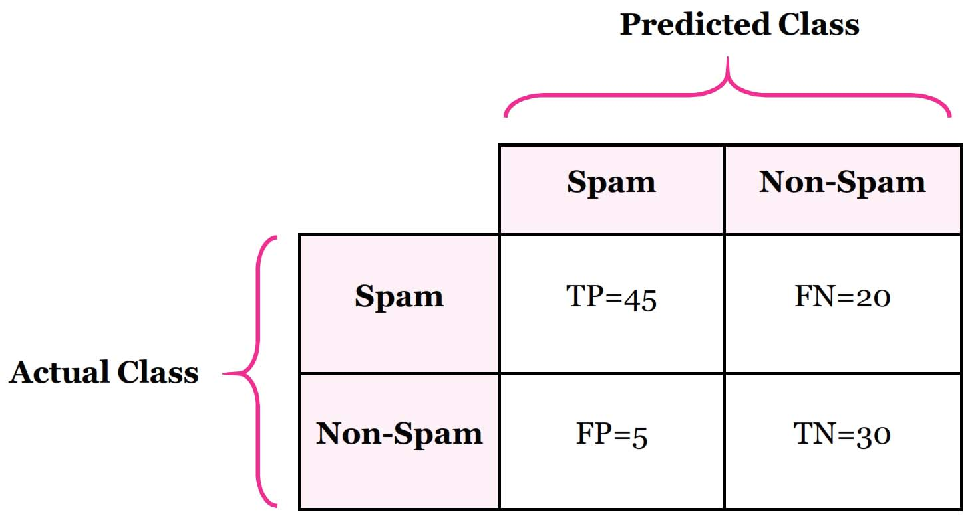
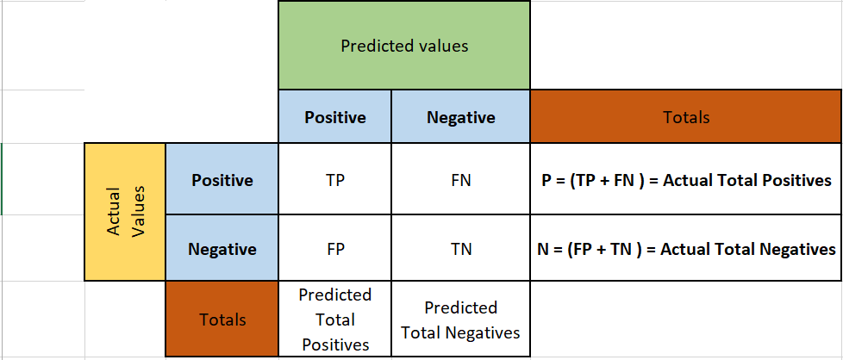
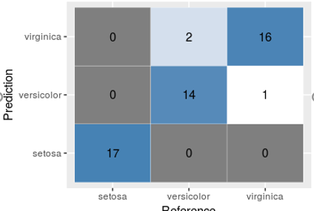
Metrics for Evaluation
from sklearn.metrics import classification_report, confusion_matrix, accuracy_score
result = confusion_matrix(y_test, y_pred)
print("Confusion Matrix:")
print(result)

Slide 46
Classification report and Accuracy
result1 = classification_report(y_test, y_pred)
print("Classification Report:",)
print (result1)
Classification Report:
precision recall f1-score
Iris-setosa 1.00 1.00 1.00
Iris-versicolor 1.00 0.95 0.97
Iris-virginica 0.92 1.00 0.96
result2 = accuracy_score(y_test,y_pred)
print("Accuracy:",result2)

Slide 47
NLTK

Slide 48
Natural Language Tool Kit (NLTK)
NLTK defined as ability of machine (i.e computer program) to understand and interpret the human language as is is spoken!
it seen as an AID provided to computer to understand the human languages !
The learning curve of Python is very fast and NLTK is written in Python so NLTK is also having very good learning kit.
NLTK has incorporated most of the tasks like tokenization, stemming, Lemmatization, Punctuation, Character Count, and Word count.

Slide 49
Installing NLTK
First, open the Windows command prompt and navigate to the location of the pip folder.
Next, enter the following command to install NLTK: pip3 install nltk
Now we have NLTK installed on our computers but in order to use it we need to download the datasets (corpus) available in it.

Slide 50
Tokenization
It may be defined as the process of breaking up a piece of text into smaller parts, such as sentences and words.
These smaller parts are called tokens. For example, a word is a token in a sentence, and a sentence is a token in a paragraph.
Let us understand it with the help of various functions/modules provided by nltk.tokenize package.
word_tokenize module is used for basic word tokenization.

Slide 51
Example
import nltk
from nltk.tokenize
import word_tokenize
word_tokenize('Tutorialspoint.com provides high quality technical tutorials for free.')
Output
['Tutorialspoint.com', 'provides', 'high', 'quality', 'technical', 'tutorials', 'for', 'free', '.']

Slide 52
Tokenizing text into sentences
we are going to split text/paragraph into sentences. NLTK provides sent_tokenize module for this purpose.
Why is it needed? An obvious question that came in our mind is that when we have word tokenizer then why do we need sentence tokenizer or why do we need to tokenize text into sentences.
Suppose we need to count average words in sentences, how we can do this?

Slide 53
Example
import nltk from nltk.tokenize
import sent_tokenize
text = "Let us understand the difference between sentence & word tokenizer. It is going to be a simple example."
sent_tokenize(text)

Slide 54
NLTK stopwords corpus
Natural Language Tool kit comes with a stopword corpus containing word lists for many languages. Let us understand its usage with the help of the following example:
import stopwords english_
stops = set(stopwords.words('english'))
words = ['I', 'am', 'a', 'writer']
[word for word in words if word not in english_stops]
Output ['I', 'writer']

Slide 55
what is stemming
Stemming is a technique used to extract the base form of the words by removing affixes from them.
NLTK has PorterStemmer class with the help of which we can easily implement Porter Stemmer algorithms for the word we want to stem.
This class knows several regular word forms and suffixes with the help of which it can transform the input word to a final stem

Slide 56
Example
import nltk
from nltk.stem import PorterStemmer
word_stemmer = PorterStemmer()
word_stemmer.stem('writing')
Output
'writing’

Slide 57
What is POS tagging?
Tagging, a kind of classification, is the automatic assignment of the description of the tokens.
We call the descriptors ‘tag’, which represents one of the parts of speech (nouns, verb, adverbs, adjectives, pronouns, conjunction and their sub-categories), semantic information and so on.

Slide 58
working with file: Reading file

Slide 59
Python has a well-defined methodology for opening, reading, and writing files.
Some applications for file manipulation in Python include: reading data for algorithm training and testing, reading files to create generative art, reporting, and reading configuration files.

Slide 60
Steps for reading a text file in Python
To read a text file in Python, you follow these steps:
First, open a text file for reading by using the open() function.
Second, read text from the text file using the file read(), readline(), or readlines() method of the file object.
Third, close the file using the file close() method.

Slide 61
open() function
The open() function has many parameters but you’ll be focusing on the first two:
open(path_to_file, mode)
The path_to_file parameter specifies the path to the text file.
If the program and file are in the same folder, you need to specify only the filename of the file. Otherwise, you need to include the path to the file as well as the filename.
text_file = open('file.txt','r')
print('First Method')
print(text_file)
output: First Method

Slide 62
Reading text methods
The file object provides you with three methods for reading text from a text file:
read(size) – read some contents of a file based on the optional size and return the contents as a string. If you omit the size, the read() method reads from where it left off till the end of the file. If the end of a file has been reached, the read() method returns an empty string.
readline() – read a single line from a text file and return the line as a string. If the end of a file has been reached, the readline() returns an empty string.
readlines() – read all the lines of the text file into a list of strings. This method is useful if you have a small file and you want to manipulate the whole text of that file.

Slide 63
#open the file
text_file = open('/Users/pankaj/file.txt','w')
#initialize an empty list
word_list= []
#iterate 4 times
for i in range (1, 5):
print("Please enter data: ")
line = input() #take input
word_list.append(line) #append to the list
text_file.writelines(word_list) #write 4 words to the file
text_file.close() #don’t forget to close the file

Slide 64
close() method
First, when you open a file in your script, the file system usually locks it down so no other programs or scripts can use it until you close it.
Second, your file system has a limited number of file descriptors that you can create before it runs out of them. Although this number might be high, it’s possible to open a lot of files and deplete your file system resources.
Third, leaving many files open may lead to race conditions which occur when multiple processes attempt to modify one file at the same time and can cause all kinds of unexpected behaviors.
f = open("demofile.txt", "r")
print(f.readline())
f.close()

Slide 65
Web Scraping

Slide 66
What is Web Scraping ?
Web Scraping (also termed Screen Scraping, Web Data Extraction, Web Harvesting etc.) is a technique employed to extract large amounts of data from websites whereby the data is extracted and saved to a local file in your computer or to a database in table (spreadsheet) format.
Web Scraping is the technique of automating this process, so that instead of manually copying the data from websites, the Web Scraping software will perform the same task within a fraction of the time.

Slide 67
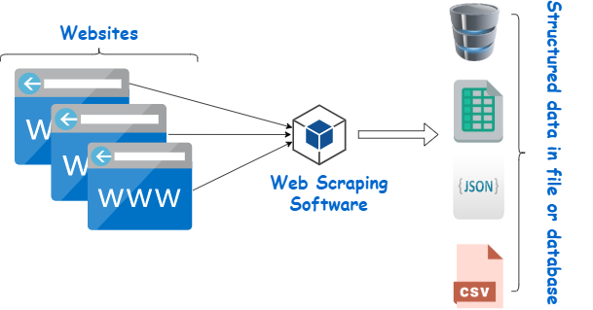

Slide 68
What is web scraping?
Web scraping is the process of collecting structured web data in an automated fashion. It’s also called web data extraction.
Some of the main use cases of web scraping include price monitoring, price intelligence, news monitoring, lead generation, and market research among many others.
In general, web data extraction is used by people and businesses who want to make use of the vast amount of publicly available web data to make smarter decisions.

Slide 69
Web scraping requires two parts namely the crawler and the scraper.
The crawler is an artificial intelligence algorithm that browses the web to search the particular data required by following the links across the internet.
The scraper, on the other hand, is a specific tool created to extract the data from the website.
Different Types of Web Scrapers
Self-built Web Scrapers but that requires advanced knowledge of programming.
Pre-built Web Scrapers are previously created scrapers that you can download and run easily. These also have more advanced options that you can customize.

Slide 70
Browser extension Web Scrapers are extensions that can be added to your browser. These are easy to run as they are integrated with your browser.
Software Web Scrapers don’t have these limitations as they can be downloaded and installed on your computer. These are more complex than Browser extension Web Scrapers but they also have advanced features that are not limited by the scope of your browser.
Cloud Web Scrapers run on the cloud which is an off-site server mostly provided by the company that you buy the scraper from.
These allow your computer to focus on other tasks as the computer resources are not required to scrape data from websites.
Local Web Scrapers, on the other hand, run on your computer using local resources.

Slide 71
The scraper
A web scraper is a specialized tool designed to accurately and quickly extract data from a web page.
Web scrapers vary widely in design and complexity, depending on the project.
An important part of every scraper is the data locators (or selectors) that are used to find the data that you want to extract from the HTML file - usually, XPath, CSS selectors, regex, or a combination of them is applied.

Slide 72
The web scraping process
Identify the target website
Collect URLs of the pages where you want to extract data from
Make a request to these URLs to get the HTML of the page
Use locators to find the data in the HTML
Save the data in a JSON or CSV file or some other structured format

Slide 73
What is web scraping used for?
Price intelligence is the biggest use case for web scraping. Extracting product and pricing information from e-commerce websites, then turning it into intelligence is an important part of modern e-commerce companies that want to make better pricing/marketing decisions based on data.
How web pricing data and price intelligence can be useful:
Dynamic pricing
Revenue optimization
Competitor monitoring
Product trend monitoring
Brand and MAP compliance

Slide 74
Using API( Ex: using Twitter APIs)

Slide 75
Create a developer account for the twitter account
Create a Project & APPs in Developer portal
Generate the API key, API Secret, Access Token and Secret for the project
Use the keys in Tweepy module to access your twitter acco

Slide 76
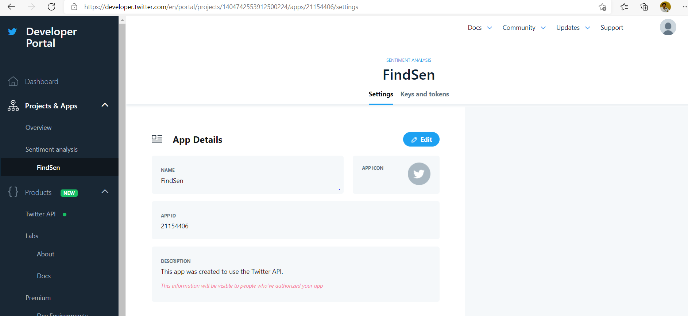

Slide 77
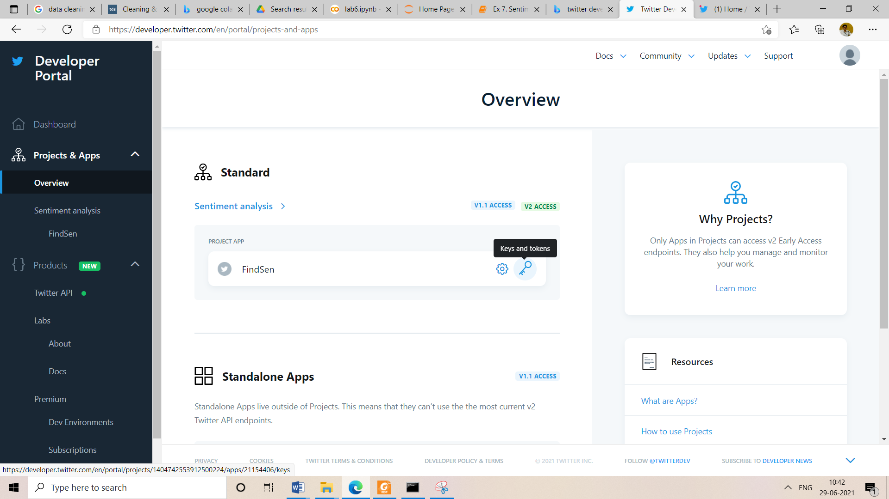

Slide 78
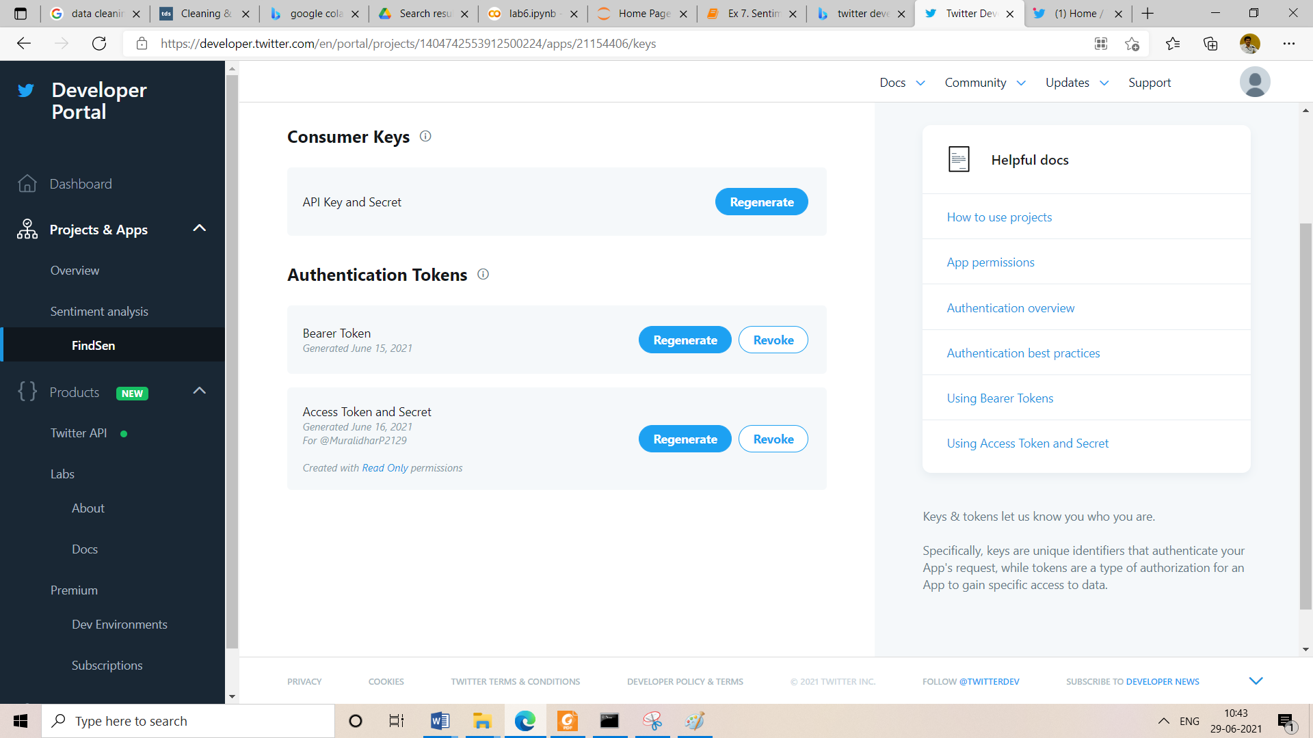

Slide 79
Data Cleaning Munging

Slide 80
What is Data Wrangling? or data Munging
Data wrangling, also referred to as data munging, is the process of converting and mapping data from one raw format into another. The purpose of this is to prepare the data in a way that makes it accessible for effective use further down the line. Not all data is created equal, therefore it’s important to organize and transform your data in a way that can be easily accessed by others.
Benefits of Data Wrangling
Although data wrangling is an essential part of preparing your data for use, the process yields many benefits. Benefits include:
Enhances ease of access to data
Faster time to insights
Improved efficiency when it comes to data-driven decision making

Slide 81
What is Data Cleaning?
Data cleaning, also referred to as data cleansing, is the process of finding and correcting inaccurate data from a particular data set or data source .
The primary goal is to identify and remove inconsistencies without deleting the necessary data to produce insights.
It’s important to remove these inconsistencies in order to increase the validity of the data set.
Cleaning encompasses a multitude of activities such as identifying duplicate records, filling empty fields and fixing structural errors.
These tasks are crucial for ensuring the quality of data is accurate, complete, and consistent.

Slide 82
Benefits of Data Cleaning
There is a wide range of benefits that come with cleaning data that can lead to increased operational efficiency. Properly cleansing your data before use leads to benefits such as:
Elimination of errors
Reduced costs associated with errors
Improves the integrity of data
Ensures the highest quality of information for decision making

Slide 83
What’s the Difference Between Data Wrangling and Data Cleaning?
Data cleaning focuses on removing inaccurate data from your data set whereas data wrangling focuses on transforming the data’s format, typically by converting “raw” data into another format more suitable for use.
Data cleaning enhances the data’s accuracy and integrity while wrangling prepares the data structurally for modeling.

Slide 84
Data manipulation

Slide 85
Data manipulation is the process of changing or altering data in order to make it more readable and organized.
example of data manipulation is website management. Website owners can use web server logs to locate the most viewed web pages, traffic sources, and much more.

Slide 86
Use Data Manipulation
Format consistency: Data organized in a unified, orderly manner helps business users make better decisions.
Historical overview: Accessing data of previous projects quickly can help an organization make decisions regarding deadline projection, team productivity, budget allocation, etc.
Improved efficiency: By having more organized data, a business can isolate and even reduce external variables to contribute to the overall efficiency of the business.

Slide 87
Importance
Data manipulation is important because it allows you to easily access the information that’s critical to your specific business and goals.
This process can be tailored to identify different data sets as your company grows or makes adjustments due to market demand.
Data manipulation is also a valuable tool for identifying and correcting data redundancies in reporting.
Consistent and organized data: Companies may manipulate their data because it can provide them with well-organized databases.
Data Projection :a business, you can’t deny the importance of data when it comes to business intelligence (BI).
Conducting an exhaustive data analysis is vital for companies, particularly when it comes to investments. Every business makes use of past data to plan for the future.

Slide 88
valuable data: Companies can tailor their results to provide specific insights. For example, if a business were interested in learning more about its website traffic and wanted to track the number of visitors over a certain period of time, it might manipulate its website traffic data to provide those results.
Data Interpretation:When dealing with complex data that involves multiple formats and business conditions, it is next to impossible to make sense of it without manipulation

Slide 89
Rescaling

Slide 90
Scaling of the data comes under the set of steps of data pre-processing when we are performing machine learning algorithms in the data set.
As we know most of the supervised and unsupervised learning methods make decisions according to the data sets applied to them and often the algorithms calculate the distance between the data points to make better inferences out of the data.

Slide 91
How to rescale features in Python
Importing Library
from sklearn import preprocessing
import numpy as np
Creating array
We have created a array with values on which we will perform operation.
x = np.array([[-500.5],
[-100.1],
[0],
[100.1],
[900.9]])

Slide 92
Scaling the array
We have used min-max scaler to scale the data in the array in the range 0 to 1 which we have passed in the parameter. Then we have used fit transform to fit and transform the array according to the min max scaler.
minmax_scale = preprocessing.MinMaxScaler(feature_range=(0, 1))
x_scale = minmax_scale.fit_transform(x)
print(x)
print(x_scale)

Slide 93
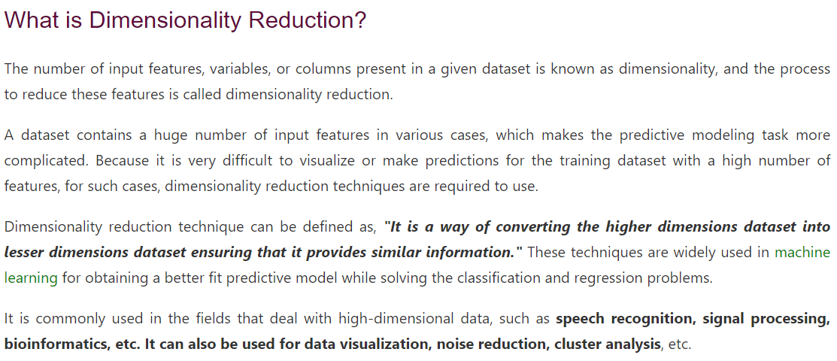

Slide 94
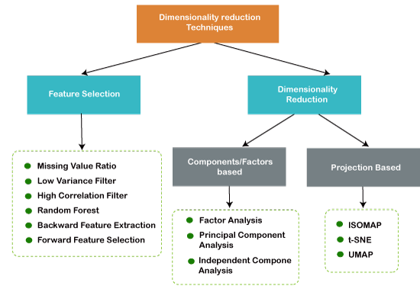

Slide 95
The Curse of Dimensionality
Handling the high-dimensional data is very difficult in practice, commonly known as the curse of dimensionality.
If the dimensionality of the input dataset increases, any machine learning algorithm and model becomes more complex.
As the number of features increases, the number of samples also gets increased proportionally, and the chance of overfitting also increases.
If the machine learning model is trained on high-dimensional data, it becomes overfitted and results in poor performance.
Hence, it is often required to reduce the number of features, which can be done with dimensionality reduction.

Slide 96
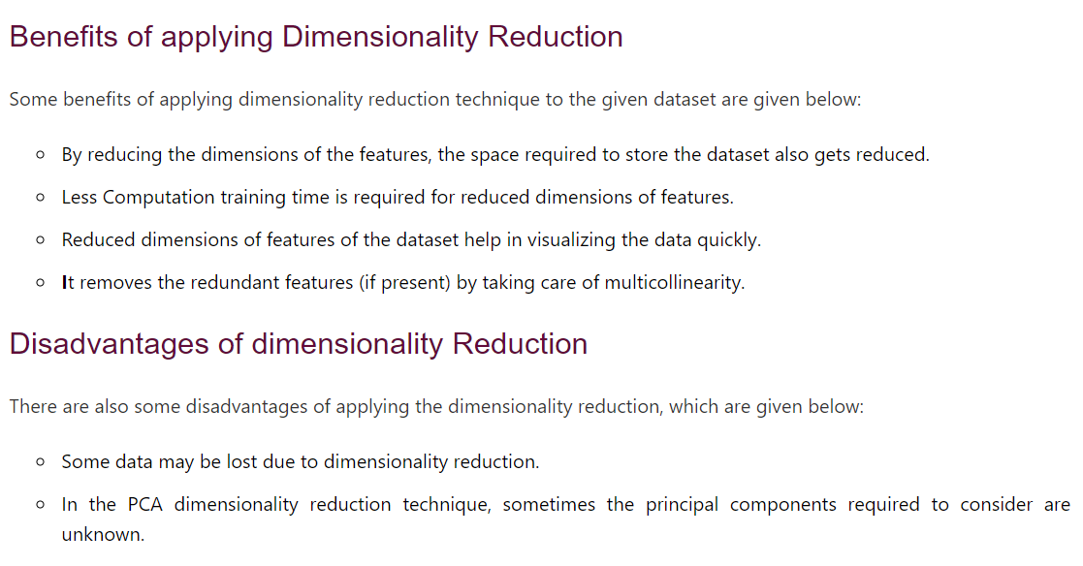

Slide 97
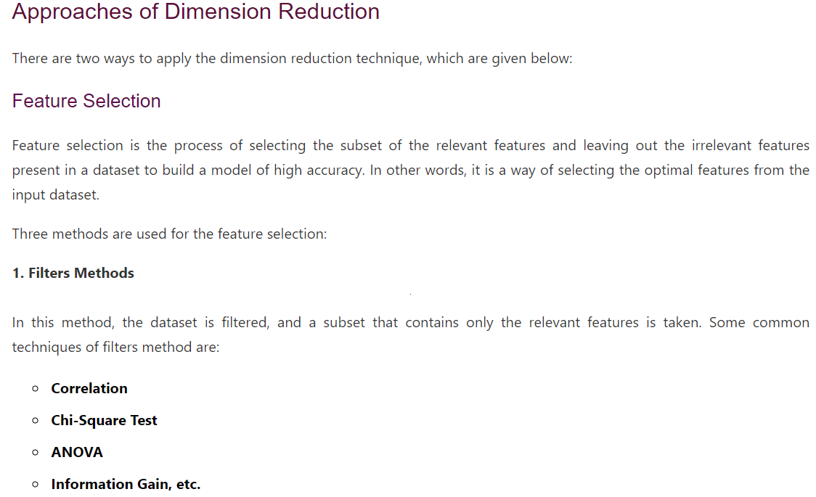

Slide 98
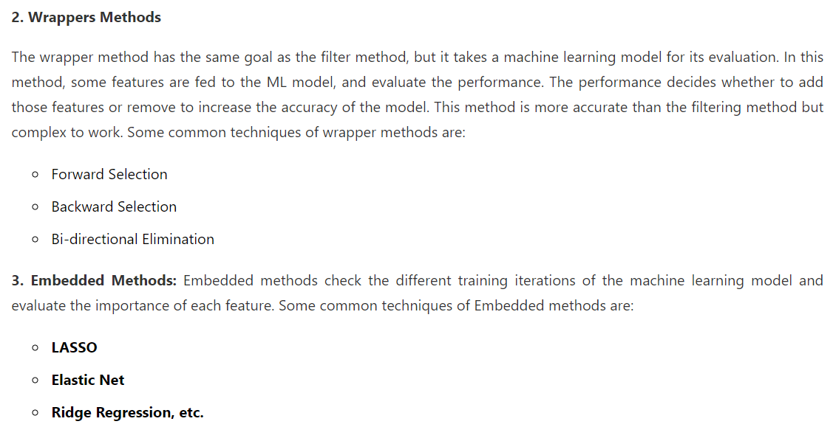

Slide 99
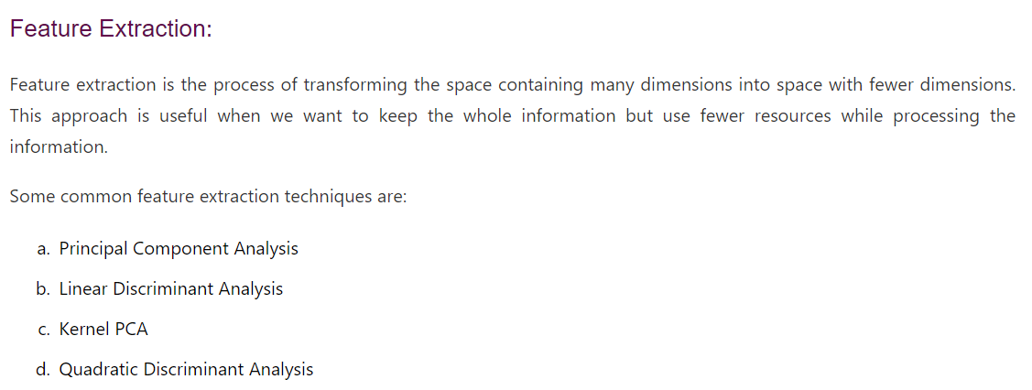

Slide 100
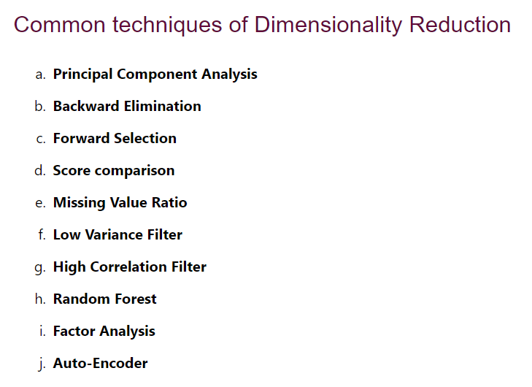

Slide 101
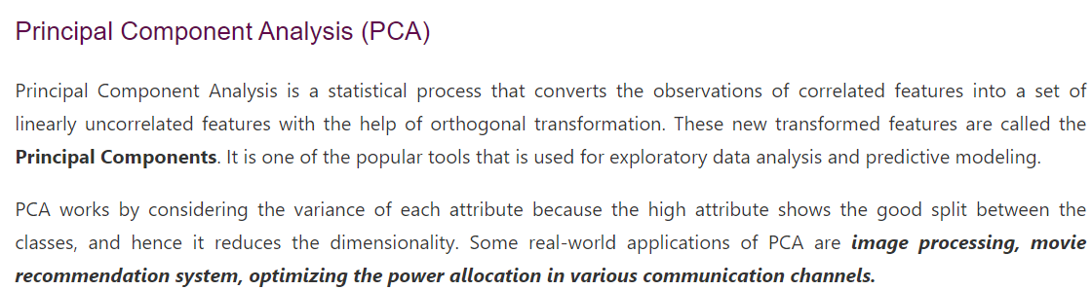

Slide 102
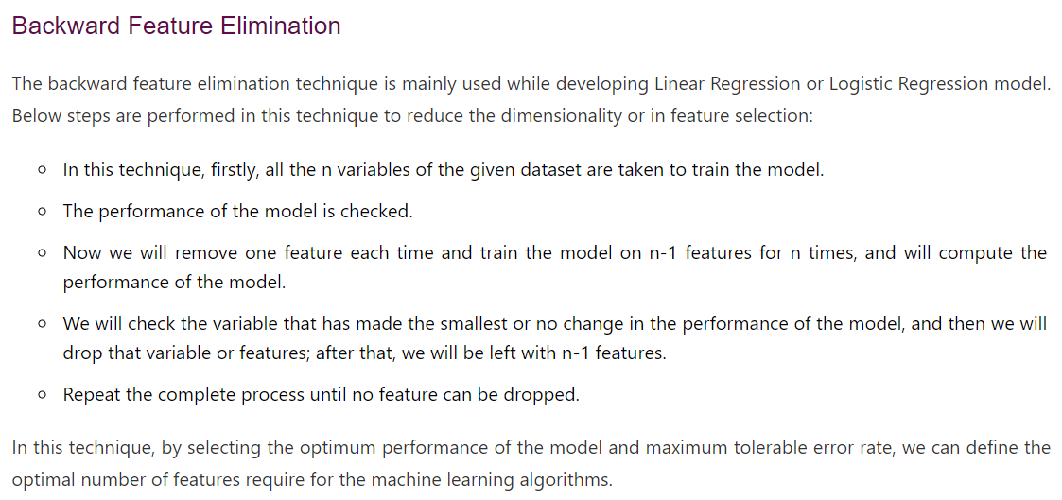

Slide 103
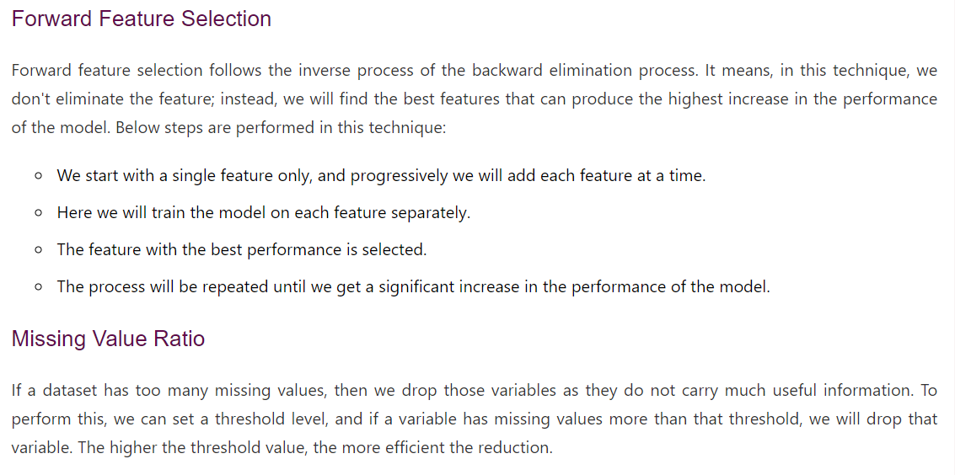

Slide 104
