Slide 1
UNIT-4
Numpy, Pandas, Matplotlib, Scikit learn

Slide 2
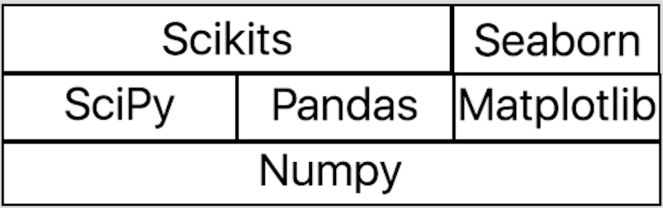
Python Libraries

Slide 3
NumPy: Numerical Python
It is an extension to the Python Programming language that adds support for large and multidimensional arrays.
It has an extensive API for mathematical, logical, statistical and many more functions to operate on arrays.
Installation of Numpy:
Download Numpy from Python Extension Packages for Windows - Christoph Gohlke (uci.edu)
Open windows terminal
Type pip install path-of-numpy installation file

Slide 4
Alternative ways
Install Anacond python distributions, Numpy is pre-installed in it.
Use can user google colab to work with Numpy
Importing Basic Numpy:
import numpy as np
np is shorthand for numpy

Slide 5
N-dimensional arrays:
N dimensionl arrays or ndarrays are numpy core object used for storing items of the same datatype.
It provides an efficient data structure that is superior to ordinary python lists.
Vector operations on arrays execute much faster than loops

Slide 6
Creating an Array:
Empty array:
np.empty((2,3))
array([[0., 0., 0.],
[0., 0., 0.]])
Converting a List into an array:
np.array([0,1,2,3])
array([1, 2, 3, 4])

Slide 7
Functions for Array Creation
arange() for array creation
np.arange(4):
array([0, 1, 2, 3])
Array creating zeros
np.zeros((3,2))
array([[0., 0.],
[0., 0.],
[0., 0.]])

Slide 8
Functions for Array Creation
Creating array using Ones
np.ones((3,2))
array([[1., 1.],
[1., 1.],
[1., 1.]])
Creating array using diagonal elements
np.eye((3,2))
array([[1., 0.],
[0., 1.],
[0., 0.]])

Slide 9
Functions of array creation
Create linear-spaced array items:
np.linspace(0,1,21)
array([0. , 0.05, 0.1 , 0.15, 0.2 , 0.25, 0.3 , 0.35, 0.4 , 0.45, 0.5 , 0.55, 0.6 , 0.65, 0.7 , 0.75, 0.8 , 0.85, 0.9 , 0.95, 1. ])
Create log-space array items:
np.logspace(-2,2,5)
array([1.e-02, 1.e-01, 1.e+00, 1.e+01, 1.e+02])

Slide 10
Scalar operations on Vectors
Elementwise operations will be performed on vectors.
h=np.array([20,12,43,19])
print(h)
array([20, 12, 43, 19])
h+10
array([30, 22, 53, 29])
h*5
array([100, 60, 215, 95])
I =np.array([1,0,0,0])
h*I
array([20,0,0,0])

Slide 11
Matrix multiplication
Dot function
h.dot(h)
2754
@
h@h
2754

Slide 12
Append function
Returns a copy with values appended but not in-place
x=np.array([1,2,3,4])
np.append(x,[5,6,7,8])
array([1, 2, 3, 4, 5, 6, 7, 8])
X
array([1, 2, 3, 4])

Slide 13
Column stack and row stack
Horizontal Stack
x=np.array([0,1,2])
y=np.array([2,3,4])
z=np.array([4,5,6])
np.hstack((x,y,z))
array([0, 1, 2, 2, 3, 4, 4, 5, 6])
Vertical Stack
np.vstack((x,y,z))
array([[0, 1, 2],
[2, 3, 4],
[4, 5, 6]])

Slide 14
Array Access
Slice syntax is i:j:k where i is the starting index (inclusive), j is the stopping index (exclusive) and k is the step size.
x=np.arange(10)
print(x)
[0 1 2 3 4 5 6 7 8 9]
print(x[0])
0
print(x[0:4])
[0 1 2 3]
print(x[0:4:2])
[0 2]

Slide 15
Accessing with Negative indexing
print(x[-1])
9
print(x[-1:0:-1])
[9 8 7 6 5 4 3 2 1]

Slide 16
Multidimensional array accessing
x = np.arange(16).reshape((4,4))
print(x)
[[ 0 1 2 3]
[ 4 5 6 7]
[ 8 9 10 11]
[12 13 14 15]]
x[1,1]
5
x[0:3,0]
array([0, 4, 8])
x[0:3:2, 0:3:2]
array([[ 0, 2],
[ 8, 10]])

Slide 17
Transposing an array
arr = np.arange(10).reshape(2, 5) print(arr)
[[0 1 2 3 4]
[5 6 7 8 9]]
arr.transpose() (or) arr.T
array([[0, 5],
[1, 6],
[2, 7],
[3, 8],
[4, 9]])

Slide 18
Boolean Indexing
arr = np.arange(7)
print(arr)
[0 1 2 3 4 5 6]
arr > 4
array([False, False, False, False, False, True, True])
arr[arr>4]
array([5, 6])

Slide 19
Broadcasting array operations
Arithmetic operations are performed elementwise on Numpy arrays.
For arrays of identical shape, this means that the operation is executed between elements at corresponding indices
a = np.arange(6).reshape(2, 3)
b = np.ones(6).reshape(2, 3)
print(a)
[[0 1 2]
[3 4 5]]
print(b)
[[1. 1. 1.]
[1. 1. 1.]]
a+b
array([[1., 2., 3.],
[4., 5., 6.]])

Slide 20
Broadcasting
Arithmetic operations may also be executed on arrays of different shapes by means of Numpy broadcasting.
a = np.arange(5).reshape(1, 5)print(a)
array([[0, 1, 2, 3, 4]])
b = np.arange(4).reshape(4, 1)
print(b)
array([[0],
[1],
[2],
[3]])
a*b
array([[ 0, 0, 0, 0, 0],
[ 0, 1, 2, 3, 4],
[ 0, 2, 4, 6, 8],
[ 0, 3, 6, 9, 12]])

Slide 21
Properties of Arrays
X.shape:
Retrieves the shape of the array X.
X.dtype:
Retrieves type of elements in the array X.
X.ndim:
Retrieves the dimensions of the array X.

Slide 22
Random Module in NumPy
np.random.rand(5)
Generates 5 random numbers from a uniform distribution [0, 1) array([ 0.4071833 , 0.069167 , 0.69742877, 0.45354268, 0.7220556 ])
np.random.seed(n)
The seed method makes the random number same for n times
np.random.randint(10, 20, (5, 5))
Creates a 5x5 random integer array ranging from 10 (inclusive) to 20 (inclusive)

Slide 23
Linear algebra with np.linalg
x0 + 2 * x1 + x2 = 4 x1 + x2 = 3 x0 + x2 = 5 A = np.array([[1, 2, 1], [0, 1, 1], [1, 0, 1]]) b = np.array([4, 3, 5])
Ax=b x = np.linalg.solve(A, b) array([ 1.5, -0.5, 3.5])

Slide 24
Unary functions
abs()
sqrt()
square()
sign()
exp()
log(),log10(),log2
ceil()
floor()
cos(),cosh(),sin(),sinh(),tan(),tanh()

Slide 25
Binary Functions
• add()
• substract()
• multiply()
• divide()
• floor_divide()
• power()
• maximum()
• minimum()
• mod()
greater(),greater_equal(),less(),less_equal(),equal(),not_equal()
logical_and(),logical_or(),logical_xor()

Slide 26
Basic Statistical methods
sum()
mean()
std()
var()
min()
max()
cumsum()
cumprod()
sort()

Slide 27
Pandas
Pandas is a Python package providing fast, flexible, and expressive data structures designed to make working with “relational” or “labeled” data both easy and intuitive.
It aims to be the fundamental high-level building block for doing practical, real world data analysis in Python.

Slide 28
Installing pandas
pip install pandas
Once Pandas has been installed, you can check if it is working properly by creating a dataset of randomly distributed values and plotting its histogram.
Creating a Series- One dimensional datastructures import pandas as pd import numpy as np np.random.seed(0) values = np.random.randn(100) s = pd.Series(values) # generate a pandas series

Slide 29
Descriptive Statistics
Descriptive statistics (mean, standard deviation, number of observations, minimum, maximum, and quartiles) of numerical columns can be calculated using the .describe() method, which returns a pandas dataframe of descriptive statistics.

Slide 30
Some of the data's statistics (mean, standard deviation, etc.)
print(s.describe())
count 100.000000
mean 0.059808
std 1.012960
min -2.552990
25% -0.643857
50% 0.094096
75% 0.737077
max 2.269755
dtype: float64

Slide 31
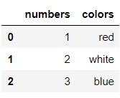
Creating DataFrames
DataFrame is a data structure provided by pandas library,apart from Series & Panel. It is a 2- dimensional structure & can be compared to a table of rows and columns.
Each row can be identified by an integer index (0..N) or a label explicitly set when creating a DataFrame object. Each column can be of distinct type and is identified by a label.
Create a sample DataFrame df = pd.DataFrame({'numbers': [1, 2, 3], 'colors': ['red', 'white', 'blue']}

Slide 32
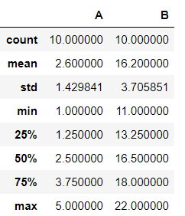
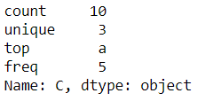
Two Dimensional Data Structure
In [ ]:
df = pd.DataFrame({'A': [1, 2, 1, 4, 3, 5, 2, 3, 4, 1], 'B': [12, 14, 11, 16, 18, 18, 22, 13, 21, 17], 'C': ['a', 'a', 'b', 'a', 'b', 'c', 'b', 'a', 'b', 'a']})
df.describe()
​
 | A | B | C
0 | 1 | 12 | a
1 | 2 | 14 | a
2 | 1 | 11 | b
3 | 4 | 16 | a
4 | 3 | 18 | b
5 | 5 | 18 | c
6 | 2 | 22 | b
7 | 3 | 13 | a
8 | 4 | 21 | b
9 | 1 | 17 | a
df['C'].describe()

Slide 33

DataFrame and Properties
Creating a Empty DataFrame
df=pd.DataFrame(columns=[‘A’,’B’,’C’])
Attributes of DataFrame
df.columns
Index(['A', 'B', 'C'], dtype='object')
df.index
Int64Index([0], dtype='int64')

Slide 34

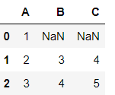
Accessing a Specific location in dataFrame
df.loc[0, 'A'] = 1
df.loc[1]=[2,3,4]
df.loc[2]={'A':3,'B':4,'C':5}

Slide 35


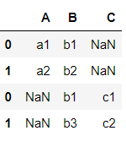
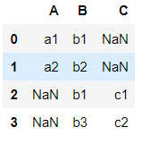
Appending a DataFrame with another DataFrame
df1= pd.DataFrame({'A':['a1','a2'],'B':['b1','b2']})
df1
df2=pd.DataFrame({'B':['b1','b3'],'C':['c1','c2']})
df2
df3=df1.append(df2)
df3
df3=df1.append(df2,ignore_index=True)
df3

Slide 36
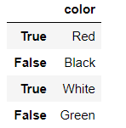


Boolean indexing of dataframes
Accessing rows in a dataframe using the DataFrame indexer objects .loc, .iloc.
Accessing a DataFrame with a boolean index df4=pd.DataFrame({'color':['Red','Black','White','Green']},index=[True,False,True,False])
df4.loc[True]
df4.iloc[1]

Slide 37
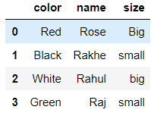

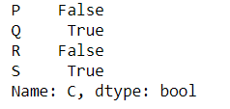
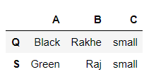
Boolean indexing
df5=pd.DataFrame({'color':['Red','Black','White','Green'],
'name':['Rose','Rakhe','Rahul','Raj'],
'size':['Big','small','big','small']})
df5[[True,False,True,False]]
df5['C']=='small'
df5[df5['C']=='small']

Slide 38
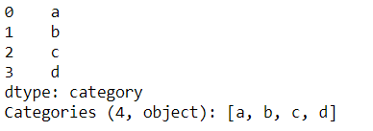
Categorical Data
Categoricals are a pandas data type, which correspond to categorical variables in statistics: a variable, which can take on only a limited, and usually fixed, number of possible values.
Examples are gender, social class, blood types, country affiliations, observation time or ratings via Likert scales.
s=pd.Series(["a","b","c","d"],dtype="category")
s

Slide 39
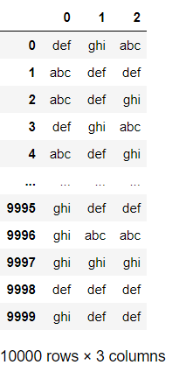
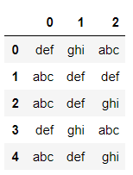
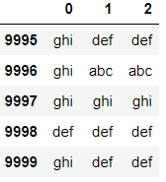
Creating large random dataset
import numpy as np
import pandas as pd
a=pd.DataFrame(np.random.choice(['abc','def','ghi'],size=(10000,3)))
a Change of datatype a=a.astype("category")
Retrieve the first n elements: a.head()
Retrieve the last n elements: a.tail()

Slide 40
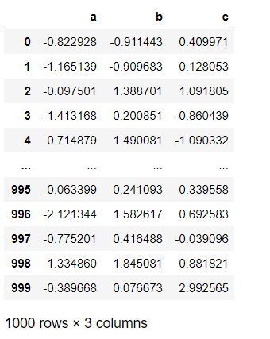
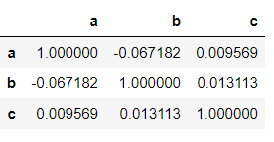
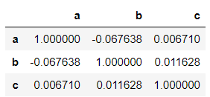
Computational Tools
Find The Correlation Between Columns df6=pd.DataFrame(np.random.randn(1000,3),columns=['a','b','c'])
Pearson Correlation
df6.corr()
df6.corr(method='spearman')

Slide 41
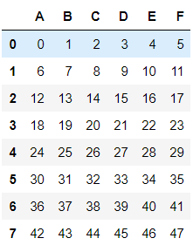
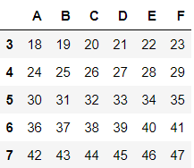
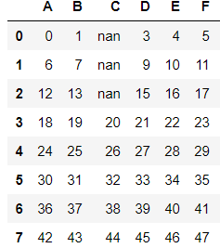
df = pd.DataFrame(np.arange(48).reshape(8,6),columns=list('ABCDEF'))
df.dropna()
df.iloc[:3,2]=np.nan
df

Slide 42

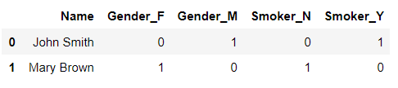
Dealing with categorical variables- One Hot encoding
df = pd.DataFrame({'Name':['John Smith', 'Mary Brown'], 'Gender':['M', 'F'], 'Smoker':['Y', 'N']})
df
df_with_dummies = pd.get_dummies(df, columns=['Gender', 'Smoker'])

Slide 43

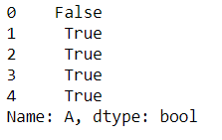

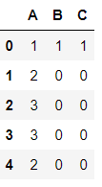
Duplicated Data
df = pd.DataFrame({'A':[1,2,3,3,2], 'B':[1,7,3,0,8]})
mask=df.A.duplicated(keep=False)
mask
df.loc[mask, 'B'] = 0
df
df['C'] = df.A.mask(mask, 0)
df

Slide 44


Drop Duplicates
df.drop_duplicates(subset=['A'], keep='first')
df.drop_duplicates(subset=['A'], keep=‘last')

Slide 45
Counting and getting unique values
id_numbers = pd.Series([111, 112, 112, 114, 115, 118, 114, 118, 112])
id_numbers.nunique()
5
id_numbers.unique()
array([111, 112, 114, 115, 118], dtype=int64)

Slide 46
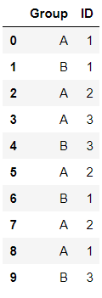

groupby
df = pd.DataFrame({'Group': list('ABAABABAAB'),'ID': [1, 1, 2, 3, 3, 2, 1, 2, 1, 3]})
df.groupby('Group')['ID'].unique()

Slide 47
Reading and Writing into files
Read the data from csv,excel and json files
df= pd.read_csv("data.csv")
df=pd.read_excel(“data.xls”)
df=pd.read_json(“data.json”)
Write the data to csv file
pd.to_csv(“filename”)
pd.to_excel(“filename”)
pd.to_json(“filename”)

Slide 48



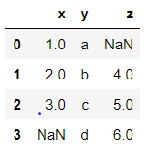
Merging of DataFrames
df1 = pd.DataFrame({'x': [1, 2, 3], 'y': ['a', 'b', 'c']})
df2 = pd.DataFrame({'y': ['b', 'c', 'd'], 'z': [4, 5, 6]})
Inner Join outer join
df1.merge(df2) df1.merge(df2,how='outer')

Slide 49
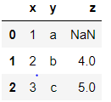
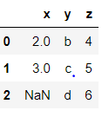
df1.merge(df2,how='left')
df1.merge(df2,how='right')

Slide 50
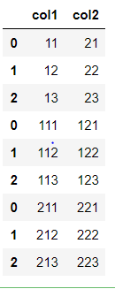
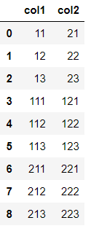
Concatenation
df1 = pd.DataFrame({'col1':[11,12,13], 'col2': [21,22,23]})
df2 = pd.DataFrame({'col1':[111,112,113], 'col2': [121,122,123]})
df3 = pd.DataFrame({'col1':[211,212,213], 'col2': [221,222,223]})
pd.concat([df1,df2,df3]) pd.concat([df1,df2,df3],ignore_index=True)

Slide 51
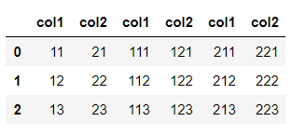
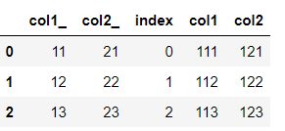
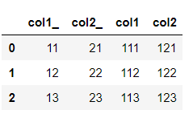
pd.concat([df1,df2,df3],axis=1)
df1.join(df2.reset_index(),lsuffix='_')
df1.join(df2,lsuffix='_')

Slide 52
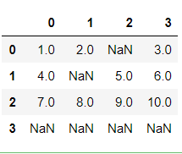
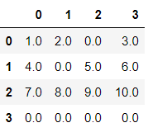
Filling of missing values
df7 = pd.DataFrame([[1, 2, None, 3], [4, None, 5, 6],[7, 8, 9, 10], [None, None, None, None]])
df7
df7.fillna(0)

Slide 53
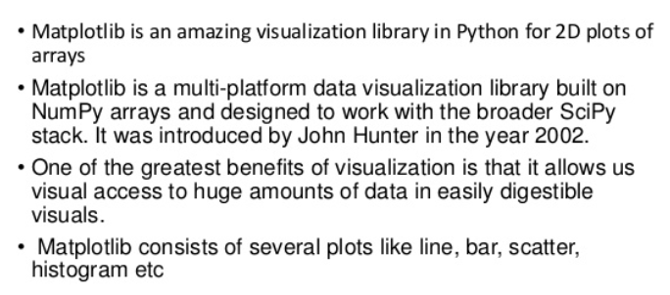
Matplotlib is a plotting library for Python. It provides object-oriented APIs for embedding plots into applications.
Install Matplotlib in Windows:
pip install matplotlib (in Command Prompt)

Slide 54
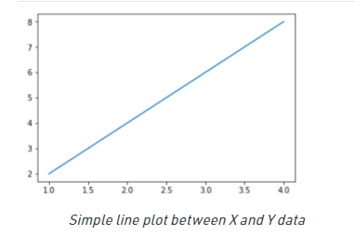
Line Plot
# importing the required libraries
import matplotlib.pyplot as plt
import numpy as np
# define data values
x = np.array([1, 2, 3, 4]) # X-axis points
y = x*2 # Y-axis points
plt.plot(x, y) # Plot the chart
plt.show() # display

Slide 55
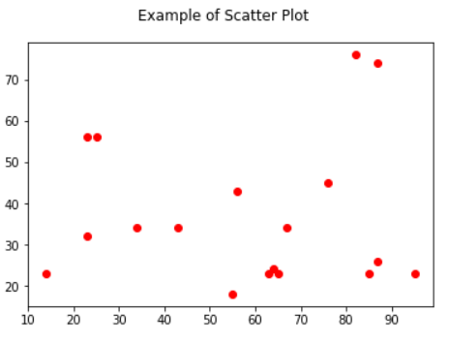
Scatter plot
A scatter plot is a chart type that is normally used to observe and visually display the relationship between variables.
import matplotlib.pyplot as plt
x = [43,76,34,63,56,82,87,55,64,87,95,23,14,65,67,25,23,85]
y = [34,45,34,23,43,76,26,18,24,74,23,56,23,23,34,56,32,23]
plt.scatter(x,y,color='red')
plt.suptitle("Example of Scatter Plot")
plt.show()

Slide 56
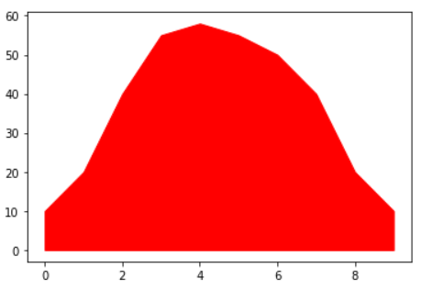
Shaded Line
import matplotlib.pyplot as plt
x = [0,1,2,3,4,5,6,7,8,9]
y1 = [10,20,40,55,58,55,50,40,20,10]
plt.fill_between(x,y1,color='red')
plt.show()

Slide 57
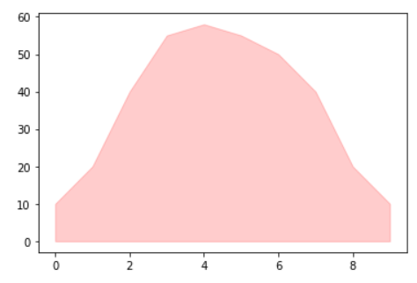
Shaded Region with transparency
import matplotlib.pyplot as plt
x = [0,1,2,3,4,5,6,7,8,9]
y1 = [10,20,40,55,58,55,50,40,20,10]
plt.fill_between(x,y1,color='red',alpha=0.2)
plt.show()

Slide 58
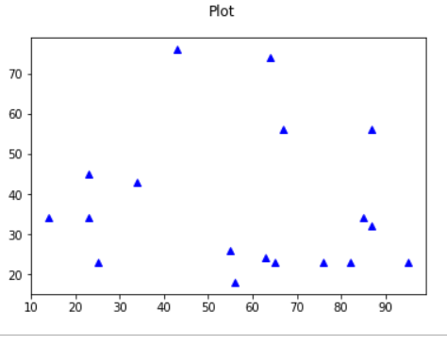
Simple Plot
import matplotlib.pyplot as plt
x = [14,23,23,25,34,43,55,56,63,64,65,67,76,82,85,87,87,95]
y = [34,45,34,23,43,76,26,18,24,74,23,56,23,23,34,56,32,23]
plt.plot(x, y, 'b^')
plt.suptitle("Plot")
plt.show()

Slide 59
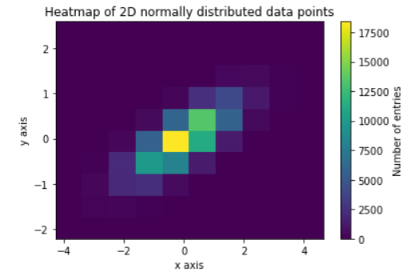
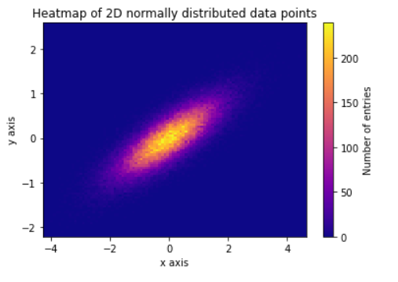
Heatmap
Heatmaps are useful for visualizing scalar functions of two variables. They provide a “flat” image of two-dimensional histogram import numpy as np
import matplotlib.pyplot as plt N_numbers = 100000 N_bins = 100 np.random.seed(0) x, y = np.random.multivariate_normal(mean=[0.0, 0.0], cov=[[1.0, 0.4],[0.4, 0.25]], size=N_numbers).T
plt.hist2d(x, y) cb = plt.colorbar() cb.set_label('Number of entries') plt.title('Heatmap of 2D normally distributed data points') plt.xlabel('x axis') plt.ylabel('y axis') plt.show()

Slide 60
Heatmap
Import numpy as np
import matplotlib.pyplot as plt N_numbers = 100000 N_bins = 100 np.random.seed(0) x, y = np.random.multivariate_normal(mean=[0.0, 0.0], cov=[[1.0, 0.4],[0.4, 0.25]], size=N_numbers).T
plt.hist2d(x, y, bins=N_bins) cb = plt.colorbar() cb.set_label('Number of entries') plt.title('Heatmap of 2D normally distributed data points') plt.xlabel('x axis') plt.ylabel('y axis') plt.show()

Slide 61
Figure and Axes Objects
The figure contains all the plot elements. The main way to create a figure in matplotlib is to use pyplot.
import matplotlib.pyplot as plt fig = plt.figure()
You can optionally supply a number, which you can use to access a previously-created figure.

Slide 62
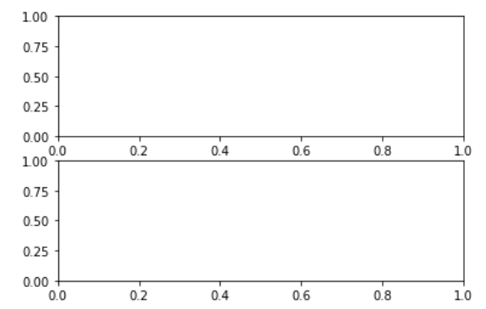
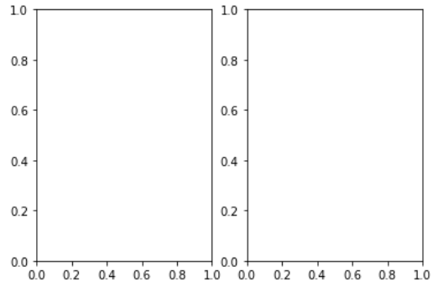
Create an axes
import matplotlib.pyplot as plt
fig,(ax1,ax2)=plt.subplots(1,2)
fig,(ax1,ax2)=plt.subplots(1,2)

Slide 63
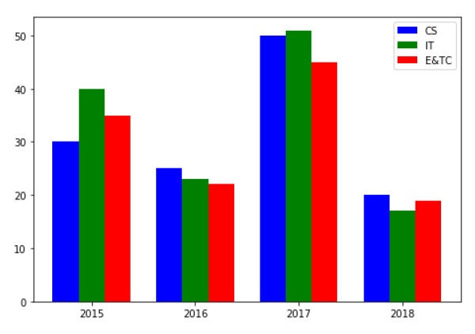
Bar graph
A bar chart or bar graph is a chart or graph that presents categorical data with rectangular bars with heights or lengths proportional to the values that they represent.
import numpy as np
import matplotlib.pyplot as plt
data = [[30, 25, 50, 20],
[40, 23, 51, 17],
[35, 22, 45, 19]]
X = np.arange(4)
fig = plt.figure()
ax = fig.add_axes([0,0,1,1])
ax.bar(X + 0.00, data[0], color = 'b', width = 0.25)
ax.bar(X + 0.25, data[1], color = 'g', width = 0.25)
ax.bar(X + 0.50, data[2], color = 'r', width = 0.25)
ax.legend(labels=['CS', 'IT',E&TC])
ax.set_xticks(ind, ('2015', '2016', '2017', '2018'))
ax.set_yticks(np.arange(0, 50, 10))
plt.show()

Slide 64
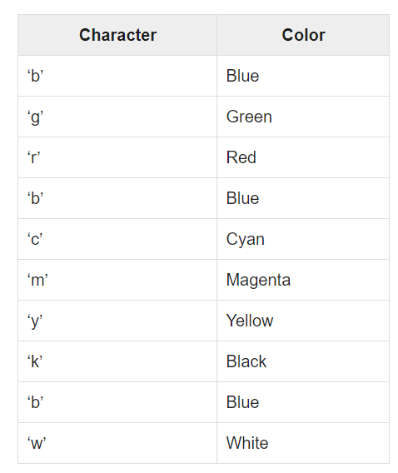
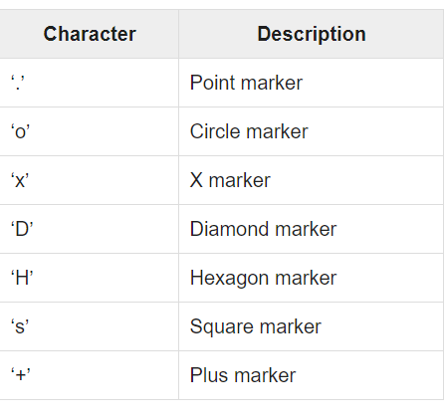
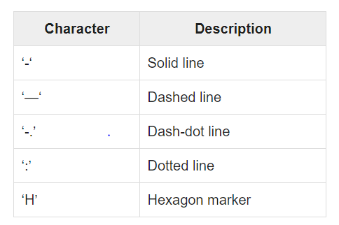
Color, Marker and Line codes

Slide 65
Scikit-Learn
scikit-learn is a general-purpose open-source library for data analysis written in python.
scikit-learncontains a number of implementation for different popular algorithms of machine learning.
Installing with Scikit-learn
pip install scikit-learn

Slide 66
Dataset Loading
A collection of data is called dataset.
It is having the following two components:
Features: The variables of data are called its features.
They are also known as predictors, inputs or attributes.
Feature matrix: It is the collection of features, in case there are more than one.
Feature Names: It is the list of all the names of the features.
Response: It is the output variable that basically depends upon the feature variables. They are also known as target, label or output.
Response Vector: It is used to represent response column.

Slide 67
from sklearn.datasets import load_iris
iris = load_iris()
X = iris.data
y = iris.target
feature_names = iris.feature_names
target_names = iris.target_names
print("Feature names:", feature_names)
print("Target names:", target_names)
Feature names: ['sepal length (cm)', 'sepal width (cm)', 'petal length (cm)', 'petal width (cm)']
Target names: ['setosa' 'versicolor' 'virginica']

Slide 68
Splitting the dataset
X = iris.data
y = iris.target
from sklearn.model_selection import train_test_split
X_train, X_test, y_train, y_test = train_test_split(X, y, test_size=0.3, random_state=1)
print(X_train.shape)
print(X_test.shape)
print(y_train.shape)
print(y_test.shape)
(105, 4)
(45, 4)
(105,)
(45,)

Slide 69
Training and Prediction
from sklearn.neighbors import KNeighborsClassifier
classifier_knn = KNeighborsClassifier(n_neighbors=3)
classifier_knn.fit(X_train, y_train)
y_pred = classifier_knn.predict(X_test)
from sklearn.linear_model import LinearRegression
model = LinearRegression(fit_intercept=True)
model.fit(X_train, y_train)
y_pred = classifier_knn.predict(X_test)

Slide 70
SVM, Naïve Bayesian
from sklearn.svm import SVC
SVCClf = SVC(kernel='linear',gamma='scale', shrinking=False,) SVCClf.fit(X_train, y_train)
y_pred=SVCClf.predict(X_test)
from sklearn.naive_bayes import GaussianNB
GNBclf = GaussianNB()
GNBclf.fit(X_train, y_train)
y_pred=GNBclf.predict(X_test)

Slide 71
Decision Tree, Random Forest
X_train, X_test, y_train, y_test = train_test_split(X, Y, test_size=0.3, random_state=1)
DTclf = tree.DecisionTreeClassifier()
DTclf.fit(X_train,y_train)
y_pred=DTclf.predict(x_test)
X_train, X_test, y_train, y_test = train_test_split(X, y, test_size=0.30) RFclf = RandomForestClassifier(n_estimators=50)
RFclf.fit(X_train, y_train)
y_pred = RFclf.predict(X_test)

Slide 72
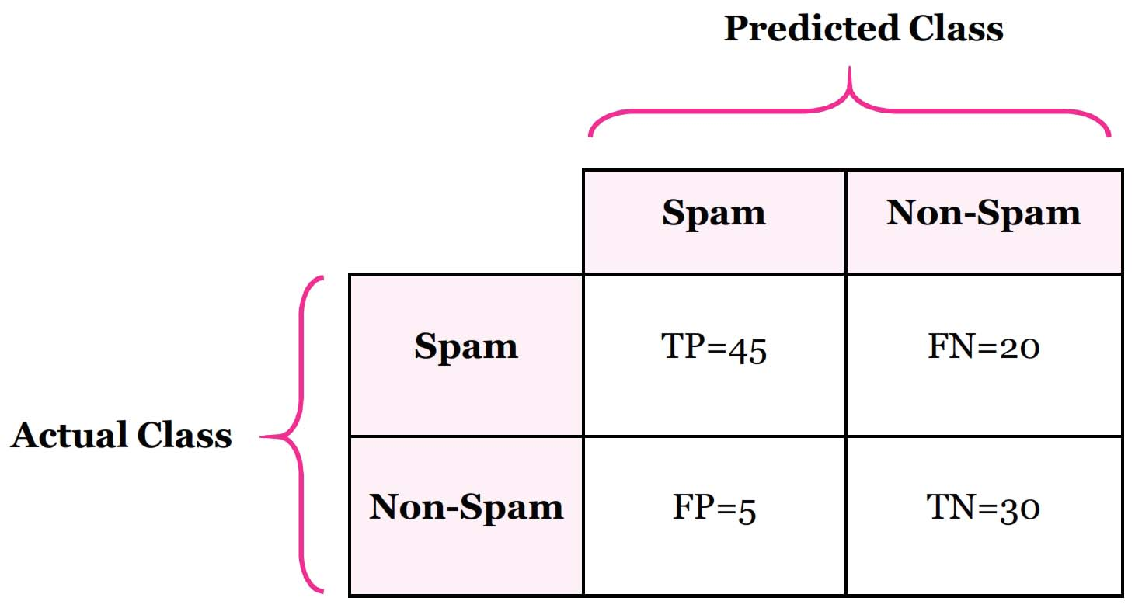


Metrics for Evaluation
from sklearn.metrics import classification_report, confusion_matrix, accuracy_score
result = confusion_matrix(y_test, y_pred)
print("Confusion Matrix:")
print(result)

Slide 73
Classification report and Accuracy
result1 = classification_report(y_test, y_pred)
print("Classification Report:",)
print (result1)
Classification Report:
precision recall f1-score
Iris-setosa 1.00 1.00 1.00
Iris-versicolor 1.00 0.95 0.97
Iris-virginica 0.92 1.00 0.96
result2 = accuracy_score(y_test,y_pred)
print("Accuracy:",result2)

Slide 74
What is Data Wrangling?
Data wrangling, also referred to as data munging, is the process of converting and mapping data from one raw format into another. The purpose of this is to prepare the data in a way that makes it accessible for effective use further down the line. Not all data is created equal, therefore it’s important to organize and transform your data in a way that can be easily accessed by others.
Benefits of Data Wrangling
Although data wrangling is an essential part of preparing your data for use, the process yields many benefits. Benefits include:
Enhances ease of access to data
Faster time to insights
Improved efficiency when it comes to data-driven decision making

Slide 75
What is Data Cleaning?
Data cleaning, also referred to as data cleansing, is the process of finding and correcting inaccurate data from a particular data set or data source .
The primary goal is to identify and remove inconsistencies without deleting the necessary data to produce insights.
It’s important to remove these inconsistencies in order to increase the validity of the data set.
Cleaning encompasses a multitude of activities such as identifying duplicate records, filling empty fields and fixing structural errors.
These tasks are crucial for ensuring the quality of data is accurate, complete, and consistent.

Slide 76
Benefits of Data Cleaning
There is a wide range of benefits that come with cleaning data that can lead to increased operational efficiency. Properly cleansing your data before use leads to benefits such as:
Elimination of errors
Reduced costs associated with errors
Improves the integrity of data
Ensures the highest quality of information for decision making

Slide 77
What’s the Difference Between Data Wrangling and Data Cleaning?
Data cleaning focuses on removing inaccurate data from your data set whereas data wrangling focuses on transforming the data’s format, typically by converting “raw” data into another format more suitable for use.
Data cleaning enhances the data’s accuracy and integrity while wrangling prepares the data structurally for modeling.

Slide 78
What is Web Scraping ?
Web Scraping (also termed Screen Scraping, Web Data Extraction, Web Harvesting etc.) is a technique employed to extract large amounts of data from websites whereby the data is extracted and saved to a local file in your computer or to a database in table (spreadsheet) format.
Web Scraping is the technique of automating this process, so that instead of manually copying the data from websites, the Web Scraping software will perform the same task within a fraction of the time.

Slide 79


Slide 80
What is web scraping?
Web scraping is the process of collecting structured web data in an automated fashion. It’s also called web data extraction.
Some of the main use cases of web scraping include price monitoring, price intelligence, news monitoring, lead generation, and market research among many others.
In general, web data extraction is used by people and businesses who want to make use of the vast amount of publicly available web data to make smarter decisions.

Slide 81
Web scraping requires two parts namely the crawler and the scraper.
The crawler is an artificial intelligence algorithm that browses the web to search the particular data required by following the links across the internet.
The scraper, on the other hand, is a specific tool created to extract the data from the website.
Different Types of Web Scrapers
Self-built Web Scrapers but that requires advanced knowledge of programming.
Pre-built Web Scrapers are previously created scrapers that you can download and run easily. These also have more advanced options that you can customize.

Slide 82
Browser extension Web Scrapers are extensions that can be added to your browser. These are easy to run as they are integrated with your browser.
Software Web Scrapers don’t have these limitations as they can be downloaded and installed on your computer. These are more complex than Browser extension Web Scrapers but they also have advanced features that are not limited by the scope of your browser.
Cloud Web Scrapers run on the cloud which is an off-site server mostly provided by the company that you buy the scraper from.
These allow your computer to focus on other tasks as the computer resources are not required to scrape data from websites.
Local Web Scrapers, on the other hand, run on your computer using local resources.

Slide 83
The scraper
A web scraper is a specialized tool designed to accurately and quickly extract data from a web page.
Web scrapers vary widely in design and complexity, depending on the project.
An important part of every scraper is the data locators (or selectors) that are used to find the data that you want to extract from the HTML file - usually, XPath, CSS selectors, regex, or a combination of them is applied.

Slide 84
The web scraping process
Identify the target website
Collect URLs of the pages where you want to extract data from
Make a request to these URLs to get the HTML of the page
Use locators to find the data in the HTML
Save the data in a JSON or CSV file or some other structured format

Slide 85
What is web scraping used for?
Price intelligence is the biggest use case for web scraping. Extracting product and pricing information from e-commerce websites, then turning it into intelligence is an important part of modern e-commerce companies that want to make better pricing/marketing decisions based on data.
How web pricing data and price intelligence can be useful:
Dynamic pricing
Revenue optimization
Competitor monitoring
Product trend monitoring
Brand and MAP compliance

Slide 86
NLTK: Natural Language Tool Kit
The Natural Language Toolkit (NLTK) is an open source Python library for Natural Language Processing.
NLTK is a leading platform for building Python programs to work with human language data.
Text processing libraries for classification, tokenization, stemming, tagging, parsing, and semantic reasoning, wrappers for industrial-strength NLP libraries.

Slide 87

NLTK Installation
Install NLTK, start up the Python interpreter as before, and install the data
>>> import nltk
>>> nltk.download()

Slide 88
Tokenizing
Splitting up text by word or by sentence.
This will allow you to work with smaller pieces of text that are still relatively coherent and meaningful even outside of the context of the rest of the text.
Tokenization is of two types
1. Tokenizing by word
2. Tokenizing by sentence

Slide 89
Word and Sentence Tokenize
from nltk.tokenize import sent_tokenize, word_tokenize
example_string = """ Muad'Dib learned rapidly because his first training was in how to learn. And the first lesson of all was the basic trust that he could learn. It's shocking to find how many people do not believe they can learn, and how many more believe learning to be difficult."""
sent_tokenize(example_string)
["Muad'Dib learned rapidly because his first training was in how to learn.", 'And the first lesson of all was the basic trust that he could learn.', "It's shocking to find how many people do not believe they can learn, and how many more believe learning to be difficult."]

Slide 90
word_tokenize(example_string)
["Muad'Dib",
'learned',
'rapidly',
'because',
'his',
'first',
'training',
'was',
'in',
'how',…..]

Slide 91
Filtering Stop Words
Stop words are words that you want to ignore, so you filter them out of your text when you’re processing it. Very common words like 'in', 'is', and 'an' are often used as stop words since they don’t add a lot of meaning to a text in and of themselves.
>>> nltk.download("stopwords")
>>> from nltk.corpus import stopwords
>>> from nltk.tokenize import word_tokenize
>>> Sentence="Sir, I Protest. I am not merry man!"
>>> words=word_tokenize(Sentence)
>>> words
['Sir', ',', 'I', 'Protest', '.', 'I', 'am', 'not', 'merry', 'man', '!']
>>> stop=set(stopwords.words('english'))
>>> filtword=[]
>>> filtword
['Sir', ',', 'I', 'Protest', '.', 'I', 'merry', 'man', '!']
>>> stop
{"it's", 'and', 'o', 'them', 'your', 'you', 'through', 'who', 'over', 'an', 'own', 'against', 'why', "hasn't", "needn't", 'y', 'theirs', 'until', 'very', 'hers', 'because', 'the', 'have', 'same', 'mustn', 'more', 'these', 'were', 'her', 'ours', 'it', 'shan', 'having', "don't", "couldn't", 'other', 'into', 'he', 'under', "isn't", 's', 'again', 'don', 'too', 'we', 'where', 'but', 'was', 'so', 'in', 'than', 'haven', 'all', 'what', 'been', 'ourselves', 'isn', "you've", 'now', 'which', 'be', 'before', 'then', 'do', 'd', "wouldn't", 'not', 'should', "you're", 'few', 'when', "weren't", "should've", "shouldn't", 'no', 'this', 'on', 'above', 'his', 'between', 'can', "you'd", 'once', 'didn', 'are', 'my', 've', 'm', 'their', 'being', 'if', "aren't", 'our', 'i', 'yours', 'wasn', 'only', "you'll", 'him', 'doing', 'by', 'most', 'off', 'out', 'a', 'about', "wasn't", 'does', 'such', "didn't", 'll', 'me', 'will', 'after', 'yourselves', 'himself', 'that', 'did', 'wouldn', 'up', 'down', 'ain', 'at', "she's", 'she', 't', 're', "shan't", 'or', "mightn't", "doesn't", 'won', 'those', 'while', 'aren', 'hadn', 'there', 'is', 'had', 'some', 'couldn', "that'll", 'any', 'both', 'am', 'as', 'here', 'ma', 'each', 'weren', 'of', 'has', 'for', 'herself', 'itself', "mustn't", 'needn', 'whom', 'shouldn', 'how', 'further', 'mightn', 'yourself', 'themselves', 'its', 'below', 'with', 'myself', 'just', "won't", 'from', 'during', "hadn't", 'to', 'hasn', "haven't", 'doesn', 'nor', 'they'}

Slide 92
Stemming
Stemming is a text processing task in which you reduce words to their root, which is the core part of a word.
For example, the words “helping” and “helper” share the root “help.”
>>> from nltk.stem import PorterStemmer
>>> from nltk.tokenize import word_tokenize
>>> stemmer = PorterStemmer()
>>> string_for_stemming = """
The crew of the USS Discovery discovered many discoveries.
Discovering is what explorers do.""“
>>> words = word_tokenize(string_for_stemming)
stemmed_words = [stemmer.stem(word) for word in words]

Slide 93
>>> stemmed_words
['the',
'crew',
'of',
'the',
'uss',
'discoveri',
'discov',
'mani',
'discoveri',
'.',
'discov',
'is',
'what',
'explor',
'do',
'.']

Slide 94
Tagging Parts of Speech
Part of speech is a grammatical term that deals with the roles words play when you use them together in sentences.
>>> from nltk import pos_tag
>>> Sentence="Sir, I Protest. I am not merry man!“
>>> from nltk.tokenize import word_tokenize
>>> words= word_tokenize(Sentence)
>>> words
['Sir', ',', 'I', 'Protest', '.', 'I', 'am', 'not', 'merry', 'man', '!']
>>> pos_tag(words)
[('Sir', 'NNP'), (',', ','), ('I', 'PRP'), ('Protest', 'VBP'), ('.', '.'), ('I', 'PRP'), ('am', 'VBP'), ('not', 'RB'), ('merry', 'JJ'), ('man', 'NN'), ('!', '.')]

Slide 95


Slide 96


Slide 97
The Curse of Dimensionality
Handling the high-dimensional data is very difficult in practice, commonly known as the curse of dimensionality.
If the dimensionality of the input dataset increases, any machine learning algorithm and model becomes more complex.
As the number of features increases, the number of samples also gets increased proportionally, and the chance of overfitting also increases.
If the machine learning model is trained on high-dimensional data, it becomes overfitted and results in poor performance.
Hence, it is often required to reduce the number of features, which can be done with dimensionality reduction.

Slide 98


Slide 99


Slide 100


Slide 101


Slide 102


Slide 103


Slide 104


Slide 105


Slide 106



Slide 107



Slide 108



