Slide 1
Unit-5
Recommender Systems, Sentiment analysis

Slide 2
Recommender Systems
Recommender systems are algorithms aimed at suggesting relevant items to users (items being movies to watch, products to buy or anything else depending on industries).
Recommender systems are really critical in some industries as they can generate a huge amount of income when they are efficient or also be a way to stand out significantly from competitors.
Netflix organised a challenges (the “Netflix prize”) where the goal was to produce a recommender system that performs better than its own algorithm with a prize of 1 million dollars to win.

Slide 3
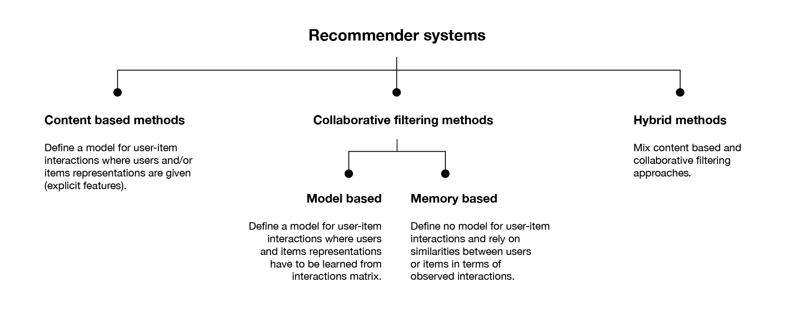
Paradigms of Recommender Systems

Slide 4
Collaborative Recommendation
The basic idea of these systems is that if users shared the same interests in the past – if they viewed or bought the same books, for instance – they will also have similar tastes in the future.
for example, user A and user B have a purchase history that overlaps strongly and user A has recently bought a book that B has not yet seen, the basic rationale is to propose this book also to B. Because this selection of hopefully interesting books involves filtering the most promising ones from a large set and because the users implicitly collaborate with one another, this technique is also called collaborative filtering (CF).

Slide 5
Typical questions that arise in the context of collaborative approaches
How do we find users with similar tastes to the user for whom we need a recommendation?
How do we measure similarity?
What should we do with new users, for whom a buying history is not yet available?
How do we deal with new items that nobody has bought yet?
What if we have only a few ratings that we can exploit?
What other techniques besides looking for similar users can we use for making a prediction about whether a certain user will like an item?

Slide 6
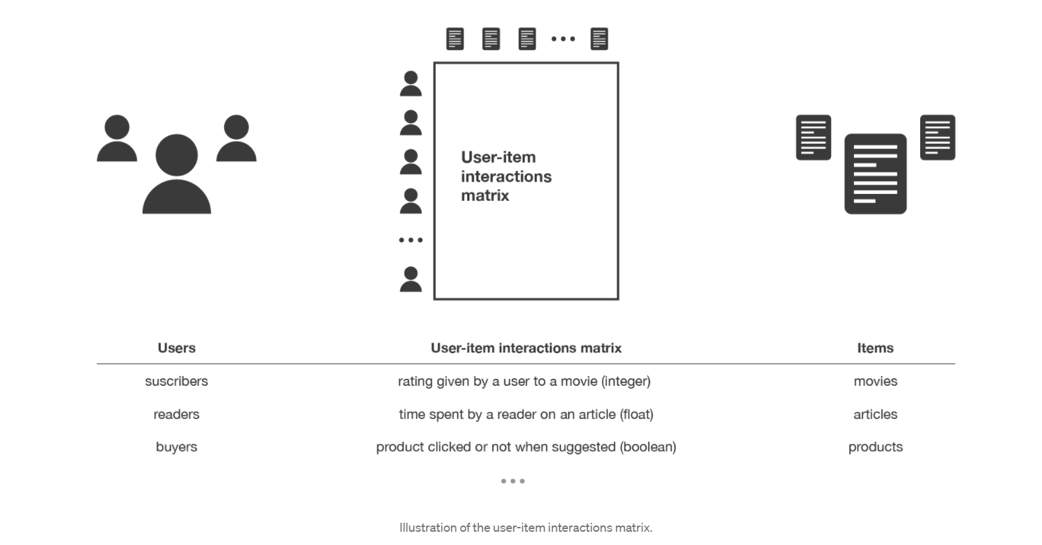

Slide 7
Content-based recommendation
Recommender systems can also be seen as tools for dealing with information overload, as these systems aim to select the most interesting items from a larger set.
Recommender systems research is also strongly rooted in the fields of information retrieval and information filtering.
In these areas, however, the focus lies mainly on the problem of discriminating between relevant and irrelevant documents
Many of the techniques developed in these areas exploit information derived from the documents’ contents to rank them.
These techniques will be discussed in the chapter on content-based recommendation.

Slide 8
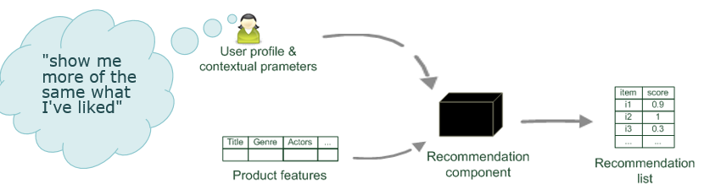

Slide 9
Content-based recommendation is based on the availability of item descriptions and a profile that assigns importance to these characteristics.
If we think again of the bookstore example, the possible characteristics of books might include the genre, the specific topic, or the author.
Similar to item descriptions, user profiles may also be automatically derived and “learned” either by analyzing user behavior and feedback or by asking explicitly about interests and preferences.

Slide 10
Typical questions that arise in the content-based recommendation
How can systems automatically acquire and continuously improve user profiles?
How do we determine which items match, or are at least similar to or compatible with, a user’s interests?
What techniques can be used to automatically extract or learn the item descriptions to reduce manual annotation?

Slide 11
Advantages of content-based recommendation
First, it does not require large user groups to achieve reasonable recommendation accuracy. In addition, new items can be immediately recommended once item attributes are available.
In some domains, such item descriptions can be automatically extracted or are already available in an electronic catalog.
In many domains, however, the more subjective characteristics of an item – such as “ease of use” or “elegance of design” – would be useful in the recommendation process.
These characteristics are hard to acquire automatically, however, meaning that such information must be manually entered into the system in a potentially expensive and error-prone process

Slide 12
Hybrid approaches
We have already seen that the different approaches discussed so far have certain advantages and, of course, disadvantages depending on the problem setting.
One obvious solution is to combine different techniques to generate better or more precise recommendations
If, for instance, community knowledge exists and detailed information about the individual items is available, a recommender system could be enhanced by hybridizing collaborative or social filtering with content-based techniques

Slide 13
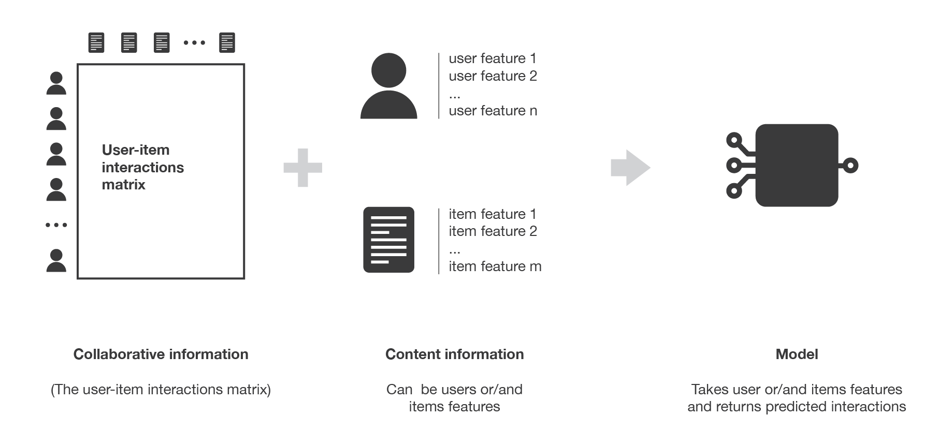

Slide 14
Sentiment Analysis
Sentiment Analysis (or Opinion Mining) is a natural language processing technique used to determine whether the data is positive, negative or neutral.
Sentiment Analysis is often performed on textual data to help businesses monitor brand and product sentiment in customer feedback and understand customer needs.

Slide 15
Definition
Sentiment Analysis is process of detecting positive or negative sentiment in the text.
Its often used by businesses to detect sentiment in social data, brand reputation and understand customers.
Since customers express their thoughts and feelings more openly than ever before sentiment analysis is an essential tool to monitor and understand the customer.
It allows businesses learn what makes customers happy or frustrated.
For Example, using sentiment analysis to automatically analyse 4000+ reviews about the product could help you discover whether the customers are happy about product and services

Slide 16
Why Sentiment Analysis is Important
Sentiment Analysis is extremely important because it helps businesses quickly understand the overall opinions of their customers. By automatically sorting sentiment behind reviews.
For this huge volumes of unstructured data are created everyday : emails, support tickets, chats, social media conversations surveys.

Slide 17
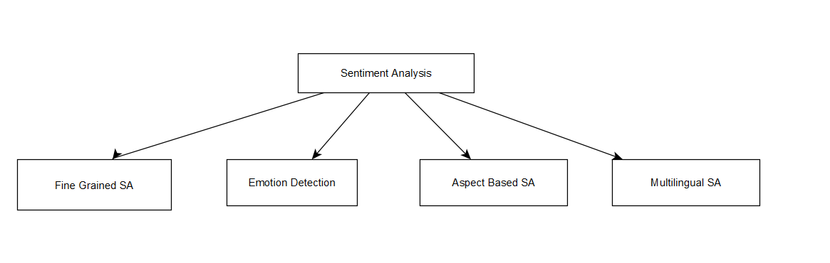
Types of Sentiment Analysis

Slide 18
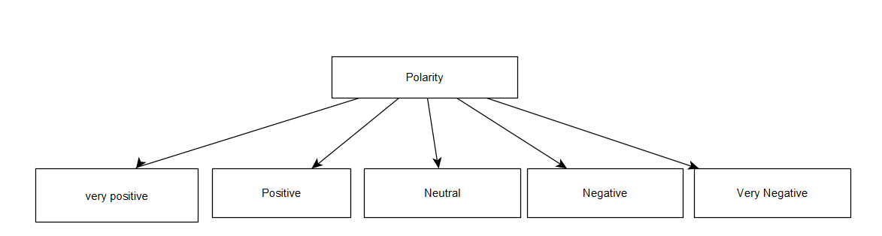
Fined grained Sentiment Analysis
If polarity precision is important to your business, consider expanding your polarity

Slide 19
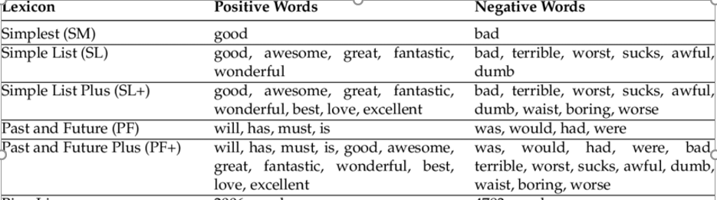
Emotion Detection
This type of SA aims to detect emotion like happiness, frustration, anger, sadness and so on
Many emotion detection systems use lexicons (i.e., list of words and the emotion they convey) or complex machine learning algorithms.

Slide 20
Aspect based Sentiment Analysis
When analysing sentiments of text lets say product reviews we will want to know which particular aspect or features people are mentioning in positive, negative or neutral way.
Example: The battery life of this camera is too short, a aspect based classifier able to determine that the sentence expresses a negative opinion about the feature battery life.

Slide 21
Multilingual Sentiment Analysis
Multilingual Sentiment Analysis can be difficult.
It involves a lot of preprocessing and resources
Example: Noise detection Algorithms
Sentiment lexicons translated corpora

Slide 22
Benefits of Sentiment Analysis
Storing data at scale:
It is difficult to sort thousands of review manually. Sentiment analysis helps business process huge amount of data in efficient and cost effective way.
Real Time Analysis:
Sentiment Analysis can identify critical issues in real time. Sentiment Analysis models can help you immediately identify thesis kinds of situations.

Slide 23
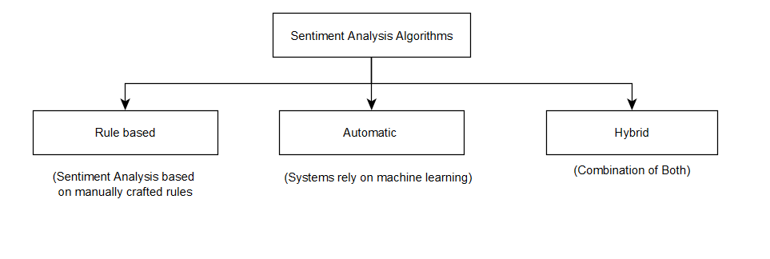
Sentiment Analysis Algorithms

Slide 24
Rule Based Sentiment Analysis
A rule based system uses a set of human crafted rules to help identify, subjective polarity or subject of an opinion.
Rules may include various NLP techniques such as:
Stemming, tokenization, part of speech, tagging.
Lexicons
Working:
Define two lists of polarized words(negative and positive words)
Counts the number of positive and negative words in given text
Based on number of polarity ratio the system returns its sentiment.

Slide 25
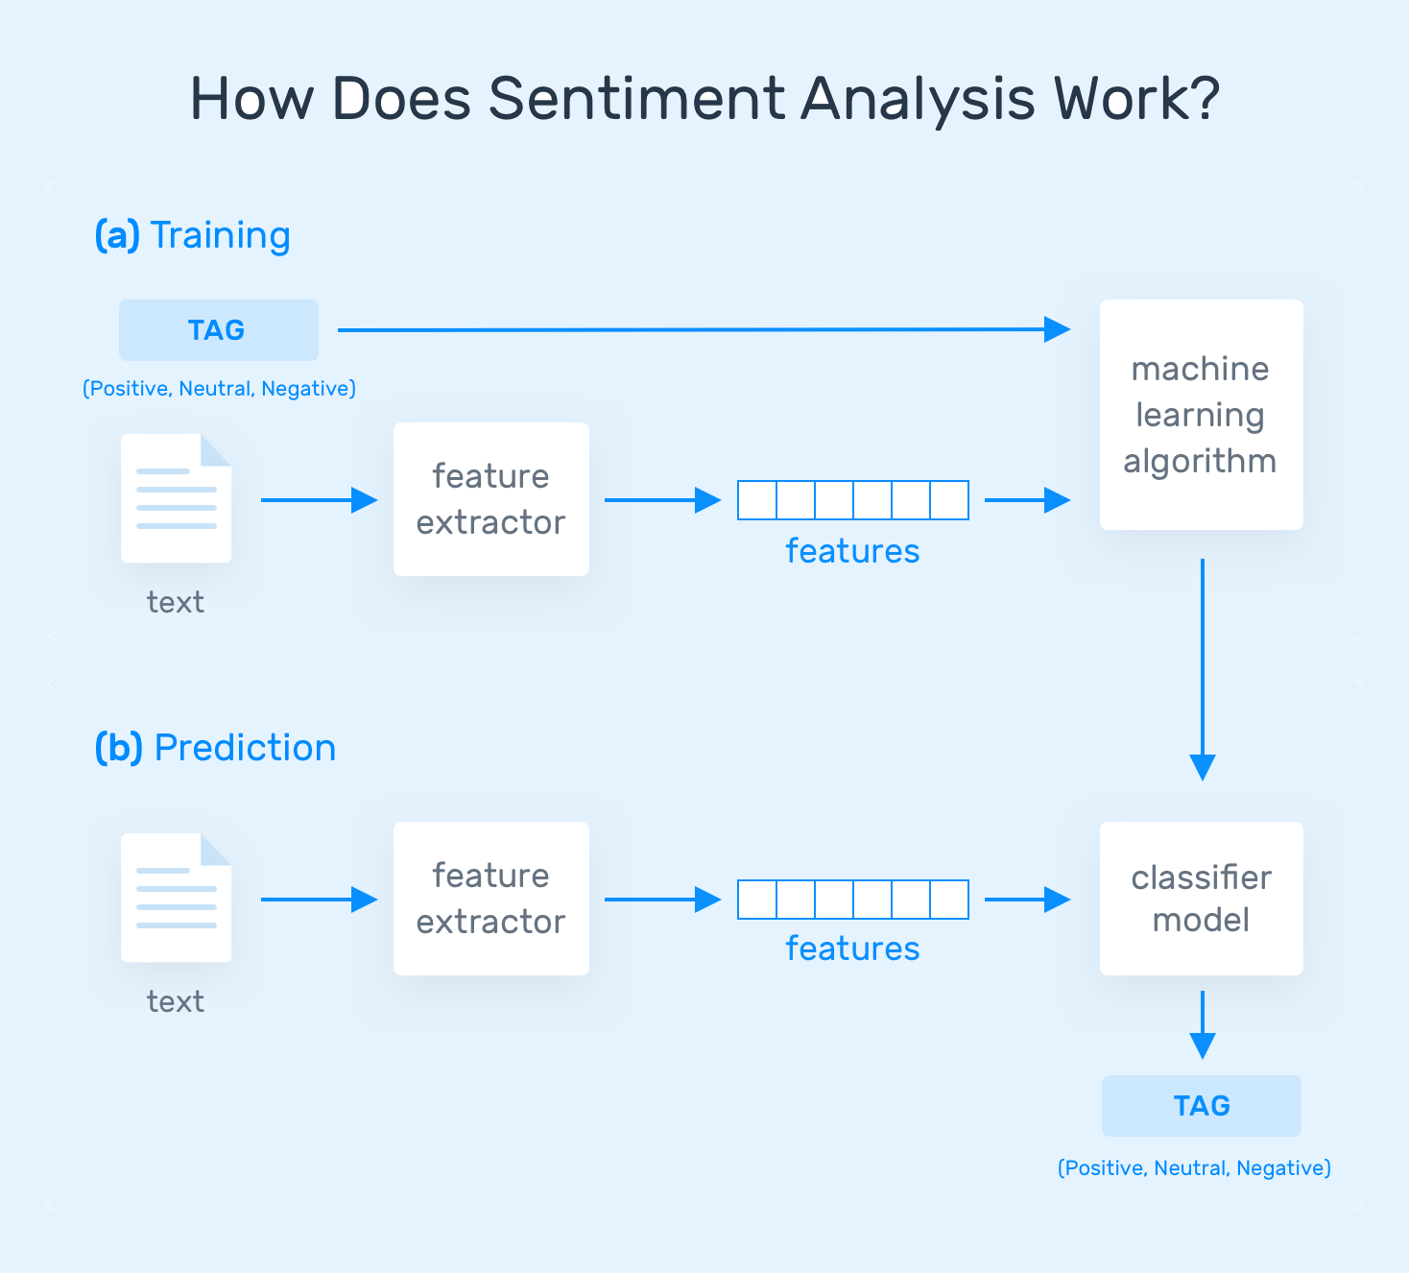
Automatic Approach

Slide 26
Data Cleaning
Transforming data into lower case:
text = “This is a Demo Text for NLP using NLTK. Full form of NLTK is Natural Language Toolkit” lower_text = text.lower()
Removing punctuations:
sentence = "Think and wonder, wonder and think."
words = nltk.word_tokenize(sentence)
new_words= [word for word in words if word.isalnum()]
print(new_words)

Slide 27
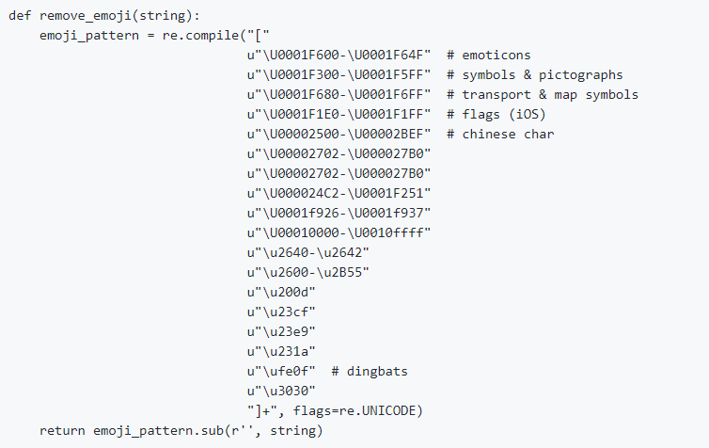
Removing emoji
Removing stop words
Lemmatization or stemming

Slide 28
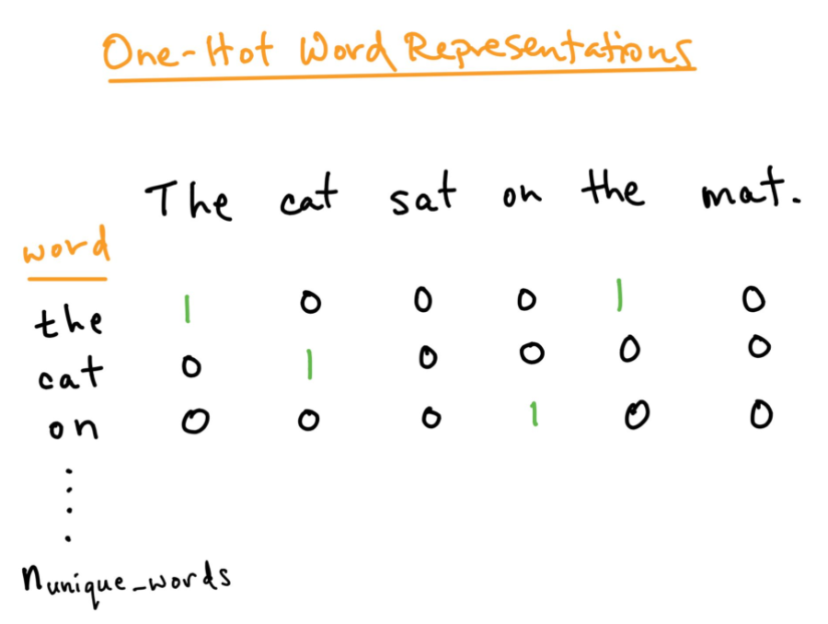
Text Representation

Slide 29
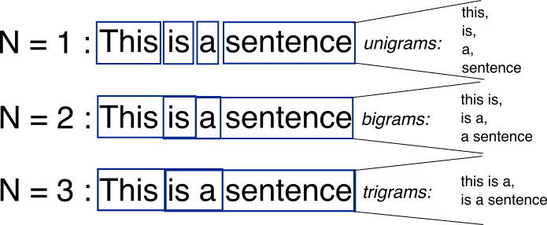
N-grams
An n-gram is a contiguous sequence of n items from a given sample of text or speech.
n-gram of size 1 is referred to as a "unigram"; size 2 is a "bigram“, size 3 is a "trigram".

Slide 30
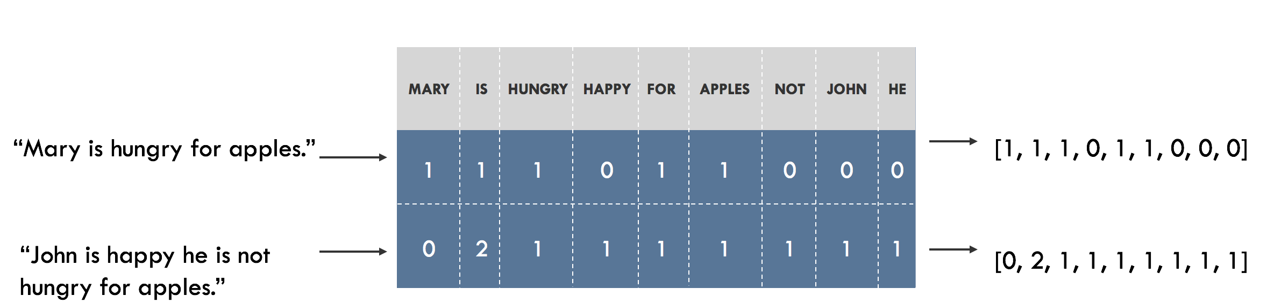
Bag of words

Slide 31
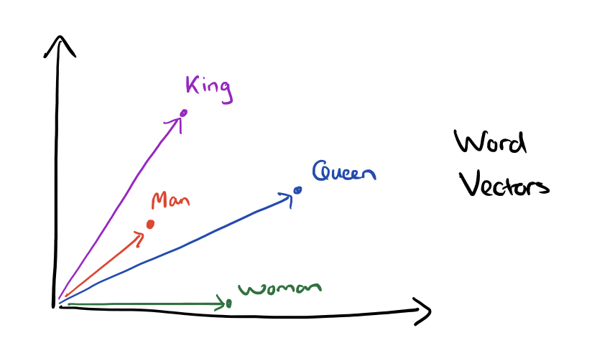
Word Embedding: Word2vec

Slide 32
Word embedding is a mapping of words into vectors.
A word gets converted into a vector of N dimensions, where each of these dimensions will have an underlying meaning. How the word relates to these underlying meanings will define the values for the dimension.
A word embedding of 2 dimensions may map words as follows:
man → [0.85, 0.05 ]
dog → [ 0.9, 0.1 ]
apple → [ 0.12, 0.9 ]
banana → [0.06, 0.95 ]

Slide 33
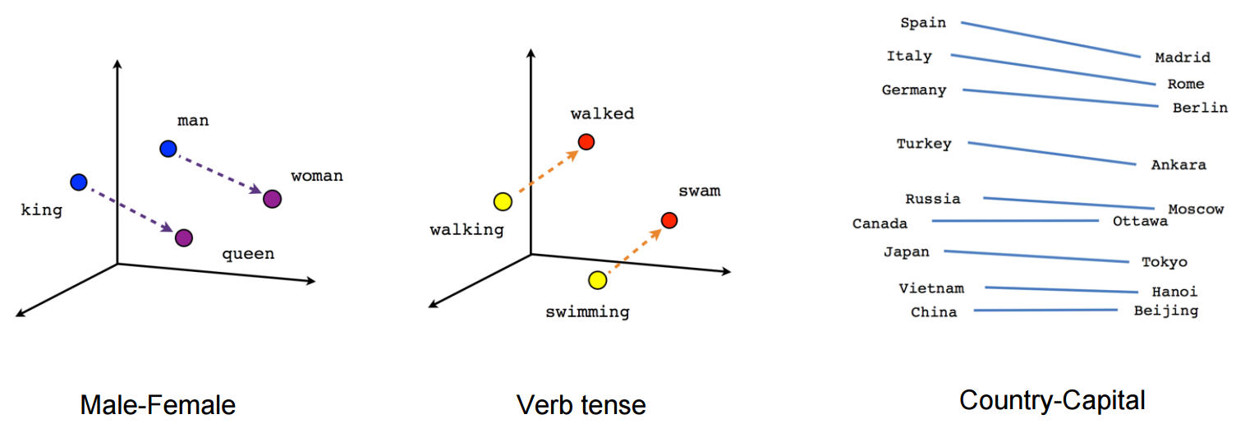
<man> — <woman> = <king> — <queen>

Slide 34
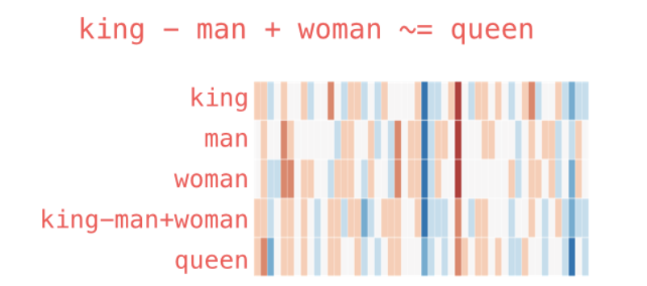

Slide 35

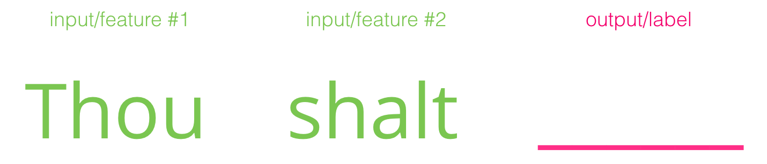
Word Prediction

Slide 36
