Slide 1
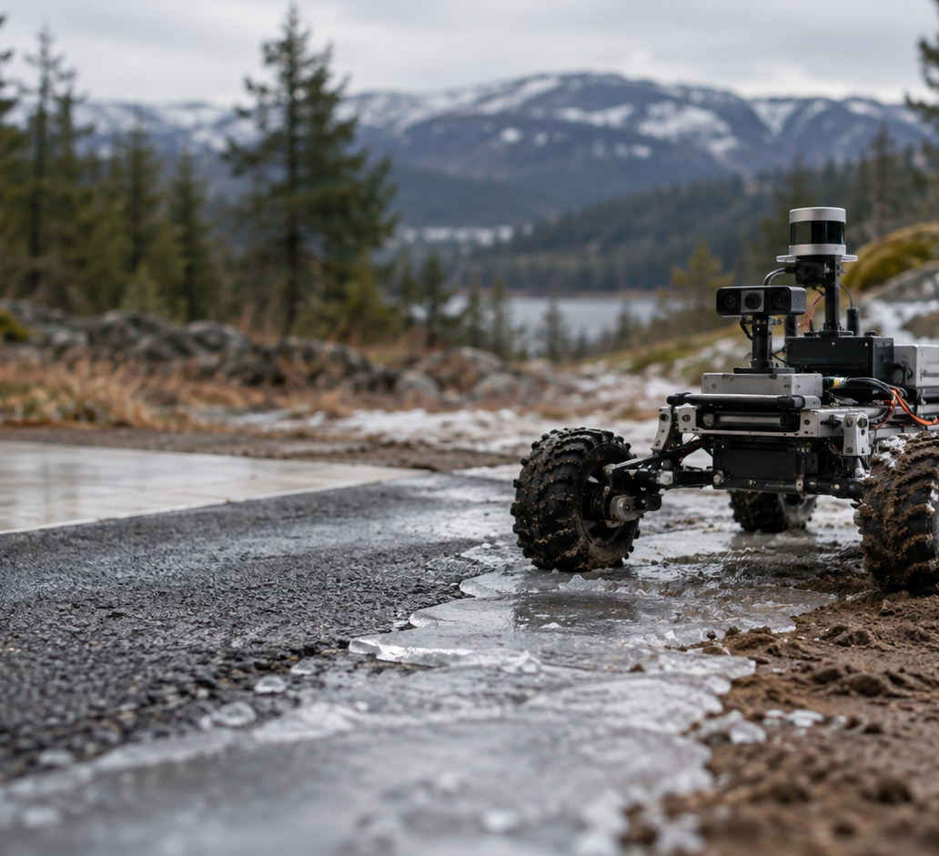
UE24CS352A / MACHINE LEARNING
Terrain
classification
from real robot sensor time series
A feature-engineering and temporal CNN study
Mini-project review | October 2026
Cover illustration; project results use recorded BorealTC data.
Notes:
Source: the supplied ml_mini_project-main archive, checked against the GitHub checkout. Facts are drawn from README.md, data/source_manifest.json, terrain/data.py, terrain/models.py, terrain/train.py, results/metrics.json, results/test_predictions.npz, results/training_history.json, results/confusion_matrices.png, results/training_curves.png and docs/VALIDATION.md.
Dataset source: BorealTC, pinned at 0146dcd9fa08c34a9075a80448ac04c0a947b568. The project downloader verified the 144 manifested files against Git blob hashes. The generated cover image is illustrative and is not a dataset photograph.
Opening: The project uses real inertial and wheel signals to classify five terrain labels. The rover image is a generated illustration, not the robot used to collect the source recordings.

Slide 2
PROJECT QUESTION AND SCOPE
Can robot motion identify the terrain?
Input
RESEARCH INSPIRATION
A short time window from inertial and wheel sensors on a mobile robot.
Tactile terrain classification on a small legged robot.
Output
THIS IMPLEMENTATION
One of five recorded terrain classes
Real BorealTC measurements from a wheeled Husky: IMU, motor-current and wheel-speed channels.
Asphalt · Flooring · Ice · Loam · Snow
A real-data adaptation, not an exact reproduction.
UE24CS352A | Terrain classification from robot sensor time series
02 / 20
Notes:
Source: the supplied ml_mini_project-main archive, checked against the GitHub checkout. Facts are drawn from README.md, data/source_manifest.json, terrain/data.py, terrain/models.py, terrain/train.py, results/metrics.json, results/test_predictions.npz, results/training_history.json, results/confusion_matrices.png, results/training_curves.png and docs/VALIDATION.md.
Dataset source: BorealTC, pinned at 0146dcd9fa08c34a9075a80448ac04c0a947b568. The project downloader verified the 144 manifested files against Git blob hashes. The generated cover image is illustrative and is not a dataset photograph.
The supplied Choi and Thomasson paper uses tactile sensors and different terrain labels. The final project uses BorealTC proprioceptive data. Its scores are not directly comparable to the paper.

Slide 3
DATASET PROVENANCE
The pinned dataset contains 71 recordings
Terrain | Recordings | Sensor CSVs
Asphalt | 7 | 14
Flooring | 10 | 20
Ice | 13 | 26
Loam (SANDY_LOAM) | 14 | 28
Snow | 27 | 54
Total | 71 | 142
SOURCE SNAPSHOT
BorealTC revision
0146dcd9fa08c34a9075a80448ac04c0a947b568
144 manifested files · 90,534,541 bytes
142 sensor CSVs plus dataset README and license file. Mixed-terrain recordings are excluded.
The archive includes the manifest and checksum-verifying downloader. Raw CSVs are retrieved from the pinned source.
Dataset README declares CC0 1.0.
UE24CS352A | Terrain classification from robot sensor time series
03 / 20
Notes:
Source: the supplied ml_mini_project-main archive, checked against the GitHub checkout. Facts are drawn from README.md, data/source_manifest.json, terrain/data.py, terrain/models.py, terrain/train.py, results/metrics.json, results/test_predictions.npz, results/training_history.json, results/confusion_matrices.png, results/training_curves.png and docs/VALIDATION.md.
Dataset source: BorealTC, pinned at 0146dcd9fa08c34a9075a80448ac04c0a947b568. The project downloader verified the 144 manifested files against Git blob hashes. The generated cover image is illustrative and is not a dataset photograph.
The manifest contains 144 selected files: 142 paired IMU/proprioceptive CSVs plus the upstream dataset README and license file. The 90.5 MB CSV subset omits MIXED. The zipped project does not contain the raw data, but the project downloader retrieves and verifies it.

Slide 4
DATASET COMPOSITION
The fixed split preserves all five classes
Terrain | Train windows | Validation windows | Test windows | Total
Asphalt | 275 | 5 | 51 | 331
Flooring | 617 | 259 | 378 | 1254
Ice | 1049 | 67 | 221 | 1337
Loam | 211 | 83 | 87 | 381
Snow | 502 | 157 | 193 | 852
Total | 2,654 | 571 | 930 | 4,155
Recordings stay intact: 43 train · 14 validation · 14 test
Window counts reflect recording duration; windows are not independent field trials.
UE24CS352A | Terrain classification from robot sensor time series
04 / 20
Notes:
Source: the supplied ml_mini_project-main archive, checked against the GitHub checkout. Facts are drawn from README.md, data/source_manifest.json, terrain/data.py, terrain/models.py, terrain/train.py, results/metrics.json, results/test_predictions.npz, results/training_history.json, results/confusion_matrices.png, results/training_curves.png and docs/VALIDATION.md.
Dataset source: BorealTC, pinned at 0146dcd9fa08c34a9075a80448ac04c0a947b568. The project downloader verified the 144 manifested files against Git blob hashes. The generated cover image is illustrative and is not a dataset photograph.
Class windows in train/validation/test are taken directly from results/metrics.json and reproduced by rerunning terrain.data.prepare() on all 144 verified files. Totals: asphalt 331, flooring 1,254, ice 1,337, sandy loam 381, snow 852.

Slide 5
MEASURED INPUT
One held-out window contains ten sensor traces
Example: ASPHALT/03 · held-out sample 185 · ASPHALT · 100 Hz
Every fifth of 170 samples is shown to keep the real 1.7-second trace readable.
UE24CS352A | Terrain classification from robot sensor time series
05 / 20
Notes:
Source: the supplied ml_mini_project-main archive, checked against the GitHub checkout. Facts are drawn from README.md, data/source_manifest.json, terrain/data.py, terrain/models.py, terrain/train.py, results/metrics.json, results/test_predictions.npz, results/training_history.json, results/confusion_matrices.png, results/training_curves.png and docs/VALIDATION.md.
Dataset sample: data/demo_samples.npz, sample 0 (global test index 185), group ASPHALT/03, start_seconds 0.0. The chart uses every fifth recorded point from the original 170-sample held-out window. Channels follow terrain/data.py: wx/wy/wz, ax/ay/az, curL/curR, velL/velR.

Slide 6
DATA PREPARATION
Preprocessing keeps the sensor timeline causal
01
Read paired files
IMU + wheel CSV
02
Validate rows
Finite values; increasing timestamps
03
Align signals
Latest preceding wheel value
04
Make windows
170 samples; no overlap
05
Normalize
Fit on training data only
The 100 Hz IMU grid sets the window clock; incomplete tails are discarded.
UE24CS352A | Terrain classification from robot sensor time series
06 / 20
Notes:
Source: the supplied ml_mini_project-main archive, checked against the GitHub checkout. Facts are drawn from README.md, data/source_manifest.json, terrain/data.py, terrain/models.py, terrain/train.py, results/metrics.json, results/test_predictions.npz, results/training_history.json, results/confusion_matrices.png, results/training_curves.png and docs/VALIDATION.md.
terrain/data.py validates required columns, finite measurements and strictly increasing timestamps. IMU rows are restricted to common wheel-data coverage; pandas merge_asof(direction='backward') holds the latest prior wheel reading. This prevents using a future wheel sample.

Slide 7
EVALUATION DESIGN
The split is assigned before windowing
Recording IDs, not neighboring windows, define the partition.
43
14
14
train recordings
validation recordings
test recordings
Model fitting
Model and checkpoint selection
Final score only
Seed 42
Train-only scaling
Frozen test
Recordings are assigned within each terrain.
Channel and feature statistics are fitted on training windows.
Validation chooses settings; test labels do not select the model.
UE24CS352A | Terrain classification from robot sensor time series
07 / 20
Notes:
Source: the supplied ml_mini_project-main archive, checked against the GitHub checkout. Facts are drawn from README.md, data/source_manifest.json, terrain/data.py, terrain/models.py, terrain/train.py, results/metrics.json, results/test_predictions.npz, results/training_history.json, results/confusion_matrices.png, results/training_curves.png and docs/VALIDATION.md.
In data.py, split_runs(seed=42) allocates recordings separately within each terrain before window creation. In train.py, train, validation and test groups are checked for overlap. Normalization/scaling fit on training data; checkpoints/hyperparameters use validation only.

Slide 8
FEATURE ENGINEERING
Six statistics summarize each of ten channels
10 channels × 6 statistics = 60 features
CHANNEL FAMILIES
01 Mean
04 Maximum
Angular velocity · 3
02 Standard deviation
05 Root mean square
Acceleration · 3
Motor current · 2
03 Minimum
06 First-difference RMS
Wheel speed · 2
The terrain label is never a model input.
UE24CS352A | Terrain classification from robot sensor time series
08 / 20
Notes:
Source: the supplied ml_mini_project-main archive, checked against the GitHub checkout. Facts are drawn from README.md, data/source_manifest.json, terrain/data.py, terrain/models.py, terrain/train.py, results/metrics.json, results/test_predictions.npz, results/training_history.json, results/confusion_matrices.png, results/training_curves.png and docs/VALIDATION.md.
terrain/data.py extracts mean, standard deviation, min, max, RMS and first-difference RMS per channel into float32 features. The SVM and hybrid model use these 60 values. The raw CNN receives only the normalized signal window.

Slide 9
CANDIDATE MODELS
Three model families test feature fusion
Candidate | Model input | Comparison question
RBF SVM | 60 standardized statistics | Strong nonlinear baseline for small data
1D CNN | 10 × 170 normalized sensor window | Can learned temporal patterns compete?
CNN + statistics | CNN representation + 60 statistics | Do hand-crafted summaries add signal?
Majority baseline | Always predicts the most common train class | Reference floor for the test results
The majority model predicts ICE, the most common training class.
All five classes appear in every partition.
UE24CS352A | Terrain classification from robot sensor time series
09 / 20
Notes:
Source: the supplied ml_mini_project-main archive, checked against the GitHub checkout. Facts are drawn from README.md, data/source_manifest.json, terrain/data.py, terrain/models.py, terrain/train.py, results/metrics.json, results/test_predictions.npz, results/training_history.json, results/confusion_matrices.png, results/training_curves.png and docs/VALIDATION.md.
The SVM is an RBF SVC with balanced class weights. The baseline is sklearn DummyClassifier(strategy='most_frequent'), which predicts ICE because it has the largest training count (1,049).

Slide 10
CNN ARCHITECTURE
The hybrid joins temporal and statistical features
Raw 1D CNN path
10 × 170
Conv 24
Conv 24
Conv 24
Conv 24
240
›
›
›
›
›
sensor input
kernel 5
pool / dropout
pool / dropout
pool / dropout
learned values
Feature path
60 normalized summary features
+
Concatenate → Dense 64 → 5
Each of four Conv1d blocks uses 24 output channels, ReLU, max-pooling and dropout 0.3. Sequence lengths: 170 → 85 → 42 → 21 → 10; the CNN output contains 240 learned values.
The hybrid dense input has 240 + 60 = 300 values.
UE24CS352A | Terrain classification from robot sensor time series
10 / 20
Notes:
Source: the supplied ml_mini_project-main archive, checked against the GitHub checkout. Facts are drawn from README.md, data/source_manifest.json, terrain/data.py, terrain/models.py, terrain/train.py, results/metrics.json, results/test_predictions.npz, results/training_history.json, results/confusion_matrices.png, results/training_curves.png and docs/VALIDATION.md.
Exact architecture from terrain/models.py: Conv1d channels 10→24 then 24→24 three times, kernel 5 padding 2, ReLU, MaxPool1d(2), Dropout(0.3). Lengths 170→85→42→21→10. Flatten gives 240; hybrid adds 60 features; head 64 hidden ReLU/dropout then 5 logits.

Slide 11
TRAINING PROTOCOL
Validation macro-F1 governs every model choice
Model / option | Search or training setup | Selected setting
SVM | C ∈ {0.1, 1, 10, 100}; gamma ∈ {scale, 0.01} | C=10, gamma=0.01
Raw CNN | Adam 0.001; weight decay 0.0001; batch 64 | Best checkpoint at epoch 26
CNN + statistics | Weighted cross-entropy; patience 12; max 60 epochs | Best checkpoint at epoch 39
Randomness | Seed 42; deterministic torch algorithms | Same seed for data and training
Winner: CNN + statistics, validation macro-F1 = 0.726.
Test scores are not used to choose a checkpoint or model.
UE24CS352A | Terrain classification from robot sensor time series
11 / 20
Notes:
Source: the supplied ml_mini_project-main archive, checked against the GitHub checkout. Facts are drawn from README.md, data/source_manifest.json, terrain/data.py, terrain/models.py, terrain/train.py, results/metrics.json, results/test_predictions.npz, results/training_history.json, results/confusion_matrices.png, results/training_curves.png and docs/VALIDATION.md.
The SVM grid has eight combinations and selects validation macro-F1. CNN and hybrid use Adam (learning rate 0.001, weight decay 0.0001), weighted cross-entropy and early stopping at patience 12, up to 60 epochs. Histories record 38 raw-CNN epochs (best 26) and 51 hybrid epochs (best 39).

Slide 12
VALIDATION SET · 571 WINDOWS
Validation results select the hybrid
Model | Accuracy | Balanced accuracy | Macro-F1
Majority baseline | 0.117 | 0.200 | 0.042
RBF SVM | 0.804 | 0.802 | 0.688
1D CNN | 0.816 | 0.777 | 0.690
1D CNN + features | 0.823 | 0.797 | 0.726
Macro-F1 weights each terrain class equally.
The hybrid has the top validation macro-F1, so it is the selected model.
UE24CS352A | Terrain classification from robot sensor time series
12 / 20
Notes:
Source: the supplied ml_mini_project-main archive, checked against the GitHub checkout. Facts are drawn from README.md, data/source_manifest.json, terrain/data.py, terrain/models.py, terrain/train.py, results/metrics.json, results/test_predictions.npz, results/training_history.json, results/confusion_matrices.png, results/training_curves.png and docs/VALIDATION.md.
Values are from results/metrics.json. Accuracy is the share of correct windows; balanced accuracy averages per-class recall; macro-F1 averages per-class F1. The majority baseline predicts ICE.

Slide 13
TEST SET · 930 WINDOWS
The held-out test favors the hybrid model
Model | Accuracy | Balanced accuracy | Macro-F1
Majority baseline | 0.238 | 0.200 | 0.077
RBF SVM | 0.841 | 0.825 | 0.817
1D CNN | 0.796 | 0.806 | 0.770
1D CNN + features | 0.863 | 0.861 | 0.845
803 / 930 correct · hybrid accuracy is 2.3 points above the SVM
One split; one seed; no significance test was performed.
UE24CS352A | Terrain classification from robot sensor time series
13 / 20
Notes:
Source: the supplied ml_mini_project-main archive, checked against the GitHub checkout. Facts are drawn from README.md, data/source_manifest.json, terrain/data.py, terrain/models.py, terrain/train.py, results/metrics.json, results/test_predictions.npz, results/training_history.json, results/confusion_matrices.png, results/training_curves.png and docs/VALIDATION.md.
Metrics exactly match results/metrics.json and were independently recomputed from all 930 saved rows in results/test_predictions.npz. Confusion matrices also match the saved results. The hybrid's accuracy exceeds the SVM by 2.258 percentage points, a descriptive difference only.

Slide 14
SELECTED MODEL · CNN + FEATURES
Class-level performance is strongest on flooring and loam
Terrain | Precision | Recall | F1 | Test windows
Asphalt | 0.657 | 0.902 | 0.760 | 51
Flooring | 0.889 | 0.934 | 0.911 | 378
Ice | 0.878 | 0.814 | 0.845 | 221
Loam | 0.940 | 0.897 | 0.918 | 87
Snow | 0.834 | 0.756 | 0.793 | 193
Smallest test support: asphalt (51) · lowest recall: snow (0.756)
UE24CS352A | Terrain classification from robot sensor time series
14 / 20
Notes:
Source: the supplied ml_mini_project-main archive, checked against the GitHub checkout. Facts are drawn from README.md, data/source_manifest.json, terrain/data.py, terrain/models.py, terrain/train.py, results/metrics.json, results/test_predictions.npz, results/training_history.json, results/confusion_matrices.png, results/training_curves.png and docs/VALIDATION.md.
Per-class metrics are the CNN+features test classification report in results/metrics.json. The support count for each class is shown. Macro-F1 gives each class equal weight despite uneven support.

Slide 15
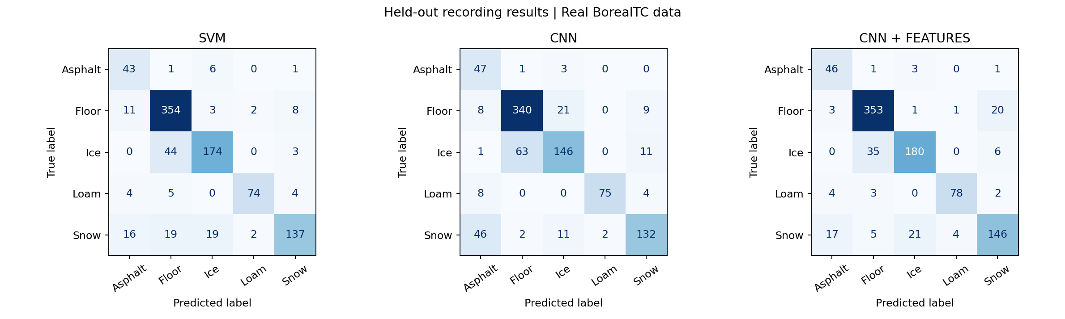
HELD-OUT PREDICTIONS
The confusion matrices expose the remaining errors
Rows are true labels. Columns are predicted labels.
Diagonal values are correct predictions; off-diagonal values are errors.
UE24CS352A | Terrain classification from robot sensor time series
15 / 20
Notes:
Source: the supplied ml_mini_project-main archive, checked against the GitHub checkout. Facts are drawn from README.md, data/source_manifest.json, terrain/data.py, terrain/models.py, terrain/train.py, results/metrics.json, results/test_predictions.npz, results/training_history.json, results/confusion_matrices.png, results/training_curves.png and docs/VALIDATION.md.
This is the source result plot generated from saved test predictions. It shows all five terrain classes for each candidate model; rows are true labels and columns are predicted labels.

Slide 16
LARGEST HYBRID OFF-DIAGONAL COUNTS
Ice and snow account for several frequent confusions
Ice → flooring
35
Snow → ice
21
Flooring → snow
20
Snow → asphalt
17
These counts describe this test split; they do not establish why the signals overlap.
UE24CS352A | Terrain classification from robot sensor time series
16 / 20
Notes:
Source: the supplied ml_mini_project-main archive, checked against the GitHub checkout. Facts are drawn from README.md, data/source_manifest.json, terrain/data.py, terrain/models.py, terrain/train.py, results/metrics.json, results/test_predictions.npz, results/training_history.json, results/confusion_matrices.png, results/training_curves.png and docs/VALIDATION.md.
Counts are read from the CNN+features confusion matrix in results/metrics.json. Largest off-diagonal entries: ICE→FLOORING 35, SNOW→ICE 21, FLOORING→SNOW 20, SNOW→ASPHALT 17. The project does not claim a causal explanation.

Slide 17
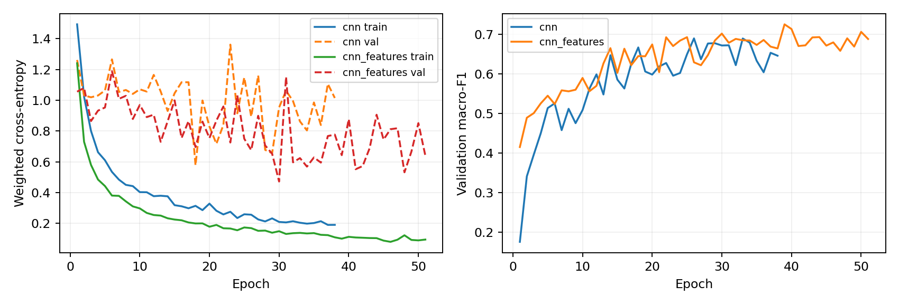
TRAINING HISTORY
The hybrid checkpoint was selected at epoch 39
Best validation macro-F1: raw CNN epoch 26 · hybrid epoch 39
Validation score selects the checkpoint; test score does not.
UE24CS352A | Terrain classification from robot sensor time series
17 / 20
Notes:
Source: the supplied ml_mini_project-main archive, checked against the GitHub checkout. Facts are drawn from README.md, data/source_manifest.json, terrain/data.py, terrain/models.py, terrain/train.py, results/metrics.json, results/test_predictions.npz, results/training_history.json, results/confusion_matrices.png, results/training_curves.png and docs/VALIDATION.md.
The figure is results/training_curves.png. The source training history has 38 epochs for cnn and 51 epochs for cnn_features, with the selected best epochs 26 and 39. The displayed hybrid epoch 39 reaches validation macro-F1 0.72557 (rounded to 0.726).

Slide 18
IMPLEMENTATION AND REPRODUCIBILITY
The repository links data preparation to a local demo
Project file | Role
scripts/download_data.py | Fetch pinned BorealTC files; verify Git SHA-1; record SHA-256
terrain/data.py | Validate, align, split recordings, window data, extract features
terrain/models.py + train.py | Define CNN; train candidates; save metrics and checkpoints
terrain/predict.py + app.py | Load a saved model; predict and display held-out examples
tests/test_pipeline.py | Data, model, checkpoint and Streamlit interaction checks
REPRODUCE
DEMO
python scripts/download_data.py
python -m terrain.data
python -m terrain.train --epochs 60 --seed 42
python -m streamlit run app.py
50 real held-out samples; softmax is uncalibrated.
UE24CS352A | Terrain classification from robot sensor time series
18 / 20
Notes:
Source: the supplied ml_mini_project-main archive, checked against the GitHub checkout. Facts are drawn from README.md, data/source_manifest.json, terrain/data.py, terrain/models.py, terrain/train.py, results/metrics.json, results/test_predictions.npz, results/training_history.json, results/confusion_matrices.png, results/training_curves.png and docs/VALIDATION.md.
The repository validation record dated 8 October 2026 reports: 144 data files checksum-verified; 4,155 windows; 930 test examples; 8 tests passed in 32.57 seconds; all 50 demo predictions matched the saved test predictions. This is the repo's recorded verification, not a fresh test run in this revision.

Slide 19
CONCLUSION
A strong split result with clear limits
WHAT THE RESULTS SUPPORT
WHAT THEY DO NOT ESTABLISH
The CNN + statistics model reached 86.3% accuracy and 0.845 macro-F1 on 930 held-out windows from unseen recordings.
Only one recording split and one training seed
Windows in each recording remain correlated
Asphalt has 5 validation windows
Different sensors and robot from the tactile study
No cross-robot or live-control evaluation
Next: grouped cross-validation, more seeds, ablations, and genuine tactile data.
UE24CS352A | Terrain classification from robot sensor time series
19 / 20
Notes:
Source: the supplied ml_mini_project-main archive, checked against the GitHub checkout. Facts are drawn from README.md, data/source_manifest.json, terrain/data.py, terrain/models.py, terrain/train.py, results/metrics.json, results/test_predictions.npz, results/training_history.json, results/confusion_matrices.png, results/training_curves.png and docs/VALIDATION.md.
Conclusion is limited to the BorealTC fixed split. The repository explicitly avoids claims of statistical significance, calibrated probabilities, cross-robot generalization or deployment readiness. Future work is listed in README.md and docs/WRITEUP_SOURCE.md.

Slide 20
REFERENCES
Source materials and project artifacts
[1] H. Choi and R. Thomasson. Terrain Classification for Small Legged Robots Using Deep Learning on Tactile Data. Stanford CS229 project report, 2020.
[2] D. LaRocque et al. Proprioception Is All You Need: Terrain Classification for Boreal Forests. IROS 2024, pp. 11686–11693. doi:10.1109/IROS58592.2024.10801407.
[3] BorealTC dataset. norlab-ulaval/BorealTC, revision 0146dcd9fa08c34a9075a80448ac04c0a947b568. Dataset README declares CC0 1.0.
[4] Project source: README.md, data/source_manifest.json, docs/DATASET.md, docs/VALIDATION.md, terrain/, scripts/, results/metrics.json and saved prediction artifacts.
Repository archive and connected GitHub checkout have the same file contents.
UE24CS352A | Terrain classification from robot sensor time series
20 / 20
Notes:
[1] https://cs229.stanford.edu/proj2020spr/report/Choi_Thomasson.pdf
[2] https://doi.org/10.1109/IROS58592.2024.10801407
[3] https://github.com/norlab-ulaval/BorealTC/tree/0146dcd9fa08c34a9075a80448ac04c0a947b568
Project: https://github.com/S-Anuj-Srijan/ml_mini_project
The included assignment PDF is treated as assignment context. Its “One-Page” heading conflicts with the body request for two pages; this report follows the two-page detail request used by the project materials.

