Slide 1

Capstone 289
W. Merritt
S. Mccartney
B. Dalton
S. Apulu

Slide 2
Problem to solve.
Product inquiries from Customers.
Inventory tracking for Products on hand
Displaying Available Catalogue
Notes:
Introduction: Silvia explaining the project as a whole.

Slide 3
Proposed Solution
Give customers ability to browse in-store available products and entire catalogue of products via our app.
Give Business Owner ability to track Inventory tracking as well.
Notes:
Our solution: Brandon explaining our chosen technology and add ons.

Slide 4
Technology Involved
C#
WPF(Windows Presentation Foundation) Versus WinForms
Local Database
Dapper
Notes:
Our solution: Brandon explaining our chosen technology and add ons.

Slide 5
User Stories
(EPIC)As a small business Owner, I want to track my inventory and customer recommendations.
(User Story) As an Employee, I want to log in so that I can recommend products in our catalog to my customers.
(User Story) As a Manager, I want to know when product is low so I can reorder and restock.
(User Story) As a Customer, I want to log in to view products and product recommendations.
Notes:
User stories: Sene will explain our epics and user stories.

Slide 6
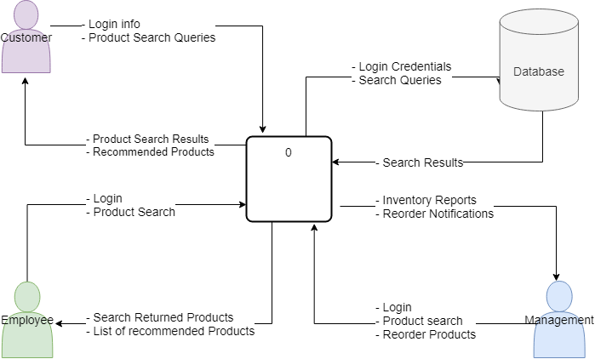
Context Diagram
Notes:
Data Flow/ Context Diagram: Sene will explain how the code will potentially flow behind the scenes.

Slide 7
Live Demo?
Notes:
Running the live demo: William. Showing off the login page and our current design.

Slide 8
Q&A
Notes:
Q&A/Summary: William. Summary of the project and our next steps.

Slide 9
Thank you.

