Slide 1


Capstone 289
W. Merrit
S. Mccartney
B. Dalton
S. Apulu

Slide 2
Problem to solve.
Customer’s questions about Products.
Products on hand
Available Catalogue

Slide 3
Proposed Solution
Application that allows customer’s to browse in-store available products and also a companies entire catalogue of products.

Slide 4
Technology Involved
C#
WPF(Windows Presentation Foundation)
Local DataBase

Slide 5
User Stories
(EPIC)As a small business Owner, I want to track my inventory and customer recommendations.
(User Story) As an Employee, I want to log in so that I can recommend products in our catalog to my customers.
(User Story) As a Manager, I want to know when product is low so I can reorder and restock.
(User Story) As a Customer, I want to log in to view products and product recommendations.

Slide 6
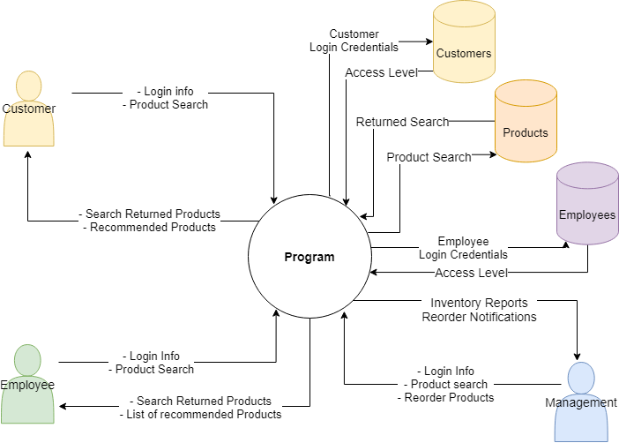
Context Diagram

Slide 7
Live Demo?

Slide 8
Q&A

Slide 9
Thank you.

