Slide 1

Capstone 289
W. Merritt
S. Mccartney
B. Dalton
S. Apulu

Slide 2
Problem to solve.
Customer’s questions about Products.
Inventory for Products on hand
Displaying Available Catalogue

Slide 3
Proposed Solution
Give customers ability to browse in-store available products and entire catalogue of products via our app.
Give Business Owner ability to track Inventory tracking as well.

Slide 4
Technology Involved
C#
WPF(Windows Presentation Foundation)
Local DataBase
Dapper
Material-Design (C# Nuget Package)

Slide 5
User Stories
(EPIC)As a small business Owner, I want to track my inventory and customer recommendations.
(User Story) As an Employee, I want to log in so that I can recommend products in our catalog to my customers.
(User Story) As a Manager, I want to know when product is low so I can reorder and restock.
(User Story) As a Customer, I want to log in to view products and product recommendations.

Slide 6
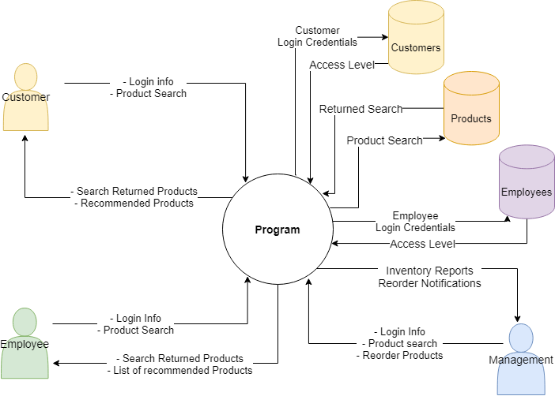
Context Diagram

Slide 7
Live Demo?

Slide 8
Q&A

Slide 9
Thank you.

