Slide 1
CSC3A Mini Project
Presentation by
azan SAJJAD
219025235

Slide 2
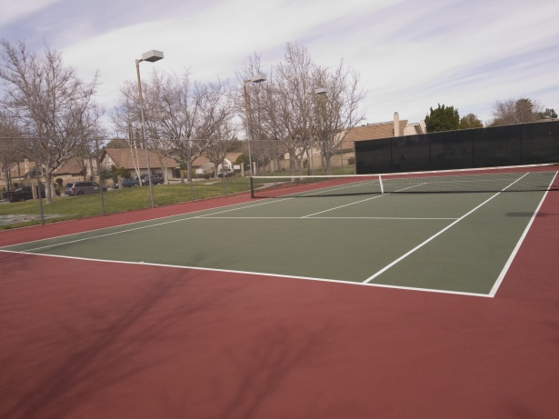
Problem Statement
During the Lockdown, sports were forgotten.
People were hesitant to leave homes.
One player cannot play tennis.

Slide 3

Solution
Get the people out.
Match with other players.
Must be from a same locality.
Additionally, same age or expertise

Slide 4
Requirements
Same locality
Same Age
OR
Same Years of Experience
Location | Age | Expertise
JHB | 23 | 3
DBN | 43 | 19
CT | 35 | 7

Slide 5
SOCIAL NETWORK GRAPH
Display Users
Add Users
Delete Users
Nodes:
Contain User’s Data i.e.
Player Name
Player Surname
Player Location
Player Age
Player’s Expertise

Slide 6
SOCIAL NETWORK GRAPH
Location
Age
Experience
Edges are formed between two Users based on their information.

Slide 7
PROGRAM FUNCTIONALITY
Reads in User’s Data
Adds USERS TO the ARRAYLIST
If conditions are met, then edges are formed between two users
Sets up the visual graph and places the nodes and edges
allows addition and deletion of new users through the user interface

Slide 8
DEMO

Slide 9

THANK YOU

