Slide 1
Capstone Presentation on
“Purchase Prediction on Black Friday”
Submitted towards partial fulfilment of the criteria
for award of PGP-DSE by GLIM
Submitted By
Group No. 8 [Batch: 2018-19]
Group Members
Arjun Thumbayil – DSEFTCJUL18006
Sahil Bansal - DSEFTCJUL18014
Shahrukh Buland Iqbal – DSEFTCJUL18042
Research Supervisor
P V Subramanian

Slide 2
Contents
Introduction
Background
Objective
Motivation
Dataset
Collection
Description
Pre-procession
Exploratory Data Analysis
Feature Engineering
Data Conversion
Discretization
Polychotomization
Response/Target Transformation
Modeling
Model Selection
Model Development
Model Evaluation
Model Optimization
Statistical Learning
Residual Analysis
Results
Future Scope
Statistical Analysis
Feature Creation
Model in Production
Model Deployment

Slide 3
Background
The day after Thanksgiving in the U.S. is called Black Friday (BF) and serves as the traditional start to the holiday shopping season.
It is known for deep discounts (e.g., doorbusters), Black Friday shopping manifests adventure, competition and urgency around getting great deals.

Slide 4
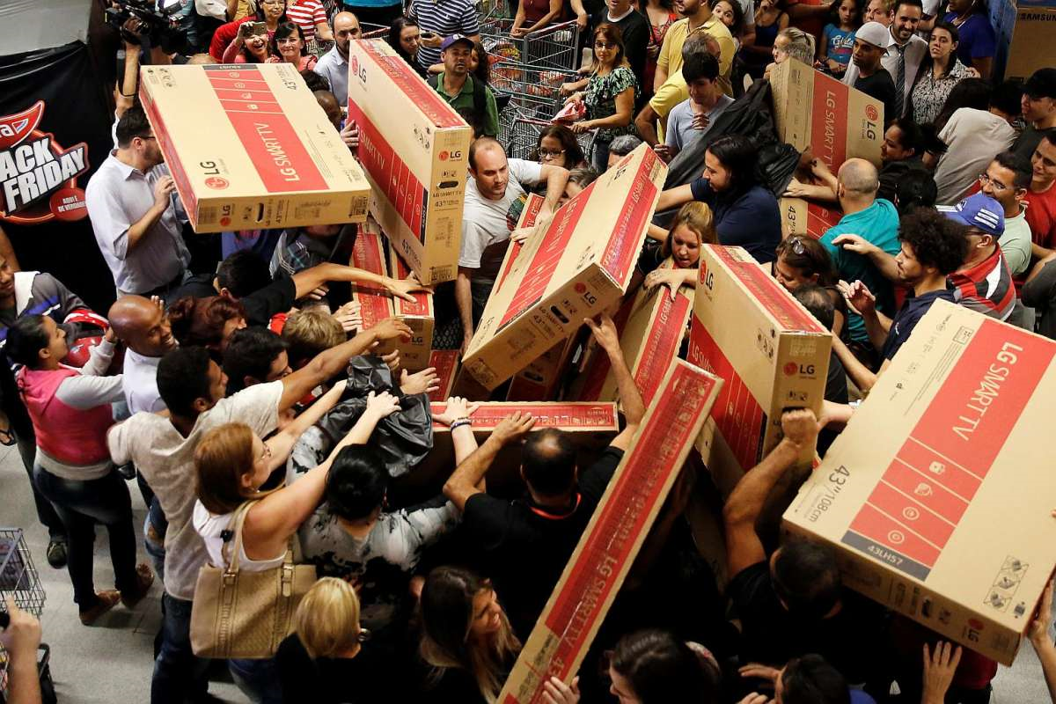

Slide 5



Background
The day after Thanksgiving in the U.S. is called Black Friday (BF) and serves as the traditional start to the holiday shopping season.
It is known for deep discounts (e.g., doorbusters), Black Friday shopping manifests adventure, competition and urgency around getting great deals.
Although Cyber Monday is gaining popularity, Black Friday shopping continues to be popular because of an abundance of doorbuster deals, instant gratification, and the benefit of social shopping.

Slide 6
Objective
Predicting Purchase
Build a simple Machine Learning model that can predict how much a Customer is likely to spend on the eve of Black Friday.
Pattern Recognition
Reveal and Understand the most important factors from predictors such as Age, Gender, City of Residence etc., that influence the spending of a Customer.
Establish a quantitative impact of the revealed factors and how they influence Purchase by a Customer on a personal level i.e., whether they have a positive or negative contribution on the Purchase.

Slide 7
Motivation
Black Friday sales in US still accounts for a whopping 6 Billion $ in revenue.^{[1]}
In order to compete with Online Shopping Platforms, Brick and Mortar based Retailers need to figure out how to boost Sales during the most important Shopping Day of the Year.
By understanding the Purchase Patterns of the Customers Retailers can provide improved Service Quality.
Improve Staffing and Inventory of the Retail Store.
Increase Revenue and Sales.

Slide 8






Tools

Slide 9
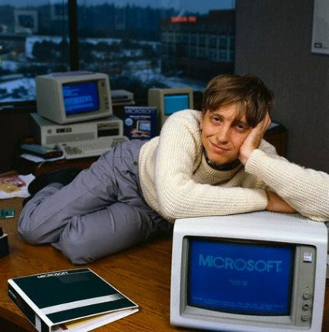
MICROSOFT POWERPOINT

Slide 10
Dataset
Collection:
The data comes from a competition hosted by Analytics Vidhya^{[2]}.
Description:
The Dataset comprises of 550000 observations about the Black Friday in a retail store.
It contains various kinds of variables either Numeric or Categorical in nature. The dataset contains 2 columns with missing values:
166986 observations missing in column ‘Product_Category_2’.
373299 observations missing in column ‘Product_Category_3’.

Slide 11
Description
Name | Data Type
User ID | Integer(Discrete)
Product ID | Categorical(Discrete)
Gender | Categorical(Nominal)
Age | Categorical(Ordinal)
Occupation | Categorical(Nominal)[Masked]
City_Category | Categorical(Nominal)
Stay_In_Current_City | Categorical(Ordinal)
Marital_Status | Categorical(Nominal)
Product_Category_1 | Categorical(Nominal)[Masked]
Product_Category_2 | Categorical(Nominal) [Masked]
Product_Category_3 | Categorical(Nominal) [Masked]
Purchase | Integer(Continuous)

Slide 12
Pre-Processing
Most of the raw data contained in any given Dataset is usually unprocessed, incomplete, and noisy.
In order to be useful for data mining purposes, the Dataset needs to undergo pre-processing, in the form of ‘Data Cleaning’ and ‘Data Transformation’.
Handling Missing Values^{[3]} .
Handling Outliers.

Slide 13
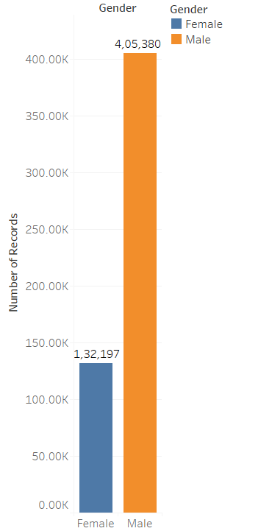
Exploring Categorical Variables
Male shoppers are more frequent than Female Shoppers.

Slide 14
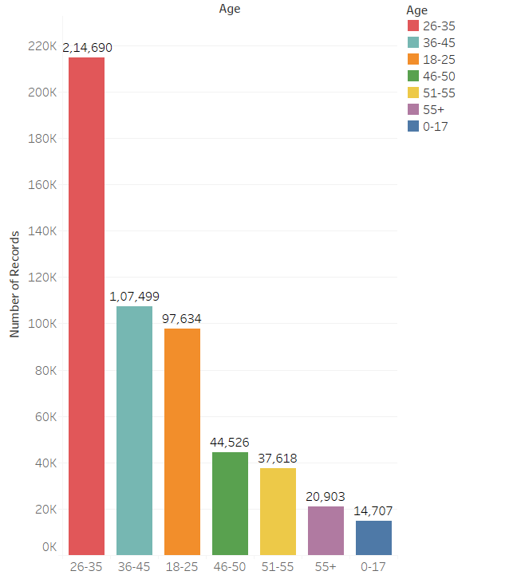
Exploring Categorical Variables
Age bracket 18-45 shops the most.

Slide 15
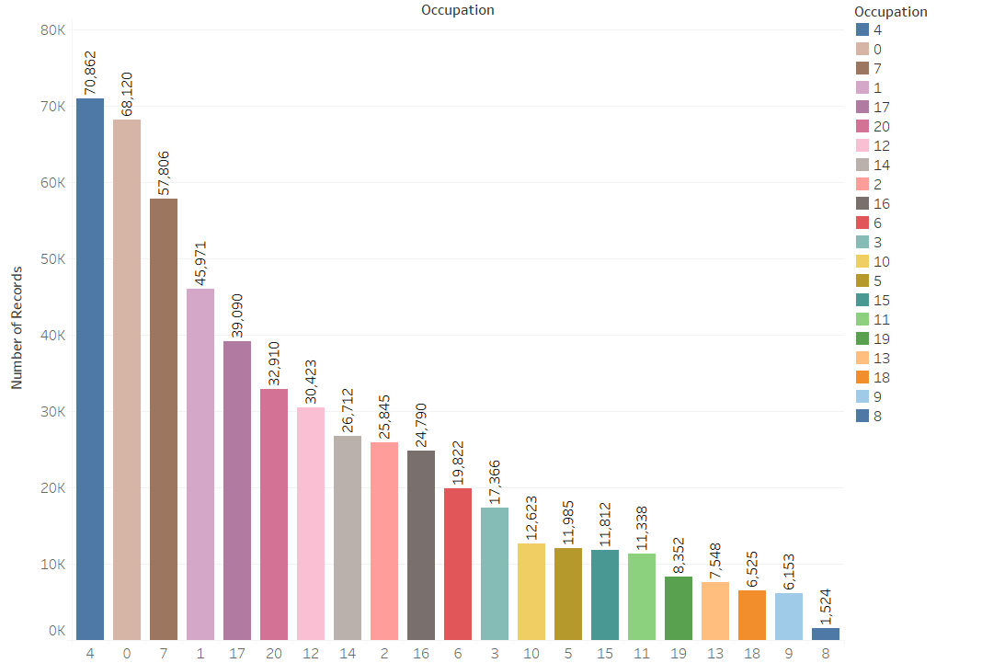
Exploring Categorical Variables
Top 5 Customers by Purchase: 4, 0,7,1,17
Lowest 5 Customers by Purchase: 19,13,18,9,8

Slide 16
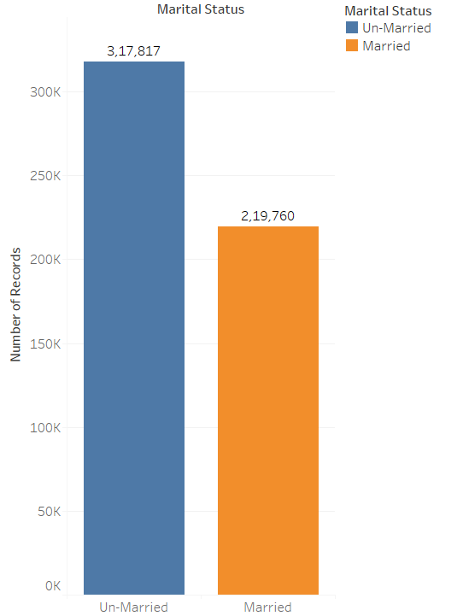
Exploring Categorical Variables
Un-Married People are more frequent shoppers.

Slide 17
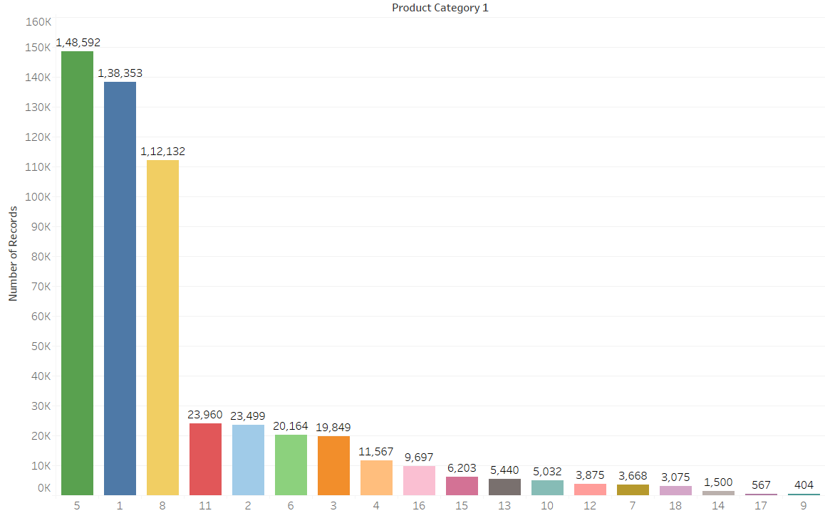
Exploring Categorical Variables
Top 5 Product Categories account for 82% of the items sold.
Product belonging to category 5, 1 and 8 are most likely to be sold on

Slide 18
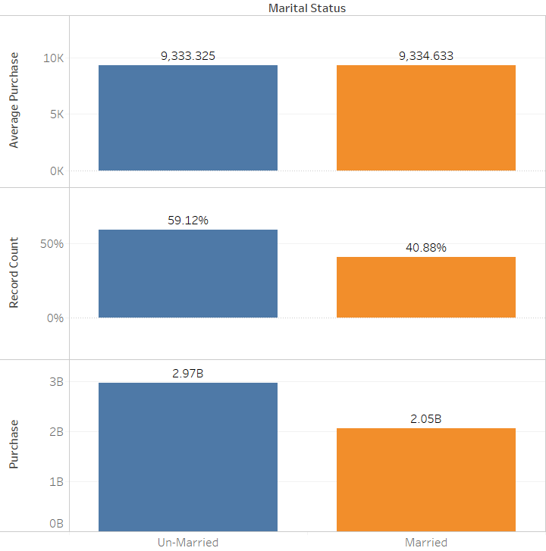
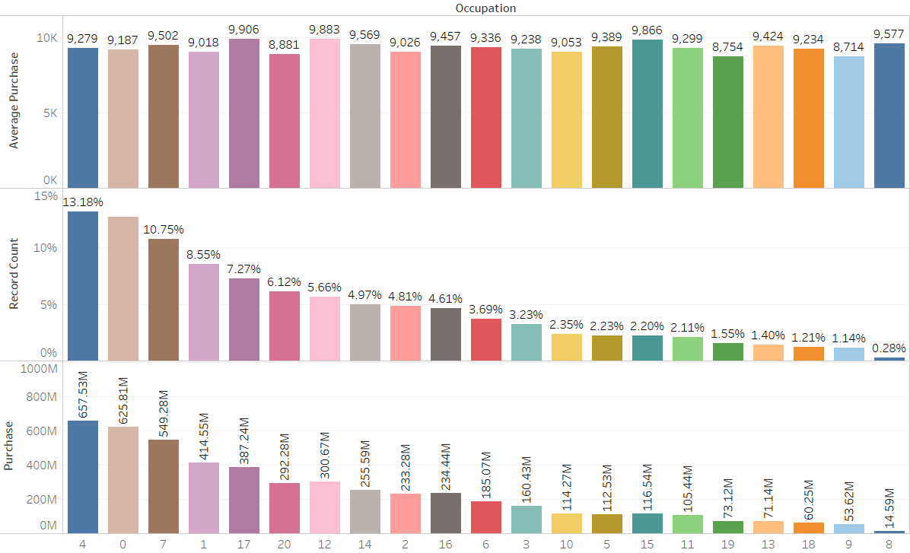
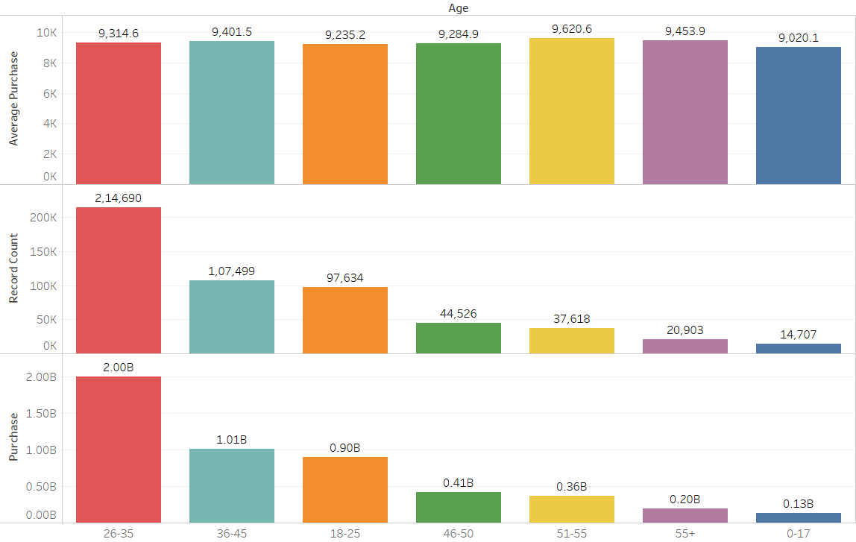
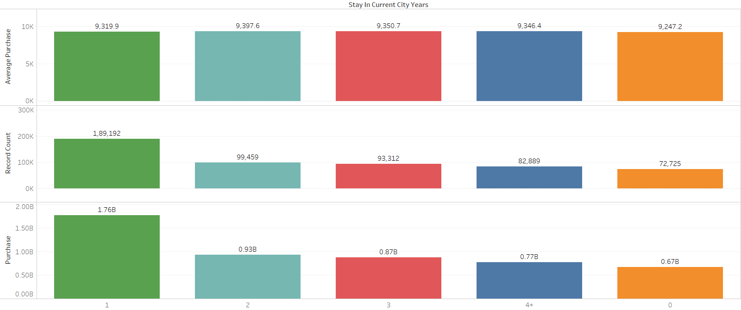
Exploring Multivariate Relationships

Slide 19
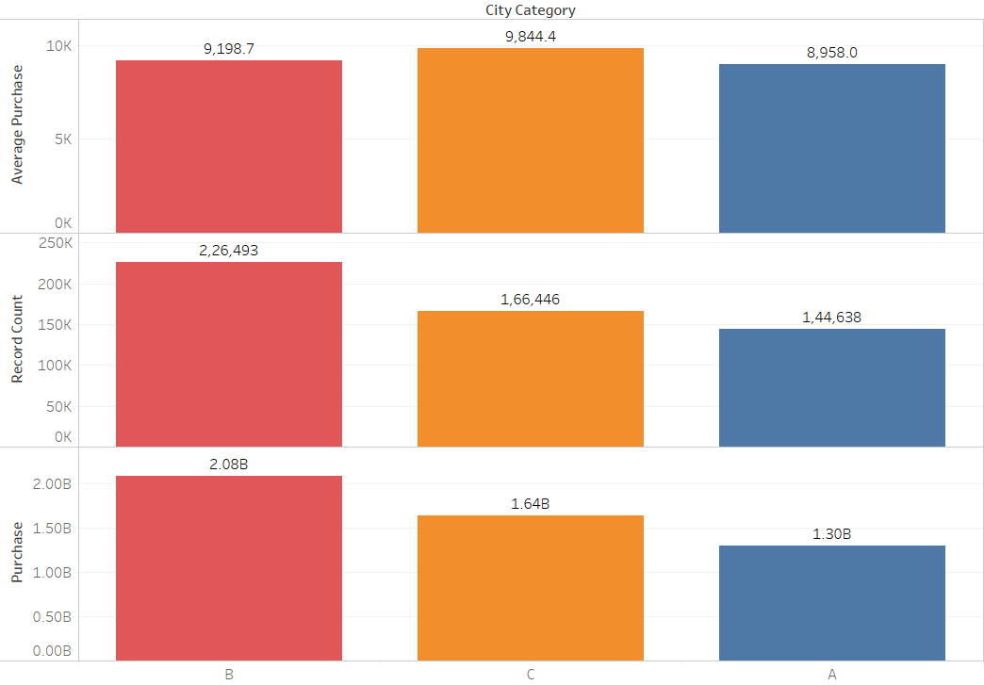
Exploring Multivariate Relationships

Slide 20
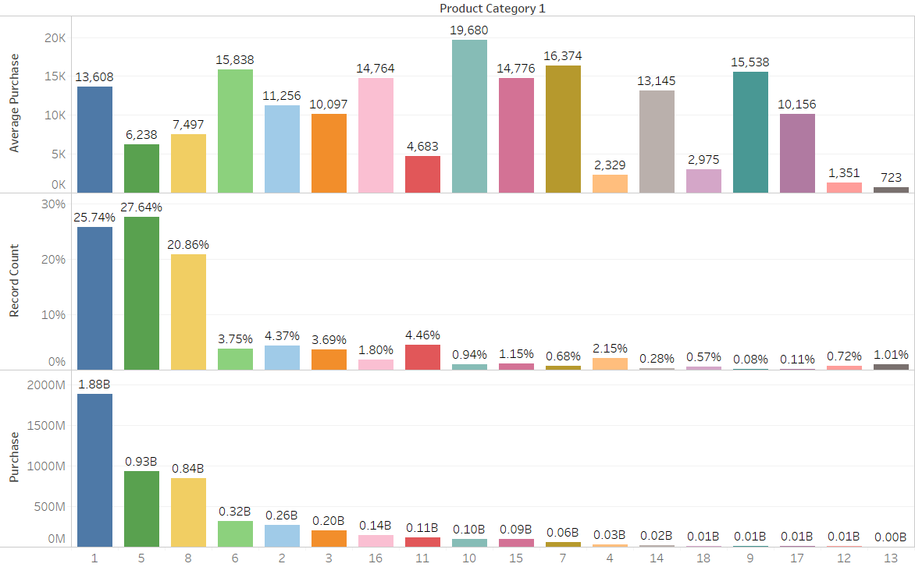
Exploring Multivariate Relationships

Slide 21
Statistical Analysis
Univariate Statistical Analysis
Multivariate Statistics
Chi-square Test of Independence
One-Way ANOVA

Slide 22
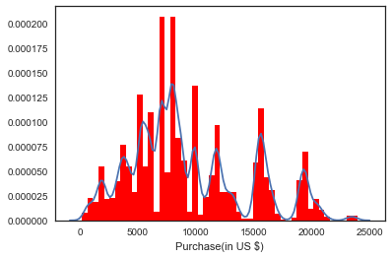
Univariate Statistical Analysis
Parameter | Purchase(in US $)
Mean(µ ) | 9333.86
Standard Deviation | 4981.02
Median | 8062
Minimum | 185
Maximum | 23961

Slide 23
Multivariate Statistics: Chi Square Test of Independence
 | AGE | CITY CATEGORY | GENDER | MARITAL STATUS | OCCUPATION | PRODUCT CATEGORY-1 | STAY
AGE
CITY CATEGORY | YES
GENDER | YES | YES
MARITAL STATUS | YES | YES | YES
OCCUPATION | YES | YES | YES | YES
PRODUCT CATEGORY-1 | YES | YES | YES | YES | YES
STAY | YES | YES | YES | YES | YES | YES
A chi-square analysis was performed to determine whether each Category was represented across all the groups proportionally to their numbers in the sample. The analysis produced a significant χ2 value, indicating that groups were overrepresented in any of the categories.

Slide 24
Multivariate Statistics: One Way ANOVA
GENDER
We performed a one-way ANOVA to compare the Two group’s average Purchase on the eve of Black Friday. This analysis produced a statistically significant result (F_{(1,9998)} = 47.34 , p < .05 ).
Post hoc Tukey test revealed that the only significant difference between the groups was found between Male(µ = 9504.77) and Female(µ = 8809.76), with the Male spending more on Purchase significantly more than the Females.
CITY CATEGORY
We performed a one-way ANOVA to compare the Three group’s average Purchase on the eve of Black Friday. This analysis produced a statistically significant result (F_{(2,9997)} =37.26 , p < .05 ).
Post hoc Tukey test revealed that significant difference between the groups was found between City A(µ = 8958.01), City B(µ =9198.65), and City C(µ = 9844.44 )with the City C Purchasing significantly more than City A and City B.

Slide 25
Feature Engineering
Variable | Conversion Type
‘User_ID’ | Used as Raw Feature.
‘Product_ID’ | Used as Raw Feature.
‘Gender’ | Converted to Binary.
‘Age’ | Converted to Numeric.
‘Marital_Status’ | Converted to Binary.
‘Occupation’ | Used as Raw Feature.
‘City_Category’ | One-Hot Encoded.
‘Stay_In_Current_City’ | Converted to Numeric.
‘Product_Category_1’ | Used as Raw Feature.

Slide 26
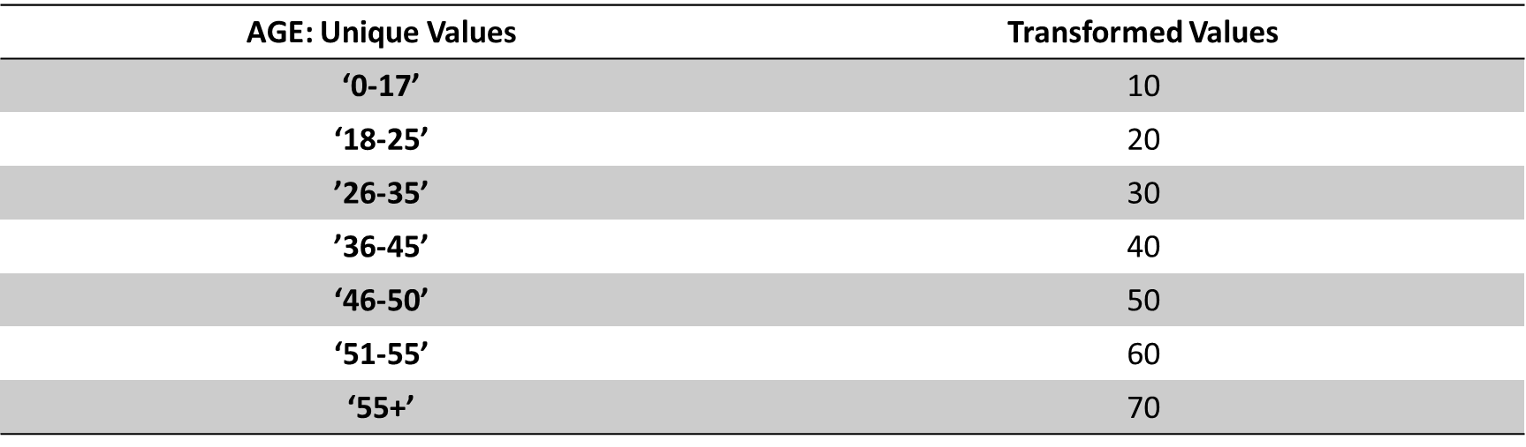
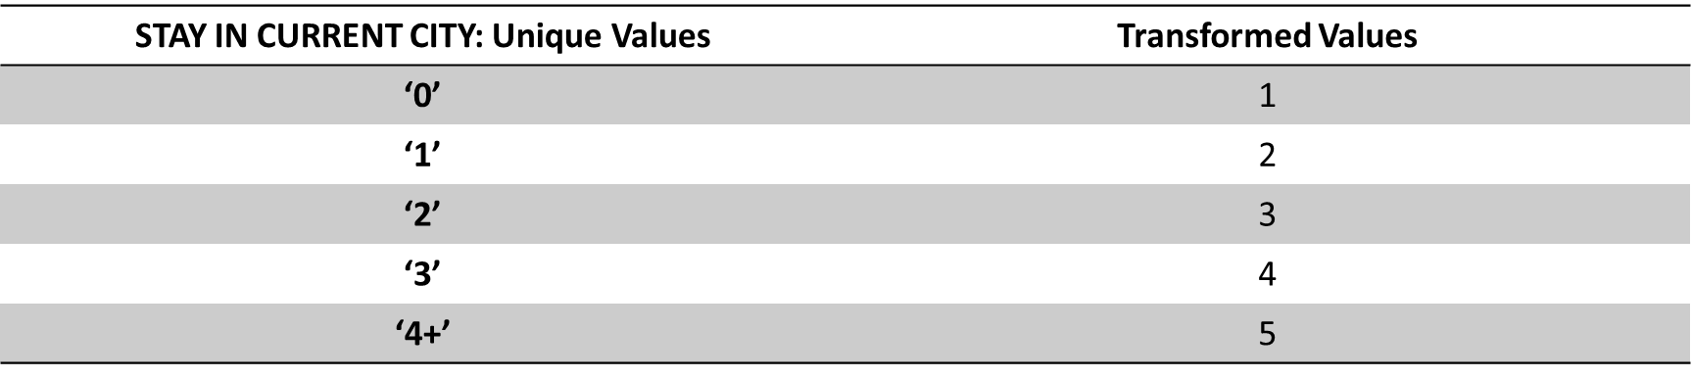
Feature Engineering: Incorporating Ordinality

Slide 27
Feature Engineering
Discretization
Polychotomization
Response/Target Transformation
Feature Creation:
Based on Average Feature Purchase
Based on Feature Frequency

Slide 28
Model Selection: Multiple Linear Regression
Model selection criteria:
Simple
Retains explainability.
Easy to understand and Implement
Model that helps in answering important Business related Questions such as:
Is there a relationship between Purchase on Black Friday by a Customer and Predictor variables?
How strong is the relationship?
Which Predictor contributes to the Purchase on the eve of Black Friday?
How large is the effect of each predictor on Purchase?
How accurately can we predict the Purchase?
Is the relationship linear?

Slide 29
Model Development
Step 1: Data Transformation
Step 2: Data division using ‘Validation Set Approach’^{[4]}
Step 3: Model Development

Slide 30
Model Evaluation
Metrics used:
RMSE
R²
Adjusted R²

Slide 31
Model Evaluation
Regression Models | Training Set |  |  | Validation Set
 | RMSE | R² | Adjusted R² | RMSE | R² | Adjusted R²
Baseline Model | 4707.53 | 0.11 | 0.11 | 4715.49 | 0.11 | 0.11
Model 1(DB) | 3888.17 | 0.39 | 0.39 | 3895.55 | 0.39 | 0.39
Model 2(AFP + FF) | 4979.67 | 0 | 0 | 4984.44 | 0 | 0
Model 3(DC + FF) | 2903.5 | 0.66 | 0.66 | 2906.65 | 0.66 | 0.66
Model 4(DC + AFP) | 4979.71 | 0 | 0 | 4984.36 | 0 | 0
Ridge Regression(Model 3) | 2903.84 | 0.66 | 0.66 | 2906.96 | 0.66 | 0.66
LASSO Regression(Model 3) | 2928.48 | 0.65 | 0.65 | 2930.12 | 0.66 | 0.66
Feature Engineering Techniques
DC | Data Conversion
DB | Data Binning
AFP | Average Feature Purchase
FF | Feature Frequency

Slide 32
LASSO Regression
Performs variable selection by forcing some of coefficient estimates to be zero.
Simpler and more interpretable model than Ridge.
Handles Multicollinearity.
Initial 52 variables were in Model-3.
Post LASSO Regularization:18 variables were left.

Slide 33

Statistical Learning

Slide 34
 | coef | std err | t | P>|t| | [0.025 | 0.975]
Const | 1.134e+04 | 20.082 | 564.769 | 0.000 | 1.13e+04 | 1.14e+04
Product_Category_1_10 | 6534.2674 | 50.434 | 129.561 | 0.000 | 6435.419 | 6633.116
Product_Category_1_7 | 4267.2267 | 58.652 | 72.755 | 0.000 | 4152.270 | 4382.183
Product_Category_1_6 | 2659.5272 | 26.192 | 101.541 | 0.000 | 2608.192 | 2710.862
Product_Category_1_16 | 2026.6088 | 36.722 | 55.187 | 0.000 | 1954.634 | 2098.583
Product_Category_1_15 | 2123.6187 | 45.426 | 46.749 | 0.000 | 2034.586 | 2212.651
City_Category_C | 283.9126 | 10.471 | 27.114 | 0.000 | 263.389 | 304.436
Age | 10.0330 | 0.359 | 27.939 | 0.000 | 9.329 | 10.737
Product_ID_Counts | 2.5978 | 0.014 | 185.461 | 0.000 | 2.570 | 2.625
Stay_In_Current_City_Years | 7.8901 | 3.708 | 2.128 | 0.033 | 0.622 | 15.158
Occupation_1 | -162.6174 | 17.166 | -9.473 | 0.000 | -196.262 | -128.973
Product_Category_1_3 | -2811.2377 | 26.454 | -106.270 | 0.000 | -2863.086 | -2759.389
Product_Category_1_8 | -5218.7197 | 13.907 | -375.253 | 0.000 | -5245.977 | -5191.462
Product_Category_1_18 | -9453.6809 | 64.223 | -147.202 | 0.000 | -9579.555 | -9327.806
Product_Category_1_11 | -7742.6858 | 24.644 | -314.179 | 0.000 | -7790.988 | -7694.384
Product_Category_1_5 | -6633.2756 | 12.698 | -522.406 | 0.000 | -6658.162 | -6608.389
Product_Category_1_12 | -1.122e+04 | 56.755 | -197.758 | 0.000 | -1.13e+04 | -1.11e+04
Product_Category_1_4 | -1.045e+04 | 33.805 | -309.155 | 0.000 | -1.05e+04 | -1.04e+04
Product_Category_1_13 | -1.191e+04 | 48.513 | -245.426 | 0.000 | -1.2e+04 | -1.18e+04

Slide 35
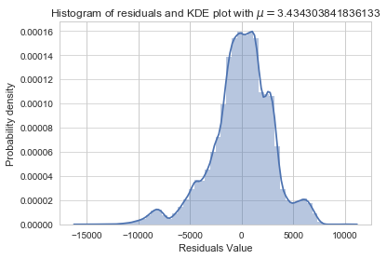
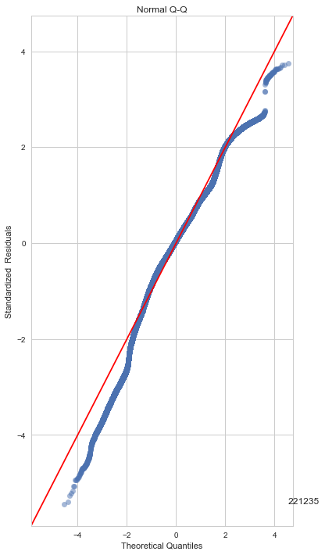
Residual Analysis
Normality of the Residuals

Slide 36
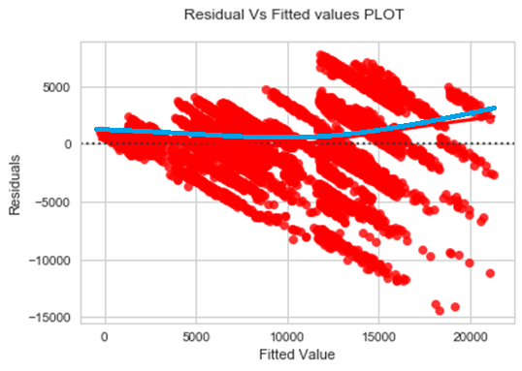
Residual Analysis
Non-Linearity of the Response-Predictor Relationship:
No visible pattern in the residuals.

Slide 37
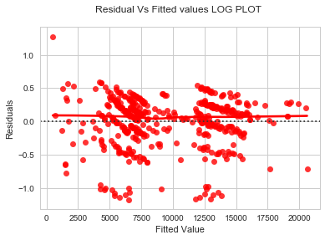
Residual Analysis
Heteroskedasticity:
Funnel shape is evident
Response Log-Transformed in order to achieve Homoskedasticity

Slide 38


Slide 39
Results
Based on Descriptive Analytics
Based on Behavioural Analytics
Based on Predictive Analytics
Based on Prescriptive Analytics

Slide 40
Results
Based on Descriptive Analytics:
Male Shoppers are likely to buy more Products than Female Shoppers.
Older(40+) people are likely to spend more irrespective of their marital status.
Customers who arrived recently in City-B and City-C are likely to shop less frequently than those who stayed longer(Acclimatization can be an issue).

Slide 41
Results
Based on Behavioural Analytics:
Keeping Products that are more likely to sell on the front of the store will lead to an increase in the Sales.^{[6]}
Products ‘1’, ‘5’ and ‘8’ of Product_Category_1 are highest selling Products. So, should be kept at the front of the Store.

Slide 42
Results
Based on Predictive Analytics:
Purchase is heavily influenced by Product Category.
People of 60+ Age will spend as much as 600$ more than Teenagers.
People belonging to Occupation-1 are likely to spend less.
Product Category that have an average price over 9000$ are likely to influence Purchase positively and vice versa.
City C Customers will spend 283$ more than other city Customers.

Slide 43
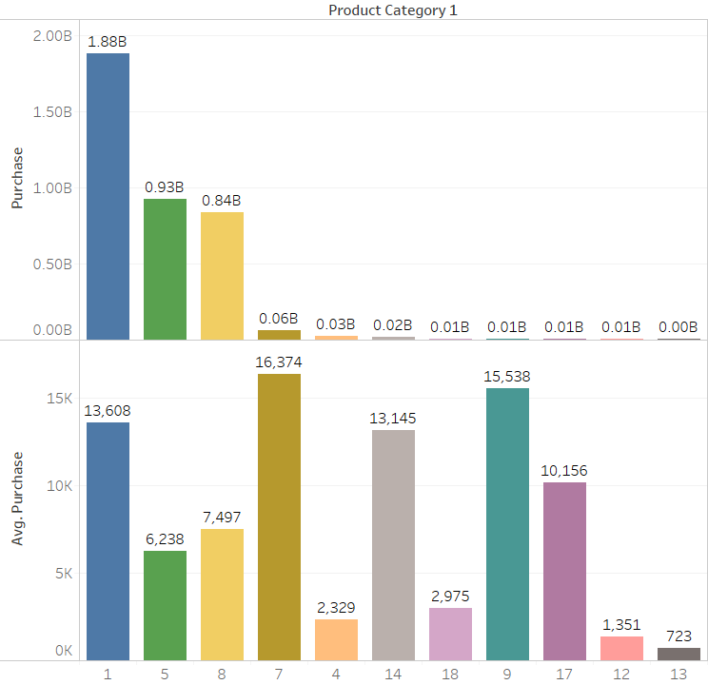
Results
Based on Prescriptive Analytics:
If the Price of ‘Product-5’ is increased by 5%, ‘Product-1’ by 3% and ‘Product-8’ by 4% then the Revenue will increase by 150 Million $ which is higher than the combined Revenue of eight lowest selling Products.

Slide 44
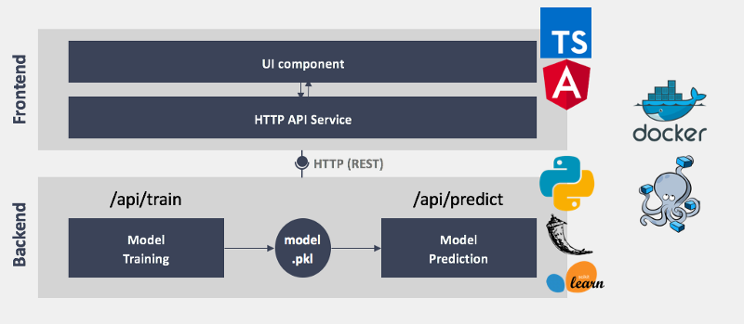
Future Scope: Model Deployment

Slide 45


