Slide 1

Automated Resume Screening System
AI COURSE
Team Members
S BALAKRISHNA-1DB21CI076
SOWMYA J S-1DB21CS146

Slide 2
Introduction
• Hiring process is time-consuming and requires automation.
• This project leverages AI and NLP for resume screening.
• Goal: Efficiently filter and score candidate’s resume based on job description.

Slide 3
PROBLEM STATEMENT
Manual resume screening is time-consuming, inconsistent, and prone to bias. Recruiters struggle to process large volumes, leading to inefficiencies. This project automates screening using AI and NLP, extracting key details, classifying resumes, and matching them to job roles using TF-IDF and Cosine Similarity. The system ensures faster, unbiased, and accurate hiring.)

Slide 4
KEY FEATURES
1.Resume Parsing & Job Description Extraction
2.AI-Based Candidate Matching
3.Bias-Free Resume Screening
4.Streamlit-Based UI

Slide 5
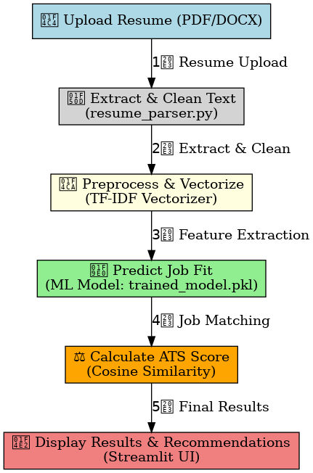
ANALYSIS

Slide 6
PREDICTION AND RESPONSE DISPLAY
The system utilizes Machine Learning (ML) and NLP
ML Model (trained_model.pkl) – Trained using Random Forest.
Text Processing (tfidf_vectorizer.pkl) Extracts relevant skills and job-related terms.
ATS Score Calculation – Uses Cosine Similarity to rank resumes using dot product.

Slide 7
Benefits of the System
• Saves time in recruitment process
• Reduces manual screening workload
• Ensures unbiased and fair candidate selection

Slide 8
Conclusion
• The project automates resume screening using AI & NLP.
• Helps recruiters find the best candidates efficiently.
• Future improvements will enhance accuracy & usability.

