Slide 1

Department of Computer Science and Engineering Academic year: 2025-26 Internship Presentation (BINT803B)
Internship Title: “Software Developer”
Project : Cartiva
Internal Guide:
Mrs Hemalatha M
Assistant Professor
Dept. of CSE
External Guide:
Mr. Mallikarjun
Technical Trainer
Tap Academy
Presented By,
S Bhoomika (1DB22CS131)

Slide 2
About the Organization
Tap Academy(Tap Edtech Pvt Ltd)
• TAP Academy is an edtech platform focused on providing industry-oriented training in software development and emerging technologies
• It offers structured courses in areas such as Java, Full Stack Development, Data Structures, and problem-solving skills
• The academy emphasizes hands-on learning through real-time projects, coding practice, and practical assignments
• It provides the TAI (TAP Academy Interactive) Portal for learning, assessments, progress tracking, and interview preparation
• TAP Academy also supports career development through placement assistance, mock interviews, and job-oriented training

Slide 3
Organization Structure
Institute Name : Tap Academy(Tap Edtech Pvt Ltd)
Address : BTM 2nd Stage, BTM Layout, Bengaluru, Karnataka – 560076, India.
CEO : Rohit Ravinder
External Guide Details
Mentor : Mallikarjun
Designation: Technica Trainer
Email ID : mallikarjun@thetapacademy.com
Phone no: 8050349942

Slide 4
Training Undergone
Technical Training in Full Stack Development
Training includes learning various technologies such as:
Core Java
Programming & Problem Solving
Advanced Java
HTML
CSS
JavaScript
React
SQL
This training aims to prepare interns for real-world software development roles.

Slide 5
Objectives of Internship
Develop strong programming and logical thinking skills
Understand object-oriented programming concepts
Gain knowledge in frontend and backend web development
Learn database management using SQL
Improve problem solving ability for real-world applications

Slide 6
Problem Statement
Managing daily grocery shopping can be time-consuming and inconvenient. Traditional shopping methods do not provide easy product browsing, order tracking, or recurring purchase options. There is a need for a simple and efficient online system that makes grocery shopping easier and more convenient for users.

Slide 7
Proposed Solution
The proposed system is a web-based grocery shopping application developed to simplify online grocery shopping. The system allows users to browse products, manage cart and wishlist, place orders, track orders, and subscribe for recurring purchases. An admin panel is also provided to manage products, orders, customers, and revenue efficiently.

Slide 8
Features
Customer Features
User Registration and Login
Browse Products by Categories
Add, Remove, and Update Cart Items
Wishlist Management
Order Placement and Tracking
Product Ratings and Reviews
Subscription for Regular Purchases
Profile Management.
Admin Features
Product Management
Order Management
Customer Management
Revenue Monitoring
Review Management
Low Stock Monitoring

Slide 9
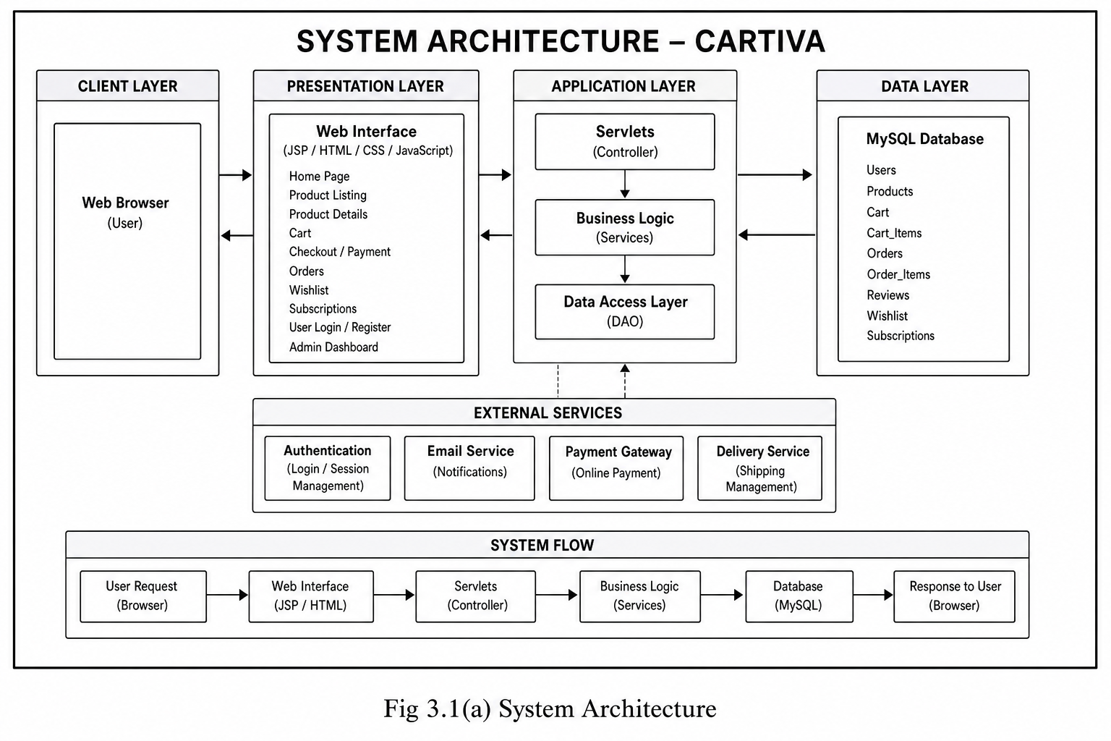
System Architecture
Fig.1 System Architecture of the Cartiva website

Slide 10
Tech Stack
Java → Backend logic
Servlets & JSP → Request Handling & Dynamic Web Pages
MySQL → Database
JDBC → Database connection
HTML/CSS → UI
Tomcat → Server
Javascript → Dynamic Features
AJAX / Fetch API → Live Updates
Maven → Dependency Management

Slide 11
Working of the System
User logs into the system
User browses grocery products
Products are added to cart or wishlist
User places the order
System stores order details in the database
Stock is updated automatically
User can track orders and manage profile
User can give ratings and reviews
Admin manages products, orders, and customers

Slide 12
Key Features
Secure User Authentication
Product Browsing and Filtering
Dynamic Cart Management
Wishlist Functionality
Order Placement and Tracking
Subscription System
Live Review and Rating System
Revenue Dashboard
Low Stock Alerts
Responsive UI/UX

Slide 13
Challenges Faced
Preventing duplicate order items during checkout
Implementing live review updates using AJAX
Synchronizing frontend and backend dynamically
Maintaining proper MVC architecture

Slide 14
Skills & Knowledge Gained
Technical Skills
Java Programming
Problem Solving
Web Development Basics
SQL Query Writing
Soft Skills
Logical thinking
Analytical ability
Time management
Continuous learning

Slide 15
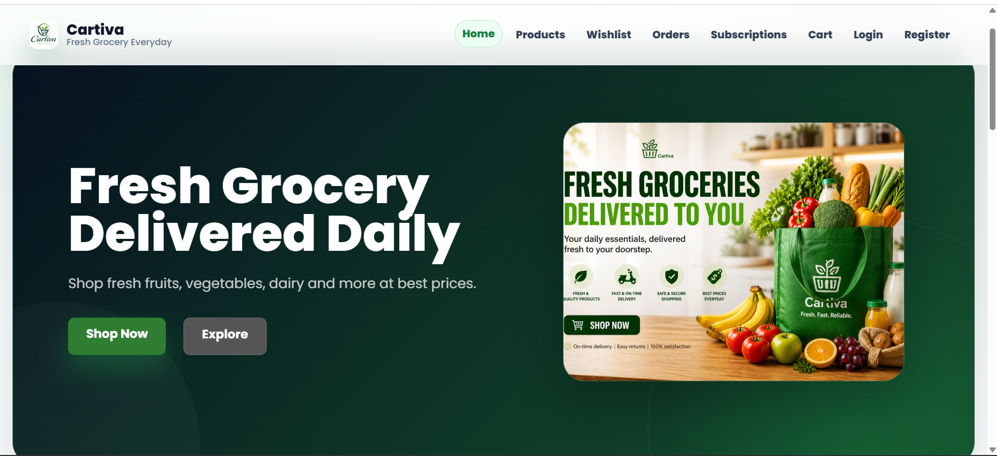
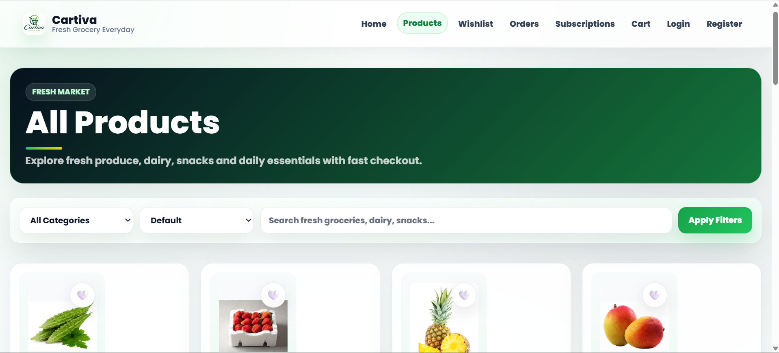
Snapshots
Fig-01: Home Page
Fig-02: Products Page

Slide 16
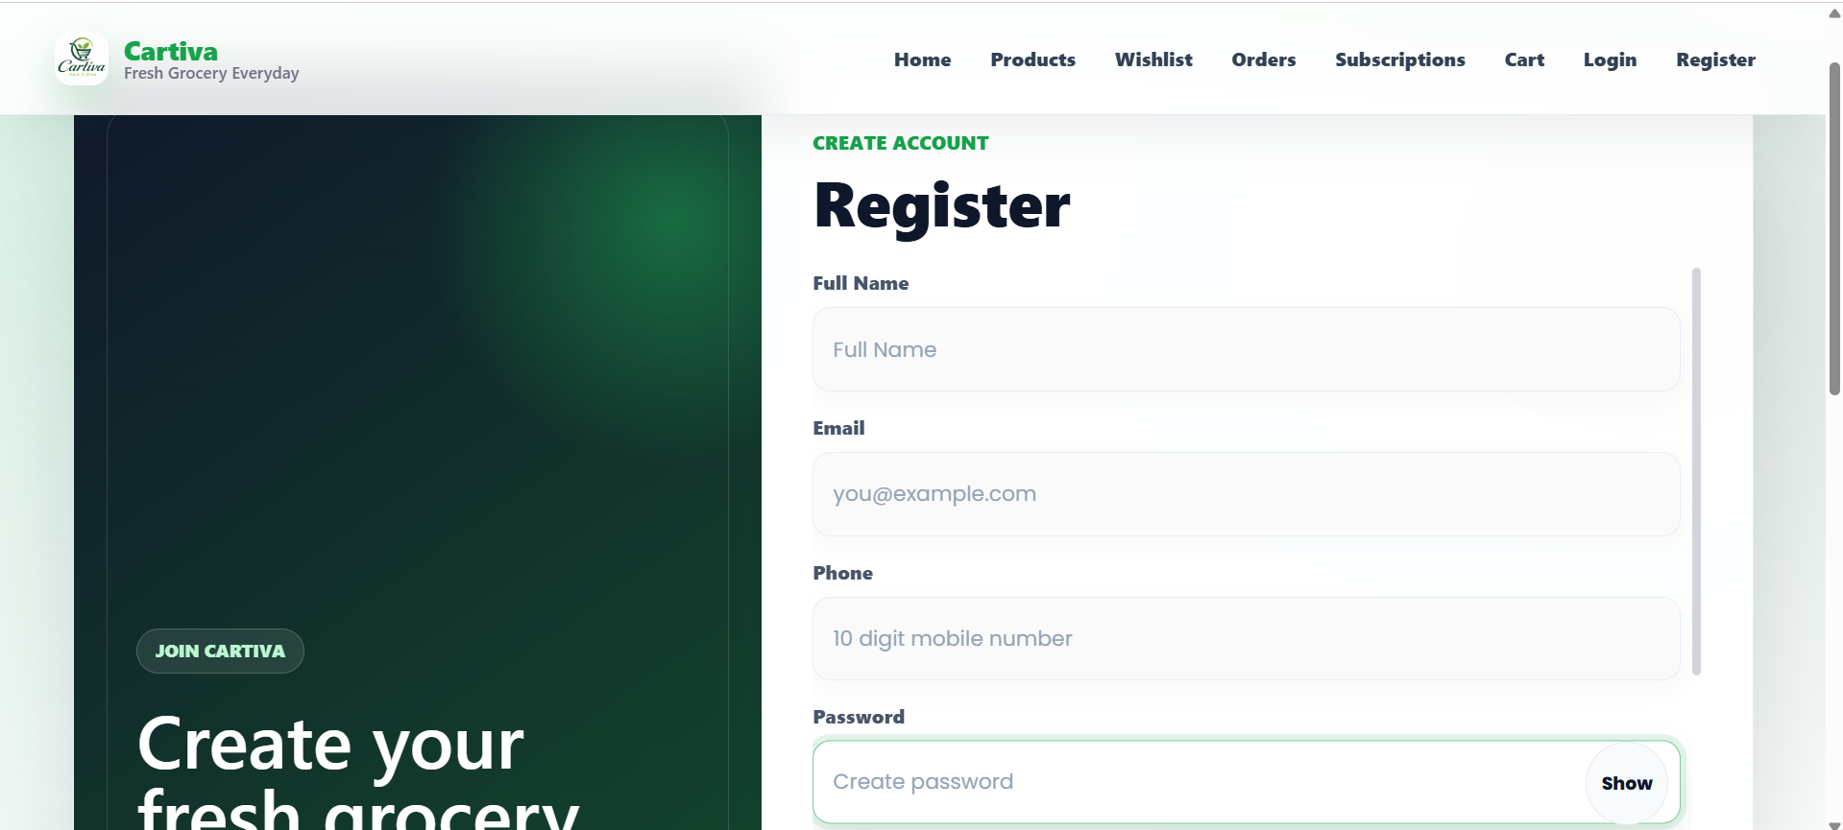
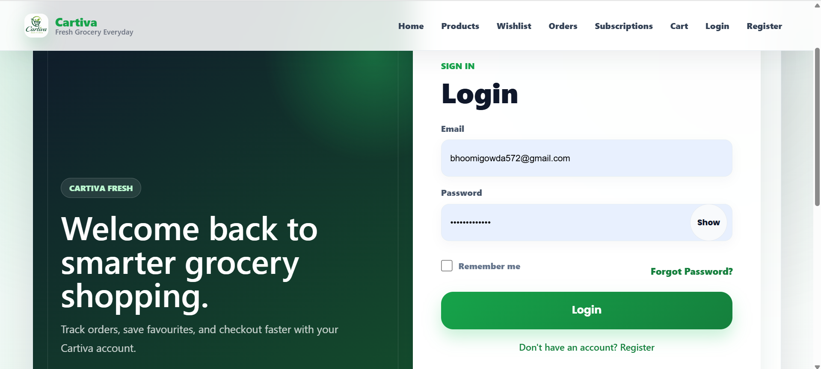
Snapshots
Fig-03: Registration Page
Fig-04: Login Page

Slide 17
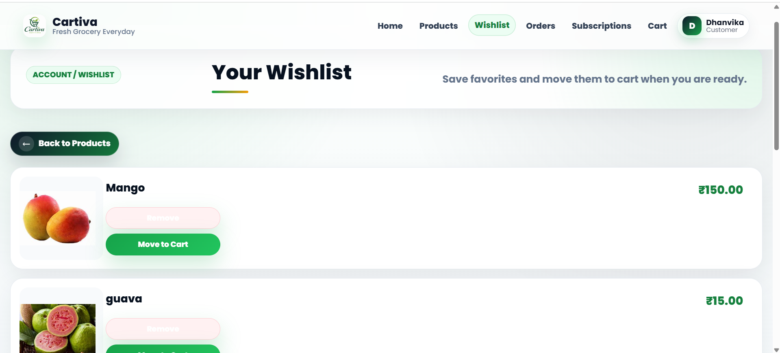
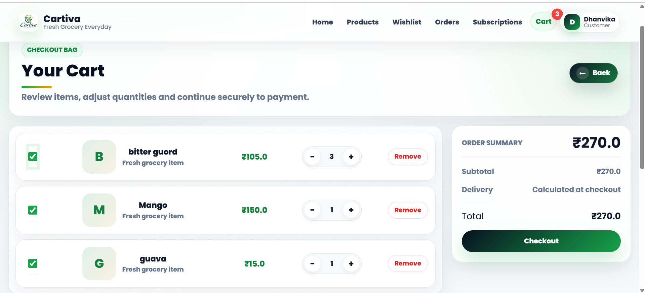
Snapshots
Fig-05: Wish-list Page
Fig-06: Cart Page

Slide 18
Conclusion
The internship provided practical exposure to software development technologies.
It helped improve programming and problem solving skills.
The structured training, assignments, and weekly tests ensured continuous learning.
The internship experience helped prepare for future software development roles.

Slide 19
Thank You

