Slide 1
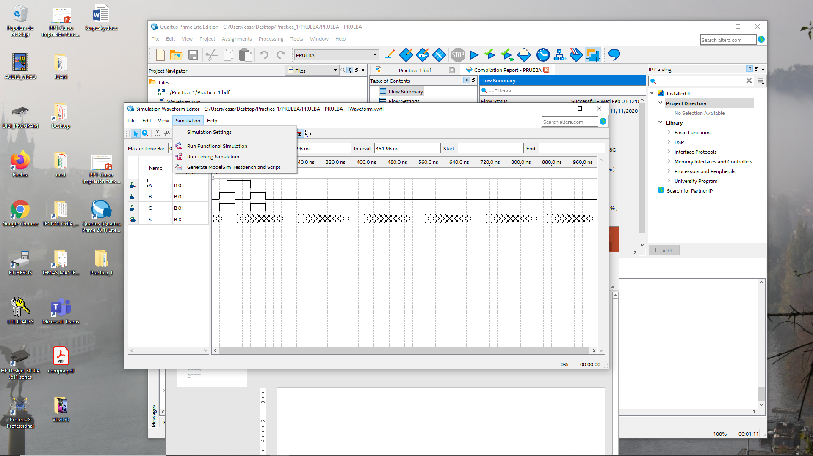

Slide 2
onerror {exit -code 1}
vlib work
vcom -work work PRUEBA.vho
vcom -work work Waveform.vwf.vht
vsim -novopt -c -t 1ps -L fiftyfivenm -L altera -L altera_mf -L 220model -L sgate -L altera_lnsim work.Practica_1_vhd_vec_tst
vcd file -direction PRUEBA.msim.vcd
vcd add -internal Practica_1_vhd_vec_tst/*
vcd add -internal Practica_1_vhd_vec_tst/i1/*
proc simTimestamp {} {
echo "Simulation time: $::now ps"
if { [string equal running [runStatus]] } {
after 2500 simTimestamp
}
}
after 2500 simTimestamp
run -all
quit -f
onerror {exit -code 1}
vlib work
vcom -work work PRUEBA.vho
vcom -work work Waveform.vwf.vht
vsim -c -t 1ps -L fiftyfivenm -L altera -L altera_mf -L 220model -L sgate -L altera_lnsim
work.Practica_1_vhd_vec_tst
vcd file -direction PRUEBA.msim.vcd
vcd add -internal Practica_1_vhd_vec_tst/*
vcd add -internal Practica_1_vhd_vec_tst/i1/*
proc simTimestamp {} {
echo "Simulation time: $::now ps"
if { [string equal running [runStatus]] } {
after 2500 simTimestamp
}
}
after 2500 simTimestamp
run -all
quit -f

