Slide 1

ReTrade
Revolutionising the P2P trading of renewable energy
By Enigma

Slide 2
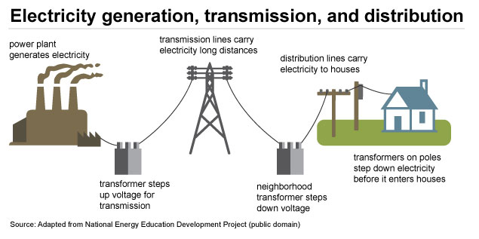
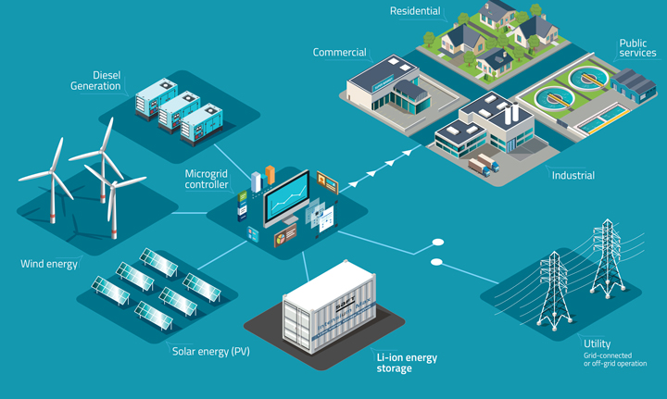
Context – What is a microgrid
Conventional Electricity Grids Microgrids
Smoother integration of renewables
Operation in Grid-mode or Island-mode

Slide 3


Problem Statement
Conventional Electricity Grid –> Lack of reward for ‘Prosumer’s’ surplus energy to feed back into grid

Slide 4
User Case
As a supplier/prosumer, I want more autonomy in determining the prices of the energy I generate
As a consumer, I want more autonomy over the prices I am paying for energy and quantity I am receiving for energy
Solution: Peer-2-Peer energy trading platform meeting the user’s requirements

Slide 5
Software Architecture for Prototype
Scenario: Consumer wants to set electricity plan for the day
Browse through interactive heat map generated by Splunk
Input
Supplier Network Address
Load demanded
Price Agreed
Input
Smart Meter Measurements measures energy received at consumers end
Execution of Ethereum Smart Contract
No
Does consumer's received power match their demanded load?
Transaction verified and block of data added to chain
Yes

Slide 6
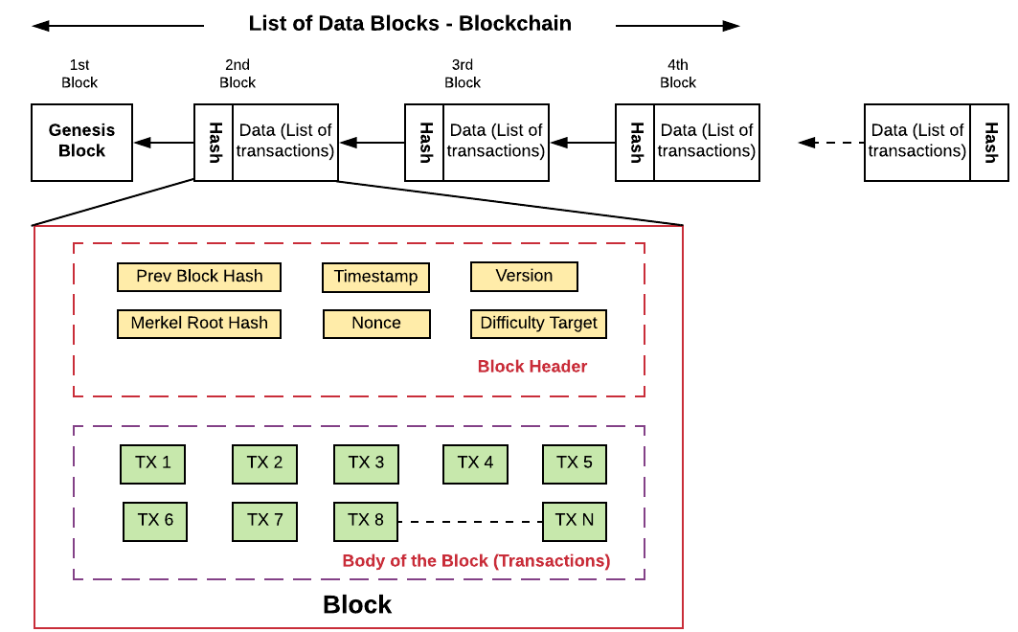
Application of Ethereum

Slide 7
Prototype – Heat map and Smart Contract

Slide 8

Business Viability
Competition -
Implementation requires two different cryptocurrency tokens (POWR and Sparks)
White paper and demonstrations are heavily focused on PV panels on rooftop
Viability
Strong growth in renewables
2019 Australian Budget - $50 million investment in microgrids for rural areas
Monetary Value
Attract prosumers through lower supply-side costs

Slide 9
Conclusion
Questions Please!

