Slide 1


Team Details
  Team name: Agamya
  Team leader name: Siddhi Pandirkar
  Team member: Sumit Jadhav
  Problem Statement: Future of Work & Enterprise Productivity
Notes:
Team Agamya: Siddhi Pandirkar (team leader) and Sumit Jadhav. Problem statement: Future of Work and Enterprise Productivity.
Agamya (Sanskrit: "hard to reach") captures the judgment experts carry in their heads and hands, and passes it on, with the reason, to people and to AI agents.

Slide 2

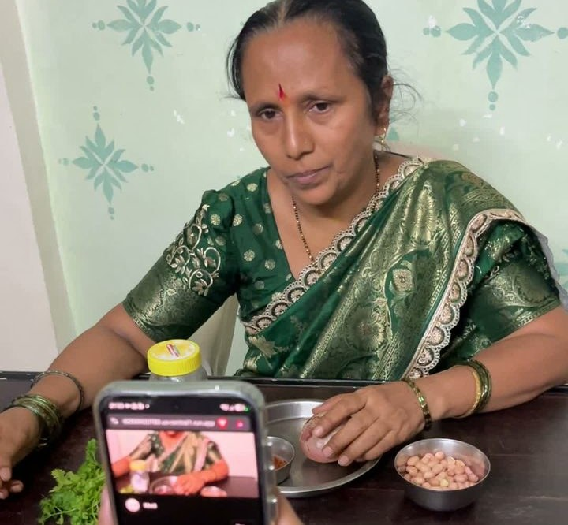
Brief about the idea
When an expert leaves, the why leaves with them. It has happened for centuries.
Bengal, muslin
One of history's finest cloths, spun from phuti karpas cotton. The cotton and the skills are gone.
The "cut thumbs" story is legend; the record shows tariffs and machine-made imports. [1]
Sikkim, Majhi (माझी)
2013: India's last known speaker, Thak Bahadur Majhi, aged 80. Majhi has 15 words for river.
Still spoken in Nepal, where Nepali is replacing it. [2]
Japan, traditional crafts
Registered craft workers: about 288,000 (1979) to 48,334 (FY2022).
In Kanazawa, craft families close for lack of successors. [3]
Every company
42% of institutional knowledge is unique to the employee in their role.
Panopto survey, 2018. [4]
Agamya captures the why, live, and passes it on
1 The expert works as usual, on screen or camera. Moti, a Gemini Live agent, asks one question at a pause.
2 A Work Map: steps, decisions, reasons in the expert's own verified words, and guardrails.
3 Learners practise with Moti as tutor, in their language. AI agents ask "would the expert stop here?"
Real sessions: a JMeter handover before leave · a Satara recipe in Marathi
[1] Daily Star 2026; Wikipedia [2] Down To Earth 2013; Wikipedia [3] Garland 2026, citing Assoc. for the Promotion of Traditional Craft Industries; NPR 2022 [4] Panopto 2018. Full references: slide 14 and notes.
Notes:
SAY: When an expert leaves, the why leaves with them, and it has happened for centuries.
- Bengal muslin was among the finest cloths ever made, spun from phuti karpas cotton. The cotton and the skills are lost. A popular story says weavers' thumbs were cut off. We present that as legend: it goes back to a 1772 account by William Bolts. The documented decline is economic: tariffs on Bengal cloth in England, and cheap machine-made Lancashire cotton in Bengal.
- In 2013 the People's Linguistic Survey of India traced India's only known Majhi speaker, Thak Bahadur Majhi, 80, in Sikkim. His language has 15 words for river. Majhi is still spoken in Nepal, where Nepali is replacing it.
- In Japan, the registered traditional-craft workforce fell from about 288,000 in 1979 to 48,334 in fiscal 2022 (association data, as reported).
- In companies, Panopto's 2018 survey found 42% of institutional knowledge is unique to the employee in their role.
Agamya captures the why while the expert works, and passes it on to people and AI agents.
REFERENCES
[1] The Daily Star (2026), "What Bengal made and let others claim". https://www.thedailystar.net/supplements-0/news/what-bengal-made-and-let-others-claim-4217271 ; Wikipedia, "Dhaka muslin". https://en.wikipedia.org/wiki/Dhaka_muslin
[2] A. Chakravartty, "Survey tracks down only speaker of Majhi in India", Down To Earth, 6 Sep 2013. https://www.downtoearth.org.in/amp/story/environment/survey-tracks-down-only-speaker-of-majhi-in-india-42123 ; Wikipedia, "Majhi language". https://en.wikipedia.org/wiki/Majhi_language
[3] Garland Magazine (2026), "Kimono and lacquerware sales down up to 90 per cent as Japan's craft base narrows", citing the Association for the Promotion of Traditional Craft Industries. https://garlandmag.com/kimono-and-lacquerware-sales-down-up-to-90-per-cent-as-japans-craft-base-narrows/ ; NPR/WFAE (29 Jul 2022), "Japan's traditional crafts are struggling to survive the country's population decline". https://www.wfae.org/2022-07-29/japans-traditional-crafts-are-struggling-to-survive-the-countrys-population-decline
[4] Panopto Workplace Knowledge and Productivity Report (2018), via HR Dive. https://www.hrdive.com/news/inefficient-knowledge-sharing-costs-large-us-businesses-47m-a-year/527892/

Slide 3
Opportunities
How different is it from any of the other existing ideas?
How will it be able to solve the problem?
USP of the proposed solution
Others
Agamya
1 Capture
Moti asks why while the expert works
One confirmed judgment, in the expert's own words, becomes three things:
Screen recorders, SOP writers
record what was clicked
ask why, live, at a pause
2 Understand
Work Map with verified quotes
Document chatbots
may invent answers
the expert's verified quote, or "AI-inferred"
a lesson
for people, in 15 languages
3 Confirm
the expert approves and chooses who learns
Training videos
watch and forget
practise; a tutor stops mistakes
4 Transfer
practice, listening, Ask, AI agents
a live tutor
that stops a wrong decision
Agent guardrails
hand-written prompts
from the expert, machine-checkable
5 Measure
impact from records, not estimates
a guardrail
for AI agents (REST, MCP, ADK)
English-first tools
Marathi, Hindi, Kannada and more
Minutes of the expert's time.
Notes:
Different: existing tools record what was clicked or answer from documents. Agamya asks why at the right moment, keeps the expert's exact words (or labels anything else AI-inferred), lets people practise with a tutor that stops mistakes, and turns the same judgment into machine-checkable guardrails for AI agents.
Solves: capture, understand, confirm, transfer, measure, in one loop that takes minutes of the expert's time.
USP: one confirmed judgment becomes a lesson, a live tutor and an agent guardrail.

Slide 4
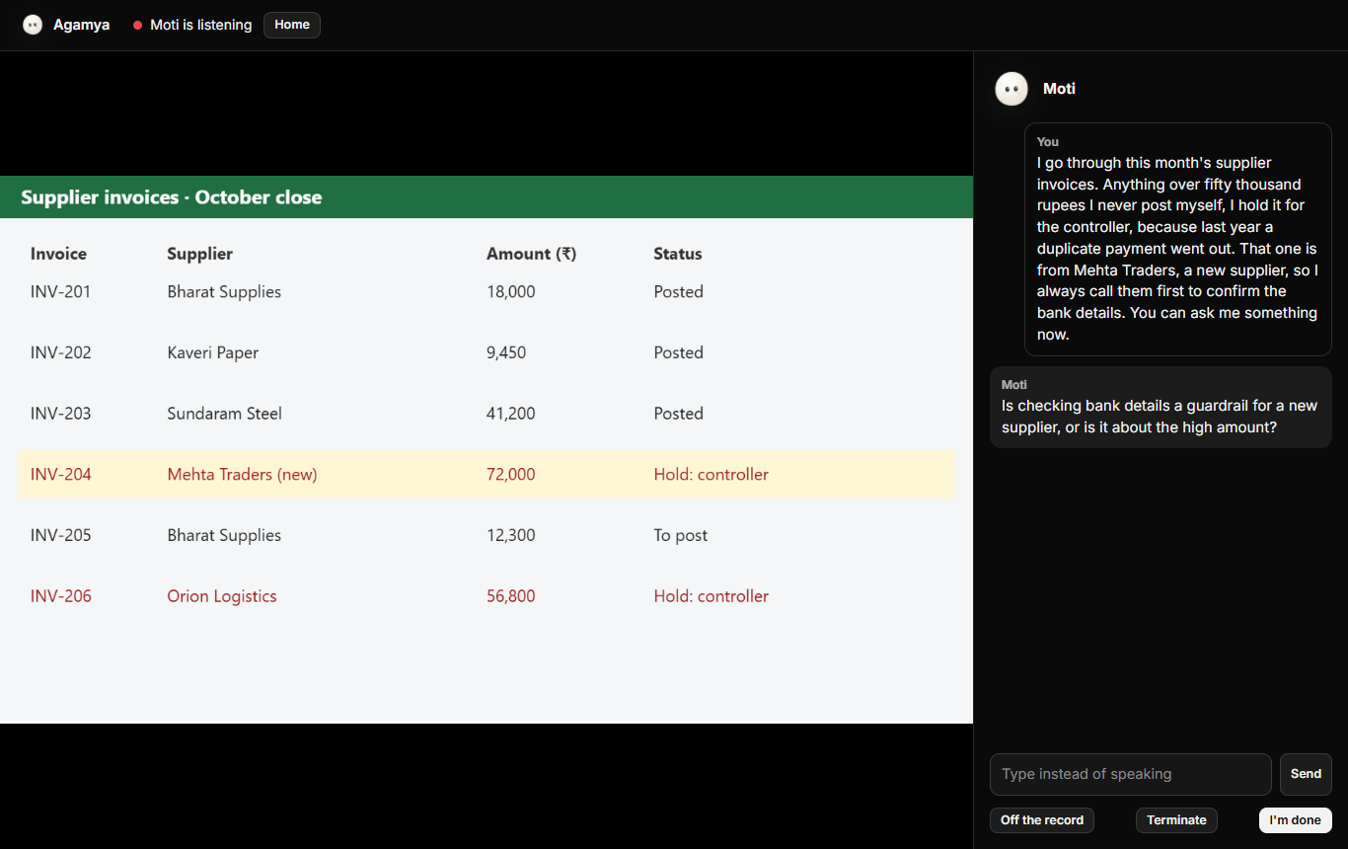
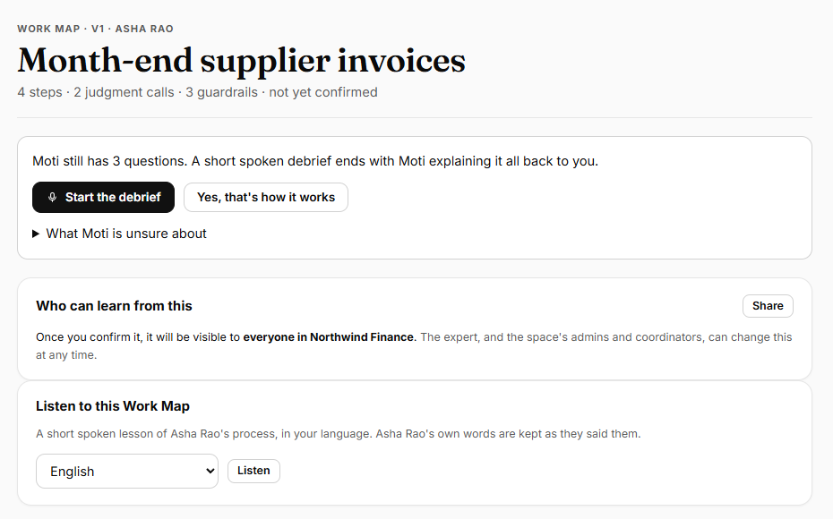
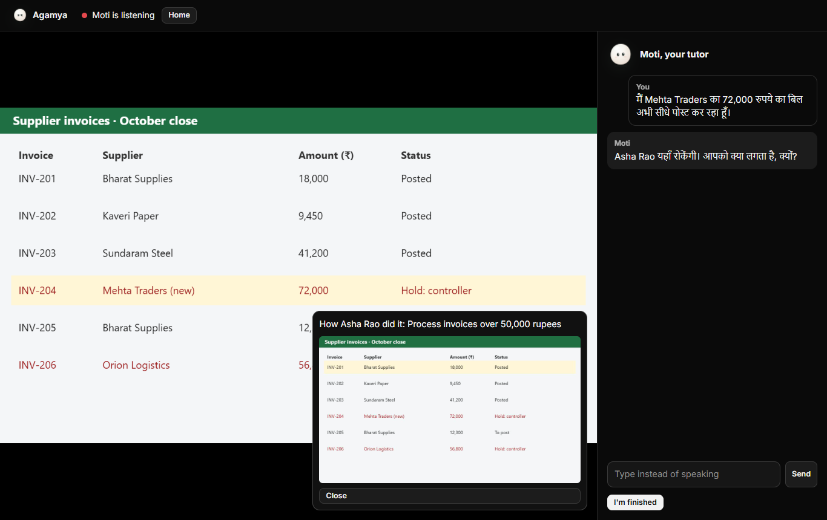
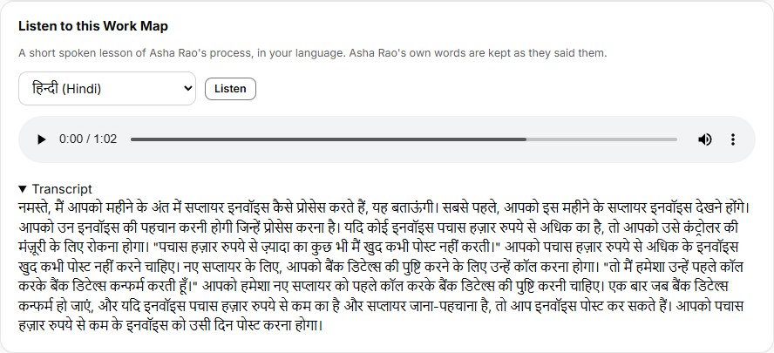
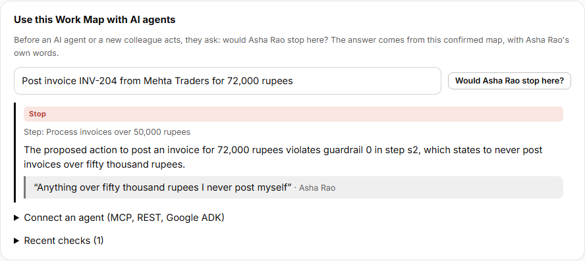
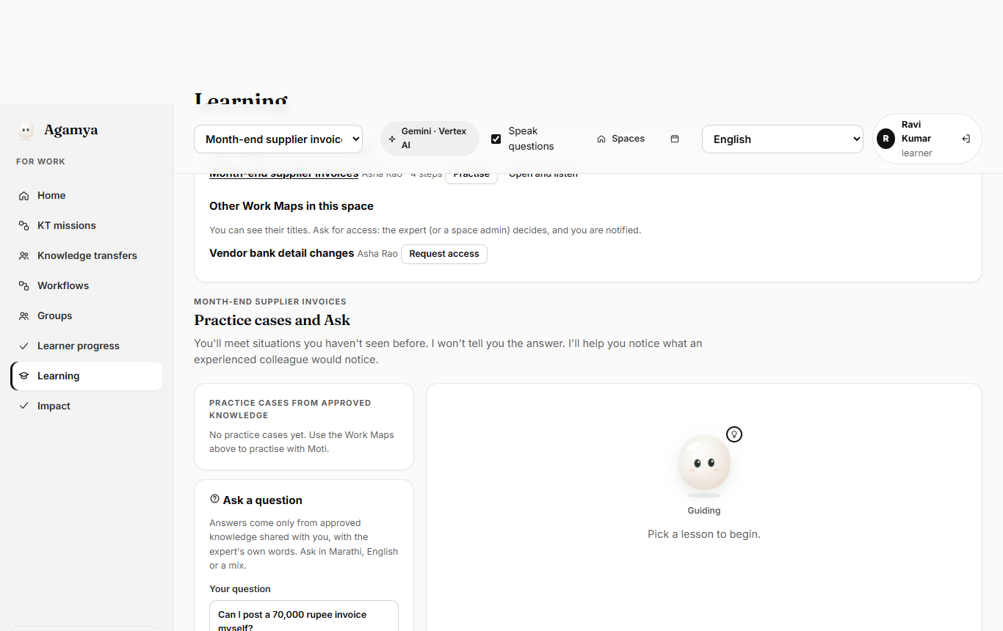
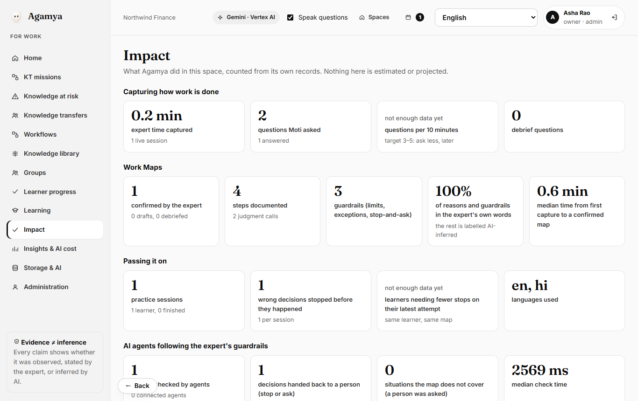
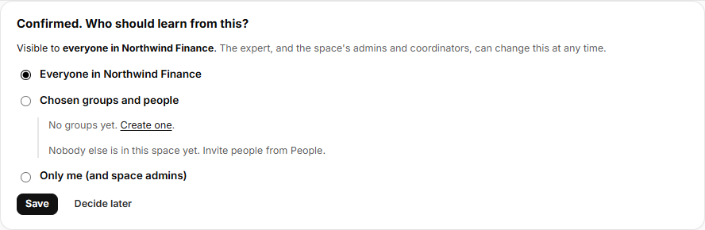
List of features offered by the solution
1. Live capture with Moti
Gemini Live asks at a pause; off the record any time
2. Work Map
steps, reasons in the expert's verified words, guardrails
3. Practise with a tutor
camera or screen; Moti stops a wrong decision
4. Listen
a spoken lesson in 15 languages
5. AI Guardian
STOP / ASK / PROCEED via REST, MCP, ADK
6. Ask
answers only from shared maps, quoting the expert
7. Confirm and share
space, groups or people; request access
8. Impact, measured
minutes, maps, mistakes stopped, AI cost
Also: debrief and teach-back · spaces and roles · optional space passcode · consent, masking of personal data, per-space isolation · works on phones (camera)
Notes:
1 Live capture with Moti (Gemini Live): screen or camera, voice; asks at natural pauses, at least one guardrail question; off the record at any time.
2 Work Map: steps, screen moment, decision, the reason in the expert's own verified words, guardrails, open questions.
3 Practise with a tutor: camera (also on phones) or screen; Moti stops a wrong decision and shows how the expert did it.
4 Listen: the map as a spoken lesson in 15 languages (Gemini TTS).
5 AI Guardian: STOP / ASK / PROCEED / NOT_COVERED for a proposed action, through REST, MCP or a Google ADK agent on Vertex AI Agent Engine.
6 Ask: answers only from confirmed maps shared with you, quoting the expert.
7 Confirm and share: the expert approves, then shares with the space, groups or people; others can request access.
8 Impact: measured from records.

Slide 5
Process flow diagram or Use-case diagram
Expert works
screen or camera
Moti asks why
one question at a pause
Work Map
verified quotes, guardrails
Debrief
Moti explains it back
Expert confirms
and chooses who learns
Learners practise
Moti stops mistakes, in their language
Listen and Ask
15 languages; answers quote the expert
AI agents check
"Would the expert stop here?"
Work: accounts payable, IT runbooks, escalations, a retiring specialist
Impact, measured
Culture: a Kathak guru's footwork, a weaver's loom, a family recipe in Marathi
Notes:
The expert works as usual; Moti asks why at a pause; Agamya builds the Work Map; a short debrief where Moti explains it back; the expert confirms and chooses who learns. Then the same map powers practice, listening and Ask, and AI agent checks. Impact is measured from the records.
Use cases: Work (accounts payable, IT runbooks, escalations, a retiring specialist) and Culture (dance, weaving, recipes, languages).

Slide 6
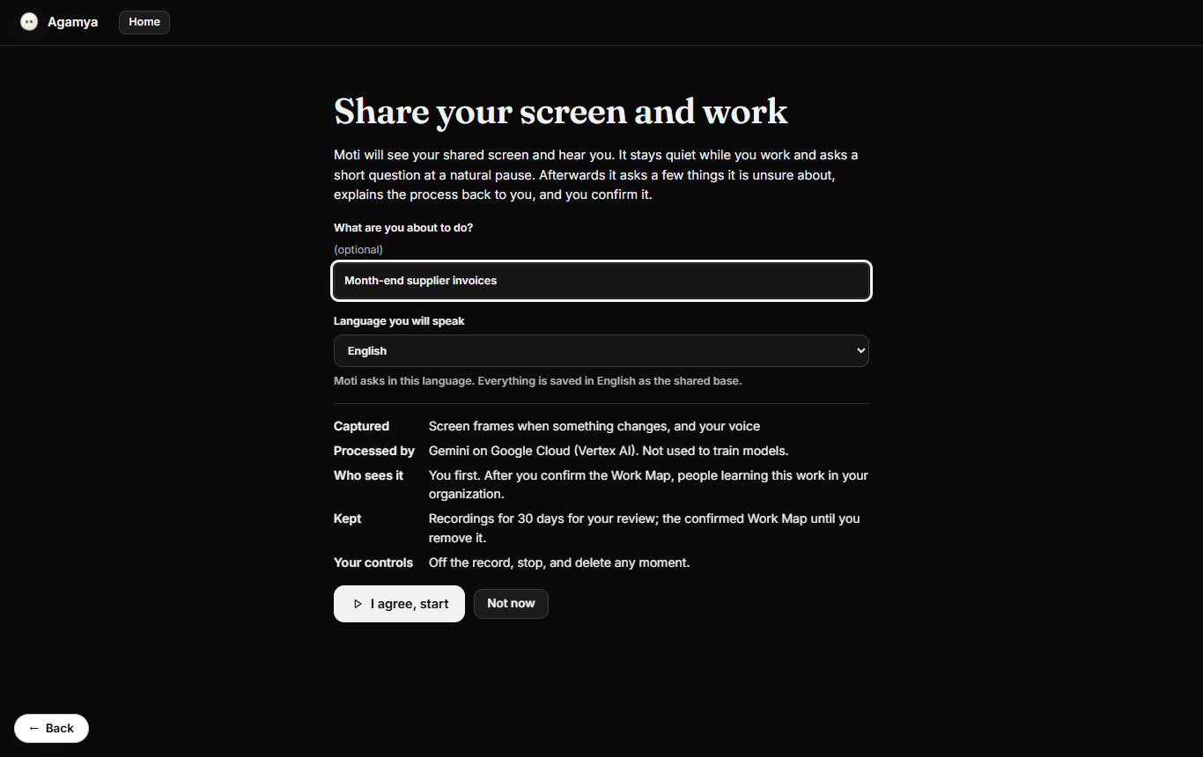
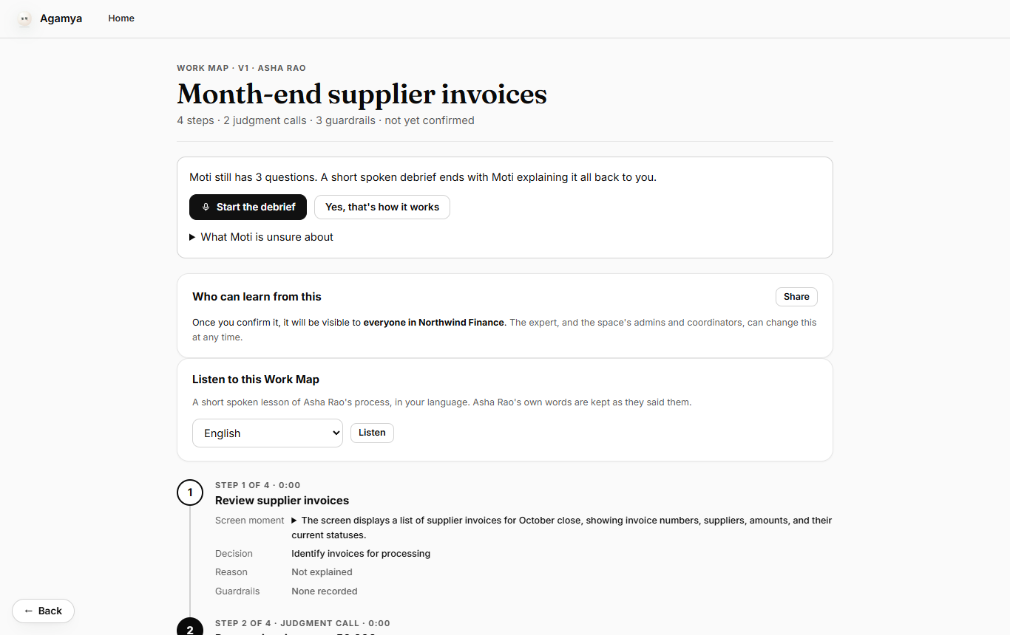
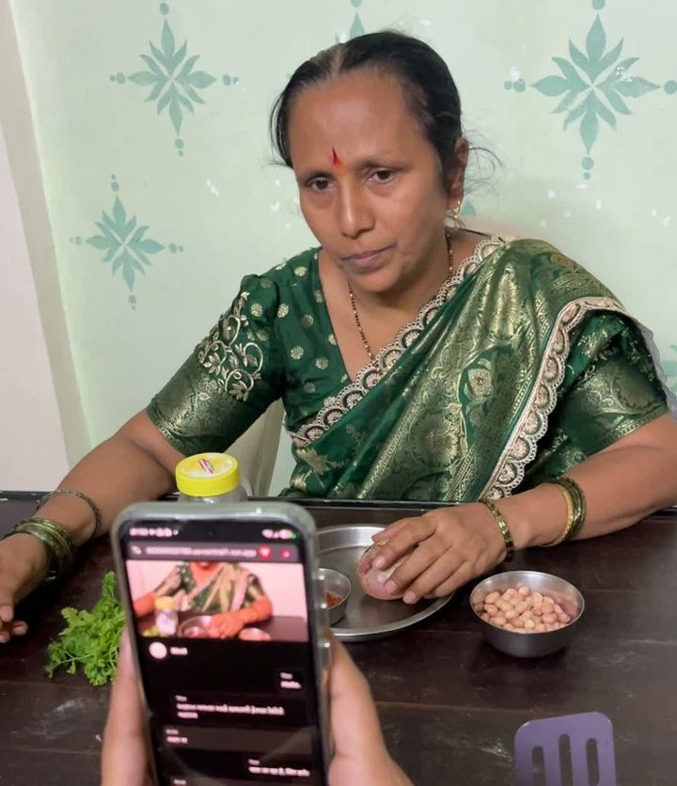
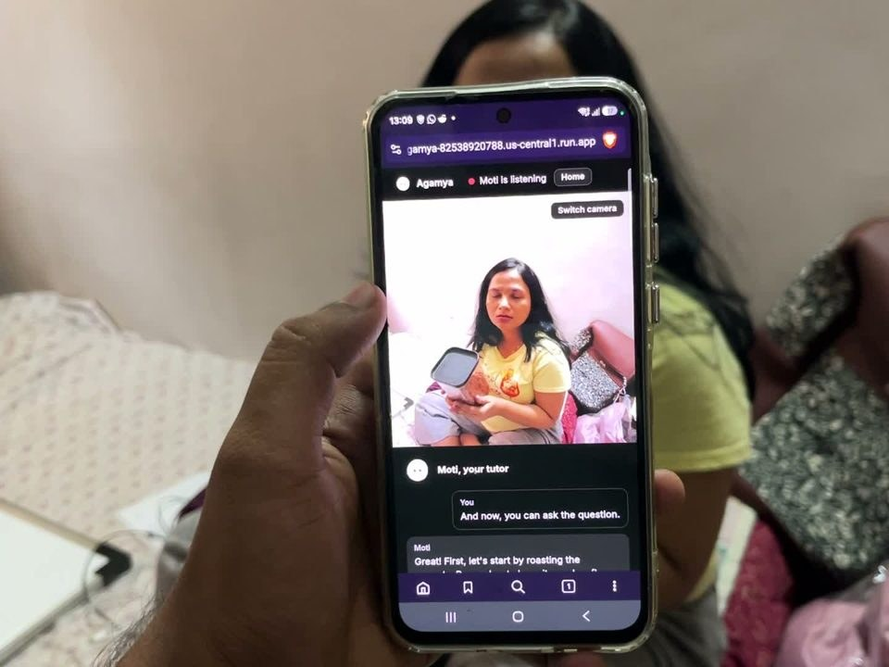

Wireframes/Mock diagrams of the proposed solution (optional)
1 Consent
what is captured, who sees it
2 Moti asks
at a pause, by voice
3 Work Map
steps, quotes, guardrails
4 Confirm, share
who learns from this
5 Practise
Moti stops a mistake
Not mock-ups
The top row is the deployed prototype. The photos are real sessions recorded on phones: a family recipe in Marathi, and a work handover on a laptop.
Tested on iPhone and Android.
In real use: Bharati records with Moti · Kiran practises with Moti · an expert shares her screen
Notes:
Instead of wireframes, these are screens of the deployed prototype: consent, live capture, Work Map, confirm and share, practice. Bottom: phone layout and a Culture session in Marathi.

Slide 7
Architecture diagram of the proposed solution
Browser / phone
Cloud Run · Node 24 / Fastify
Vertex AI
Data
Agamya web app
plain JS, no build
REST API
sessions, maps, spaces
Gemini Live
native audio: Moti
Cloud SQL
PostgreSQL + RLS
Live relay
WebSocket, 1 h, affinity
Gemini 2.5 Flash
JSON-schema output
Screen · camera · mic
changed frames ≤1/s
Cloud Storage
frames, audio
Job worker
Work Maps, narration
Gemini TTS
15 languages
Web Audio
AudioWorklet, 16 kHz
Secret Manager
no secrets in code
Agent API
REST + MCP, scoped keys
Agent Engine + ADK
Guardian agent
Flow: audio and changed frames go through the relay to Gemini Live, and Moti's voice comes back. The worker builds Work Maps with Gemini 2.5 Flash; every quote is checked in code. External AI agents, and the ADK Guardian on Agent Engine, call the Agent API before acting. Row-Level Security isolates each space in the database.
Notes:
Browser: screen, camera and mic; only changed frames, at most one per second.
Cloud Run: REST API, Gemini Live WebSocket relay (1 h timeout, session affinity), job worker, Agent API (REST + MCP).
Vertex AI: Gemini Live native audio (Moti), Gemini 2.5 Flash with JSON schemas (Work Maps, tutor stops, agent checks, Ask, narration scripts), Gemini TTS, Agent Engine hosting the Google ADK Guardian.
Data: Cloud SQL PostgreSQL with Row-Level Security per space, a private Cloud Storage bucket, Secret Manager.

Slide 8
Technologies to be used in the solution
Google Cloud, and why
Also used
Gemini Live API
gemini-live-2.5-flash-native-audio
Moti: real voice conversation with vision, in Indian languages
Node.js 24 · Fastify
server and WebSocket relay
Gemini 2.5 Flash
structured JSON output
Work Maps, tutor stops, agent checks, Ask: fast and cheap, checked in code
Plain JavaScript web app
no build step, works on phones
Gemini TTS
gemini-2.5-flash-tts
narration in 15 languages
Web Audio · media capture
AudioWorklet, screen and camera
Vertex AI Agent Engine + ADK
Python Guardian agent
managed agent hosting with tracing
Model Context Protocol
agents call the guardrails as a tool
Cloud Run
WebSockets, 1 h timeout, affinity
the whole app; scales to zero
PGlite
local development database
Cloud SQL · Storage · Secret Manager
PostgreSQL 16 + RLS
isolation enforced by the database; private media; no secrets in code
axe-core · Playwright
accessibility checks, screenshots
Cloud Build · Artifact Registry
Cloud Logging
one-command deploy: npm run deploy
Public datasets
YouCook2, ai4privacy (evaluation)
Notes:
Google Cloud: Gemini Live API, Gemini 2.5 Flash, Gemini TTS, Vertex AI Agent Engine with ADK, Cloud Run, Cloud SQL, Cloud Storage, Secret Manager, Cloud Build, Artifact Registry, Cloud Logging. Other: Node.js 24, Fastify, plain JavaScript, Web Audio, MCP, PGlite for local development, axe-core and Playwright for testing.

Slide 9
Estimated implementation cost (optional)
Build one Work Map (Gemini 2.5 Flash)
≈ $0.005
Measured: 50 builds cost $0.23
Example
One expert, 20 workflows, about 30 minutes each:
under $15 of AI
for a fully mapped role (estimate)
10-minute live capture with Moti
≈ $0.10–0.20
Estimate at list prices
Spoken lesson, per language (cached)
≈ $0.01
Estimate at list prices
One agent check
< $0.001
Estimate at list prices
How we know: every AI call is logged with its list-price cost, and the Impact page shows AI cost per map. Green = measured; gold = estimate.
Cloud Run
pay per use
scales to zero
Cloud SQL (db-f1-micro) + Storage
≈ $10–15/mo
pilot size, estimate
Notes:
Measured: building a Work Map with Gemini 2.5 Flash, 50 builds for $0.23 (about half a cent each). Estimates at list prices: a 10-minute live capture is about 10 to 20 cents; narration about 1 cent per language; an agent check under a tenth of a cent; Cloud SQL plus storage about $10 to 15 a month for a pilot. Example: 20 workflows of 30 minutes, under $15 of AI (estimate).

Slide 10


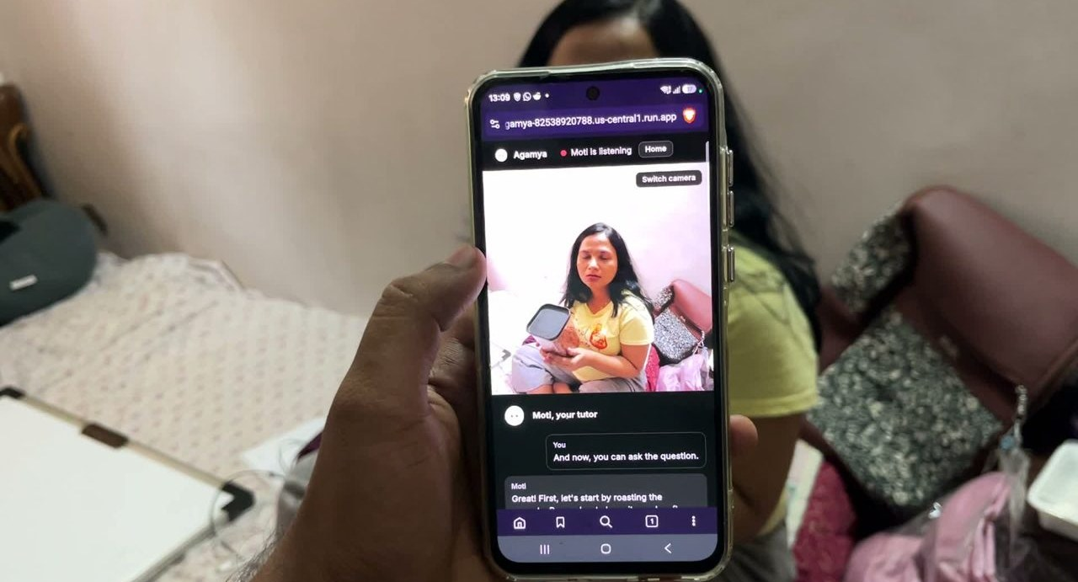
Snapshots of the prototype
Work: an expert shares her screen
Culture: Moti asks in Marathi
Kiran practises; Moti tutors
Moti asks a guardrail question
Work Map, verified quotes
Tutor stops a mistake (Hindi)
Notes:
Top: photos from real sessions (a JMeter knowledge transfer before maternity leave; a Satara recipe taught in Marathi; the learner practising with Moti). Bottom: the deployed prototype: live capture, Work Map, tutor stopping a mistake in Hindi.

Slide 11
Prototype Performance report/Benchmarking
176 / 176
automated tests pass
22 / 22
end-to-end checks on the live app
≈ 2 s
Moti asks after the expert pauses
≈ 1.6 s
tutor stops a wrong decision
Work Maps on 25 real recipes (YouCook2, 212 steps)
Personal data masked before storage
100%
steps covered
0%
invented evidence
100%
steps in order
Quotes the expert didn't say: silent videos 1 claimed → 0 verified; narrated 3 → 3. Unspoken quotes are labelled AI-inferred, every time.
Cost: 50 Gemini calls, $0.23.
Guardian agent on Agent Engine: returned STOP for ₹88,000 and ₹64,500 postings over the expert's limit (live test).
ai4privacy, 43,501 sentences. Amounts and dates: 0% changed.
All figures measured by the team (see docs/EVALUATION.md). Latencies are from a small number of live sessions. Also tested on iPhone.
Notes:
Measured results:
- 176 of 176 automated tests pass; 22 of 22 end-to-end checks pass on the deployed app.
- Moti asks about 2 seconds after the expert pauses; the tutor stops a wrong decision in about 1.6 seconds (Hindi, Kannada, English). Small sample of live sessions.
- YouCook2 (25 recipes, 212 steps): 100% of steps covered, 0% invented evidence, 100% in order. Silent videos: 1 quote claimed, 0 verified; narrated videos: 3 claimed, 3 verified. 50 calls cost $0.23.
- Masking on ai4privacy (43,501 sentences): email 100%, valid cards 100%, IBAN 99.9%, national ID 99.9%, phone 94.6%; amounts and dates unchanged.
Datasets: YouCook2 (http://youcook2.eecs.umich.edu/); ai4privacy pii-masking-200k (https://huggingface.co/datasets/ai4privacy/pii-masking-200k).

Slide 12

Additional Details/Future Development (if any)
Next 3 months
6 months
12 months
Two experts on one map: where they agree, differ, and why
Export guardrails to agent platforms and RPA tools
Culture archive: opt-in community collections of crafts and languages
Native-speaker review of all 15 narration languages
On-device masking of faces and screens before upload
Partnerships with craft associations and language surveys
Google Workspace sign-in and directory groups
Expert-shift alerts when a confirmed rule changes
Certified practice paths for regulated roles
Our Inspiration
The app has a story page: Bengal muslin, Majhi, Japan's craft families, and the expert at your desk, with sources. The same loop that keeps an invoice rule can keep a weaver's reason.
agamya-82538920788.us-central1.run.app/#/inspiration
Notes:
Future development (planned, not built): two experts on one map, native-speaker review of narration, Workspace sign-in, exporting guardrails to agent platforms, on-device masking, alerts when a confirmed rule changes, an opt-in culture archive with community consent, partnerships with craft associations and language surveys, practice paths for regulated roles. The Inspiration page in the app tells the story behind Agamya, with sources.

Slide 13
Provide links to your:
GitHub Public Repository
github.com/S-D-P/Agamya-AI-Builder-Cup-26
Judge sign-in
One click fills these in on the sign-in page.
Work: judge.work@agamya.example
Culture: judge.culture@agamya.example
Password: agamya-judges-2026
Demo Video Link (3 Minutes)
ADD YOUTUBE LINK
Work demo video (a JMeter handover, kept separate for the time limit)
ADD YOUTUBE LINK
Final Product Link
agamya-82538920788.us-central1.run.app
Start here: docs/JUDGES_GUIDE.md in the repository shows every feature, one screenshot at a time.
Use Chrome or Edge on a computer for screen sharing; on a phone, use the camera. Allow the microphone and wear headphones.
Notes:
GitHub: https://github.com/S-D-P/Agamya-AI-Builder-Cup-26
Demo video: (add link)
Product: https://agamya-82538920788.us-central1.run.app
Judge accounts (public by design, test data only): judge.work@agamya.example and judge.culture@agamya.example, password agamya-judges-2026.

Slide 14
References
[1] The Daily Star (2026). What Bengal made and let others claim. thedailystar.net · Wikipedia: Dhaka muslin.
[2] Chakravartty, A. (6 Sep 2013). Survey tracks down only speaker of Majhi in India. Down To Earth · Wikipedia: Majhi language.
[3] Garland Magazine (2026). Kimono and lacquerware sales down up to 90 per cent as Japan's craft base narrows (data: Association for the Promotion of Traditional Craft Industries) · NPR/WFAE (29 Jul 2022). Japan's traditional crafts are struggling to survive the country's population decline.
[4] Panopto (2018). Workplace Knowledge and Productivity Report, via HR Dive.
[5] Polanyi, M. (1966). The Tacit Dimension.
[6] Zhou, L., Xu, C., Corso, J. (2018). YouCook2 dataset · ai4privacy. pii-masking-200k (Hugging Face).
Agamya's own results: docs/EVALUATION.md. Full URLs in these notes and in docs/submission/RESEARCH_LEDGER.md.
Notes:
[1] https://www.thedailystar.net/supplements-0/news/what-bengal-made-and-let-others-claim-4217271 ; https://en.wikipedia.org/wiki/Dhaka_muslin
[2] https://www.downtoearth.org.in/amp/story/environment/survey-tracks-down-only-speaker-of-majhi-in-india-42123 ; https://en.wikipedia.org/wiki/Majhi_language
[3] https://garlandmag.com/kimono-and-lacquerware-sales-down-up-to-90-per-cent-as-japans-craft-base-narrows/ ; https://www.wfae.org/2022-07-29/japans-traditional-crafts-are-struggling-to-survive-the-countrys-population-decline
[4] https://www.hrdive.com/news/inefficient-knowledge-sharing-costs-large-us-businesses-47m-a-year/527892/
[5] Michael Polanyi, The Tacit Dimension, 1966.
[6] http://youcook2.eecs.umich.edu/ ; https://huggingface.co/datasets/ai4privacy/pii-masking-200k
All accessed 18 Oct 2026.

Slide 15

Notes:
Thank you. Agamya: show it once, confirm it, pass it on, without losing why.

