Slide 1
DataScience Foundation with Python
Project Presentation

Slide 2
Table of contents
My Introduction
Project Specification
Various Statistical Analysis
Plots & Tables
Reports
Conclusion
DataScience Foundation with Python
Project Presentation

Slide 3
My Introduction
Name : Ms. Dheepa Sundaresan
Academic Background : MCA
IT industry Experience : 15 years
Occupation : Tech Specialist (P1 Band) in Tech Mahindra
Technical Area - Mainframe
Domain Experience :
Healthcare – 10 years
Automobile – 5 years
Contact me @ dheepa78@gmail.com

Slide 4

Domain
Automobile
Topic of the Project
Automobile data

Slide 5
Data Science
Data science, or data-driven science, combines different fields of work in statistics and computation in order to interpret data for the purpose of decision making.

Slide 6
Project Introduction
Use the given automobile data and arrive at a buying decision of a car
Data Scientist
Here u go..!! Lot of data about cars..
Data Scientist
Let me make it readable. Here you go with Bars & Graphs. Read through and make a decision
Guy
I don’t understand anything here ☹
Guy
I want to buy a Car..!!

Slide 7
Dataset Description
Details of cars
Fields – ‘symboling', 'normalized-losses', 'make', 'fuel-type', 'aspiration', 'num-of-doors', 'body-style', 'drive-wheels', 'engine-location', 'wheel-base', 'length', 'width', 'height', 'curb-weight', 'engine-type', 'num-of-cylinders', 'engine-size', 'fuel-system', 'bore', 'stroke', 'compression-ratio', 'horsepower', 'peak-rpm', 'city-mpg', 'highway-mpg', 'price'

Slide 8
Exploration Idea # 1 Python KeyTechnicals : Dataframe , fillna , dropna , NaN
Cleaning & Loading data
Automobile data given in a *.CSV file
CSV file loaded into Python Dataframe
Missing data were marked as ‘?’
Less significant field – Normalized-losses when missing replaced with zero & num-of-doors with ‘four’
Significant field – Price – Missing row discarded as insufficient data
8

Slide 9
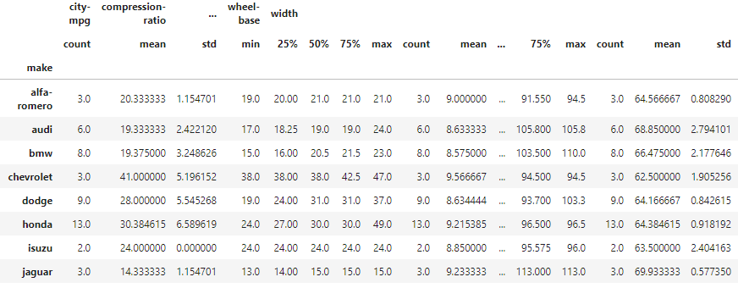
Exploration Idea # 2 Python Technicals : Panda – Dataframe Describe Business Question: How do I compare a feature value within the cars available in the same brand and against other brands?
Statistical Analysis of variables
Statistical Analysis of all the numerical fields available in the data is shown below
We see the counts, mean, Standard deviation, percentiles, min & max

Slide 10
Exploration Idea # 3 Python Technicals : Seaborn – Box Plot Business Question: How do I infer the price range of the cars in each brand?
Bivariate Analysis
Statistical Methods used to investigate the relationship between data samples
Bivariate Analysis to find out the impact of the Brand / Make on the price of the car.
Box Plot is classical example for Bivariate Analysis – Inferential Statistics;
The plot shows you the price range of cars available in each Brand. Shows the quartile & outliers too ☺

Slide 11
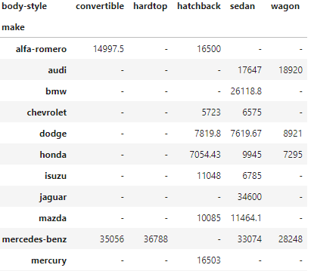
Exploration Idea # 4 Python Technicals : Panda – Dataframe Pivot Business Question: How do I know the average price of the cars in each brand per body-style?
Multi-variate Analysis
Pivot table is an example of descriptive statistical analysis of Multiple variables. Below is the table that describes the mean price of cars as per Make & Body-style.

Slide 12
Exploration Idea # 5 Python Technicals : Seaborn - PairPlot Business Question: How do I see the data and arrive at pattern?
Univariate Analysis
Plot the data and find a pattern
Take a subset of fields Make, Body-Style, Fuel-type , City MPG & Highway MPG
Fuel-type & Body-Style fields are categorical variables. Scope for feature engineering
Analyze the car’s mileage further for Fuel-type = ‘Gas’.
Analyze further for few brands to arrive at patterns of cars performing better in City MPG or highway MPG

Slide 13
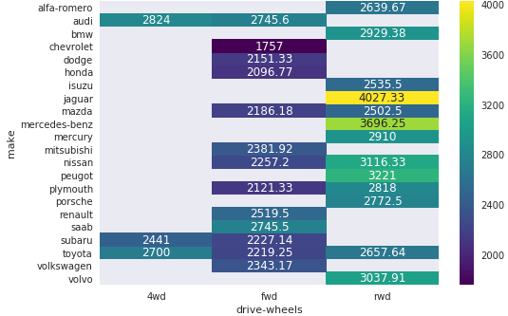
Exploration Idea # 6 Python Technicals : Seaborn Heatmap Business Question: How do I see a presence or density of a feature against other features
Correlation of Variables
Make, Curb-weight & Drive-Wheel Analysis (suggested in Requirement document)
Colored cells show presence. Cells show mean Curb-weight

Slide 14
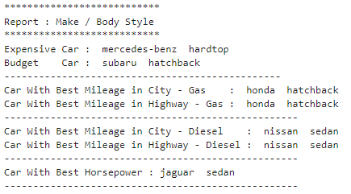
Exploration Idea # 7 Python Technicals : Panda Dataframe Business Question: I want to decide a car based on Budget, mileage or horsepower. What would you suggest
My view of this data
Generate a report as below:

Slide 15
I would buy Honda – Hatchback….!!!!
Price : 7k (apprx) Fuel-type : Gas
Thank you very much for your time

