Slide 1

PERFORMANCE ANALYSIS OF FULL ADDER BASED ON DOMINO LOGIC TECHNIQUE
Microelectronics & VLSI Design
Department of Electronics and Communication Engineering
NIT Silchar
Presented by
Soham Sen(2224211)

Slide 2
CONTENTS
Abstract
Introduction
1-bit Full Adder
Applications
Existing system
Disadvantages
Proposed system
Advantages
Tools used
Results
Conclusion
Future Scope

Slide 3
ABSTRACT
In modern VLSI area efficient devices are most used because most of the devices are becoming portable. The Domino logic technique is often employed in designing the area efficient and high-speed devices. In this seminar paper. one- bit full adder circuit using CMOS based logic and domino based logic on Cadence Virtuoso has been designed based on 90m technology having the supply voltage of 1.8V. This seminar paper is mainly centralized on the design of area efficient and fast speed devices. This work evaluates the performance CMOS and Domino logic based on full adder circuit in terms of delay and power consumption. It was found that Domino logic based one-bit full adder circuit occupied lesser area and introduces less delay as comparison to one-bit full adder circuit. based on CMOS logic.
Keywords— CMOS, Domino, Full adder, Performance Parameters.

Slide 4
INTRODUCTION
In the fast-growing VLSI industry, transistor density is increasing with rapid rate day-by-day. According to Moore’s law transistor density will get doubled itself after every eighteen months. As the number of transistors will increase, correspondingly area, delay and power consumption of the device will also increase. So, a technology is required by which the area can be reduced and increase the performance of the device. From the past few decades CMOS technology is being used for designing the chips in semiconductor industry, but as the number of transistors are increasing, area of the device and delay both are increasing. So, it requires to switch to a technology, which uses lesser area and smaller delay. Hence, the Domino logic is used for designing the one-bit full adder and compared the various performance parameter like area, delay, and power consumption in both technologies.

Slide 5
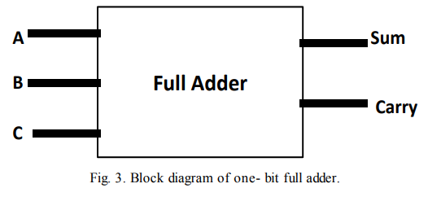
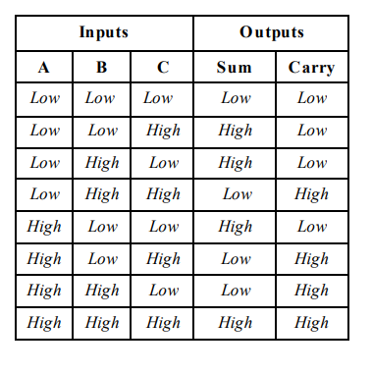
1 bit Full Adder
Fig. Block diagram of Full Adder
Fig. Truth table for Full Adder

Slide 6
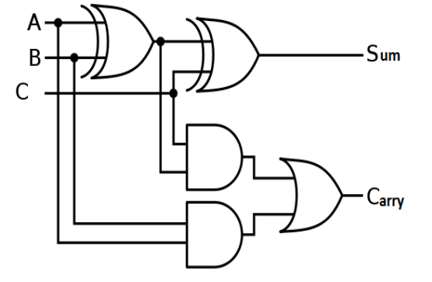
=A⊕B⊕C
=AB+BC+AC
Fig. Logic diagram of Full Adder

Slide 7
APPLICATIONS
A Full Adder’s circuit can be used as a part of many other large circuits like Ripple Carry Adder ,which adds n-bits simultaneously.
The dedicated multiplication circuit uses Full Adders circuit to perform Carryout Multiplication.
Full Adders are used in ALU-Arithmetic Logic Unit.
In order to generate memory addresses inside a computer and to make the Program Counter point to next instruction ,the ALU makes use of Full Adders.
Full-Adders are a part of Graphics Processing Unit for graphics related applications.

Slide 8
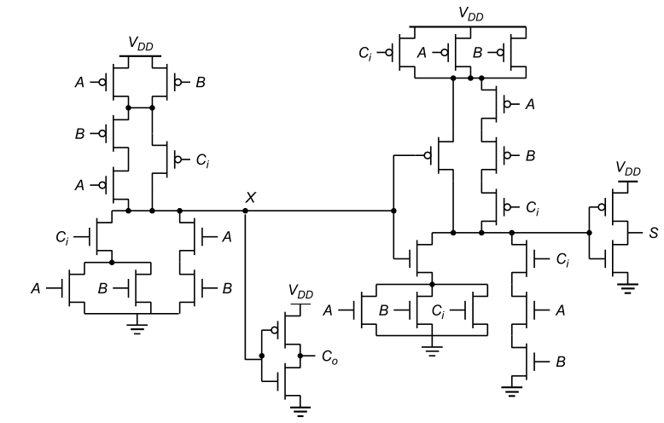
Existing Method
Fig. One-bit full adder using 28 Transistors based on CMOS logic

Slide 9
DISADVANTAGES
More number of transistors due to CMOS technology.
Large delay
More Power Consumption

Slide 10
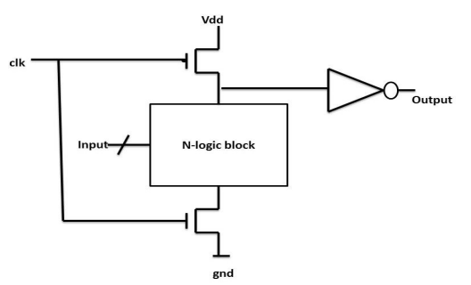
PROPOSED METHOD
Operation
-Clk is low during Pre-charge stage
>>PMOS will be on and NMOS is off
>>Output node charged to Vdd
-Clk is high during evaluation stage
>>PMOS will be off and NMOS will be on
>>Output depend on the input’s configuration
Pull down network design is same as static CMOS
Fig. Domino Logic

Slide 11
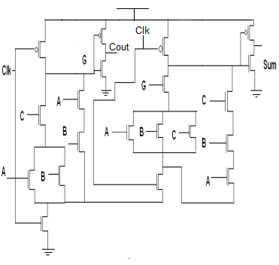
Fig. One-bit full adder using 20 Transistors based on domino logic

Slide 12
ADVANTAGES
Less number of transistors is required as only nmos logic is used
Less delay is achieved due to domino logic
Less power consumption

Slide 13
TOOLS USED
Cadence Virtuoso
Technology used:90nm

Slide 14
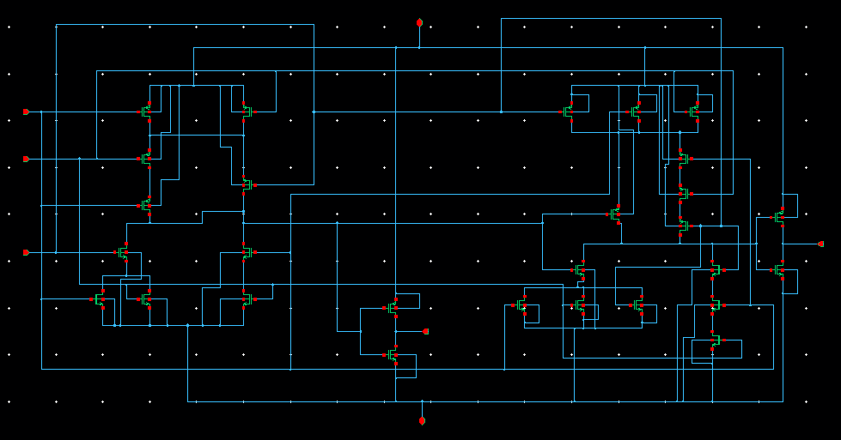
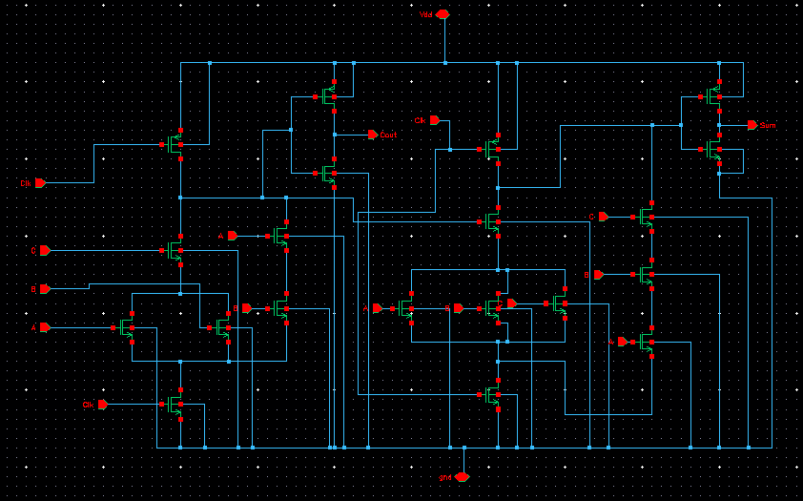
RESULTS
Fig. Schematic of one-bit full adder using 28T based on CMOS logic
Fig. Schematic of Domino full adder using 20T

Slide 15
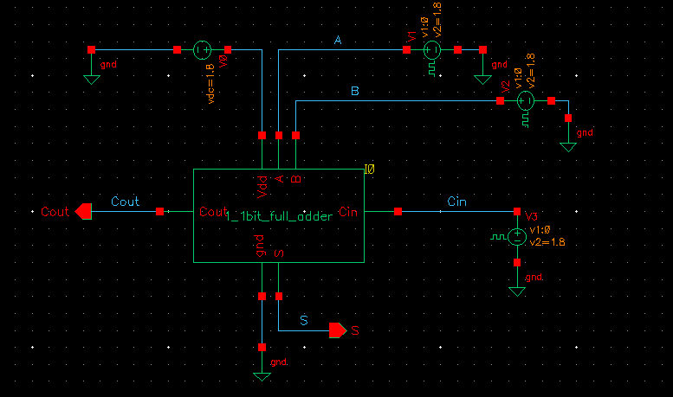
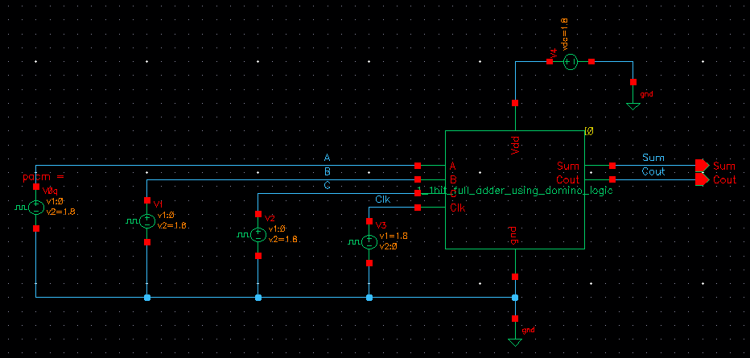
Fig. Testbench for FA based on CMOS logic
Fig. Testbench for FA based on domino logic

Slide 16
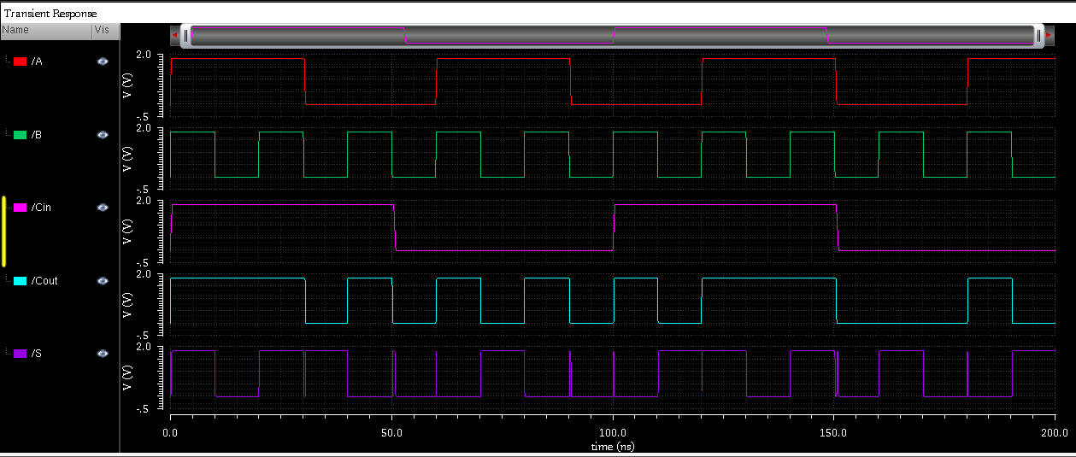
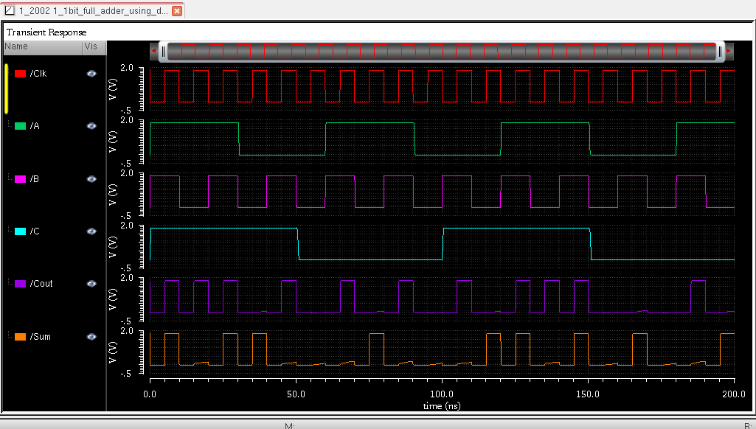
Fig. Simulated result of FA based on CMOS logic
Fig. Simulated result of FA using 20T based on domino logic

Slide 17
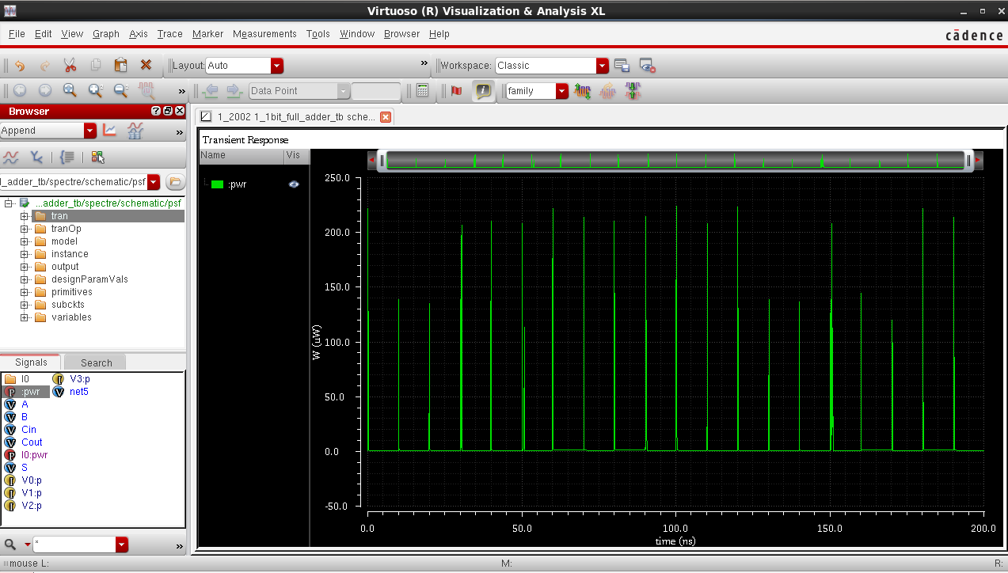
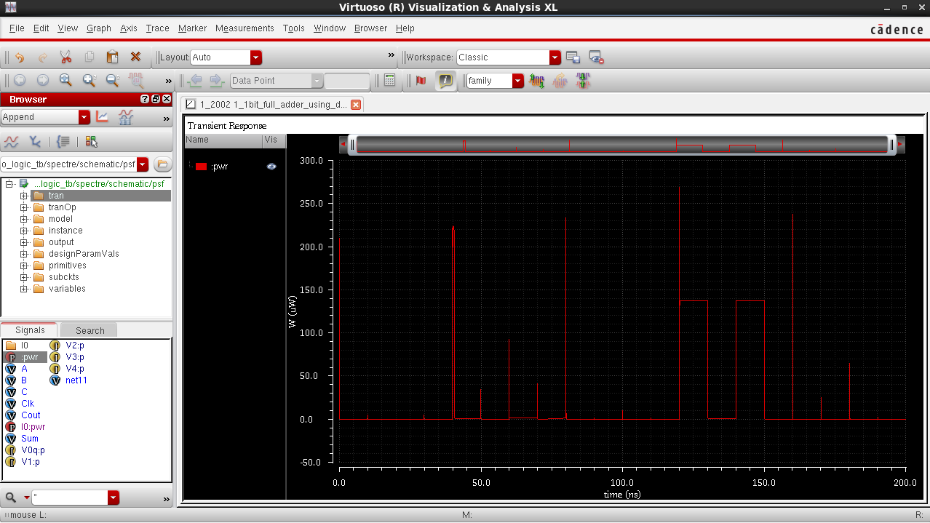
Fig. Simulated power analysis result of FA based on CMOS logic
Fig. Simulated power analysis result of FA using 20T based on domino logic

Slide 18
Parameters | CMOS logic | Domino logic
Technology | 90nm | 90nm
Input Voltage | 1.8V | 1.8V
No. of transistors | 28 | 20
Average delay | 0.404ns | 0.088ns
Table. Comparison of various performance parameters

Slide 19
CONCLUSION
It was found that Domino logic gives us accurate results
Domino logic requires less number of transistors
There is a decrease in chip area
The delay in domino logic is less as compared to CMOS logic.
It was observed that instantaneous power is more in CMOS based logic as compared to the Domino logic.
Notes:
so there are more chances of device failure in CMOS logic as compared to the Domino logic.

Slide 20
FUTURE SCOPE
To extend this concept , we may change the different configurations of Full adders using PTL , Transmission Gate , GDI .
Notes:
GDI-Gate Diffusion input technique

Slide 21
THANK YOU

