Slide 1
Derka Digital
Coding Test
Prepared By – Shweta Bhilare.

Slide 2
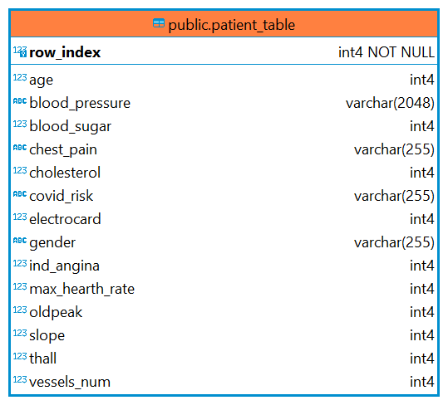
Database Shema
This is the database schema containing table name “patient_table” including 15 columns with there datatypes.
CREATE TABLE public.patient_table (
row_index int4 NOT NULL,
age int4 NULL,
blood_sugar int4 NULL,
blood_pressure varchar(2048) NULL,
chest_pain varchar(255) NULL,
cholesterol int4 NULL,
covid_risk varchar(255) NULL,
electrocard int4 NULL,
gender varchar(255) NULL,
ind_angina int4 NULL,
max_hearth_rate int4 NULL,
oldpeak int4 NULL,
slope int4 NULL,
thall int4 NULL,
vessels_num int4 NULL,
CONSTRAINT patient_table_pkey PRIMARY KEY (row_index)
);

Slide 3
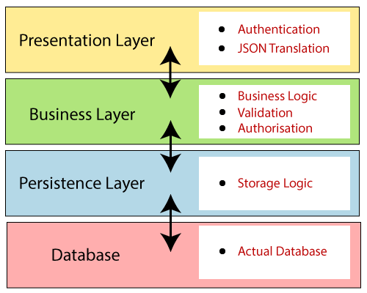
System Architecture
I have used the Java Spring Boot module of Spring Framework to develop this project.
Spring Boot follows a layered architecture in which each layer communicates with the layer directly below or above (hierarchical structure) it.

Slide 4
System Architecture
Repository Class Extending
CRUD Services
Dependency Injection
Client
Controller
Service
Layer
Model
Https
Request
JPA/ Spring Data
Database

Slide 5
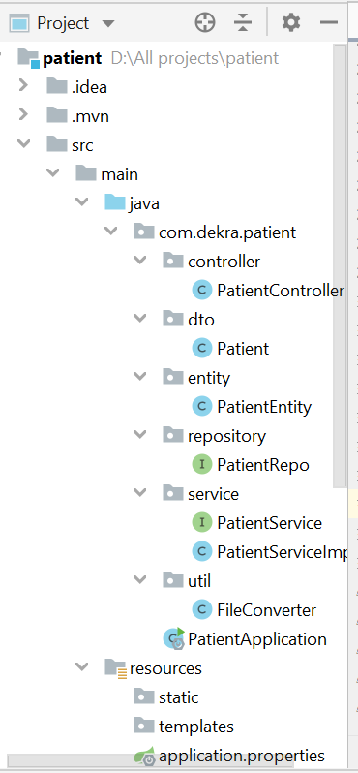
System Architecture
Project Name : Patient
REST Endpoint
  http://localhost:8080/admin/getDataByGender?gender=female
  http://localhost:8080/admin/getAllData
  http://localhost:8080/admin/getDataByCovidRisk?covidRisk=High
  http://localhost:8080/save?file

Slide 6
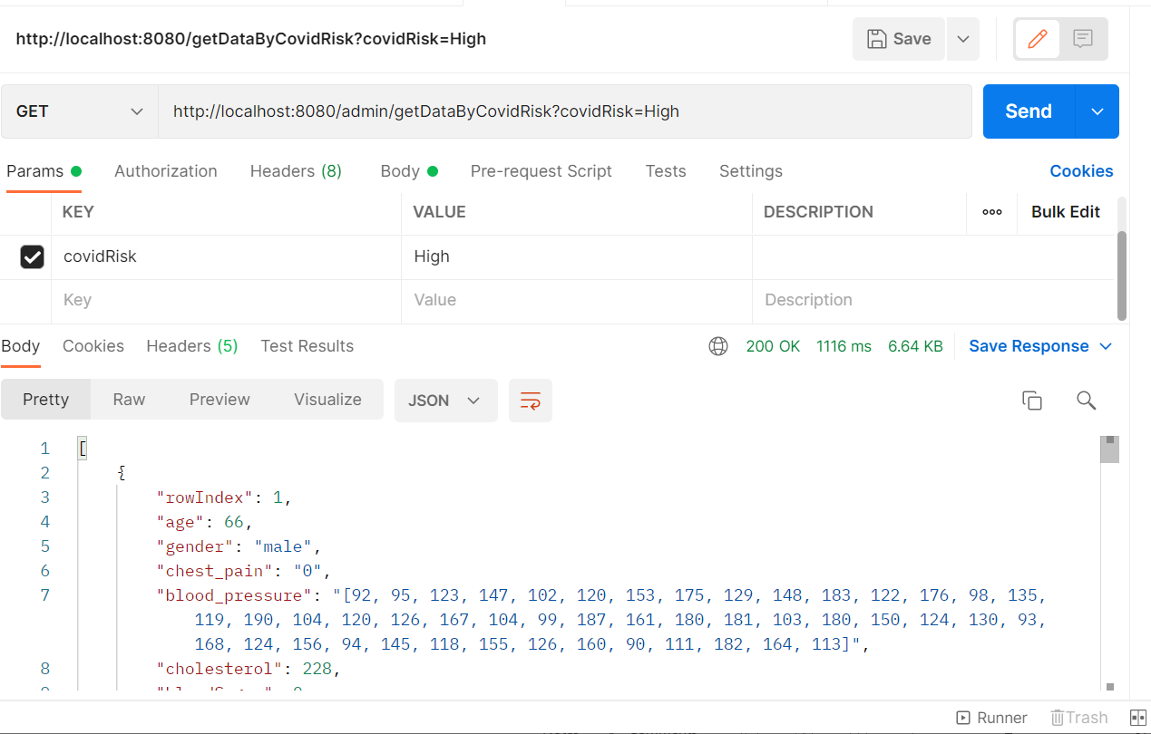
System Architecture
REST API’s
REST Method – Get
URL’s :
  http://localhost:8080/admin/getDataByCovidRisk?covidRisk=High
  http://localhost:8080/admin/getDataByGender?gender=female
  http://localhost:8080/admin/getAllData
  http://localhost:8080/save?file

Slide 7
Thank You

