Slide 1
Simulation of an Autonomous Vision-Based Robot with a Spiking Neural Controller
Stefan Walke
stefan.walke@tum.de
<number>
Notes:
<number>

Slide 2
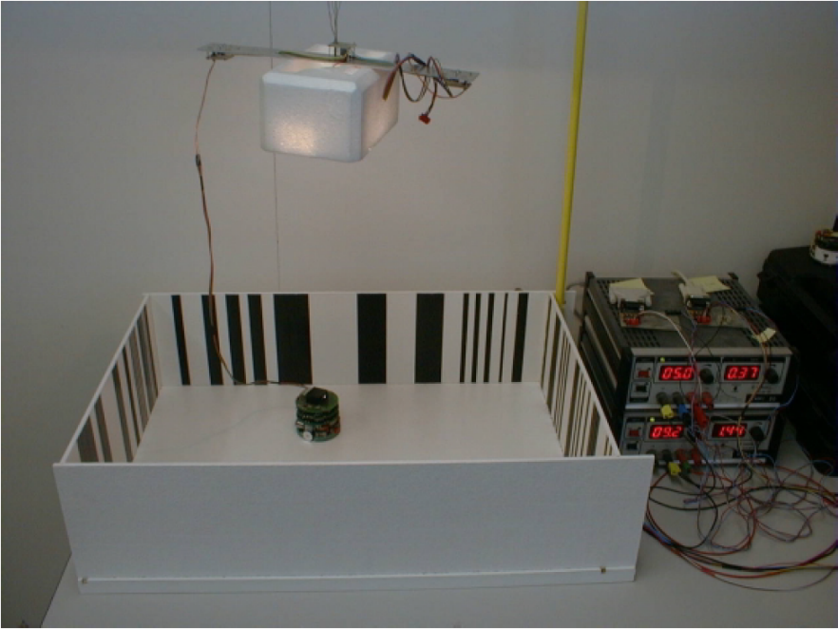
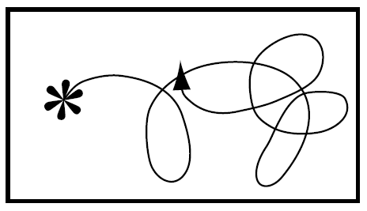
Basics
Based on the work of Floreano et al.:
Evolution of Spiking Neural Controllers for Autonomous Vision-Based Robots, 2001
Goal:
Based on visual input, the robot should drive around the box autonomously.
The wheels are not allowed to rotate backwards and the robot must not collide with the wall.
No knowledge of the arena is encoded in the brain of the robot.
Learning via evolutionary algorithm.
Source: Floreano et al., 2001
Basics
<number>
Notes:
<number>

Slide 3
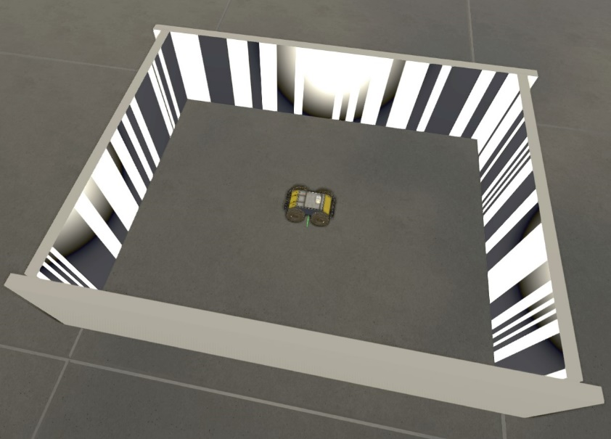
Experiment Setup in the NRP
Using Husky Model instead of Khepera
Camera resolution of 1x64 pixels, producing 16 input values
Random markings on the walls
Current State of Development
<number>
Notes:
<number>

Slide 4
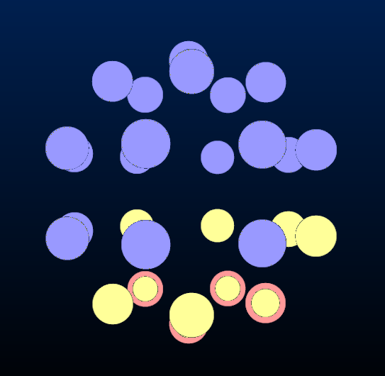
Brain Structure
18 input neurons, 10 brain neurons, 4 of which are used to set the wheel speeds
16 inputs from camera, 2 from errors in left and right wheel speeds
Connections are set by a 10x29 matrix, representing genetic information
Each row in this matrix corresponds to one of the brain neurons
Input neuron to brain neuron synapses are always excitatory
Current State of Development
<number>
Notes:
<number>

Slide 5
Robot to Brain Transfer Function
For better results we use 64 pixels to calculate values for our 16 visual input neurons
Images are converted to binary and 4 neighboring pixels are mapped to one input
The other two input neurons’ are firing rates are proportional to the difference in the wheel speed, of the left and right wheel pairs, we set in the last time step and the speed we get when reading the actual speed.
Current State of Development
<number>
Notes:
<number>

Slide 6
Brain to Robot Transfer Function
4 arbitrary brain neurons are specified as the output neurons (firing rate)
One for each right and left wheels forward and backwards speed, take difference for total wheel speed
Husky controls are divided into linear and angular. Linear is the average of left and right speeds, while angular is the difference between them.
For smoother operation all these values are multiplied with experimentally determined constants
Current State of Development
<number>
Notes:
<number>

Slide 7
Current Problems and Upcoming Work
Suboptimal controls (linear, angular)
-> Change Husky control to left and right, or switch to different robot model
Implement Learning
Improve handling of camera data
Potentially restrict movements or change parameters for faster results with evolutionary algorithm
Current Problems and Upcoming Work
<number>
Notes:
<number>

Slide 8
Questions
?
Questions
<number>
Notes:
<number>

