Slide 1
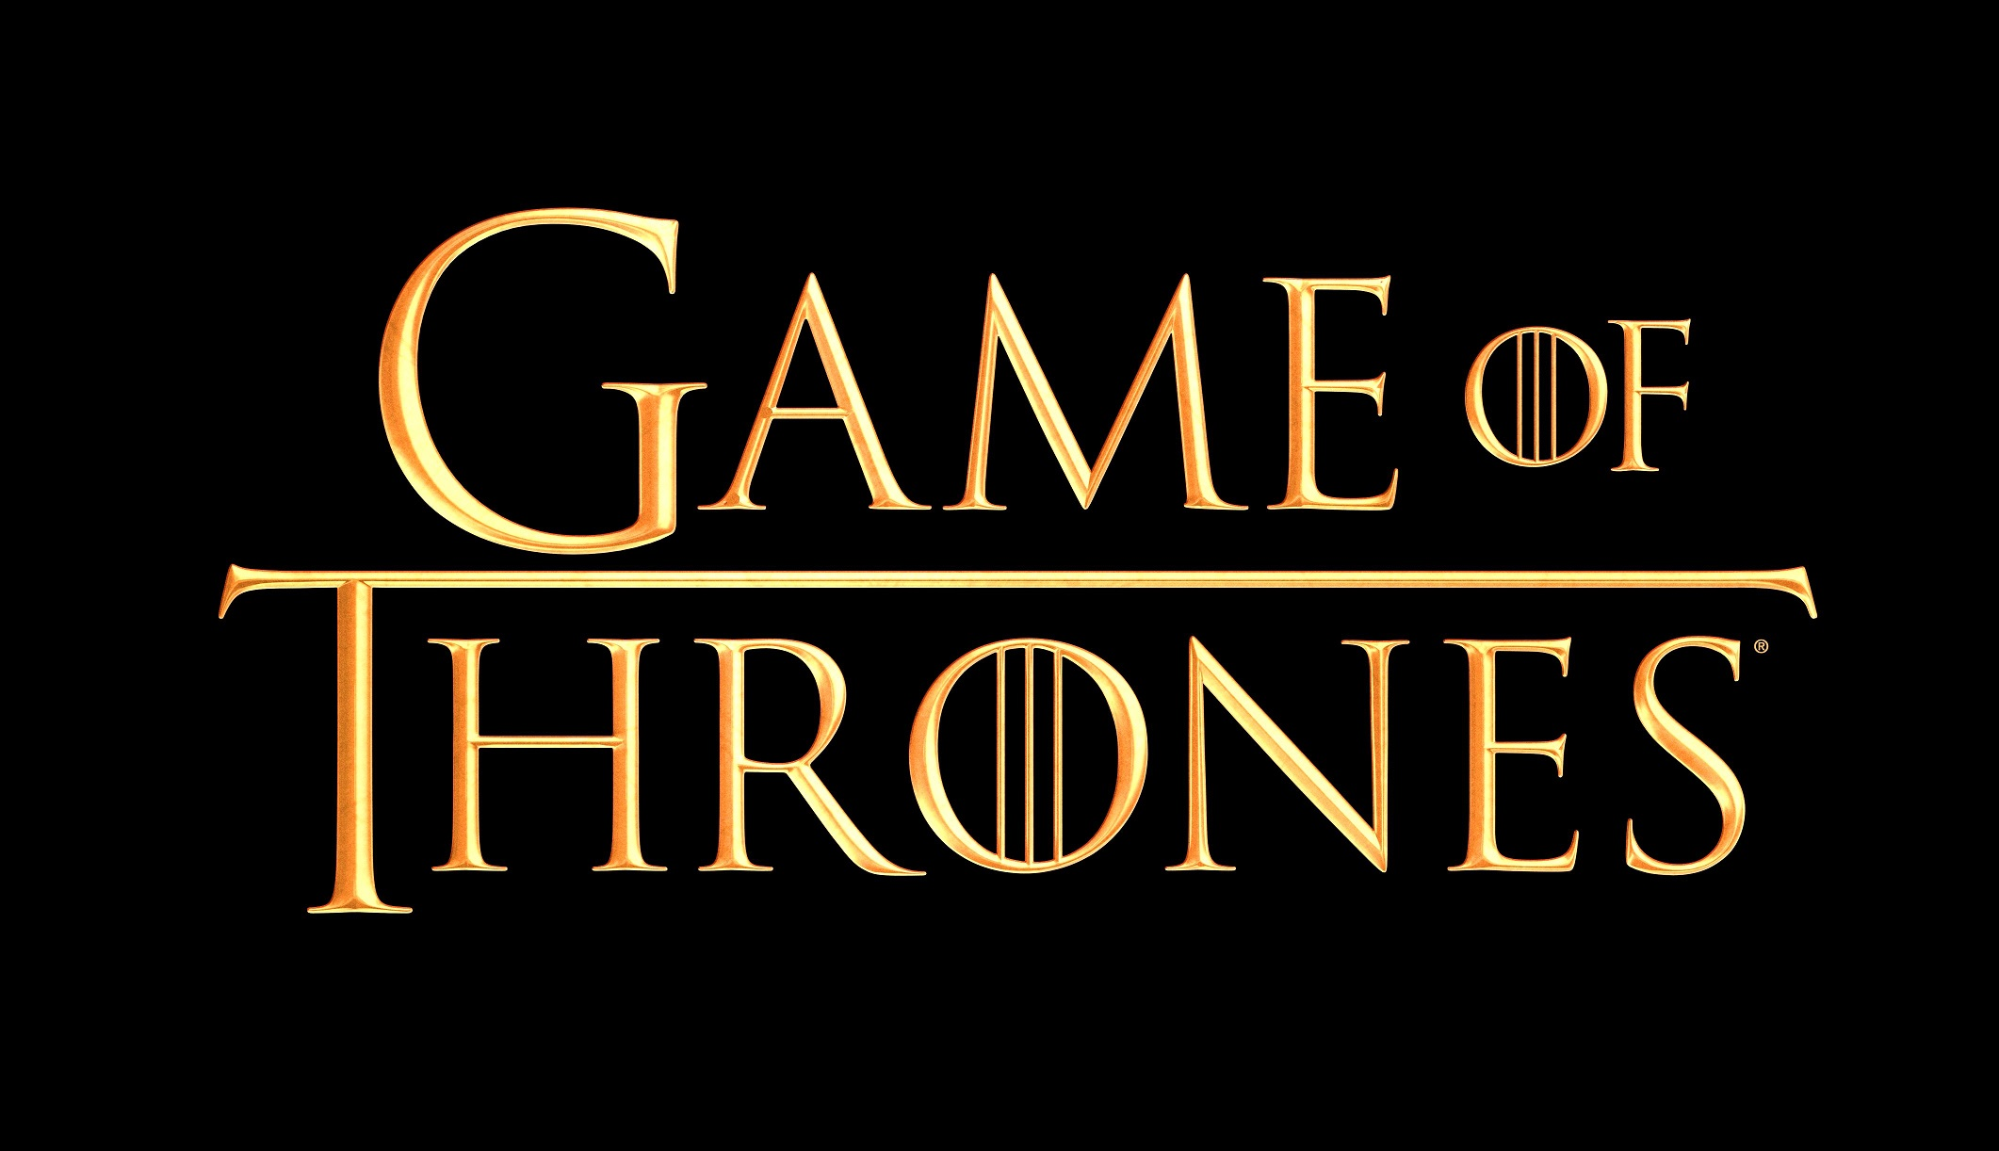
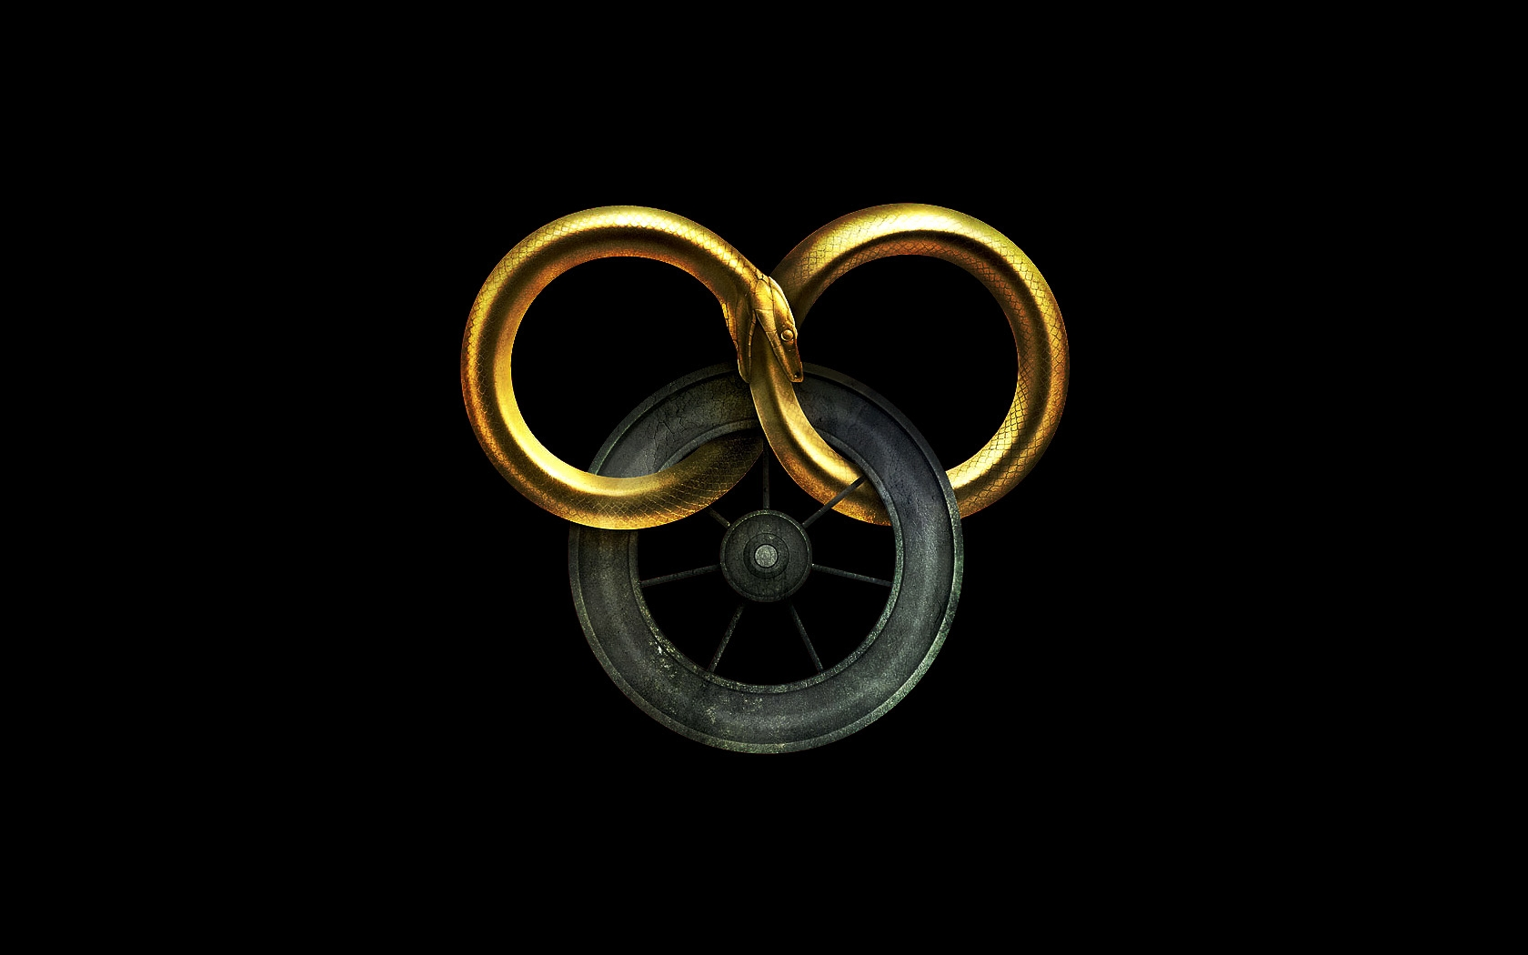
Tip for this slide. | There are two place holders in this slide (one on the left, and one on the right).The default order of both is as follows (from back to front): Picture Placeholder > Color Overlay (shape) > Box in the middle. Make sure you follow this exact order. To make things easier, just drag and drop the image into the slide, or use the selection pane.
Notes:
Once upon a Time, in an era now known as the 90’s, before it was cool to be nerd a mighty battle was being fought in the realm of epic fantasy. A battle for the title of “who will be the next Tolkien”.
In one corner was George RR Martin with his series “A Song of Ice and Fire”, now known by many as *click* Game of Thrones
Less well know by the masses, but in my opinion the stronger contestant was Robert Jordan, and his series is called *click* The Wheel of Time. Get ready to become familiar with it, because the tv show comes out sometime next year.

Slide 2

My computer reads ‘The Wheel of Time’
Stephan Hermanides
Notes:
So today I am presenting: My Computer Reads ‘The Wheel of Time’

Slide 3
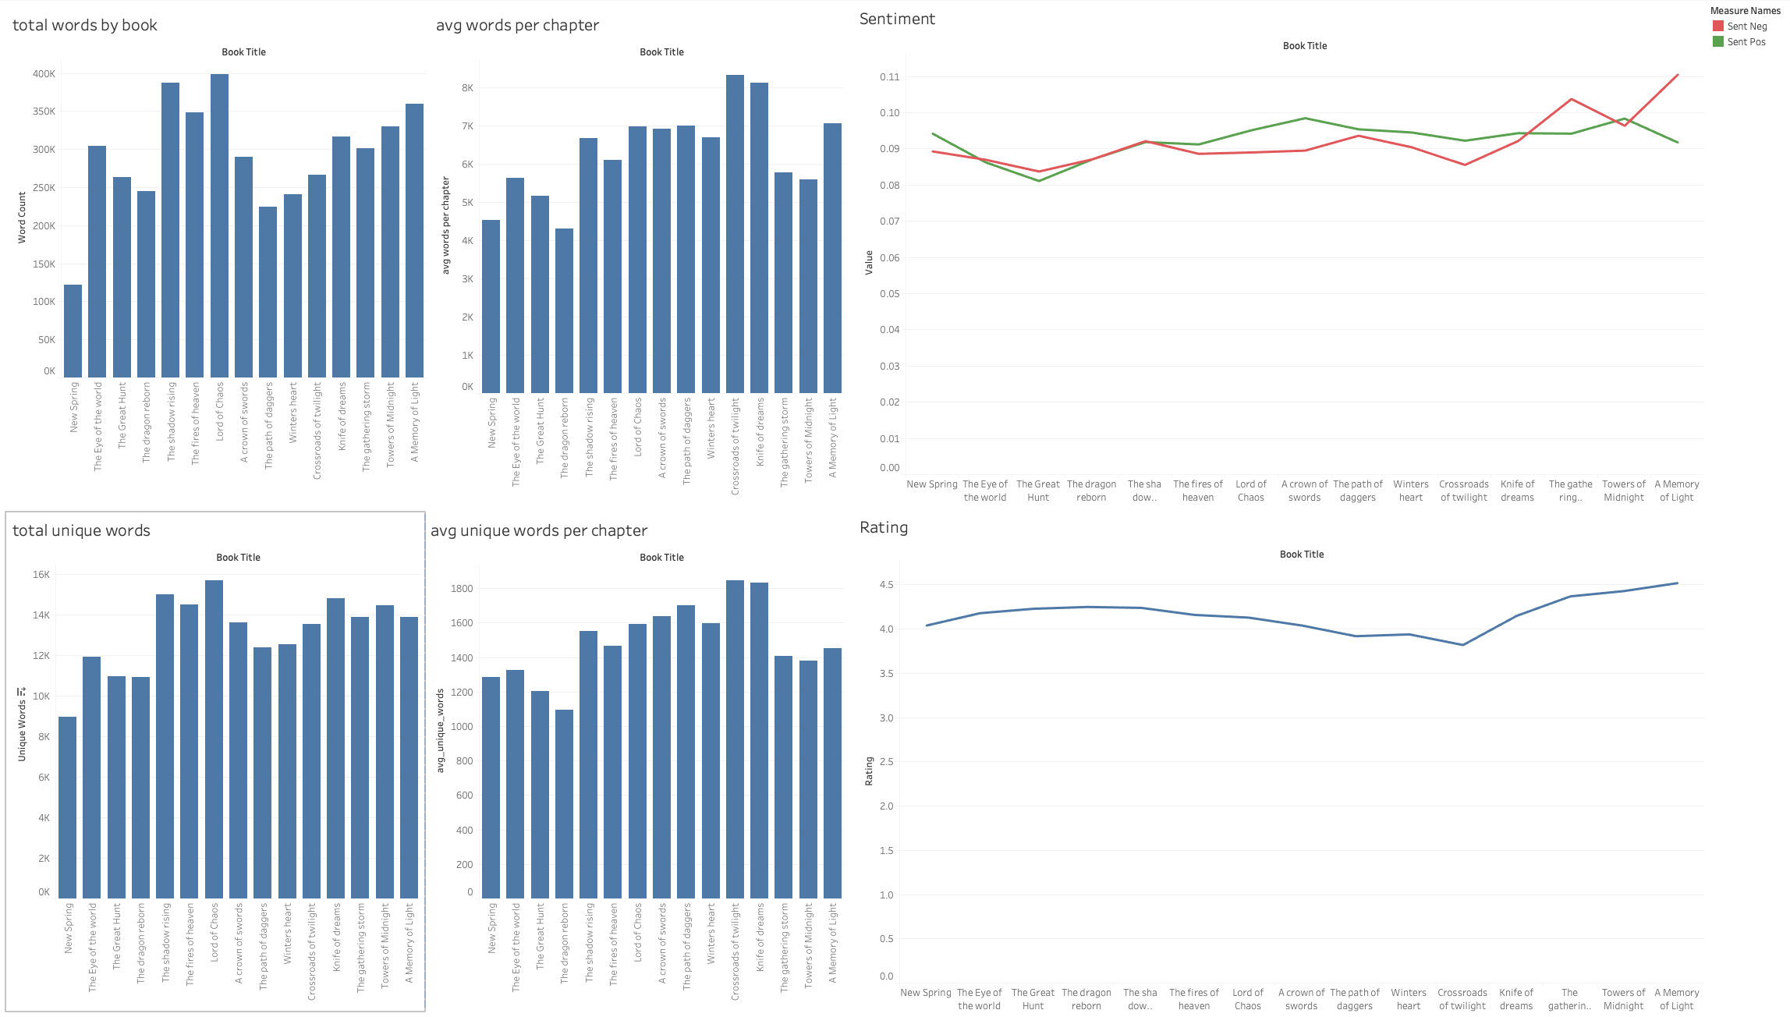
Exploration
15 Books
704 chapters
4,398,373 words
Large Cast, 147 unique Points of View
Two writers
Robert Jordan passed away working on book 12
Finished by Brandon Sanderson
Light versus Dark, Good versus Evil
Central characters from a small village
Rand Al’Thor, the Dragon Reborn
Detailed world with politics, magic and many fleshed out cultures
Notes:
So what is the Wheel of Time? First of all, this series is massive, 15 books, over 4 Million words and a huge cast. It is written from the point of view of 147 different characters, some more important than others of course.
Robert Jordan unfortunately passed away before he could finish his life’s work, but his wife and editor Harriet selected Brandon Sanderson to finish the work. Rober Jordan had left extensive notes and some finished parts of books for him to work with.
My first angle for this project was to see if I could find a difference between the authors, but EDA showed no obvious initial trends. It makes sense, given the fact that Sanderson was working from half finished material.
There are many themes and stories within the series, but most of the central characters are from a small town and become the focal points of an ancient cyclical war between good and evil (The WHEEL of Time) . One in particular is the central figure and our first point of view character: Rand, who becomes the prophesied Dragon Reborn.
Like I said, initial EDA did not show any obvious trends, but I did want to call out two interesting minor things: Sentiment analysis seems to show that the book ends on a down note, with a high negative score, even though the ending is mostly positive. The last book on average contains the final battle though, and things get dire, so for a book average it makes sense. The other thing to show is the dip in user ratings for books 8,9,10. We’ll come back to that

Slide 4
Methodology
Topic Name | Supporting
Rand Main | rand, therin, lew, basher, dragon, lord, tam, taim, saidin, maiden, sword, citi, aiel, weiramon, kill
Nynaeve | nynaev, elayn, moghedien, thom, juilin, liandrin, luca, dream, telaranrhiod, door, channel, braid, galad, ship, tanchico
Mat | mat, thom, bloodi, talman, dice, olver, noal, gleeman, gholam, vanin, nalesean, cauthon, inn, mayb, tylin
Perrin | perrin, faile, berelain, gaul, hopper, wolv, elya, masema, slayer, wolf, aram, galad, whitecloak, smell, lord
Egwene | egwen, amyrlin, sheriam, elaida, tower, verin, novic, sitter, ajah, silviana, romanda, hall, dream, sister, mother
Loial & Rand | loial, hurin, rand, ingtar, ogier, verin, selen, horn, fain, lord, sted, waygat, trolloc, sniffer, perrin
Siuan & Moiraine | siuan, moirain, sister, sheriam, bryne, elaida, myrel, amyrlin, lelain, tower, novic, romanda, sitter, lean, tamra
Aviendha Aiel | aviendha, aiel, wise, ami, rhuarc, maiden, bair, spear, chief, couladin, shaido, clan, melain, gaishain, rhuidean
Elayne Queen | elayn, birgitt, aviendha, dyelin, merilil, vanden, reann, norri, arymilla, alis, andor, windfind, queen, caemlyn, sister
Moiraine Lan | moirain, lan, trolloc, warder, rand, bukama, zarin, perrin, agelmar, blight, hors, sword, ryne, loial, night
Tuon Seanchan | tuon, egeanin, seanchan, selucia, luca, daman, suldam, domon, jolin, suroth, wagon, tylin, bethamin, teslyn, juilin
Puppeteers | cadsuan, harine, semirhag, sorilea, verin, alanna, meris, althor, shalon, saren, merana, daigian, sister, alivia, graendal
Min Viewings | min, rand, logain, caralin, merana, daman, seanchan, lean, suldam, renna, darlin, ship, aura, view, nynaev
Last Battle | androl, pevara, taim, logain, emarin, trolloc, gateway, evin, demandred, ashaman, jonneth, nalaam, sharan, talman, dobser
Gawyn | gawyn, bryne, galad, egwen, sleet, iturald, trolloc, soldier, elayn, armi, camp, fight, tower, forc, sharan
eBook
EBookLib to extract
BeautifulSoup to parse
Topic Modeling
Tried LSA, LDA, NMF
Count vectorizer, TF-IDF vectorizer, bi-grams
NMF with TF-IDF and uni-grams gave the clearest topics
Topics
Almost all start with the central character(s)
Secondary words show that the topics are character story arcs
Notes:
I used the EBookLib library to extract the text from the eBook version. Then I used NMF with TF-IDF vectorizer to do my topic modeling.
The topics were super clear almost immediately. Anyone who has read the books would see that these top 15 topics are mostly character arcs for the main cast. Each neatly defined by the first word or words. In a couple of cases I needed more supporting words to identify the theme, especially for the Last Battle topic, since that’s the only one without a central character.
I had to stop somewhere, but if I kept going past 15 topics, the next ones still make sense, but they are less central topics and storylines

Slide 5
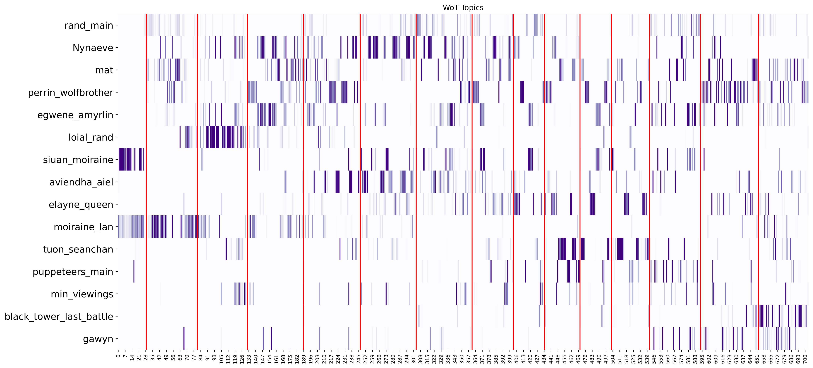
Results
New Spring is a Prequel
The Last Battle

Slide 6
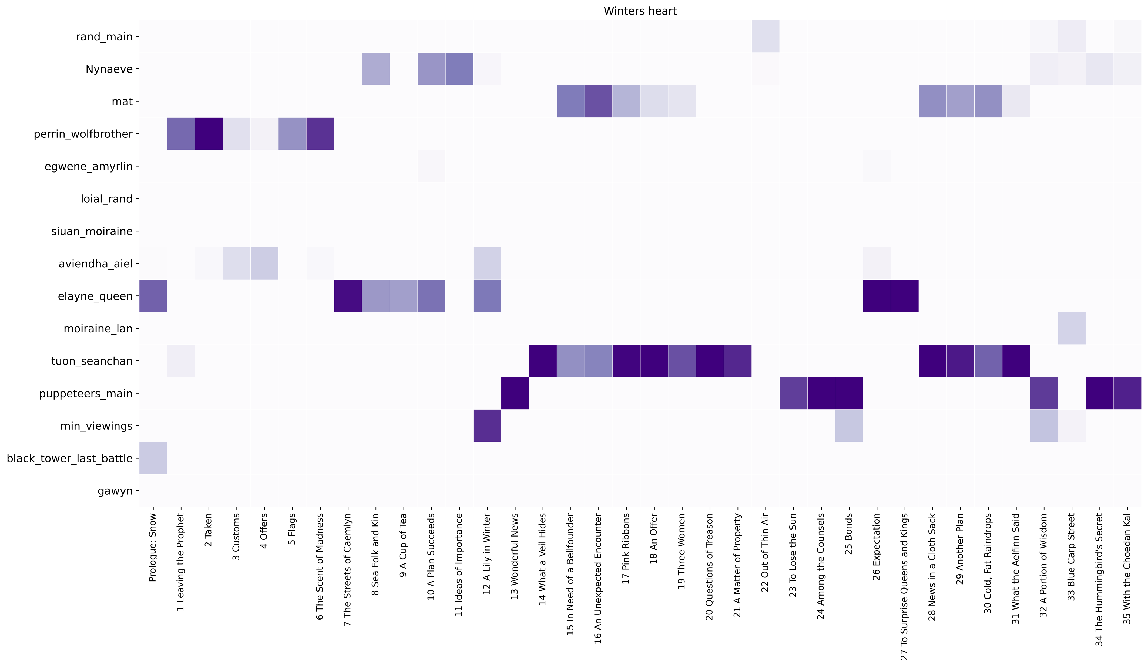
Example: Book 9
Book Summary
Perrin Aybara and his followers pursue the Shaido Aiel who kidnapped his wife, Faile Bashere.
???
Elayne Trakand attempts to solidify her grip on the Lion Throne and put down rebellious nobles.
Mat Cauthon is trapped in the city of Ebou Dar in Altara. He plans his escape, but in the end, his plans are disrupted by the interference of a Seanchan noblewoman named Tuon.
Rand al'Thor, the Dragon Reborn, and Nynaeve al'Meara Travel to Shadar Logoth. There, they cleanse saidin of the taint of the Dark One.

Slide 7
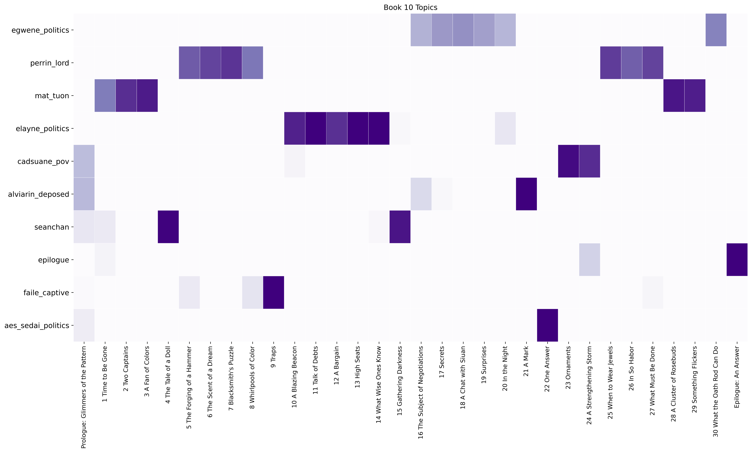
Limitations
The Plotline of Doom!!
The Plotline of Doom!!
Lowest rated: Book 10
Series topics too general
Trained second NMF model on just book 10
Reader reception
Interpretation requires knowledge of subplots and existing fanbase opinions (Plotline of Doom)
No way to model pacing, plot resolution
Pivotal moments
Scraped 704 Wheel of Time Superfan Blog chapter summaries and transformed with NMF model trained on books
Main topics align with model 86% accuracy, plus some toss-ups but…
Model misses some pivotal moments that human interpretation caught

Slide 8
Questions?

