Slide 1

UPAR Challenge 2027
Track 1 — Pedestrian Attribute Recognition
Fine-tuning an ImageNet-pretrained ResNet-50 for 40 pedestrian attributes
97,669 train images
33,407 validation images
40 attributes
Official score: 0.7021
Prepared by Haris Ahmed & Huzaifa
Computer Vision Assignment
WACV 2027 • Real World Surveillance Workshop
Notes:
1

Slide 2
1. Problem & Objective
Multi-label pedestrian attribute recognition under domain shift
Input
Output
Core Challenge
A cropped surveillance image containing a single pedestrian.
Images vary in camera quality, pose, lighting, viewpoint and background.
40 binary attribute probabilities.
Examples: age group, gender, hair length, clothing length/color, trousers/skirt, backpack, bag, glasses and hat.
The hidden test domain is unseen during training. A model that fits the development data well may still lose performance on new cameras and environments.
Goal: build a practical baseline that trains locally, follows the official interface, and submits successfully to Codabench.
UPAR Challenge 2027 • Track 1
Computer Vision Assignment
2
Notes:
2

Slide 3
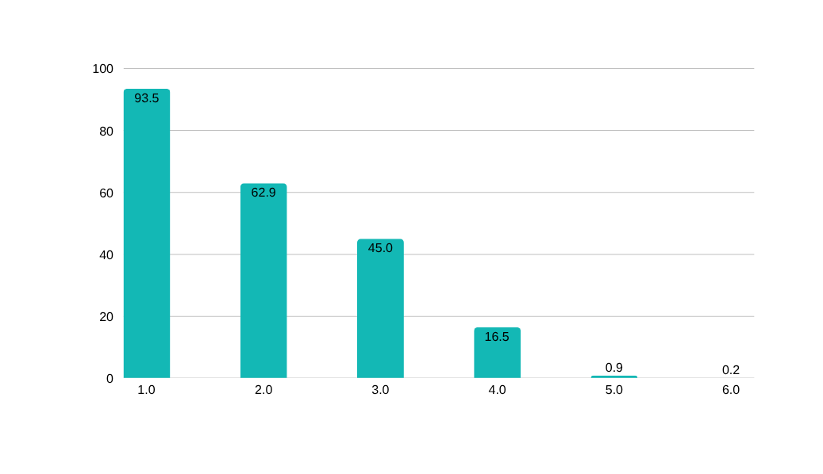
2. Dataset & Class Imbalance
Official UPAR Track 1 training and validation splits
97,669
training images
33,407
validation images
40
binary attributes
Training-set prevalence examples
Distribution Shift
Examples of train → validation prevalence changes:
• Age-Young: 4.66% → 1.10%
• LowerBody-Length-Short: 20.54% → 37.51%
• UpperBody-White: 28.11% → 22.50%
This imbalance + shift makes hidden-domain generalization difficult.
UPAR Challenge 2027 • Track 1
Computer Vision Assignment
3
Notes:
3

Slide 4
3. Methodology
ImageNet-pretrained ResNet-50 fine-tuned end-to-end
Pedestrian
image
Resize
256 × 128
ResNet-50
40 logits
Sigmoid
RGB crop
Flip + color jitter
ImageNet pretrained
New FC layer
40 probabilities
LOSS
OPTIMIZER
LEARNING RATE
WEIGHT DECAY
BCEWithLogitsLoss
AdamW
1e-4
1e-4
BATCH SIZE
EPOCHS
MIXED PRECISION
GPU
32
10
Enabled
RTX 4050 • 6 GB
23,589,992 parameters
UPAR Challenge 2027 • Track 1
Computer Vision Assignment
4
Notes:
4

Slide 5
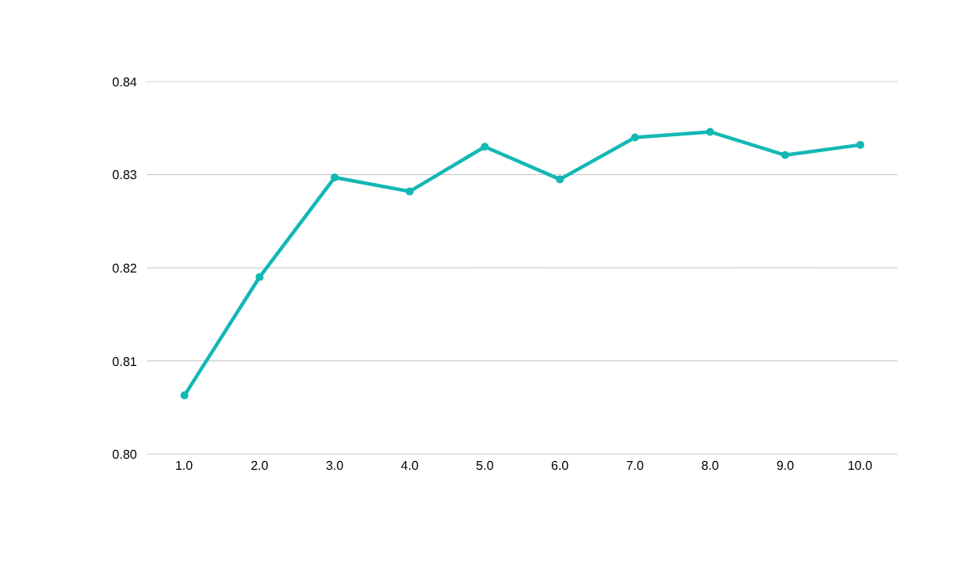
4. Training & Validation Results
Best checkpoint selected by the official Challenge_Avg metric
BEST CHECKPOINT
Epoch 8
Challenge_Avg
0.8346
mA 0.8073
Instance_F1 0.8639
Label_F1 0.6924
Instance_Acc 0.7743
Training behavior
Selection rule
Train loss kept falling while validation loss rose after the early epochs → signs of overfitting.
The final submission uses the epoch-8 checkpoint because it achieved the best validation Challenge_Avg.
UPAR Challenge 2027 • Track 1
Computer Vision Assignment
5
Notes:
5

Slide 6
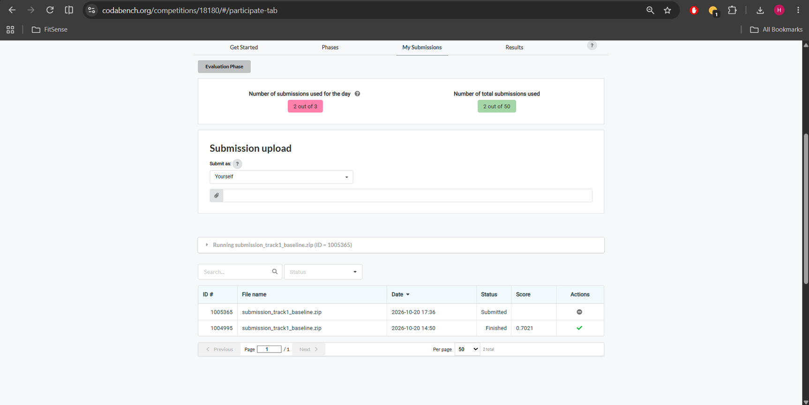
5. Official Codabench Submission
Successful hidden-test evaluation
OFFICIAL RESULT
0.7021
Challenge score
Submission ID
1004995
Status
Finished ✓
Validation 0.8346 → Hidden test 0.7021
The gap is consistent with the challenge’s core difficulty: generalizing to an unseen surveillance domain.
UPAR Challenge 2027 • Track 1
Computer Vision Assignment
6
Notes:
6

Slide 7
6. Challenges Encountered
What limited performance and what we learned
Class imbalance
Domain shift
Some attributes are extremely rare, making standard BCE favor frequent labels.
Camera, lighting, resolution and background changes reduce hidden-test generalization.
Small visual details
Overfitting
Glasses, hats, hair and subtle colors can occupy only a few pixels.
Validation loss increased in later epochs even while training loss improved.
Dataset setup
Submission constraints
Windows path/downloader issues required small compatibility fixes.
The model had to run offline in the provided PyTorch environment within the runtime limit.
UPAR Challenge 2027 • Track 1
Computer Vision Assignment
7
Notes:
7

Slide 8
7. Improvements & Conclusion
Next experiments should target imbalance and domain generalization
Most useful next experiments
Class-weighted BCE / focal / asymmetric loss
PROJECT OUTCOME
1
A complete end-to-end pipeline was implemented, evaluated, packaged and successfully submitted.
2
Stronger augmentation + random erasing
3
ConvNeXt / Vision Transformer backbone
0.8346
Best validation score
4
Attribute-specific attention or ensemble
0.7021
Official hidden-test score
5
Probability calibration on validation data
Good validation performance does not guarantee cross-domain performance.
Key learning
Thank you
Questions?
UPAR Challenge 2027 • Track 1
Computer Vision Assignment
8
Notes:
8

