Slide 1

Loan Approval Model Simon Johnston 20-Jan-2023

Slide 2
Introduction
Objective:
Generate and deploy a model to predict loan approvals based on historical performance.
Data:
614 Loans
Continuous Numerical: loan value, income
Categorical: credit score eval, property location, gender, family and work status, education level, loan term
Target Variable: Loan Approval Status
Limitations:
Missing liabilities
Property valuation and collateral
Added Features
Combined income
Estimated monthly payment to income ratio

Slide 3

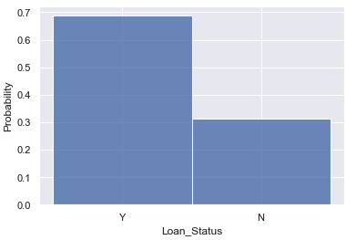
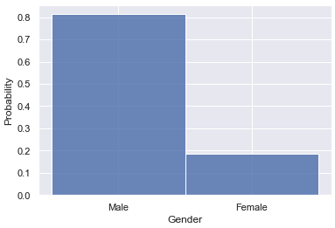
EDA Insights
Over sampling of approved loans may cause bias in the model performance.
Sample size is small recommendation is to increase sample size or resample.
For awareness the ratio of male to female applicants is 4:1.

Slide 4
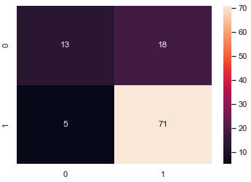
Model Development V1.0
Models:
Type: Classification
GridSearchCV:
Candidate Models
Random Forest
SVC
Nearest Neighbor
Gradient Boost
Best Performing:
Random Forest
N_estimators = 2
Max_depth =5
Results:
Accuracy 79%

Slide 5
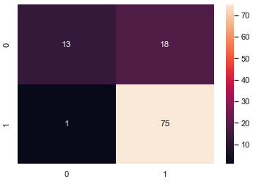
Model Development V2.0
Models:
Type: Classification
GridSearchCV:
Candidate Models
Random Forest
SVC
Nearest Neighbor
Gradient Boost
Component Reduction
PCA
KBest
Best Performing:
SVC
C = 0.1
Results:
Accuracy 82%

Slide 6
Next Steps
Resampling to improve True Negative classification
Deployment

