Slide 1

EV Vehicle/Charging Demand Perdition
-Jeevanantham S

Slide 2


Learning Objectives
Understand the factors influencing EV adoption and charging needs.
Apply machine learning techniques to predict demand patterns.
Use predictive analytics for better infrastructure planning.
Visualize demand trends for decision-making.
GOAL

Slide 3
Tools and Technology used
Programming: Python
Libraries: Pandas, NumPy, Matplotlib, Seaborn, Scikit-learn
Machine Learning Models: Linear Regression, Random Forest
Environment: Visual Studio Code
Data Sources:
EV registration data (Govt. open data)
Charging station usage logs
Traffic & population density data
Visualization: Tableau / Power BI / Matplotlib

Slide 4
Methodology
1.looked for patterns and missing values in the monthly EV adoption data.
2.developed time-based features such as lag values and moving averages.
3.used RandomizedSearchCV to fine-tune a Random Forest Regressor after it had been trained.
4.forecasted future EV adoption month by month using an autoregressive approach.
5.assessed the model's performance and displayed the differences between the actual and expected outcomes.
`

Slide 5
Problem Statement:
To evaluate the data and make precise predictions, we employed a machine learning classification model (such as Random Forest) in this project. Using input features, this model aids in pattern recognition and decision-making. Its ability to handle both numerical and categorical data and produce definite results makes it effective. By increasing prediction speed and accuracy, this model makes the system dependable and effective for real-time applications.

Slide 6
Solution:
Used historical EV population data by county to forecast 36‑month adoption trends.
Data Preparation:
Removed outliers, handled missing values, encoded categorical features.
Created time‑series features: lag values, rolling means, growth rates, slopes.
Modeling Approach:
Tested Random Forest Regressor, Decision Tree Regressor, and SVR.
Selected Random Forest Regressor for best accuracy after hyperparameter tuning.
Forecasting:
Predicted monthly & cumulative EV counts for 3 years ahead.
Identified top 5 counties with highest projected growth.
Git hub repo link : https://github.com/JEEVANANTHAM18/EV_Vehicle_Charge_Demand.git

Slide 7
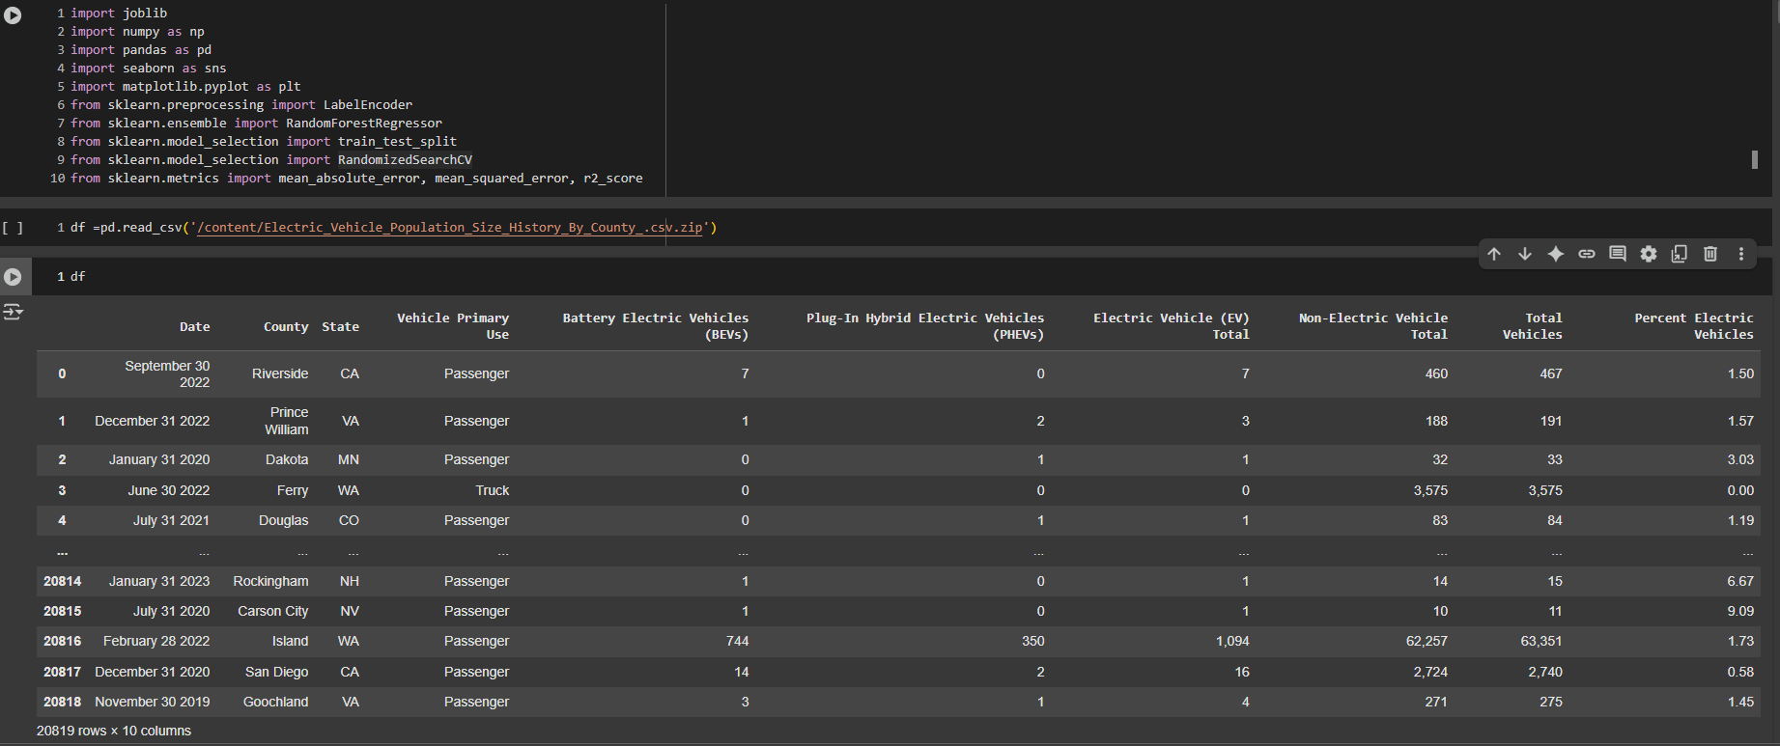
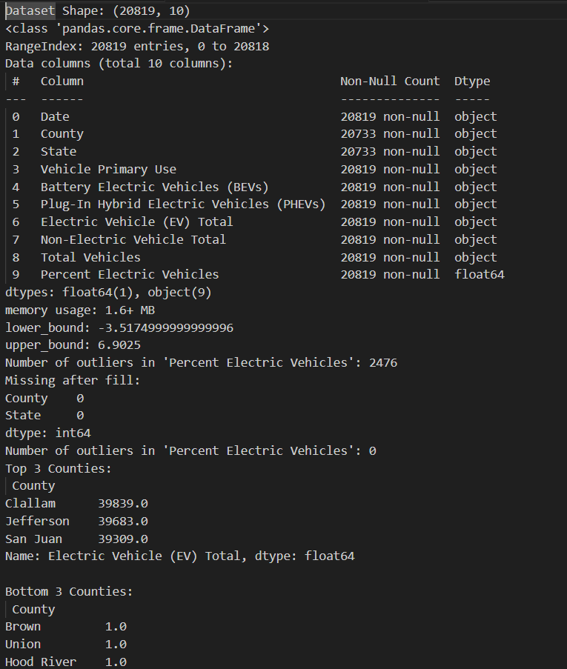
Screenshot of Output:

Slide 8
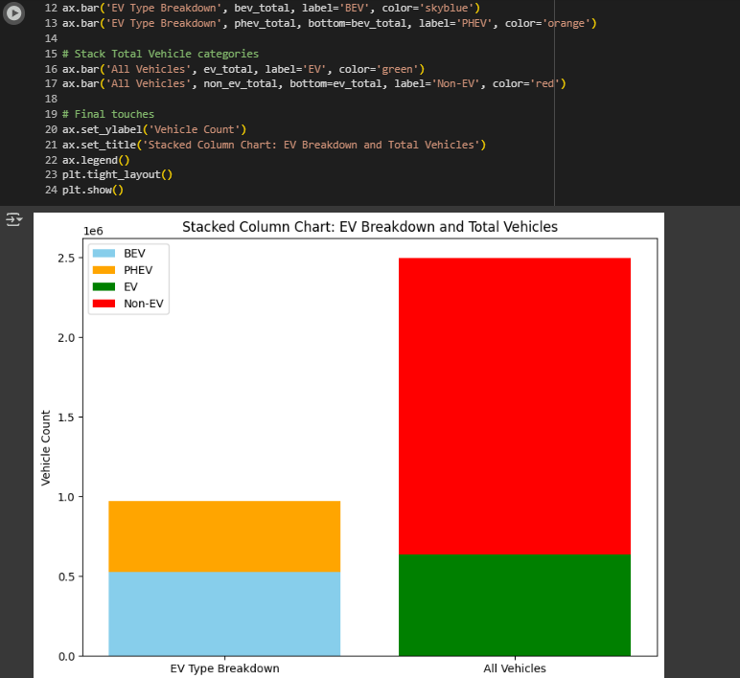
Screenshot of Output:

Slide 9
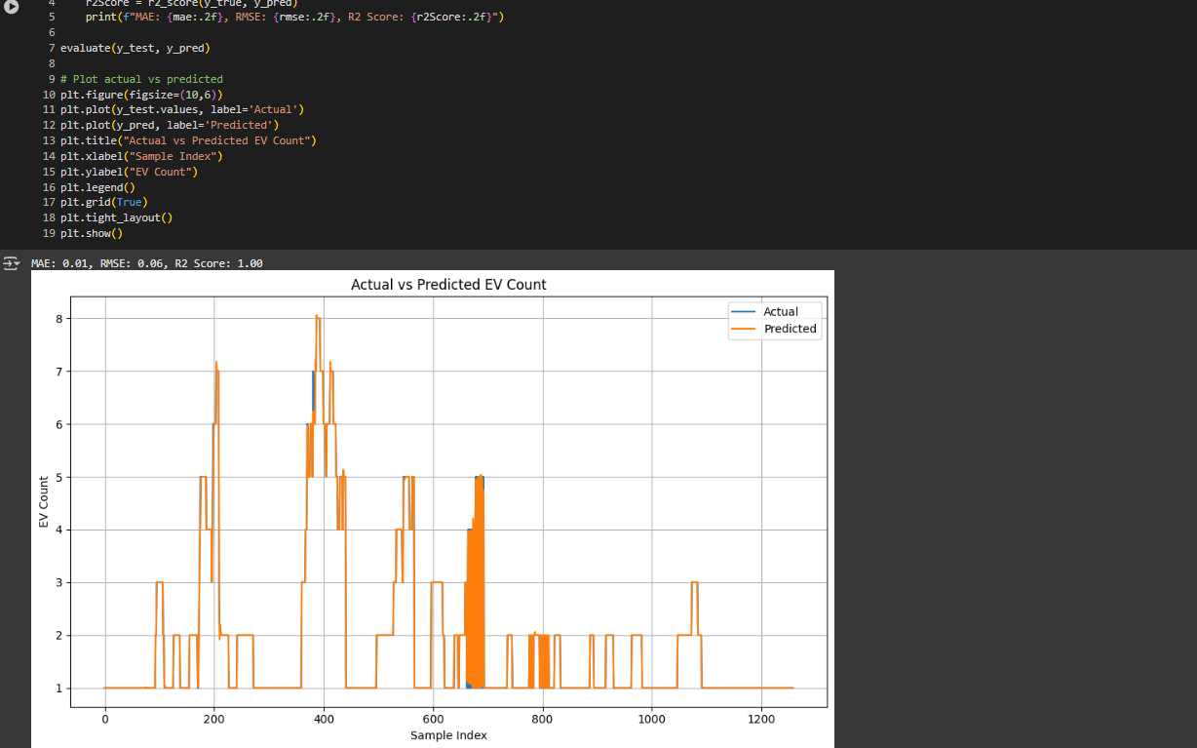
Screenshot of Output:

Slide 10
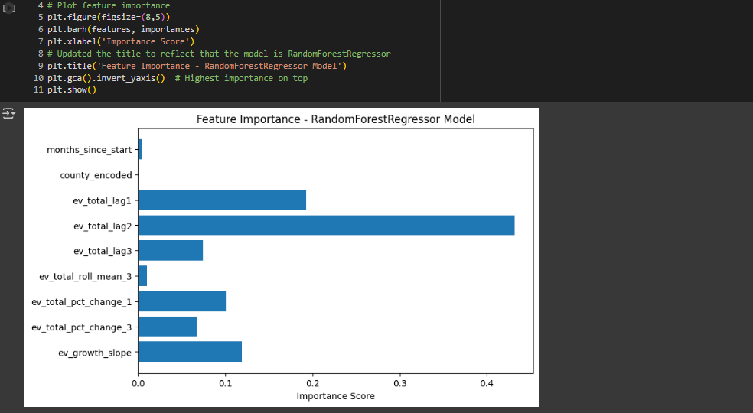
Screenshot of Output:

Slide 11
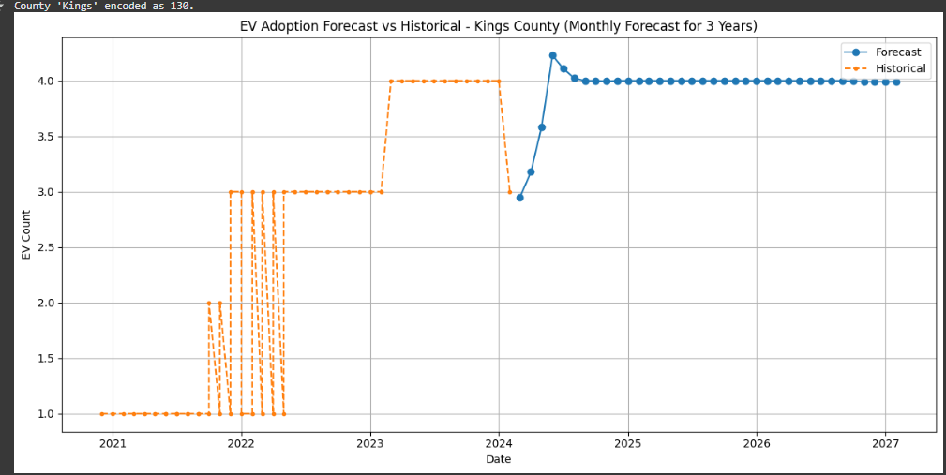
Screenshot of Output:

Slide 12
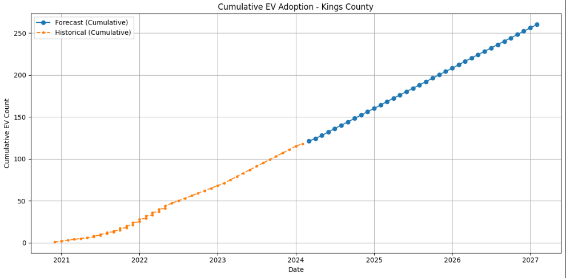
Screenshot of Output:

Slide 13
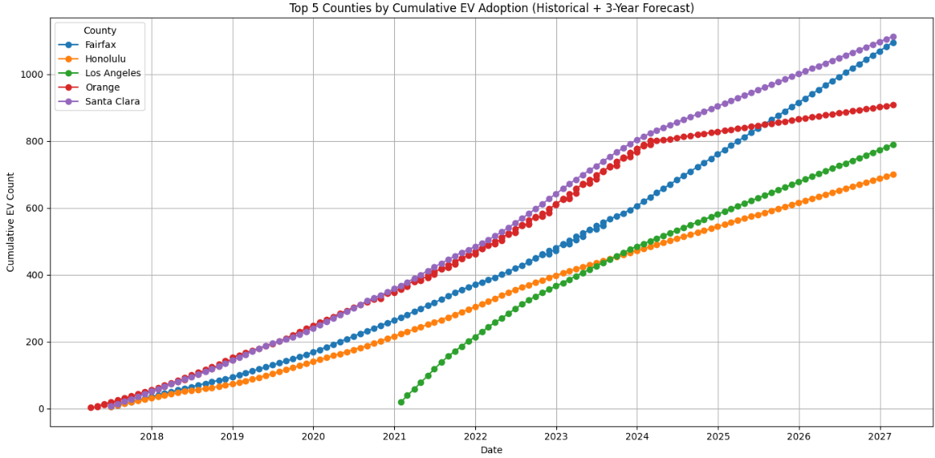
Screenshot of Output:

Slide 14
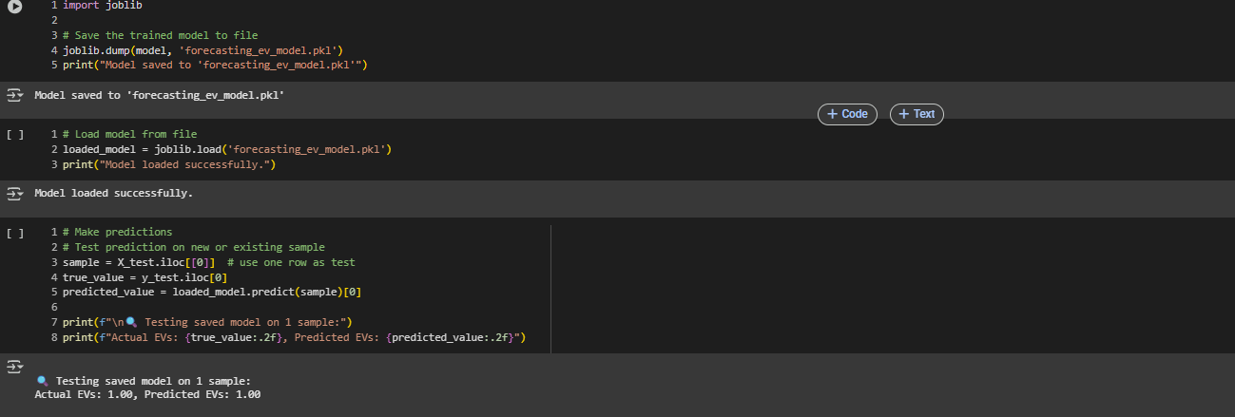
Screenshot of Output:

Slide 15
Conclusion:
The project effectively used Random Forest to forecast EV adoption trends. With proper feature engineering and model tuning, accurate predictions were achieved. These insights can help in planning sustainable transport strategies and support EV infrastructure growth.
It supports sustainable mobility growth and prepares cities for future transportation needs.

