Slide 1
Accurate MRI Image Reconstruction Using a Fast Fourier Convolution Layer within a DCR-Enhanced U-Net Architecture
Abishek SK
Roshan Bosco A
Vishal Yadav h

Slide 2
ABSTRACT
Magnetic Resonance Imaging (MRI) plays a vital role in medical diagnostics; however, its slow image acquisition and significant computational demands remain key challenges.
Classical Convolutional Neural Networks (CNNs) have been demonstrated to be useful for MRI image reconstruction, but they are hampered by their local receptive fields and high computational cost.
In order to overcome the above limitations, we introduce a new Fast Fourier Convolutional Neural Network which incorporates Fast Fourier Convolutions (FFC) within Densely Connected Residual (DCR) blocks into a U-Net architecture.
FFC layers, working in the spectral domain, afford a global receptive field such that the model is able to capture long-range dependencies and suppress aliasing artifacts better than regular CNNs.
The DCR module facilitates improved reconstruction precision through multi-level feature concatenation and enhanced gradient propagation.
Quantitative results demonstrate that our proposed model significantly out-performs both traditional CNNs and baseline U-Net architectures across all evaluation metrics. Specifically, the model achieves an improvement of +2.37 dB in PSNR and +0.034 in SSIM over the baseline U-Net, while reducing the Mean Squared Error (MSE) by more than 50% and cutting inference time by over 55%.
These improvements confirm the effectiveness of combining Fourier-domain learning and dense residual connections for high-quality and efficient MRI image reconstruction, advancing the feasibility of real-time clinical applications.

Slide 3
OBJECTIVE
To design a high-accuracy MRI image reconstruction framework by incorporating Fast Fourier Convolution (FFC) layers in a Densely Connected Residual (DCR) blocks incorporated within a U-Net architecture.
Propose a robust reconstruction model that leverages spectral-domain operations via FFC to capture global contextual features effectively.
Embed Fast Fourier - Densely Connected Residual (FF-DCR) blocks to facilitate deep feature reuse, improved representation learning, and efficient gradient propagation.
Achieve reduced inference time, supporting real-time deployment in clinical environments.
Minimize common reconstruction artifacts while preserving intricate anatomical structures and fine image details.
Provide extensive quantitative (e.g., PSNR, SSIM, MSE) and qualitative evaluation to validate the model’s advantages over standard CNN-based reconstruction methods.

Slide 4
MOTIVATION - PROJECT
Handling Large Inputs It is designed to manage larger datasets more effectively than conventional CNNs, making it suitable for high-resolution images and complex tasks.
Complex Boundary Conditions This architecture can manage complex boundary conditions and nonlinear coefficients, which are often challenging for standard CNNs.
Ease of Implementation-Integrating FFT layers into existing CNN architectures is relatively straightforward, allowing for a smooth transition to more efficient processing without extensive modifications.
Optimize Image Quality Metrics – Maximize Peak Signal-to-Noise Ratio (PSNR) and Structural Similarity Index (SSIM) to ensure high-fidelity image reconstruction.
Improve Global Feature Extraction – Leverage frequency-domain operations to capture long-range dependencies and enhance the model’s ability to reconstruct fine image details.
Generalize Across Image Degradations – Develop a robust architecture that can handle various types of image degradation, such as noise, blur, and missing pixels.

Slide 5
Literature Survey
S.No. | Title | Published Date | Publishers | Topic | Advantages | Disadvantages
1 | Image Reconstruction for Accelerated MR Scan With Faster Fourier Convolutional Neural Networks | 2024 | IEEE Transactions on Image Processing | MRI image reconstruction using enhanced Fourier-based convolutional neural networks (FFCNet) | Leverages frequency-domain convolution for better global receptive field and efficient computation. Shows strong generalization across varying acceleration factors | Higher complexity and less interpretability due to frequency-domain operations May be more sensitive to input noise compared to spatial-domain methods
2 | Deep Convolutional Neural Network for Inverse Problems in Imaging | 2019 | IEEE Transactions on Image Processing | Using deep CNNs to solve inverse problems such as image reconstruction, deblurring, and denoising | Simple yet powerful CNN architecture tailored for inverse problems Shows significant improvements in reconstruction fidelity and speed Can be generalized to a variety of imaging modalities (e.g., CT, MRI) | Limited global context due to reliance on local convolutional operations May require a large amount of labelled data for effective training
3 | U-Net: Convolutional Networks for Biomedical Image Segmentation | 2019 | Springer, MICCAI Conference Proceedings | Semantic segmentation of biomedical images using U-shaped CNN architecture | Highly effective for medical image segmentation tasks Skip connections preserve spatial information lost during downsampling Works well even with limited training data through data augmentation | Limited capacity to model global dependencies (fully spatial) Computationally expensive for very high-resolution images
4 | Fast Fourier Convolution | 2020 | Advances in Neural Information Processing Systems (NeurIPS) | Frequency-domain convolution method combining global and local receptive fields for image processing tasks | Efficiently captures both local and global features Reduces computational cost while maintaining performance Easily pluggable into existing CNN architectures | Added complexity in implementing spectral components Requires fine-tuning for best results in domain-specific applications
5 | Deep Residual Learning for Compressed Sensing MRI | 2021 | IEEE, Proceedings of the 14th International Symposium on Biomedical Imaging (ISBI) | Application of deep residual neural networks to compressed sensing MRI reconstruction | Leverages residual learning to effectively recover fine image details Faster convergence and better generalization compared to standard CNNs Enhances performance in extremely undersampled MRI scenarios | Still limited by the locality of convolution kernels May underperform if the residual assumption (low-level similarity) fails

Slide 6
EXISTING SYSTEM
Traditional MRI Reconstruction relies on fully sampled k-space data, which leads to long acquisition times and patient discomfort.
Compressed Sensing (CS) techniques were introduced to accelerate MRI by undersampling data, but often result in poor image quality and reconstruction artifacts.
Convolutional Neural Networks (CNNs) have shown promise in improving CS-MRI by learning complex data priors.
However, conventional CNNs operate in the spatial domain with limited local receptive fields, making it difficult to capture global contextual information.
They are also computationally heavy and struggle to generalize well across different noise levels or anatomical variations.
Models like U-Net have been widely used, offering decent performance through skip connections and multi-scale feature extraction.
Despite improvements, these methods still suffer from aliasing artifacts, slow inference, and limited robustness under high undersampling conditions.

Slide 7
PROPOSED SYSTEM
Proposes an accurate MRI image reconstruction model that integrates Fast Fourier Convolution (FFC) layers within Densely Connected Residual (DCR) blocks, embedded in a U-Net architecture.
Combines Fast Fourier Convolution (FFC) layers with Densely Connected Residual (DCR) blocks to synergistically leverage global spectral feature extraction and efficient multi-level spatial feature learning, resulting in more accurate and robust MRI image reconstruction.
The model effectively performs denoising, artifact suppression, and rapid inference, making it highly suitable for real-time clinical MRI workflows.
Trained and evaluated on T1-weighted brain MRI datasets, achieving strong results in terms of Peak Signal-to-Noise Ratio (PSNR), Structural Similarity Index (SSIM), and inference speed.
Demonstrates significant improvements over conventional CNN and U-Net models, particularly in reconstruction clarity, robustness under undersampling, and computational efficiency.

Slide 8
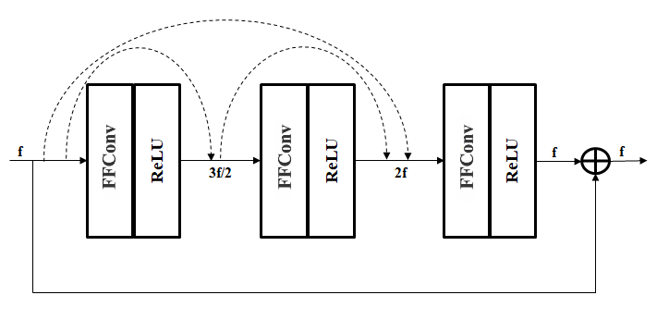
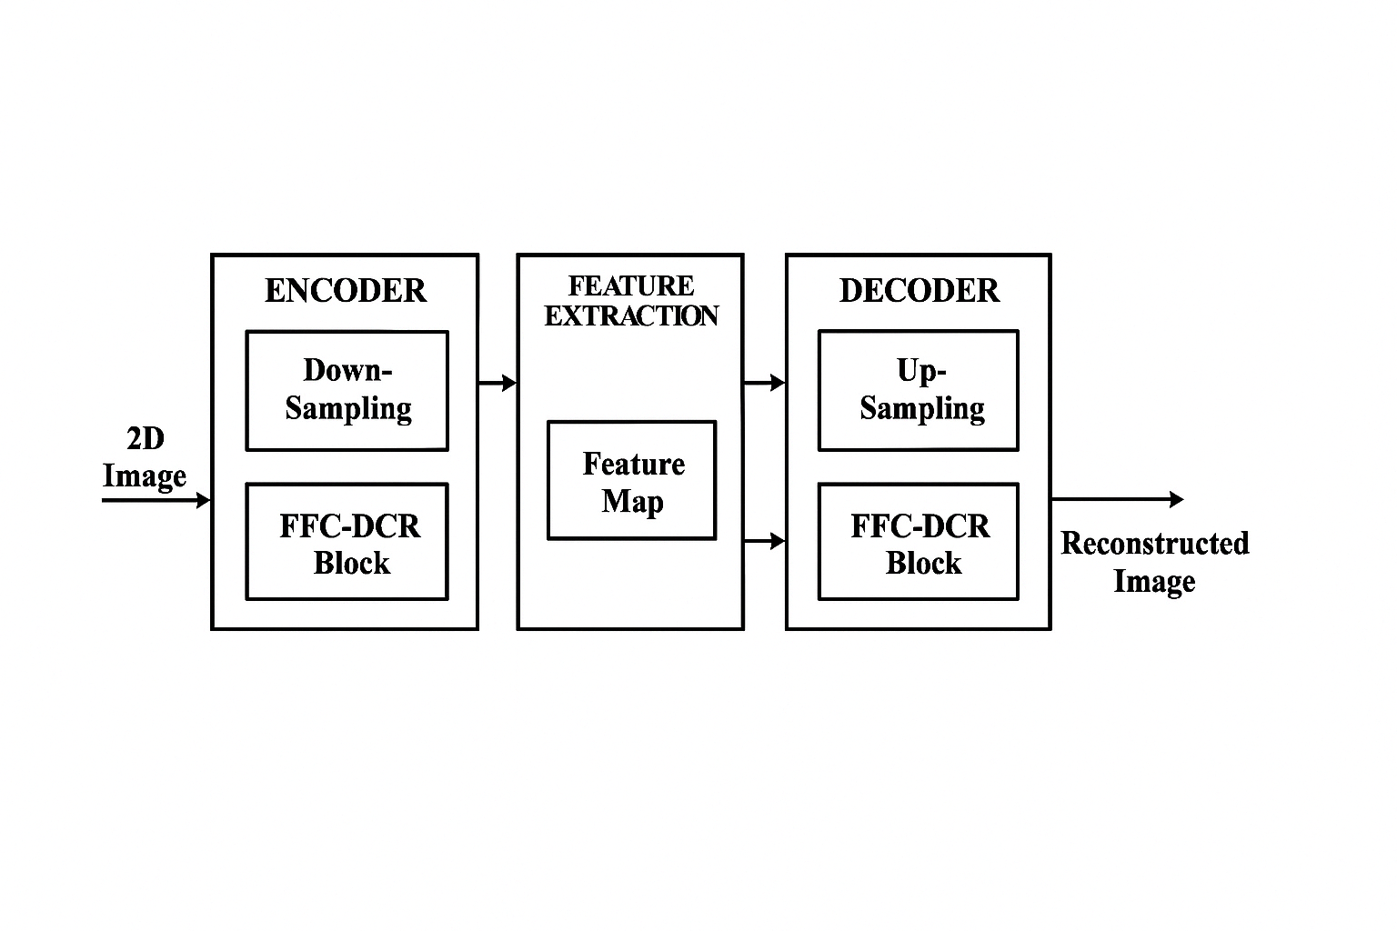
ARCHITECTURE DIAGRAM
Overview of the model
FFC DCR Block

Slide 9
MODULES DESCRIPTION
Module 1: Data Preprocessing
MRI images are acquired from the NITRC dataset.
Slices are extracted and normalized to a range of [0, 1].
Images are resized and converted to grayscale for input to the model.
Module 2: Model Building
Uses U-Net architecture incorporated with Fast Fourier Convolution (FFC) layers for spectral-domain learning in a Densely Connected Residual (DCR) Blocks for better feature propagation.
Module 3: Optimization and Activation
Optimizer: RMSprop with adaptive learning rate.
Activation functions:
ReLU in hidden layers.
Sigmoid in output layer.
Module 4: Evaluation
Performance evaluated using:
PSNR, SSIM, MSE, and Inference Time.

Slide 10
Module 1: Data Preprocessing
Dataset Source:
T1-weighted brain MRI scans from Neuroimaging Tools and Resources Collaboratory (NITRC).
Includes 36 3D MRI volumes.
Slice Selection:
Extracted center 51 slices from each 3D volume for training and testing.
Chosen for their high anatomical relevance.
Image Preparation:
Converted to grayscale with intensity scaled to [0, 255].
Normalized to [0, 1] range using min-max normalization.
Data Format:
Images processed as 2D matrices, compatible with convolutional layers.
Cross-Modality Testing:
Although trained on brain MRIs, tested on knee MRI to show generalization.

Slide 11
Module 2:Model Building
Architecture Used:
Based on U-Net, enhanced with Fast Fourier Convolution (FFC) in a Densely Connected Residual (DCR) blocks.
Key Components:
FFC Layers:
Perform convolution in the frequency domain using FFT.
Capture global contextual features with reduced complexity.
DCR Blocks:
Use multiple convolutional layers with skip and dense connections.
Help retain features and prevent vanishing gradients.
Layer Mechanics:
Feature maps from each layer are concatenated to form richer feature representations.
Residual connections enhance learning and improve gradient flow.
U-Net Structure:
Comprises Encoder, Bottleneck, and Decoder.
Skip connections bridge encoder and decoder layers to preserve spatial features.

Slide 12
RESULTS AND DISCUSSION
1. Quantitative Evaluation
Peak Signal-to-Noise Ratio (PSNR): Achieved 34.82 dB, indicating high reconstruction accuracy.
Structural Similarity Index (SSIM): Scored 0.923, showing strong preservation of structural and perceptual details.
Mean Squared Error (MSE): Recorded a low value of 0.0024, signifying minimal deviation from the ground truth.
Inference Time: Average of 0.036 seconds per image, enabling real-time application.
2. Qualitative Analysis
Reconstructed images using our proposed show clearer anatomical structures and fewer artifacts compared to standard U-Net outputs.
Edge clarity and tissue boundaries are significantly better preserved.
In noise-corrupted scenarios, the model effectively removes Gaussian noise while maintaining fine structural details.

Slide 13
RESULTS AND DISCUSSION

Slide 14
RESULTS AND DISCUSSION
3. Comparison with other models
The proposed FFC-DCR U-Net demonstrates superior reconstruction quality, achieving the highest PSNR (34.82 dB) and SSIM (0.923), indicating improved fidelity and structural consistency in the reconstructed MRI images.
It achieves a significantly lower MSE (0.0024), reflecting enhanced accuracy in pixel-wise reconstruction.
With an inference time of just 0.036 seconds per image, the proposed model is also highly efficient, making it suitable for real-time clinical applications.
Model | PSNR (dB) | SSIM | MSE | Inference Time (sec/image)
CNN (Conventional) | 29.35 | 0.811 | 0.0133 | 0.118
U-Net (Baseline) | 32.45 | 0.889 | 0.0089 | 0.091
FFC-DCR U-Net (Proposed model) | 34.82 | 0.923 | 0.0024 | 0.036

Slide 15
RESULTS AND DISCUSSION
4. Key Insights
Frequency-domain processing (FFC) enables a larger receptive field without increasing network depth or parameters.
DCR blocks promote efficient feature reuse and improved gradient flow, aiding deep supervision.
The proposed architecture outperforms traditional CNNs and baseline U-Net models in both accuracy and inference speed.
Demonstrates robustness under noise, making it well-suited for clinical MRI reconstruction tasks.
5. Future Directions
Extension to 3D volumetric MRI data for comprehensive spatial reconstruction.
Integration with adversarial loss functions to further improve perceptual quality.
Application to other imaging modalities such as CT or PET.
Exploration of hybrid models combining Fourier and wavelet transforms for enhanced multi-scale feature extraction.

Slide 16
REFERENCES
[1]X. Liu et al., "Image Reconstruction for Accelerated MR Scan With Faster Fourier Convolutional Neural Networks," in IEEE Transactions on Image Processing, vol. 33, pp. 2966-2978, 2024
[2]K. H. Jin, M. T. McCann, E. Froustey, and M. Unser, “Deep convolutional neural network for inverse problems in imaging,” IEEE Trans. Image Process., vol. 26, no. 9, pp. 4509–4522, Sep. 2017
[3]O. Ronneberger, P. Fischer, T. Brox, “U-Net: convolutional networks for biomedical image segmentation”, in,Medical Image Computing and Computer-Assisted Intervention – MICCAI 2015, Springer, Springer International Publishing, 2015, pp: 234–241.
[4]L. Chi, B. Jiang, and Y. Mu, “Fast Fourier convolution,” in Proc. Adv. Neural Inf. Process. Syst., vol. 33, 2020, pp. 4479–4488.

Slide 17
REFERENCES
[5] D. Lee, J. Yoo, and J. C. Ye, “Deep residual learning for compressed sensing MRI,” in Proc. IEEE 14th Int. Symp. Biomed. Imag. (ISBI), Apr. 2017, pp. 15–18.
[6] Y. Han, J. Yoo, H. H. Kim, H. J. Shin, K. Sung, and J. C. Ye, “Deep learning with domain adaptation for accelerated projectionreconstruction MR,” Magn. Reson. Med., vol. 80, no. 3, pp. 1189–1205, Sep. 2018.
[7] X. Li, T. Cao, Y. Tong, X. Ma, Z. Niu, and H. Guo, “Deep residual network for highly accelerated fMRI reconstruction using variable density spiral trajectory,” Neurocomputing, vol. 398, pp. 338–346, Jul. 2020.
[8] L. Bao et al., “Undersampled MR image reconstruction using an enhanced recursive residual network,” J. Magn. Reson., vol. 305, pp. 232–246, Aug. 2019

Slide 18
THANK YOU

