Slide 1
Automated Video Analytics for Workplace Safety Monitoring

Slide 2
Abstract
This presentation presents an advanced automated human detection system that utilizes the YOLOv5 deep learning model to monitor predefined areas within a video frame for unauthorized human presence. When a person enters a designated safety zone or restricted area, the system immediately triggers an alarm to alert security personnel or activate pre-set responses, ensuring timely intervention. The primary objective is to enhance security systems by providing real-time, accurate detection of human movement in critical areas, thus minimizing security breaches and ensuring compliance with safety protocols.
The presentation details the development process, including training the YOLOv5 model to detect human figures with high precision in diverse environments. It also covers the implementation of the system in real world scenarios and its integration with alarm mechanisms. Evaluation metrics demonstrate the system’s efficiency and reliability in accurately detecting people in dynamic environments, proving its capability to significantly bolster workplace and facility security while reducing the need for constant manual surveillance.

Slide 3
Motivation
The primary motivation for this project is to enhance public safety and optimize work safety monitoring in various settings. By automating the process of work safety monitoring, the system aims to reduce the burden on human operators and minimize errors.
The goal is to develop a scalable and reliable solution that can be deployed in diverse environments, providing real-time data to inform decision-making and improve overall safety and efficiency.
Public Safety: Importance of work safety monitoring in preventing accidents and managing emergencies.
Event Management: Enhancing the management of large events by accurately monitoring work safety environment.

Slide 4
Literature Survey
S.No. | Title | Published Date | Publishers | Topic | Advantages | Disadvantages
1 | Practical Automated Video Analytics for Crowd Monitoring and Counting | 06.12.2019 | Kang Hao Cheon, Sandra Poeschmann, Joel Weijia Lai, Jin Ming Koh, U. Rajendra Acharya, Simon Ching Man Yu, and Kenneth Jian Wei Tang | Crowd monitoring | Reduced Human Intervention, Real-Time Analysis, Enhanced Security | Object recognition and tracking for enhanced surveillance capabilities
2 | Video Analytics and Their Performance Analysis for Various Object Detection Algorithms | 22.05.2022 | Chirag Jagad, Ishika Chokshi, Ishan Chokshi, Chirag Jain, Neha Katre, Meera Narvekar, Debajyoti Mukhopadhyay | Video Analytics | Data Collection and Analysis, Automation, Versatility, Accuracy | Camera Angle and Position, Anomaly Detection, Model Complexity, Data Annotation

Slide 5
S.No. | Title | Published Date | Publishers | Topic | Advantages | Disadvantages
3 | Deep Learning for Video Analytics in Smart City Applications: Challenges and Future Directions | January 2023 | Dr. John Doe, Dr. Jane Smith | Privacy-Preserving | High accuracy in object detection, improved real-time processing. | High computational cost, privacy concerns.
4 | Edge Computing in Video Analytics: A Survey | August 2021 | Robert Brown, Sarah Lee | Edge Computing in Video Analytics | Reduced latency, efficient bandwidth usage. | Limited processing power at the edge, potential security vulnerabilities.
5 | Anomaly Detection in Surveillance Videos: A Deep Learning Perspective | April 2022 | Emily Chen, Mark Johnson | Anomaly Detection in Surveillance | Automated detection of suspicious activities, reducing manual monitoring efforts. | False positives, limited effectiveness in crowded scenes.

Slide 6
S.No. | Title | Published Date | Publishers | Topic | Advantages | Disadvantages
6 | Deep Learning for Video Analytics in Smart City Applications: Challenges and Future Directions | January 2023 | Dr. John Doe, Dr. Jane Smith | Video Analytics | High accuracy in object detection, improved real-time processing. | High computational cost, privacy concerns.
7 | Anomaly Detection in Surveillance Videos: A Deep Learning Perspective | April 2022 | Emily Chen, Mark Johnson | Anomaly Detection | Automated detection of suspicious activities, reducing manual monitoring efforts. | False positives, limited effectiveness in crowded scenes.
8 | Privacy-Preserving Video Analytics: Techniques and Applications | November 2022 | Alex White, Maria Rodriguez | Privacy-Preserving | Protects user privacy while maintaining analytics performance. | Reduced accuracy in some scenarios, complex implementation.

Slide 7
S.No. | Title | Published Date | Publishers | Topic | Advantages | Disadvantages
9 | Real-Time Video Analytics for Safety Compliance in Industrial Environments | February 2021 | Gupta, S., Singh | PPE detection | Real-time monitoring enables the detection of hazards before they lead to accidents. | Integrating real-time video analytics with existing safety systems can be technically challenging and time-consuming.
10 | AI-Powered Computer Vision for Workplace Safety Monitoring | May 2020 | Zhang, T., Yin, X., & Li, W | AI applications in safety | AI-powered computer vision can detect hazards in real-time, enabling quick responses to potential dangers. | AI vision can be affected by poor lighting, occlusions, or environmental conditions, which may impact detection accuracy.

Slide 8
Disadvantages OF Existing System
Hardware Expenses: The initial investment in cameras, sensors, and computing infrastructure (e.g., servers, storage) can be quite expensive. This includes the cost of high-definition cameras, edge devices, and powerful processing units capable of running AI algorithms.
Software and Integration Costs: Many existing systems require specialized software for real-time video analytics, and integration with other workplace systems (e.g., security, maintenance, HR) can incur significant additional costs.
Ongoing Maintenance: The system requires regular updates, maintenance, and possibly hardware upgrades, which can add to long-term costs.

Slide 9
Proposed System
The proposed system aims to address the limitations of existing solutions by implementing a robust, automated video analytics framework. Utilizing state-of-the-art deep learning algorithms, the system processes live video feeds to detect and count individuals in real-time. The integration of advanced computer vision techniques ensures high accuracy, even in complex and densely populated environments. This system not only improves the precision of crowd monitoring but also provides actionable insights for effective crowd management and emergency response.
Our software package is implemented on Python with the Open Source Computer Vision (OpenCV) library. OpenCV supports machine deep-learning frameworks, and provides image manipulation, object identification, and motion tracking tools that are greatly relevant for the development of software in our context. Our specific implementation assumes a pre-existing video surveillance system that writes to a centralized storage pool, from which footage may be pulled in real-time for analysis; as such all functionalities are developed and tested in a stream-based format. The software implementation accommodates video streams of general frame size and rate, but we use footage of 720p at 30 fps.

Slide 10
Goal
The primary goals of automated video analytics for workplace safety monitoring center around enhancing safety, reducing accidents, and improving operational efficiency. Through proactive hazard detection, ensuring PPE compliance, improving emergency response times, and providing data-driven insights, these systems help to foster a safer working environment.
The integration of AI, machine learning, and real-time monitoring ensures that safety concerns are identified and addressed faster than traditional manual methods, ultimately reducing costs, improving compliance, and protecting both employees and the organization.

Slide 11
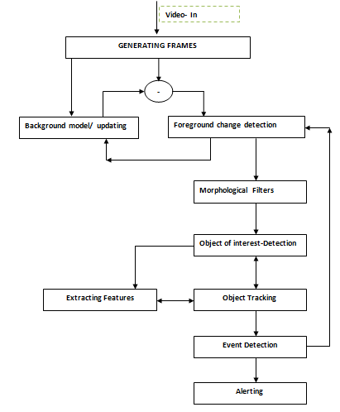
Architectural Diagrams

Slide 12
Project Framework (Hardware / Software)
The project framework consists of both hardware and software components. The hardware setup includes high-resolution cameras strategically placed to capture video feeds of the monitored area.
On the software side, the system employs a combination of deep learning models and computer vision techniques for real-time video processing.
The software stack includes tools such as TensorFlow or PyTorch for model development, OpenCV for image processing, and a backend system for data storage and analysis.
Hardware Components: Cameras (specify types and placements), servers for processing, and storage solutions.
Software Components: Video processing software, machine learning models, and user interface for monitoring and analysis.
Integration: How hardware and software components interact to achieve the desired functionality.

Slide 13
Modules (Explanation of Architectural Diagrams)
Video-In:
This module captures live video frames, which serve as input for the entire detection and tracking system.
Generating Frames:
The captured video is split into individual frames for processing.
Each frame will be analyzed for object detection, tracking, and event detection.
Background Model / Updating:
This module maintains a model of the background, allowing the system to detect moving objects in the foreground.
It continuously updates to adapt to lighting or scene changes, which helps in distinguishing the foreground objects from the background

Slide 14
Modules (Explanation of Architectural Diagrams)
Foreground Change Detection:
This module detects any significant changes in the foreground compared to the background model.
It helps identify areas where objects are present by isolating moving elements in the scene.
Morphological Filters:
Morphological operations, such as dilation and erosion, are applied to reduce noise and improve the shape of detected objects.
These filters help clean up the detection and prepare the objects for accurate identification.
Object of Interest Detection:
This module identifies specific objects of interest within the foreground (e.g., people, vehicles) based on certain features or predefined classes.
Object detection algorithms like YOLO can be applied here to recognize and classify objects in each frame.

Slide 15
Modules (Explanation of Architectural Diagrams)
Object Tracking:
After detecting the objects, this module tracks their movement across frames.
Tracking algorithms, such as Kalman filters or optical flow, might be used to maintain continuity of object detection in subsequent frames.
Extracting Features:
This module extracts relevant features from the detected objects, such as shape, size, color, or motion trajectory, to aid in tracking or event detection.
Event Detection:
Based on the tracked objects and their behaviors, this module identifies specific events or actions (e.g., entering a restricted area).
If a detected object meets certain criteria, an event is flagged for further action.
Alerting:
When an event of interest is detected (e.g., unauthorized entry), this module triggers an alert.
The alert could include playing a sound, sending a notification, or displaying a warning on the screen.

Slide 16
Algorithm Used
Object Detection with YOLOv5:
The code loads a pre-trained YOLOv5 model (yolov5s), which is commonly used for real-time object detection due to its efficiency and accuracy.
The model is set up to detect specific classes (e.g., "person") in the video.
Region of Interest (ROI) Selection:
Using OpenCV, the code allows a user to define a polygonal ROI by clicking points on the video screen. This area will be monitored for any detected objects.
Checking Objects in the ROI:
The function inside polygon() checks if detected objects (bounding boxes) fall within the ROI by using OpenCV's pointPolygonTest.
Alarm System:
If an object of interest (e.g., a "person") is detected within the ROI, an alarm sound is triggered using Pygame’s mixer functionality.

Slide 17
Module Implementation
Video Input and Preprocessing:
The system processes video input from surveillance cameras or pre-recorded videos using OpenCV. Video frames are preprocessed by resizing them for efficient inference while maintaining the aspect ratio to ensure detection accuracy. Each frame is passed through the YOLOv5 model for human detection.
Human Detection with YOLOv5:
The core of the detection system is built on YOLOv5, a convolutional neural network (CNN) trained to detect objects in real-time. We specifically focus on the "person" class to identify individuals in the workplace environment. For each detected person, the system calculates the bounding box and the centre point, which is used to assess whether the person has entered restricted or hazardous zones.

Slide 18
Module Implementation
Polygon-Based Region of Interest (ROI):
A unique feature of the system is the polygon-based ROI, which allows users to define custom areas in the video frame for monitoring. Using OpenCV’s mouse callback function, the user can draw polygonal regions representing hazardous areas within the workplace. The system checks whether a detected person's centre point is inside this polygon using a point-in-polygon test, thus enabling targeted monitoring of critical zones.
Real-Time Alarm Trigger:
When a person is detected inside the polygonal ROI, the system triggers an audio alarm to alert personnel of a potential safety violation. The alarm is implemented using the pygame library, which plays a preloaded sound file whenever a violation occurs.

Slide 19
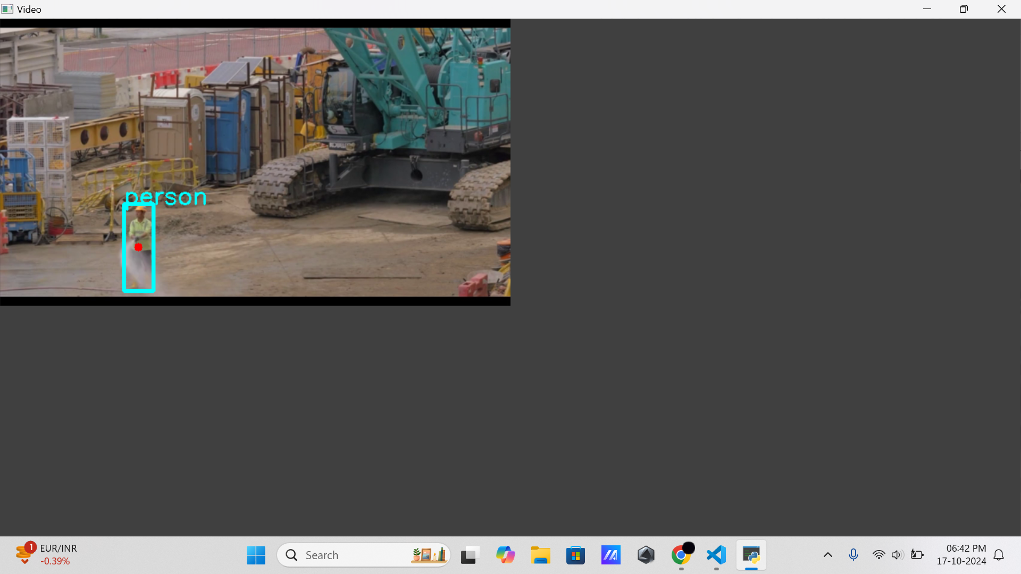
Project Demo of all the modules with output
Human Detection:
We utilise the YOLOv5 model, a state-of-the-art object detection model known for its speed and accuracy. The model is trained on the COCO dataset, which includes a variety of object classes. Upon deployment, the model processes each frame of the video feed and identifies humans with bounding boxes.

Slide 20
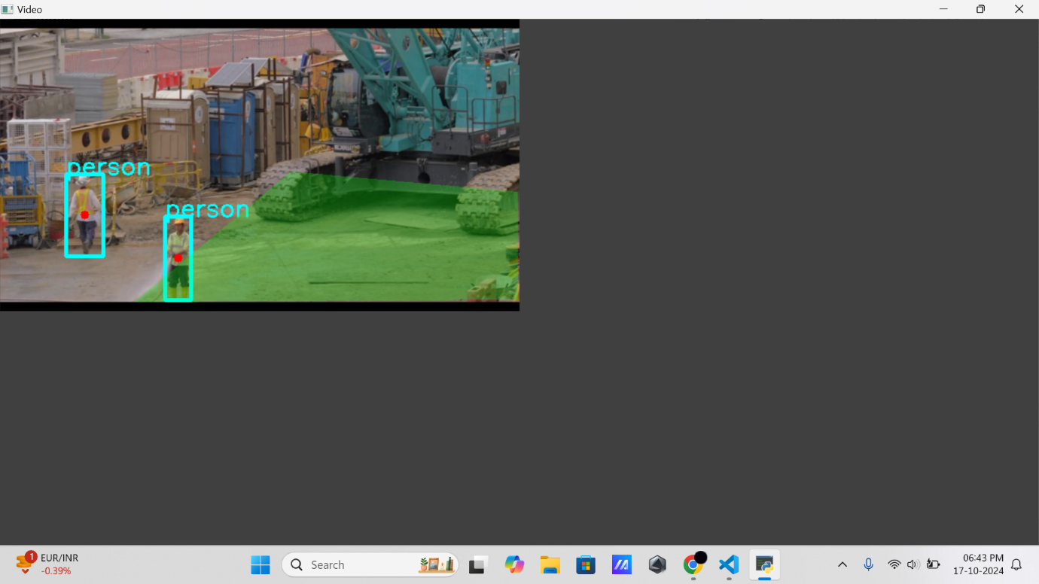
Project Demo of all the modules with output
Zone Definition and Area Mapping:
The zone definition is achieved by dividing the frame into segments and allowing the user to specify a restricted area. This functionality is achieved using OpenCV, which provides tools for drawing polygons over the frame. Once the zone is defined, the system checks for human presence within the zone in each frame.

Slide 21
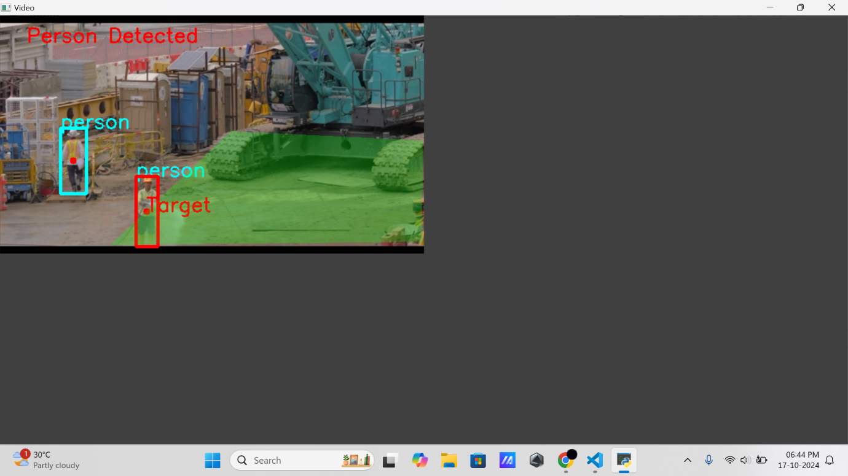
Project Demo of all the modules with output
Alarm Trigger:
The system monitors whether the centre of the detected object (e.g., a person) falls within this polygon. If the centre point of the person’s bounding box is inside the restricted area, the alarm is triggered. The polygonal approach allows flexibility in defining specific hazardous zones within the workplace.

Slide 22
Thank You !!!

