Slide 1
Name: Kabilan S
Register Number: 813821205022
Department: Information Technology
College Name: Saranathan college of engineering
NM mail id:selvakumarkabilan2@gmail.com
Final Project
3/21/2024 Annual Review
1

Slide 2
PROJECT TITLE
Project Title: AI Chatbot Development: Creating a Versatile Virtual Assistant
Problem Statement:
Develop a chatbot application using Python and TensorFlow/Keras to facilitate natural language interactions between users and the system. The chatbot should be capable of understanding user queries, providing relevant responses, and engaging in meaningful conversations on various topics. The primary goal is to create an intelligent conversational interface that enhances user experience and assists users in obtaining information or completing tasks efficiently.
3/21/2024 Annual Review
2

Slide 3


AGENDA
1. Project Goals and Objectives:
- Overview of the main goals and objectives of the project.
- Highlights what the project aims to achieve.
2. Target Audience:
- Description of the intended users or audience for the chatbot application.
- Helps in understanding user needs and preferences.
3. Scope of Work:
- Definition of the boundaries and extent of the project.
- Clarifies what functionalities and features are included.
4. Research and Planning:
- Brief overview of the research conducted on mental health issues and existing chatbots.
5. Challenges and Opportunities:
- Identification of potential challenges and opportunities associated with the project.
6. Expected Outcomes:
- Description of the expected outcomes and deliverables of the project.
- Provides a vision of what success looks like for the project.
7. Timeline and Milestones:
- Overview of the project timeline and key milestones.
- Helps in tracking progress and managing project deadlines.
3/21/2024 Annual Review
3
Notes:
3

Slide 4

PROBLEM STATEMENT
Develop an AI-powered chatbot application aimed at providing mental health support and resources to users. The chatbot should be capable of engaging in empathetic and supportive conversations, offering relevant information, resources, and guidance on various mental health issues. The primary goal is to create a user-friendly and accessible platform that empowers individuals to seek assistance, reduce stigma surrounding mental health, and promote well-being in the digital space.
Develop an AI-powered chatbot application to provide mental health support and resources.
Create empathetic conversations and offer relevant information on various mental health issues.
Enable crisis intervention features and connections with mental health professionals.
Tailor responses based on individual user profiles while ensuring privacy and confidentiality.
Aim to reduce stigma surrounding mental health and promote well-being in the digital space.
3/21/2024 Annual Review
4

Slide 5

PROJECT OVERVIEW
Chatbot Application Project:
Develop a chatbot application leveraging AI and NLP for mental health support.
Goals and Objectives:
Provide empathetic conversations, crisis intervention, and personalized resources.
Target Audience:
Individuals seeking mental health assistance, support, and information.
Scope of Work:
Design conversational flow, develop NLP models, and integrate with mental health resources.
Expected Outcome:
A user-friendly chatbot platform offering accessible and reliable mental health support.
3/21/2024 Annual Review
5

Slide 6

WHO ARE THE END USERS?
Individuals Seeking Mental Health Support: People experiencing mental health challenges such as stress, anxiety, depression, or other mental health conditions who are looking for guidance, resources, or someone to talk to.
Caregivers and Support Networks: Family members, friends, or caregivers of individuals dealing with mental health issues who seek information, advice, or support on how to assist their loved ones.
Students and Young Adults: Students, adolescents, or young adults facing academic, social, or personal stressors who may benefit from access to mental health resources and coping strategies.
Professionals in the Mental Health Field: Mental health professionals, therapists, counselors, or psychologists who may use the chatbot as a supplementary tool for their practice or recommend it to their clients for additional support.
General Public: Individuals interested in learning more about mental health, self-care practices, or ways to support others in their community, regardless of whether they are currently experiencing mental health challenges themselves.
3/21/2024 Annual Review
6

Slide 7
YOUR SOLUTION AND ITS VALUE PROPOSITION
Empathetic Support: Our chatbot engages users in empathetic conversations, demonstrating sensitivity and understanding towards their mental health concerns. This creates a safe and non-judgmental space for users to express themselves and seek assistance.
Personalized Assistance: By tailoring responses based on individual user profiles and preferences, our chatbot delivers personalized recommendations, coping strategies, and resources tailored to each user's unique needs and circumstances.
Crisis Intervention: Our chatbot includes features for crisis intervention, providing immediate access to helplines, de-escalation techniques, and emergency response protocols. This ensures timely support and assistance during critical situations.
Accessible Resources: Users can access a comprehensive repository of mental health resources, including articles, self-help tips, coping strategies, and professional support services. This empowers users to learn more about mental health, develop self-care practices, and connect with relevant support networks.
3/21/2024 Annual Review
7

Slide 8
THE WOW IN YOUR SOLUTION
Empathetic Conversations: Our chatbot engages users in conversations that feel natural, empathetic, and human-like, thanks to advanced natural language processing (NLP) techniques. Users feel understood, heard, and supported, creating a profound emotional connection.
Crisis Intervention Features: In moments of crisis, our chatbot provides immediate access to helplines, de-escalation techniques, and emergency response protocols. This proactive approach can make a life-saving difference during critical situations, offering reassurance and support when it's needed most.
Personalized Assistance: Our chatbot delivers personalized recommendations, coping strategies, and resources tailored to each user's unique needs and circumstances. By understanding and adapting to individual preferences and challenges, it provides highly relevant and impactful support.
Comprehensive Resource Repository: Users have access to a wealth of mental health resources, including articles, self-help tips, coping strategies, and professional support services. This comprehensive repository empowers users to explore, learn, and take proactive steps towards improving their mental well-being.
User-Friendly Interface: Our chatbot features a user-friendly interface designed for ease of use and accessibility. Whether users are tech-savvy or not, they can navigate the chatbot effortlessly, ensuring that everyone can benefit from its support and resources.
3/21/2024 Annual Review
8

Slide 9
MODELLING
Data Collection: We gather a diverse range of conversational data relevant to mental health topics. This data includes user queries, responses, and context-rich interactions to train our chatbot effectively.
Data Preprocessing: The collected data undergoes preprocessing steps such as tokenization, lemmatization, and cleaning to ensure consistency and prepare it for modeling.
Model Selection: We choose a suitable machine learning or deep learning model architecture for our chatbot. This could include recurrent neural networks (RNNs), long short-term memory networks (LSTMs), or transformer-based models like BERT or GPT.
Training: The selected model is trained on the preprocessed data to learn patterns and relationships between user queries and responses. We use techniques like backpropagation and gradient descent to optimize the model's parameters.
Validation: We validate the trained model using separate validation data to ensure its performance and generalization ability. This step helps us identify and address any overfitting or underfitting issues.
Evaluation: The model's performance is evaluated using metrics such as accuracy, precision, recall, and F1-score. We analyze the model's ability to understand user intents, generate relevant responses, and handle various conversational scenarios.
3/21/2024 Annual Review
9

Slide 10
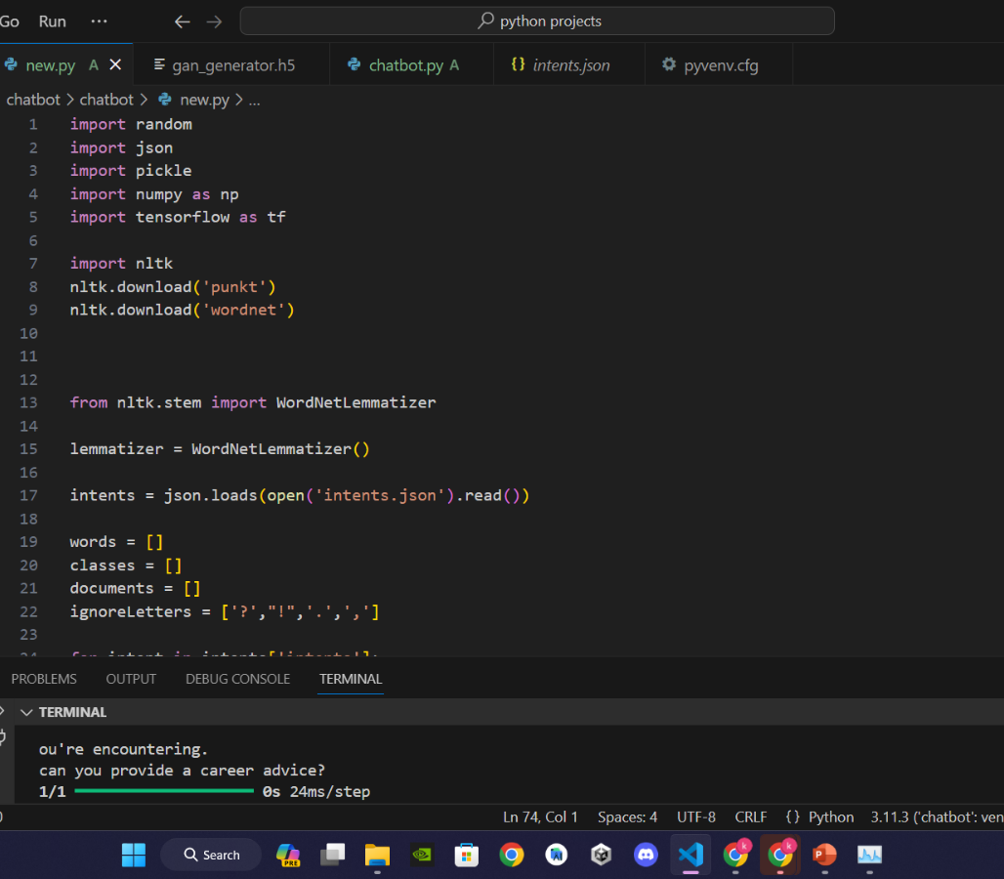
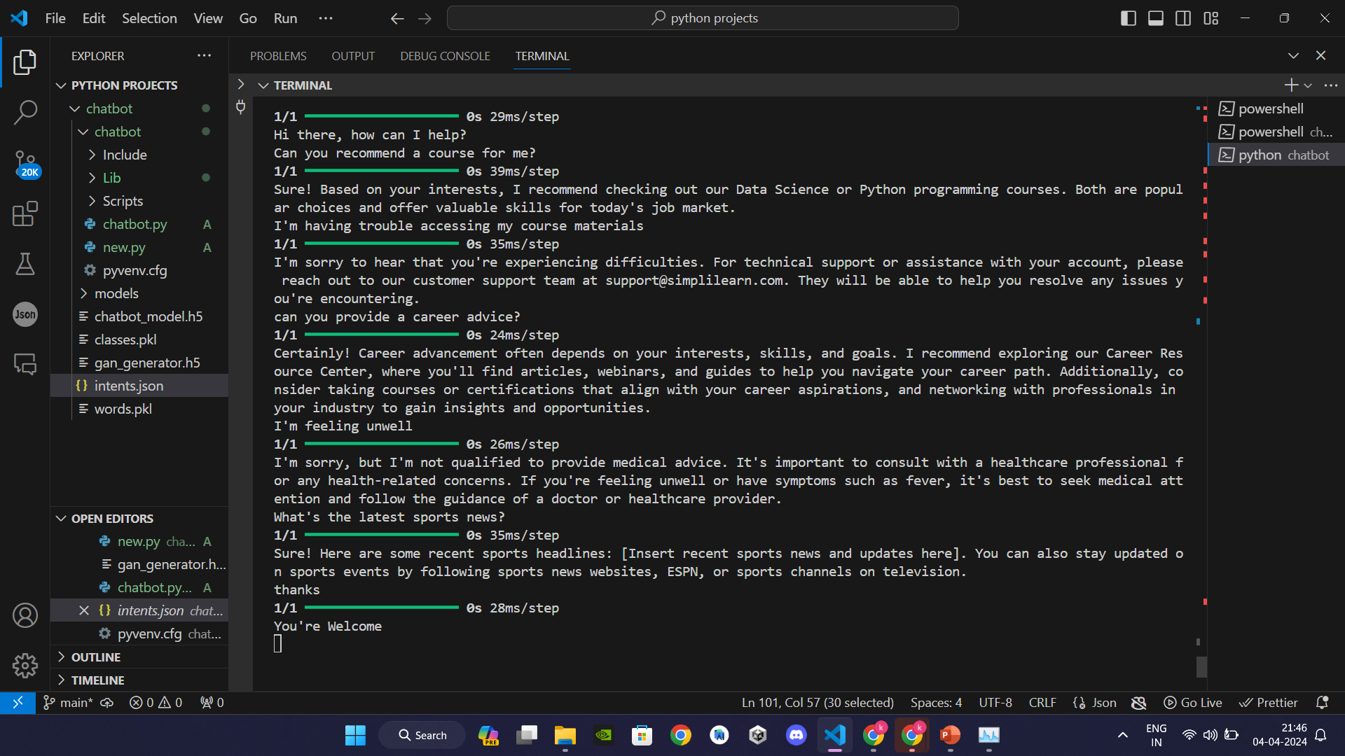
RESULTS
https://github.com/S-KABILAN/TNSDC-Generative-AI
3/21/2024 Annual Review
10

