Slide 1
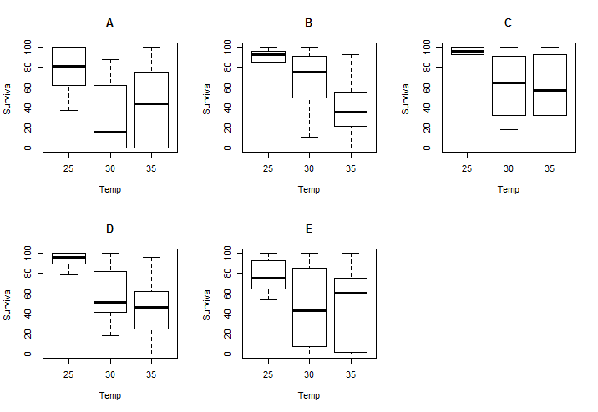
The boxplots show the dispersion of the results.
The bold think line shows the mean of the data. And the box shows the 25% and 75% limits of the data. Or the first and the third Quantile.
Mean is the 2nd quantile.

Slide 2
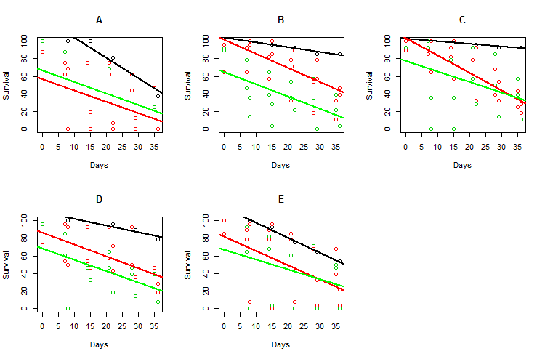
The graphs show the Survival versus the number days. The colors are representative of different temperatures.
Black: 25°C
Red: 30°C
Green: 35°C

Slide 3
Pair | 95% confidence interval: | P Value
A-B | -52.92853 -23.91298 | 1.789e-06
A-C | -47.83693 -17.62066 | 5.591e-05
A-D | -42.95085 -14.24781 | 0.0001868
A-E | -35.5577814 -0.6587365 | 0.0422
B-C | -7.913064 19.296993 | 0.4061
B-D | -2.922626 22.565483 | 0.1285
B-E | 4.114345 36.510655 | 0.01493
Results of the T-tests on 25, 35 degree results is very inconclusive.
The results of the test, shows that Sample B has a higher survival with respect to A.
The results of the test, shows that Sample E has a higher survival with respect to B.

