Slide 1

Samwel Kagwi
12 - March - 2023

Slide 2


Background
Microsoft intends to open a movie studio. Based on provided datasets, we explore what types of films are currently doing the best at the box office.
With the analysis data, we then get some insights about movies that will help in decision making, to determine what films to create.

Slide 3
Data Exploration
The data we used in this analysis was sourced from 3 datasets:
Box Office Mojo
IMDB
The Numbers

Slide 4
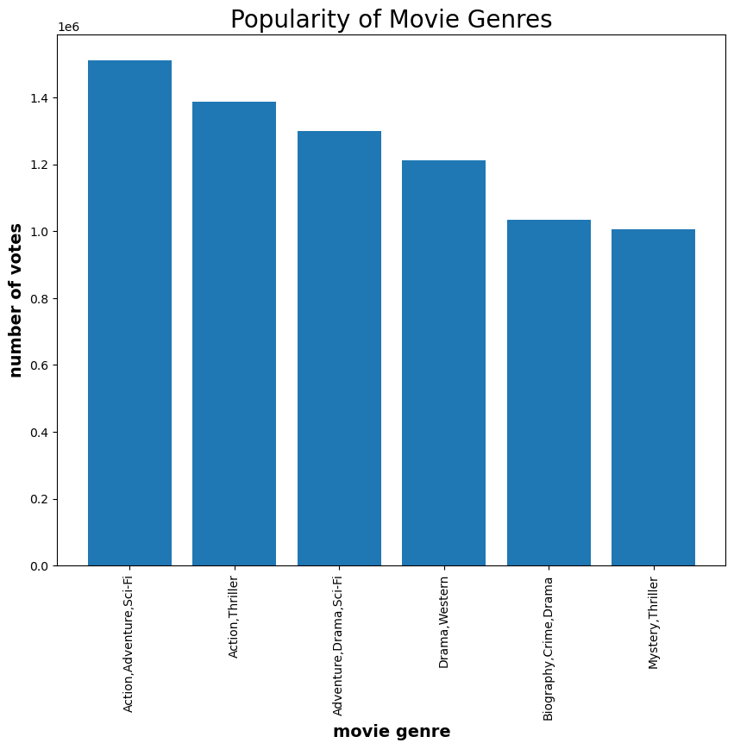
Popularity of Movie Genres
Movies with a combination of Action, Adventure and Sci-Fi genres are the most popular movies.

Slide 5
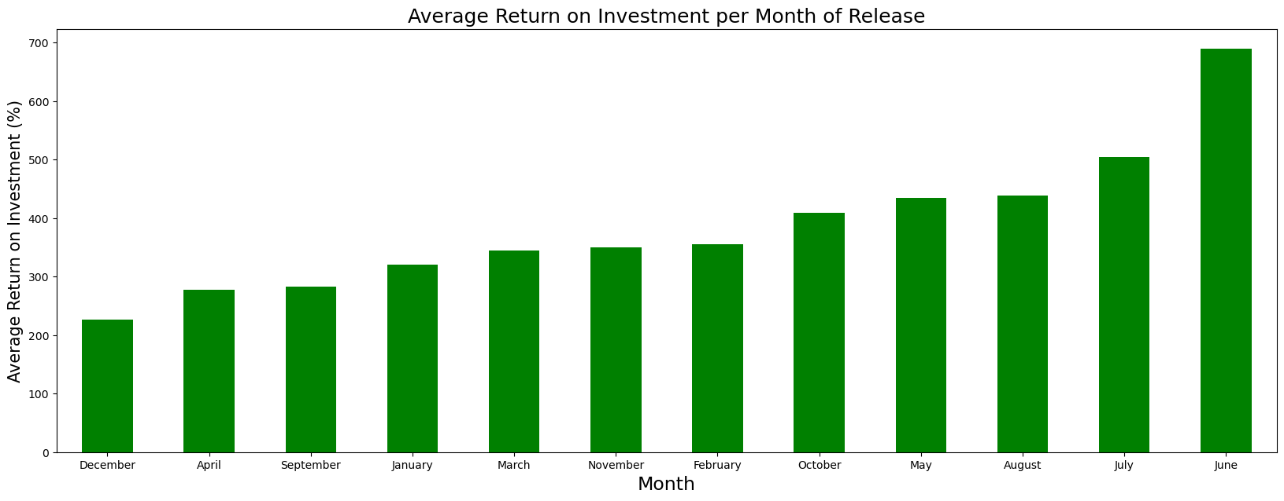
Return on Investment
Releasing movies in June would yield the highest return on investment by the movie.

Slide 6
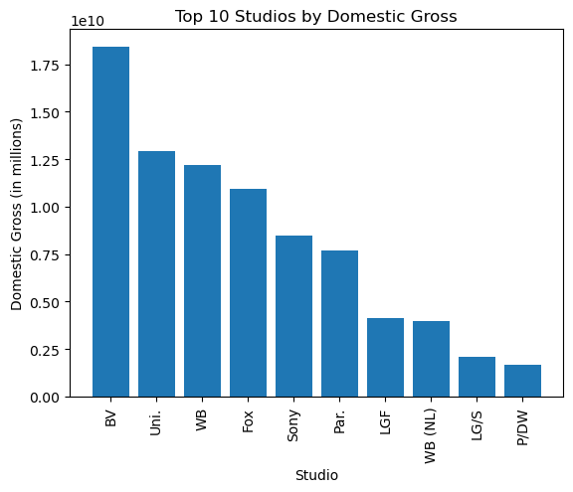
Top Studios by Gross Revenues
Microsoft Studios should consider partnering with BV studios as this would likely lead to the highest gross revenues from the movie.

Slide 7
Recommendations
Movies with a combination of Action, Adventure and Sci-Fi genres were the most popular. Microsoft should consider producing a movie with this combination of genres.
Releasing movies in December would likely lead to the highest return on investment by the movie.
BV Studios had the highest revenues generated by movies produced. Microsoft Studios should consider partnering with them.

Slide 8

THANK YOU
Samwel Kagwi

