Slide 1

Samwel Kagwi
12 - March - 2023

Slide 2


Background
Microsoft sees all the big companies creating original video content and they want to get in on the fun. They have decided to create a new movie studio, but they don't know anything about creating movies. We are charged with exploring what types of films are currently doing the best at the box office. We must then translate those findings into actionable insights that the head of Microsoft's new studio can use to help decide what type of films to create.

Slide 3

Data Exploration
The data we used in this analysis was source from 3 datasets:
bom
Movie budgets
idmb

Slide 4
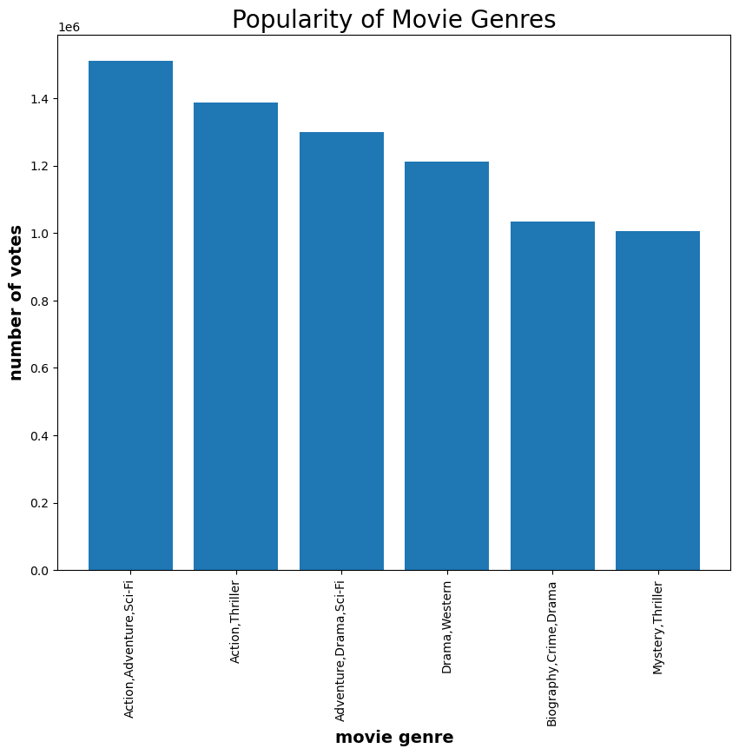
Popularity of Movie Genres
Movies with a combination of Action, Adventure and Sci-Fi genres are the most popular movies.

Slide 5
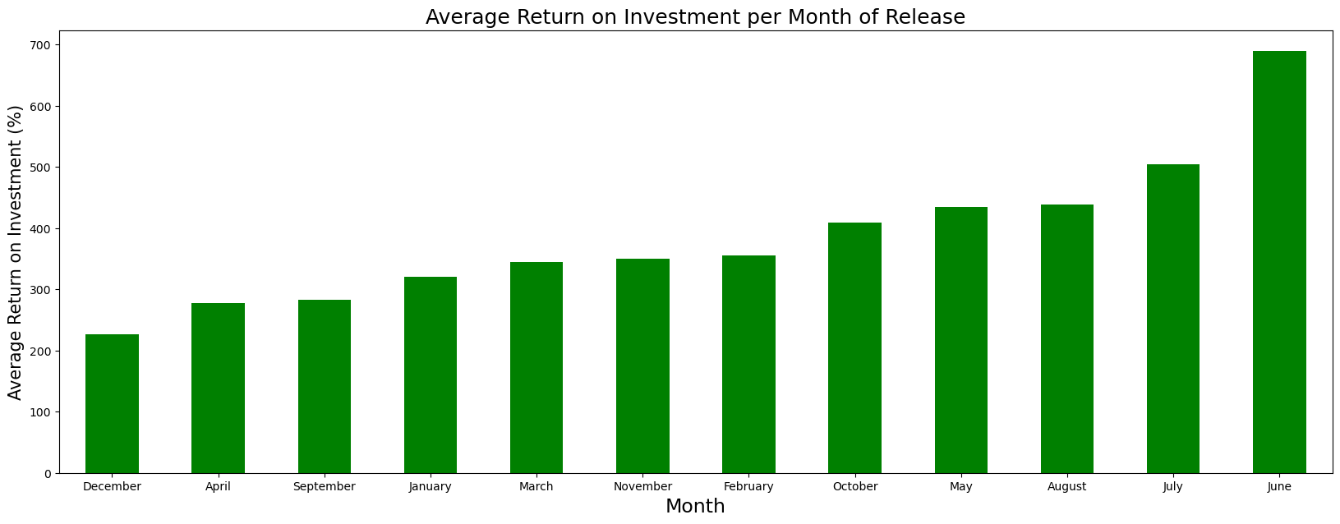
Return on Investment
Releasing movies in December would likely yield the highest return on investment by the movie.

Slide 6


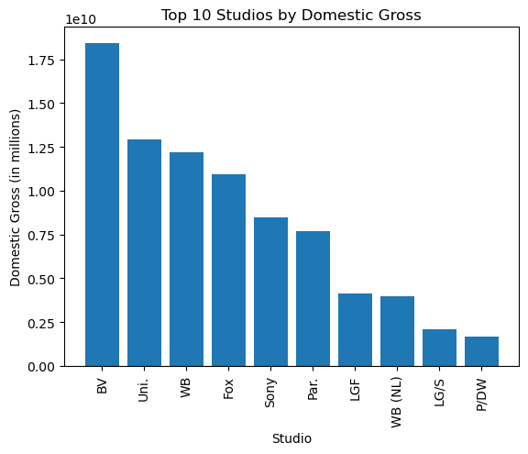

Studios with the Highest Gross Revenues
Microsoft Studios should consider patnering with BV studios as this would likely lead to the highest gross revenues from the movie.

Slide 7
Recommendations
Movies with a combination of Action, Adventure and Sci-Fi genres were the most popular. Microsoft should consider producing a movie with this combination of genres.
Releasing movies in December would likely lead to the highest return on investment by the movie.
BV Studios had the highest revenues generated by movies produced. Microsoft Studios should consider patnering with them.

Slide 8

THANK YOU
Samwel Kagwi

